Slide 1
Scope 3 Emissions: Extracting Useful data from Amazon Purchasing Reports
Rebecca Grekin (rgrekin@stanford.edu)
CURC Meeting
12/16/2021

Slide 2
Introduction
Using and Analyzing Amazon Purchasing Data
UNSPSC Codes
Deep Dive into Food Purchases

Slide 3
Possible Data Sets
Amazon for Business
Amazon for Business
SmartMart
SmartMart
Procurement
Personal Business Accounts

Slide 4
Consider purpose of analyzing these data sets
Quantifying emissions from purchased goods?
Mitigating the biggest contributors of emissions?
Identifying opportunities to reduce waste?
Opportunities to buy items in bulk for multiple departments?
Opportunities to limit or end unnecessary/particularly wasteful purchases?
Something else?

Slide 5
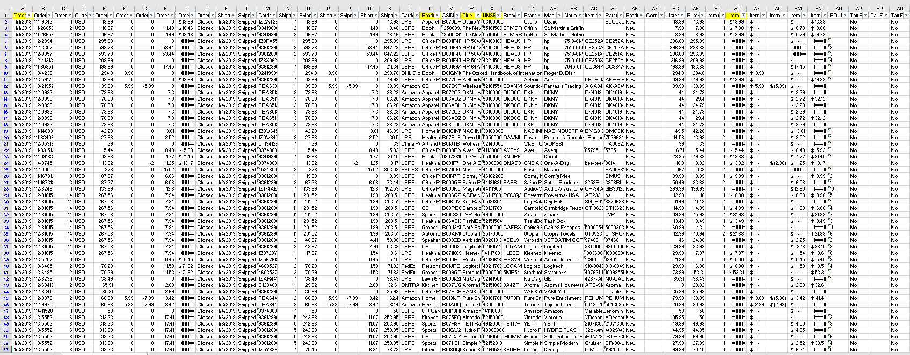
Determining what data is relevant

Slide 6
UNSPSC Codes to the Rescue
United Nations Standard Products and Services Code
- 1.2% of Stanford Amazon purchases do not have these codes
- 3,000+ unique UNSPSC codes

Slide 7
UNSPSC Codes to the Rescue ….maybe?
Amazon | 98.8% |  | 79.7% |  | 62.2% |  | 30.0%
*Percentages in terms of line items

Slide 8
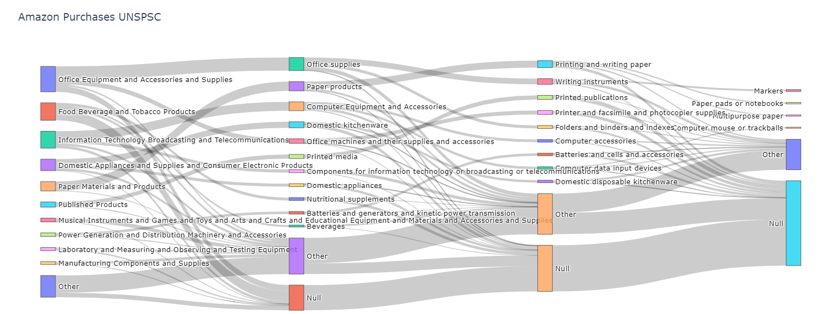
Larger data sets come at the expense of detail

Slide 9
Analyzing Food Purchased Though Amazon

Slide 10
Going from UNSPSC to Food Categories/Emissions
12.1 % of Amazon purchases are food
Categorizing food:
- Python-based script
- Available at: https://food-emissions-categorization.wl.r.appspot.com/

Slide 11
Amazon Food Data

Slide 12
Liquids Breakdown: Easy target for emissions and waste reduction

Slide 13
Conclusions
Clearly defining a goal at the outset is important
UNSPSC codes can provide a way to break your data sets into more manageable chunks
Diving into categories can illuminate opportunities for waste and emissions reduction

