Slide 1
Designing out waste via purchasing: Lessons Learned from MIT campus, so far…
Brian Goldberg, MIT Office of Sustainability
Emma Homstad, MIT Office of VP for Finance

Slide 2
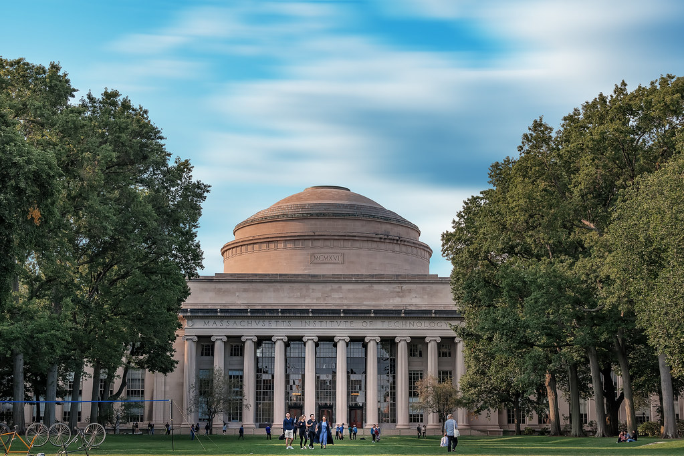
MIT Campus (Cambridge, MA)
24,000 faculty, researchers, staff, students
170 buildings, 13 million ft², 168 acres
450+ departments, labs, and centers (DLCs)
Highly decentralized purchasing environment; every administrative unit responsible for own buying.

Slide 3
MIT Consumption Scope
900,000+ items purchased each year
3,000 tons trash generated; 50-60% of trash can be recycled / composted annually
50,000+ pieces of property (i.e. equipment, furniture)
$1.5 billion spent on goods and services every year

Slide 4
Purpose Driven Spend: Sustainability
VPF
MITOS
Engage with vendors
Identify “back end” opportunities
Communicate Institute’s purchasing priorities/values
Engage and convene campus stakeholders, research, faculty
Best practices
ID opportunities with vendors for VPF to pursue
Notes:
Shared goal to fulfill MIT mission.
MIT’s climate action plan commits MIT to leverage all its might, including purchasing, to address climate challenges.

Slide 5
Leveraging Vendors
Behind the scenes “levers” i.e. highlighting green items
Sustainable items
More offerings
Price parity- conventional vs green
“Green” shopping lists on punch outs
Sustainable service provision
EV delivery service
Reduced/recycled packaging
Take-backs
Notes:
How do we leverage competitive bids to communicate MIT’s values, learn best practices from vendors, and provide the most value to our community? Lots of opportunities in our contract for sustainable service provision.
Maybe most critically for the waste conversation, how do we manage existing inventory?
Packaging waste is the biggest factor for end users from shipments that we’ve heard. How do we work with our vendors to reduce this?
Really case by case. i.e. Millipore has a reduced

Slide 6
Office Supply Example: Purpose-driven bids
Split RFP for “large” and “small” vendors
Large vendors had strict sustainability requirements
Award went to vendor with:
Competitive “green” pricing, more options for end user
EV delivery
Comprehensive reporting
Using similar strategy with other consumables

Slide 7
Packaging Challenge
Most common complaint from end users is too much packaging
Take feedback to vendors like Amazon, Millipore, other consumable vendors.
Put reduced packaging requirements in contracts
Encourage recycling/takeback

Slide 8
Sustainable-driven waste RFP + contract
Waste sensor technology and data reporting
Common contaminants feedback loop
Can waste contract and services drive sustainable purchasing?
Campus Waste Services + Purchasing

Slide 9
Drive sustainable purchasing
Consolidate delivery and take-back systems
Leverage existing mailroom operations
How can campus office supply purchasing be sustainable for both inbound delivery and take-back of hard to recycle items?
Closed Loop Design: Office Supply Purchasing

Slide 10
Most PPE is not recyclable
Over-ordering occurred at all levels
MIT COVID Store reduced waste
MIT Sustainable PPE Purchasing Study
How can centralized purchasing drive sustainability?

Slide 11
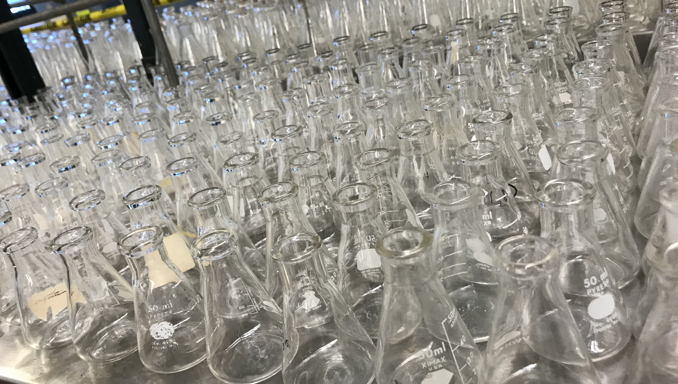
$50,000 in avoided purchasing
Extend surplus lifecycle
Instill culture of re-use
600+ matched goods avoided disposal
Front page of our B2P website
“Rheaply”: Avoided Purchasing + Reuse
Can online systems promote surplus re-use?
Notes:
EHS has been a critical partner in helping to bring one beta-test solution to MIT.
Rheaply is a tool for matchmaking surplus lab supplies and equipment.
The value is immeasurable and measurable—we can track number of items re-used, $$ savings of avoided purchases and number of labs engaging in re-use of surplus materials

Slide 12
Consolidate bins into central stations
50-80% reduction in bins, bags, process
Increase capture of food waste
How can sustainable purchasing yield benefits for waste management?
Centralized Bins Design Out Waste: plastic bags

Slide 13
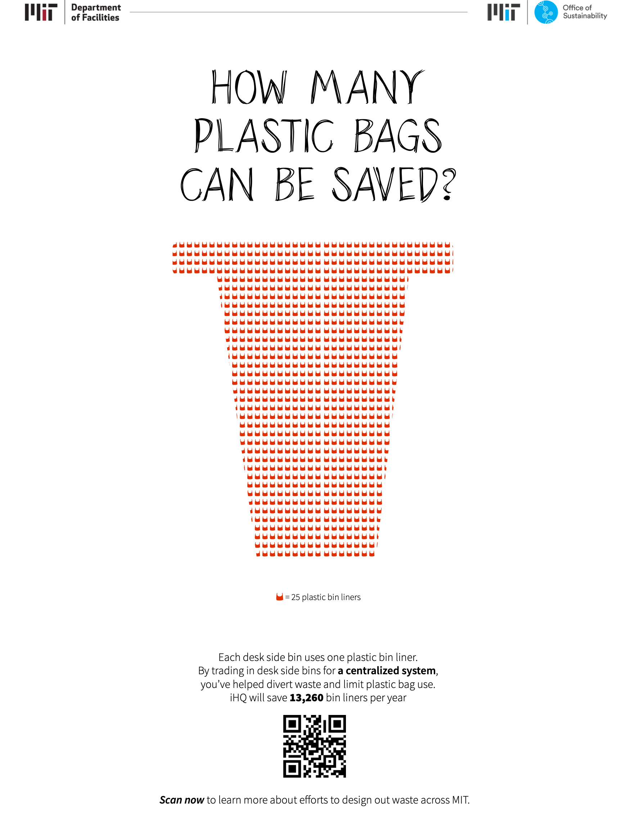
Consolidate bins into central stations
50-80% reduction in bins, bags, process
Increase capture of food waste
Centralized Bins Design Out Waste: plastic bags

Slide 14
MIT Sustainable design purchasing standards for construction and renovation
AASHE STARS base data
Join Sustainable Purchasing Leadership Council; Ellen MacArthur Foundation
Inspire vendors to help via RFIs, RFPs
Additional Purchasing Strategies to Design Out Waste
Notes:
How can we transform our systems and behaviors to design out waste?

Slide 15
MIT Climate Action + Purchasing Nexus
03
01
Greenhouse Gas Portfolio Expansion
10. Scope 3 Emissions
11. Add in Off-Campus Emissions FY23
02
04
Mitigation & Resiliency
1. Building Energy Efficiency
2. Resiliency & Adaptation
3. Rooftop Solar
4. Net Zero 2026 PPA
5. AI to Reduce Energy
6. Carbon Offset Program for business travel
EV Infrastructure
7. Zero Emissions Fleet
8. EV Charging
9. Zero Emission Shuttle Buses
Climate Leadership
12. Impact Goals for Food, Water, Waste
13. DLC Climate & Sustainability Plans FY23
14. Carbon Footprint Working Group 2050
~Fast Forward: MIT’s Climate Action Plan for the Decade (published 2021)

