Slide 1
Kent State University: Integrating Reduction and Reuse Into Messaging
Presented by
Leah Graham
Outreach Recycling Coordinator

Slide 2
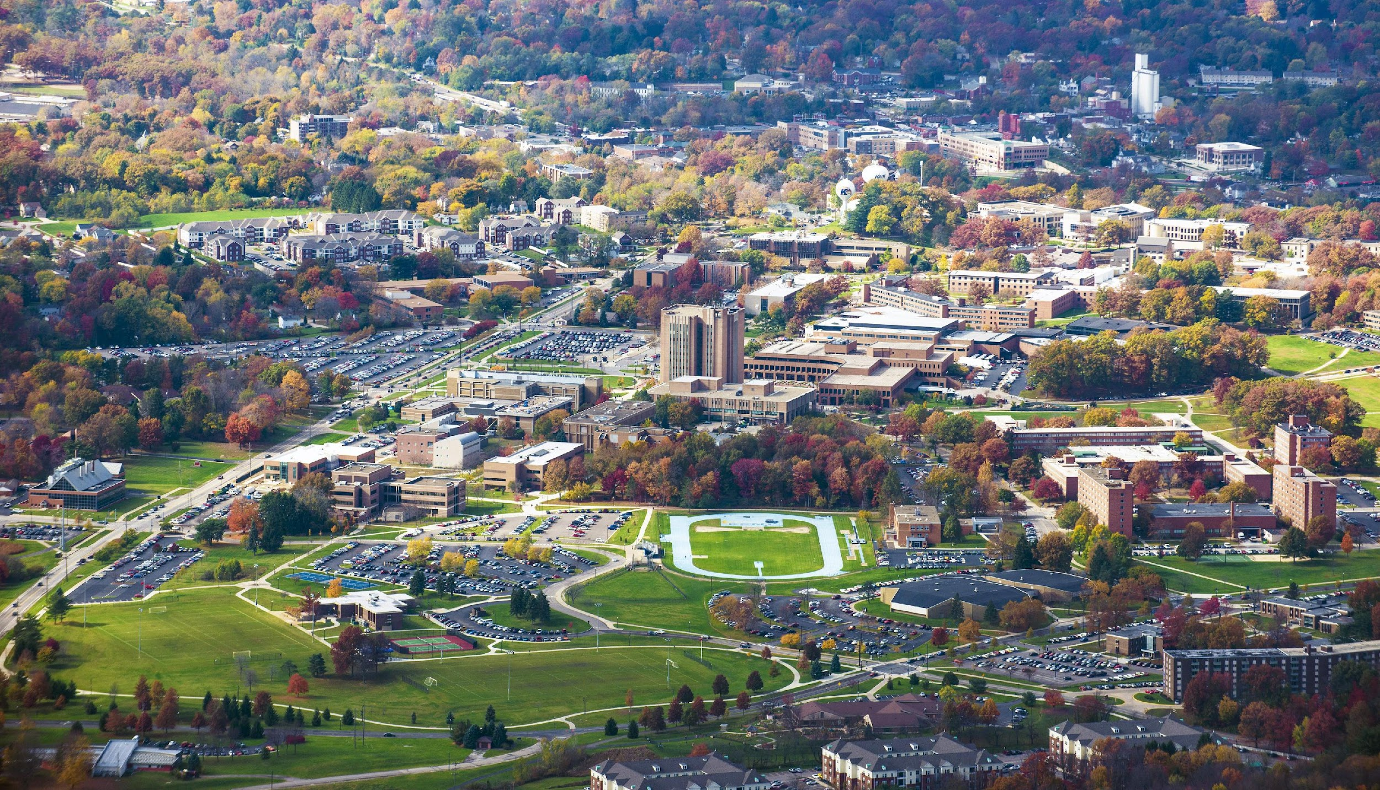
Kent State University
8 Ohio Campuses with 37,000 students
Kent campus has
950 Acres
127 Buildings
26,800 Students
18 Dining Locations
23 Residence Halls

Slide 3
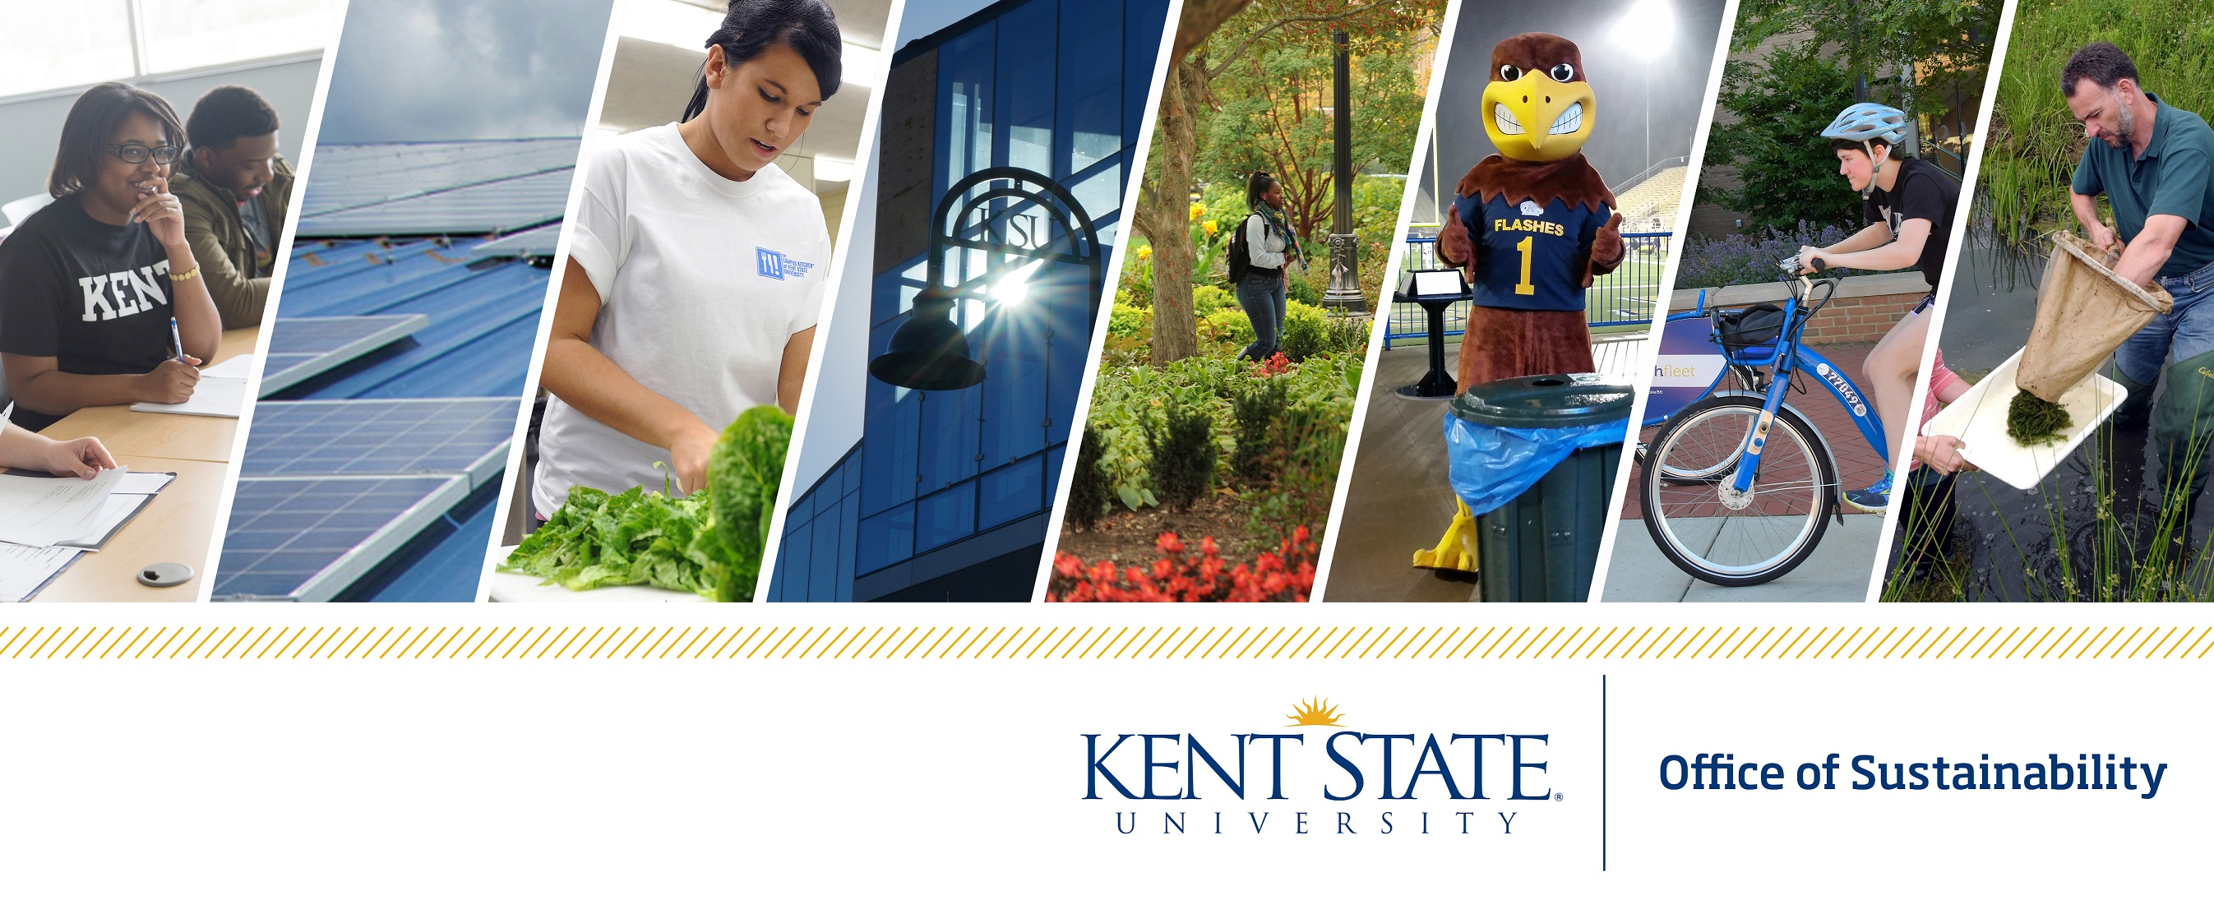
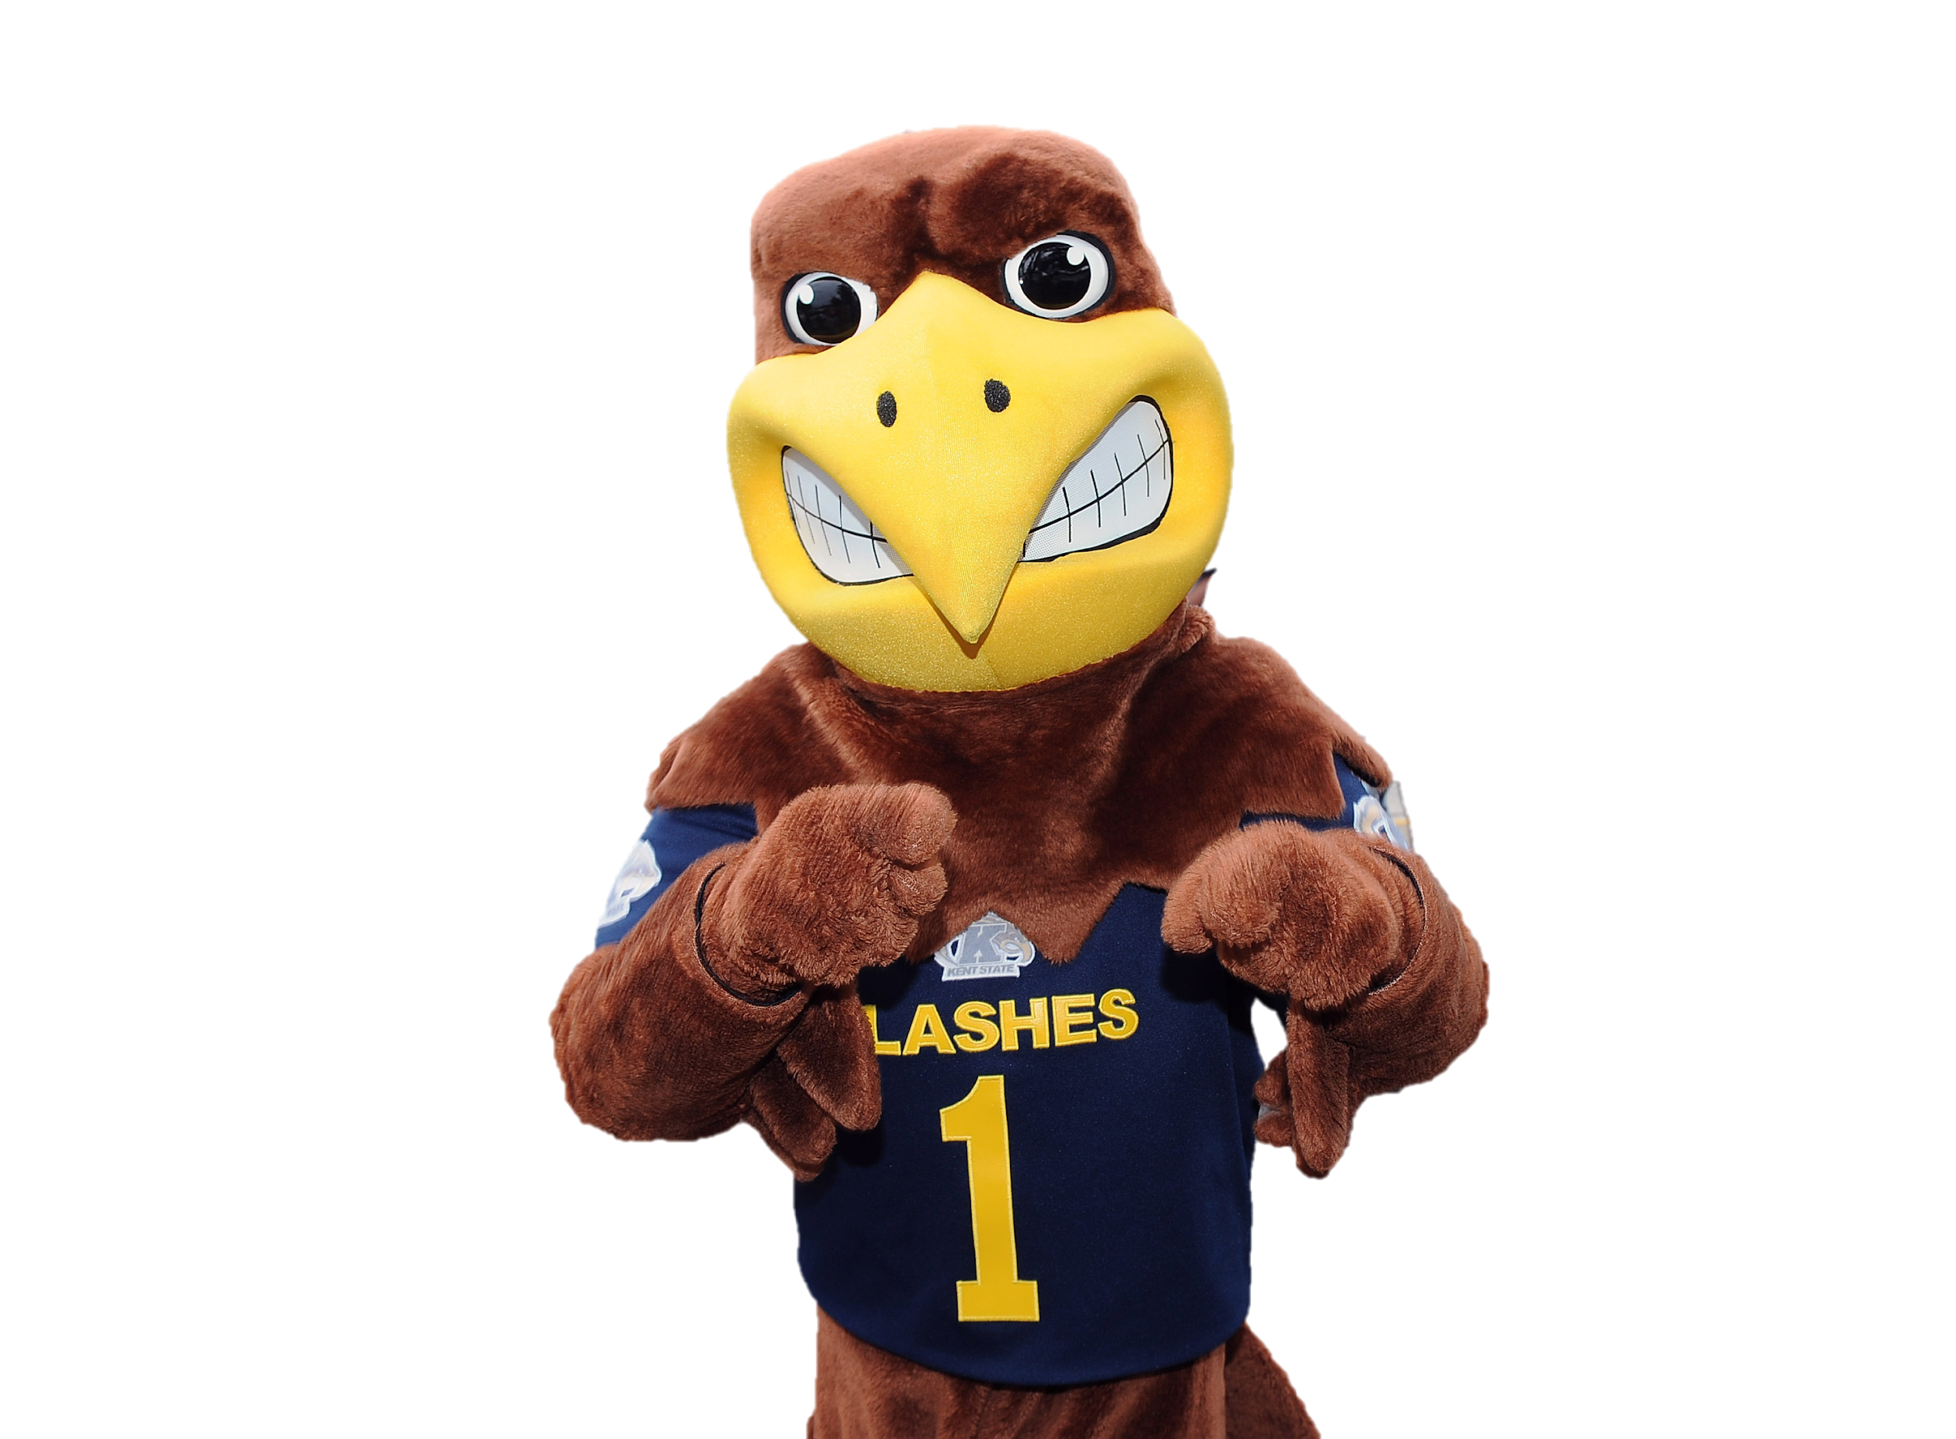
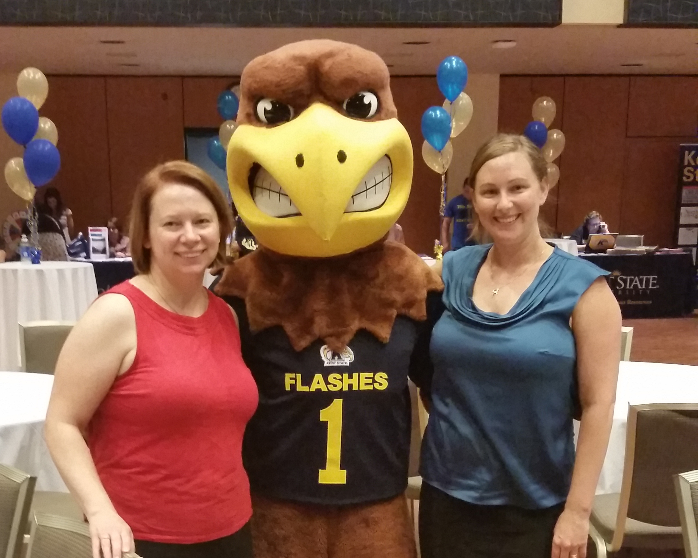
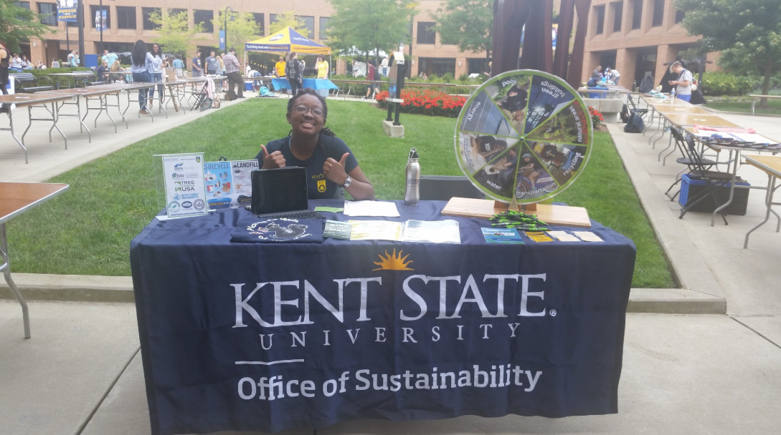
Finance and Administration
Facilities Planning and Operations
1 FTE
1 20 hr/week
~Intern depending on semester

Slide 4
Overview
Message philosophy
Peers, Place, Positive, Purpose
Free information can used to help inform messaging
Traditional website, press release, social media, digital screens, emails, newsletters
Nontraditional trivia wheel, prizes/games, CR2ZW GDC, fabric scraps display, Concrete Poetry

Slide 6
Community Based Social Marketing Dr. Doug McKenzie-Mohr

Slide 7
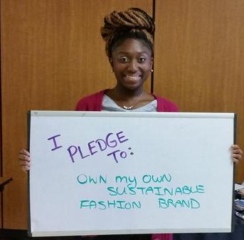
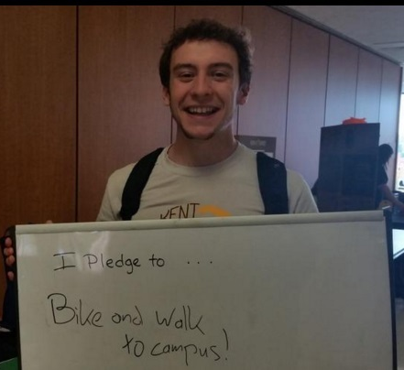
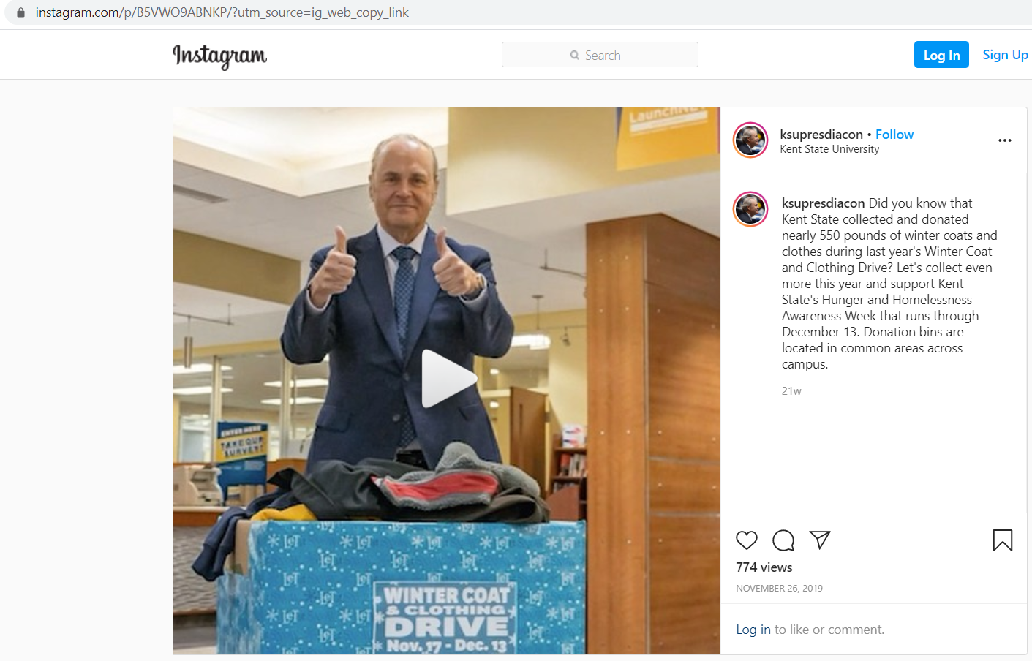
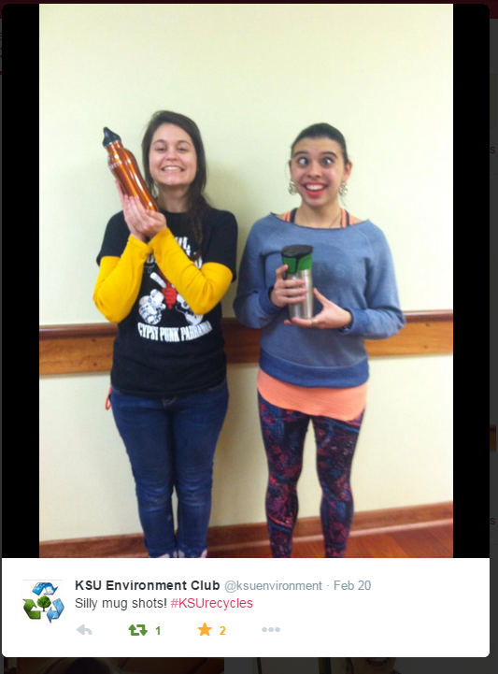
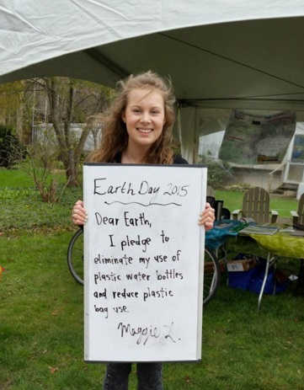
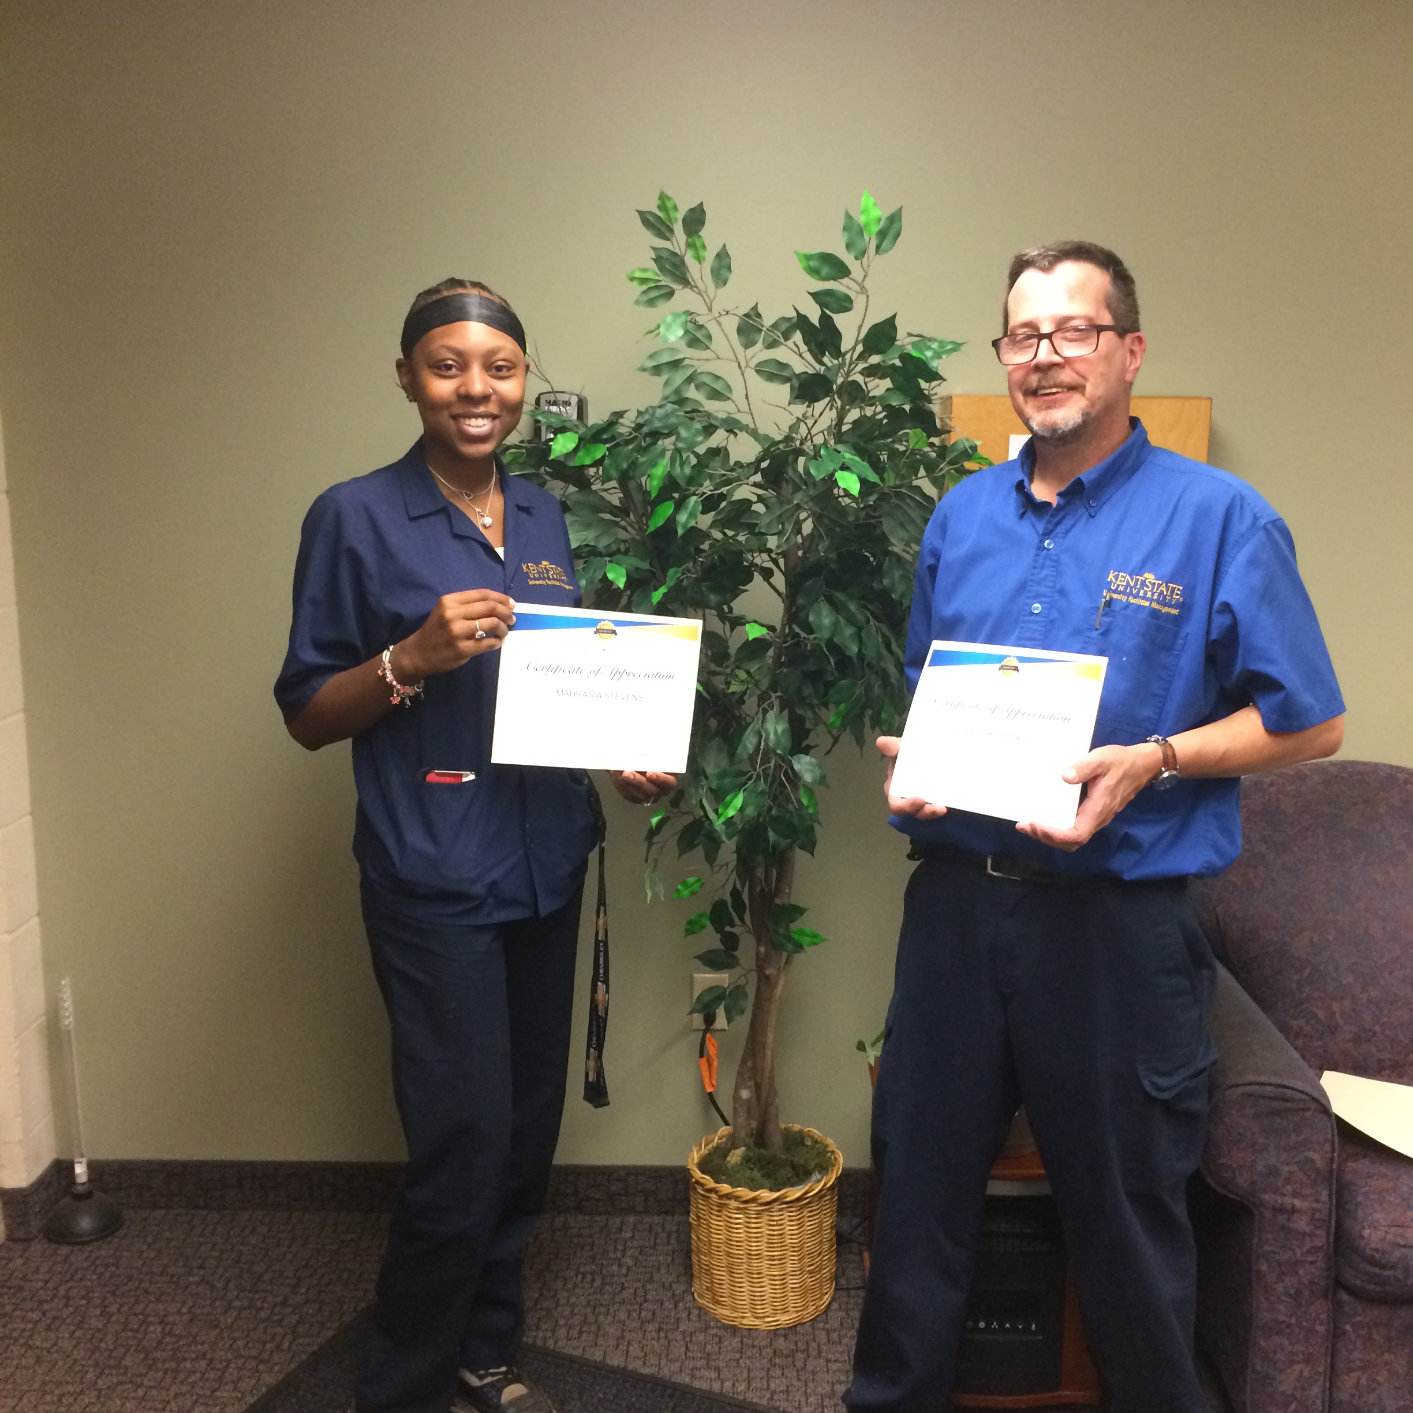
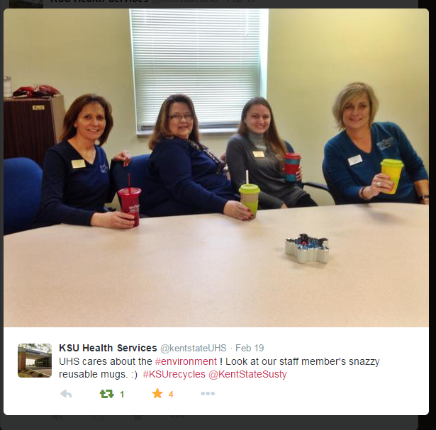

Slide 8
SPOTLIGHTS
TAGBOARD
kent.edu/sustainability/spotlights
kent.edu/sustainability/flashesgogreen
#FlashesGoGreen
Previously #KSUrecycles

Slide 9
CONNECTING TO PLACE
ENVIRONMENT: connecting to area, nature, stewardship
PEOPLE: community
#FlashesTakeCareOfFlashes
PROSPERITY: quality of life
Outdoor economy, gratitude
SOCIAL: Pre, During, Post

Slide 10
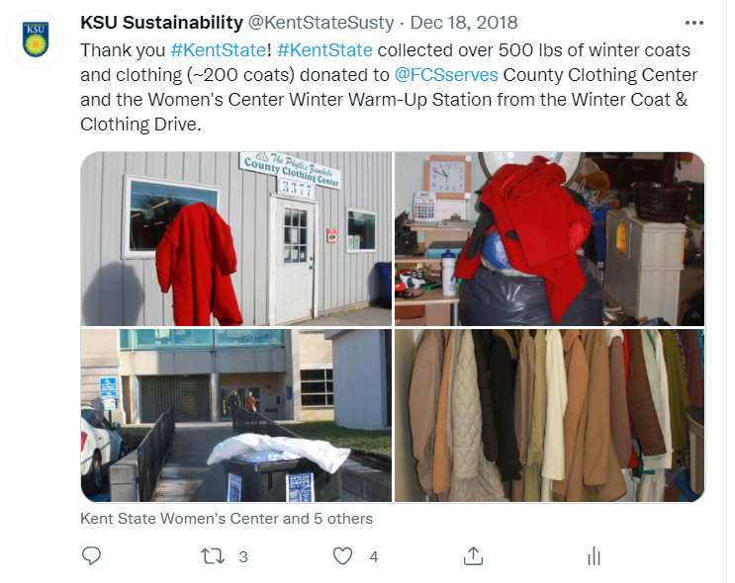
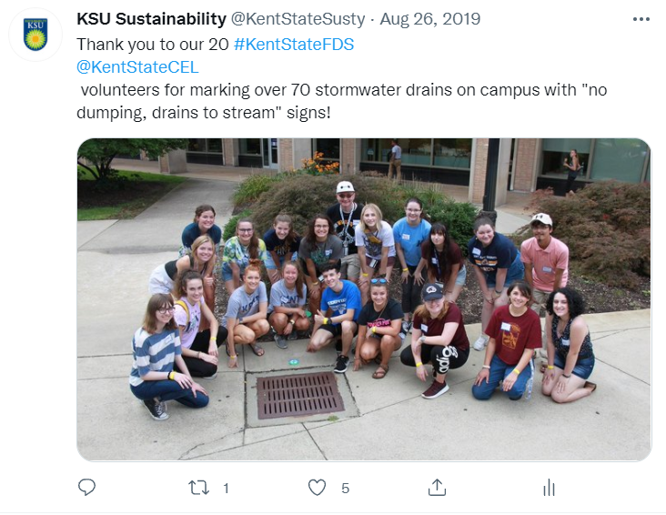
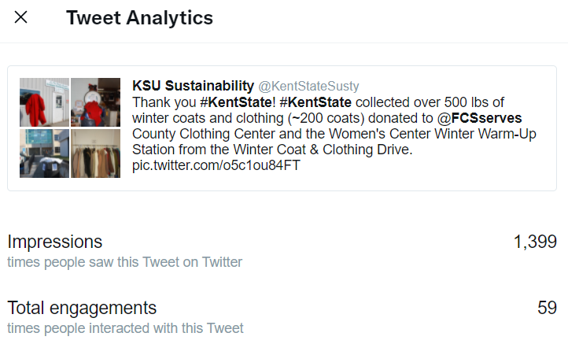
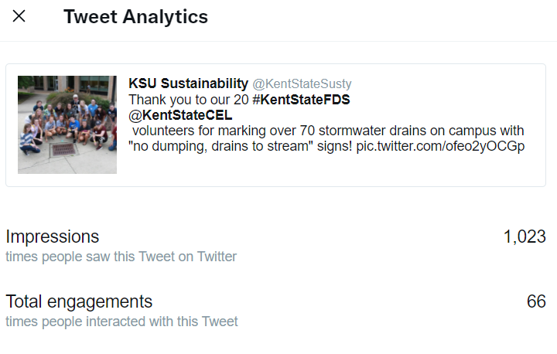

Slide 11
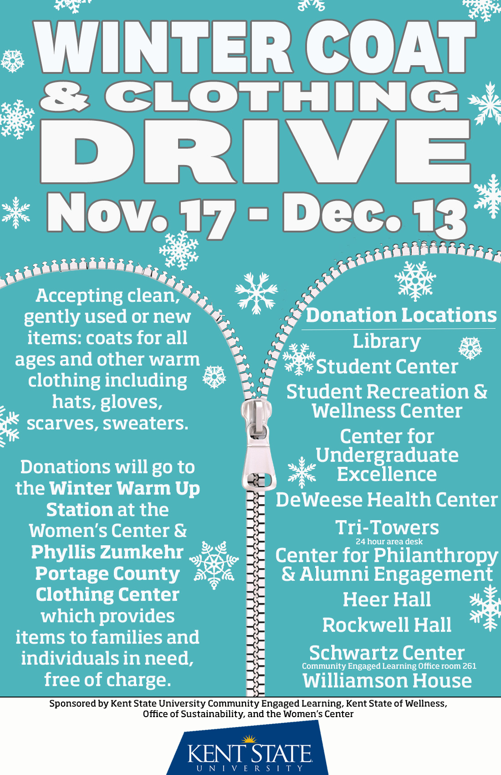
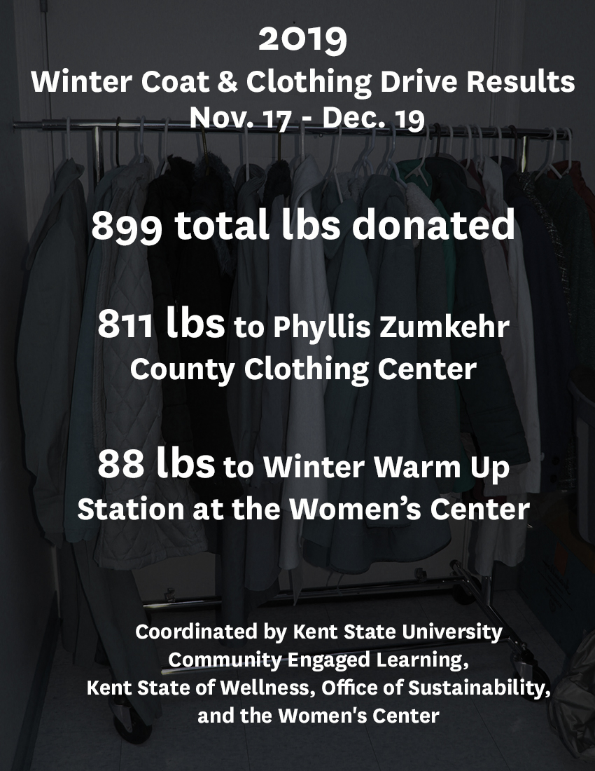

Slide 12
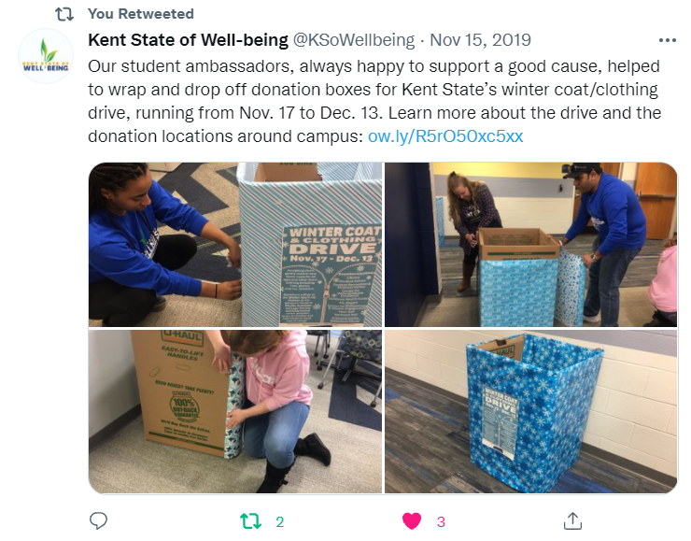

Slide 13
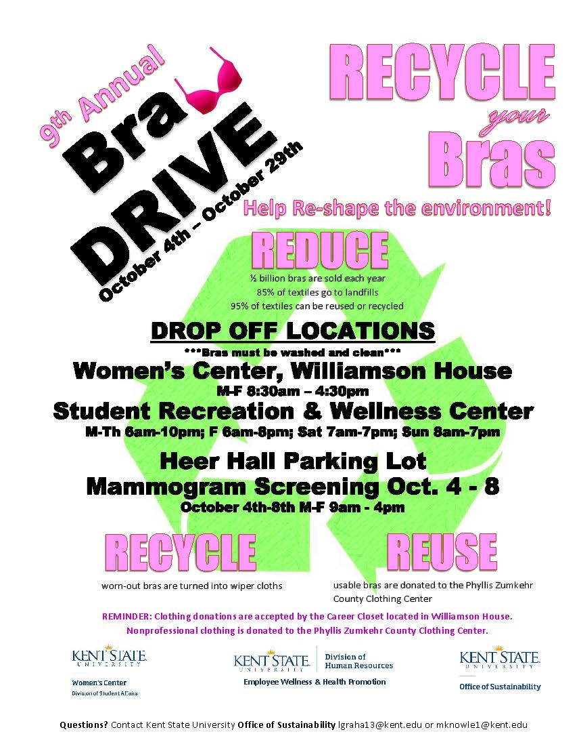

Slide 14
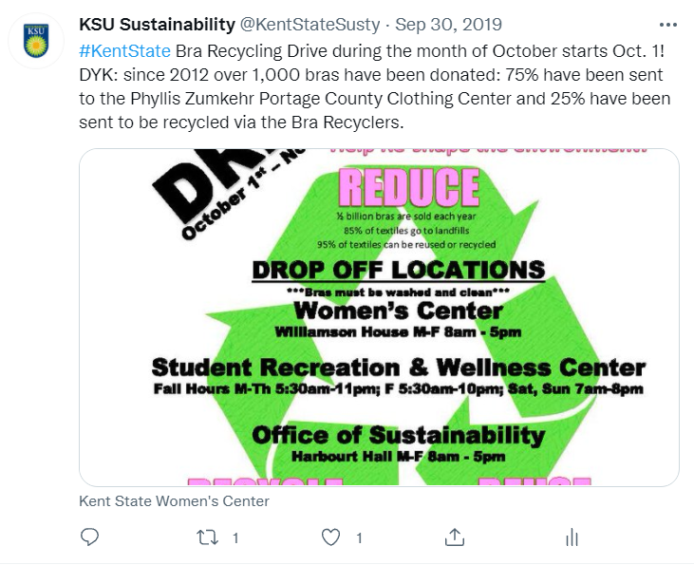
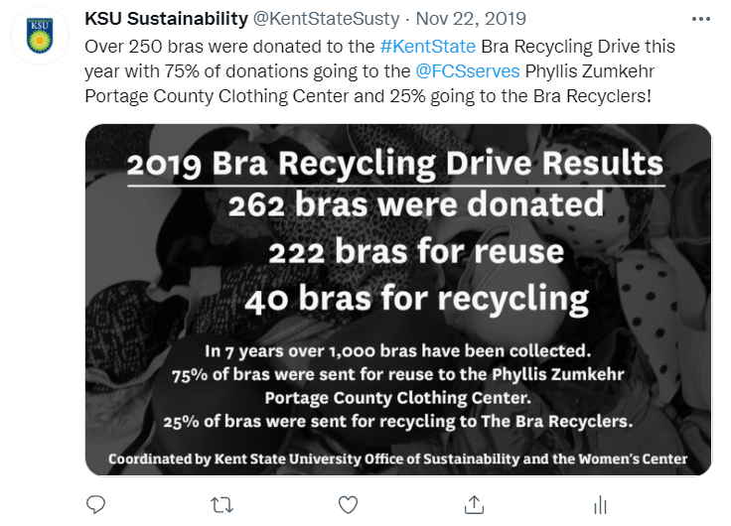
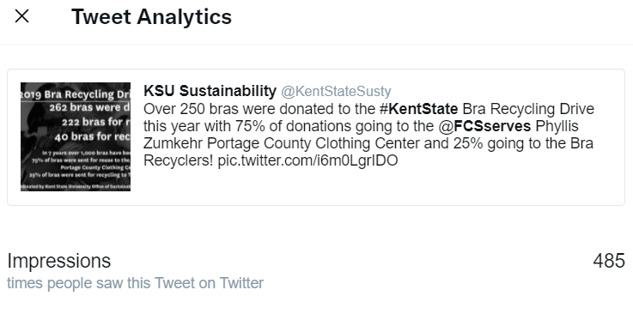
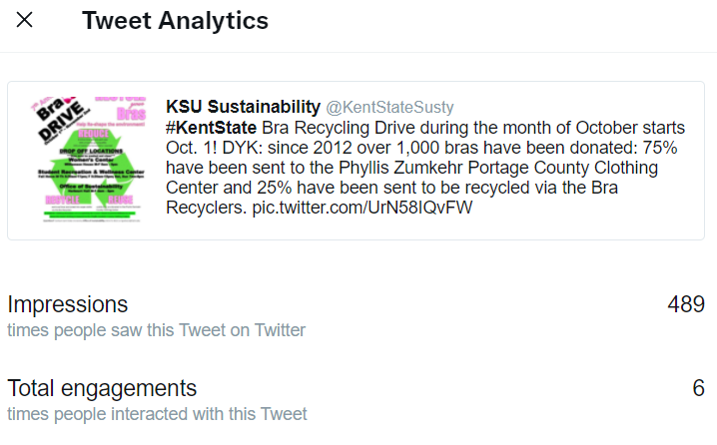

Slide 15
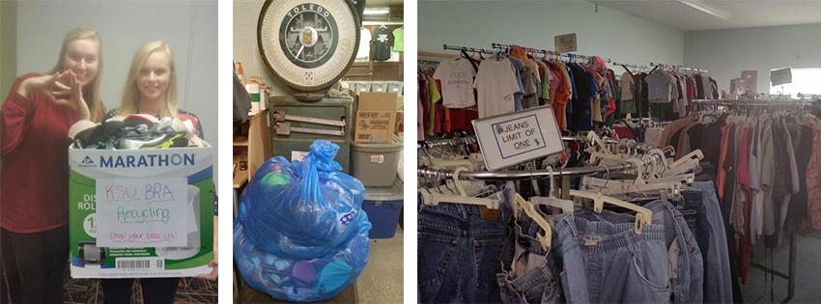
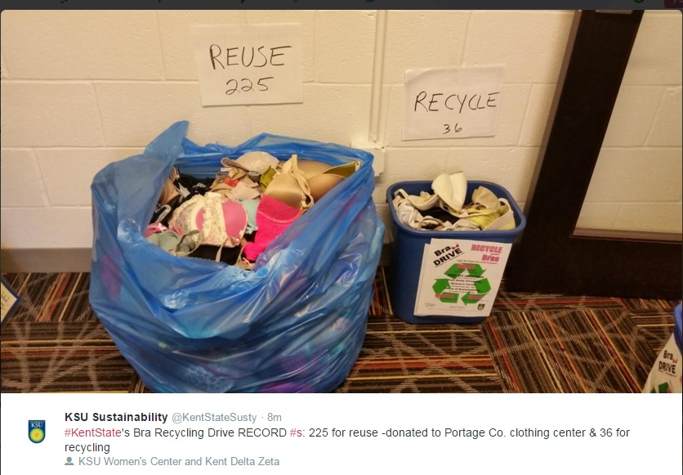

Slide 16
Office of Sustainability Statistics
2020-21
2019-20
2018-19
Twitter 1,500
50,000 impressions
166 tweets
Facebook 574
83 news articles
Newsletter subscribers 1,300; 9
Tagboard #FlashesGoGreen
Webpage views ~23,000
CR2ZW statistics
Snapchat 1,500 views
Twitter: 12,000 impressions; 47 tweets
FB: 60 posts; 1,891 visits
KSU CR2ZW video: 556 views
1 local press article; 1 campus press article; 1 radio; AASHE presentation 2020; Earth Month presentation 2021
Twitter
73,000 impressions
146 tweets
Facebook
86 news articles
Newsletter subscribers 1,221; 11
Tagboard #KSUrecycles
Twitter
70,000 impressions
150 tweets
Facebook
42 news articles
Newsletter subscribers 970; 9
Tagboard #KSUrecycles

Slide 17
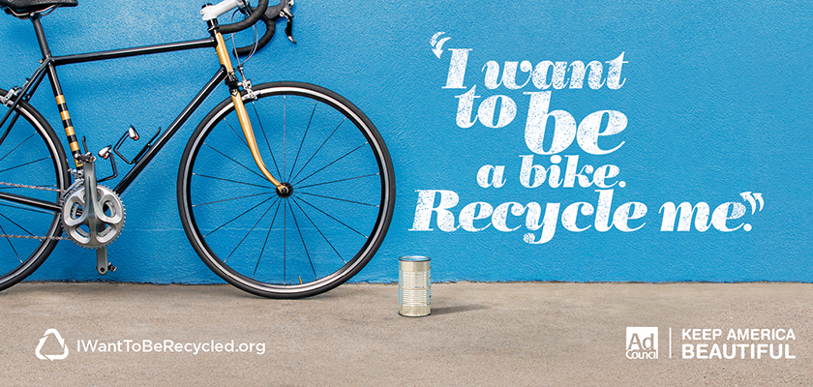
Brenda Pulley KAB; CURC Webinar March 13, 2014: The Science of Getting People to Use the Bin
http://curc3r.org/webinars/webinar-archive/archive-webinar-the-science-of-getting-people-to-use-the-bin/

Slide 18
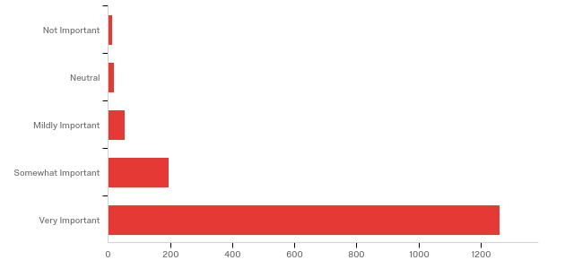
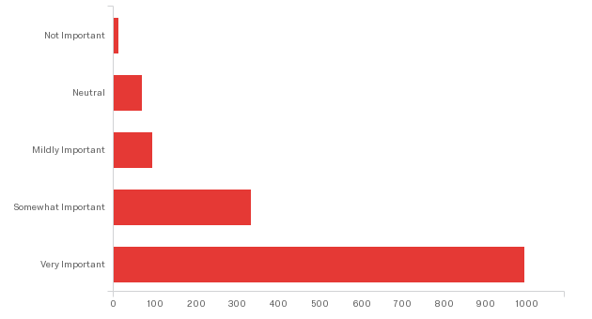
Kent State Campus Recycling Survey: Which of these statements best describes your current recycling habits?
0.8%
How important is it that Kent State University students, faculty, and staff recycle on campus?
1%
How important is it that Kent State University students, faculty, and staff recycle on campus?
1.2%
4%
3%
6%
13%
Fall 2017 1,540 respondents
22%
Fall 2014 1,492 respondents
82%
66%

Slide 19
How important is it to you that Kent State be a leader in sustainability?

Slide 20
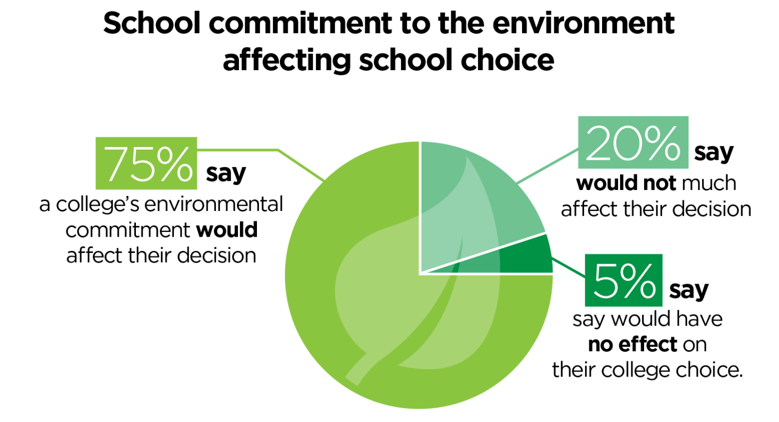
2021 College Hopes & Worries Survey | The Princeton Review
https://www.princetonreview.com/college-rankings/college-hopes-worries#Infographic

Slide 21
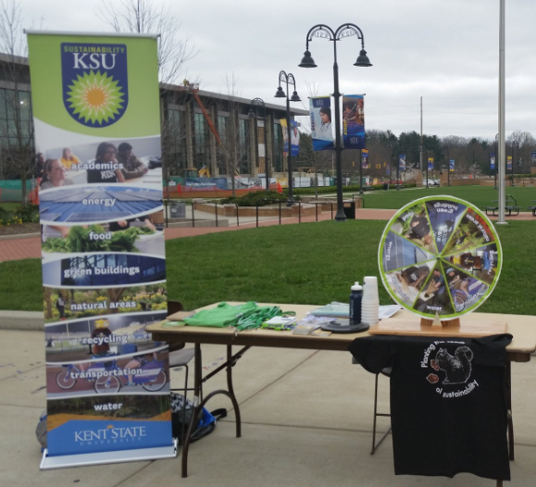
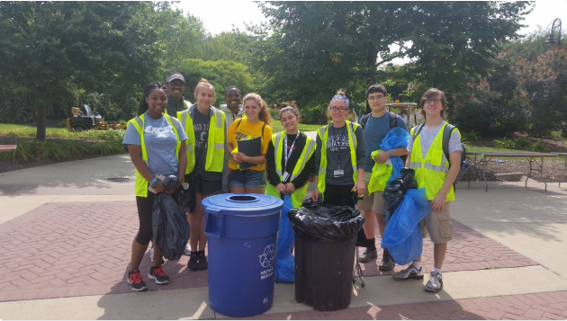
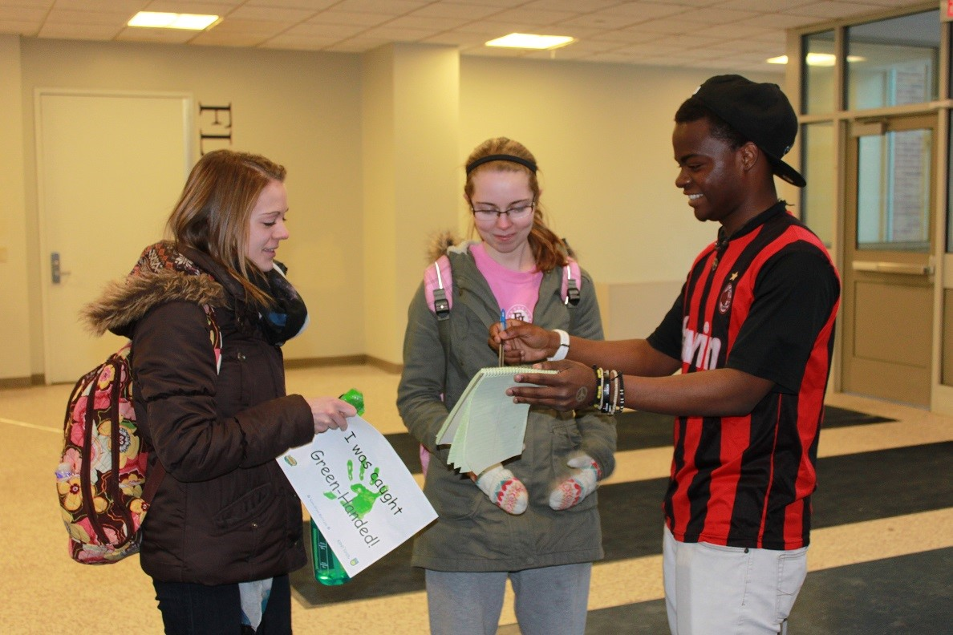

Slide 22
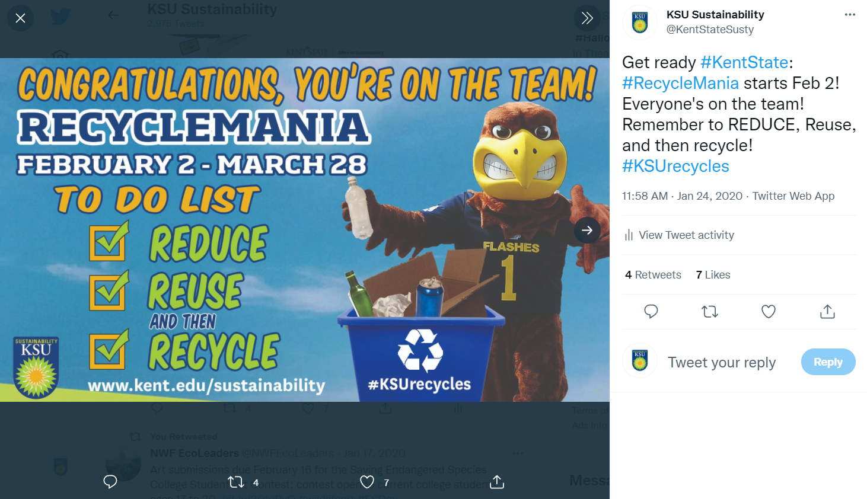
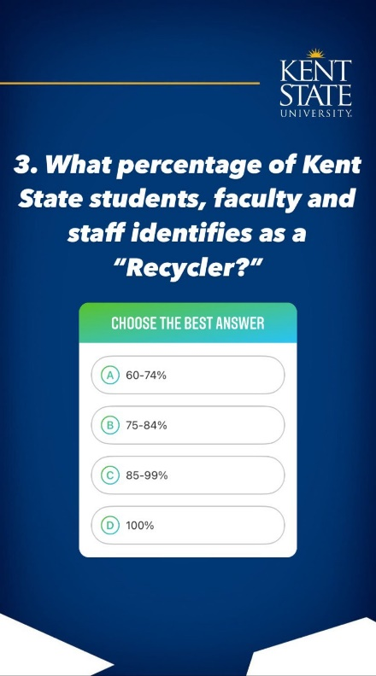
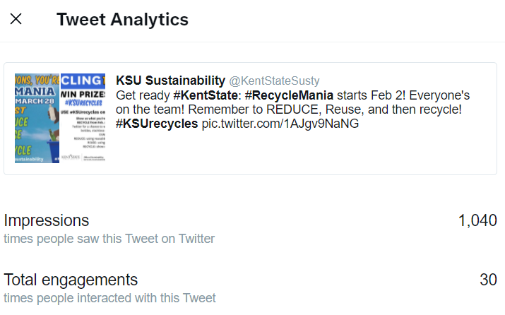

Slide 23
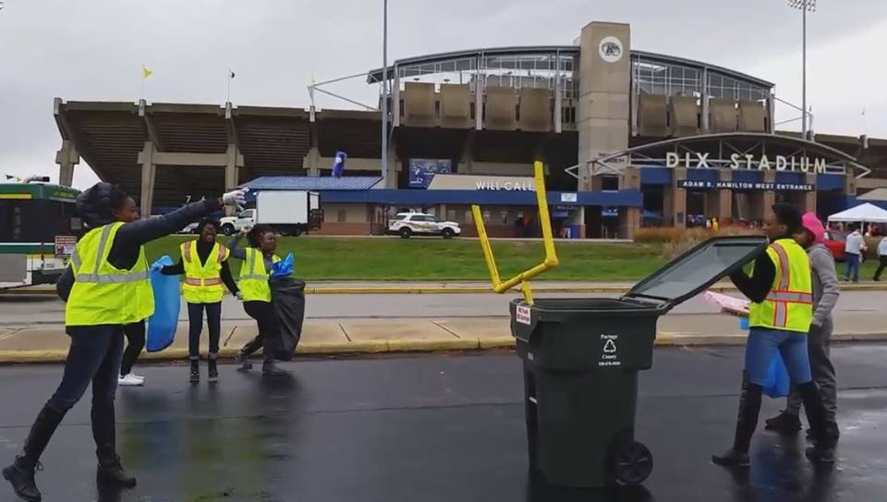

Slide 24
PURPOSE: STORYTELLING
People, Place, Plot, Purpose
Peers, Place, Positive, Purpose
Transparency

Slide 25
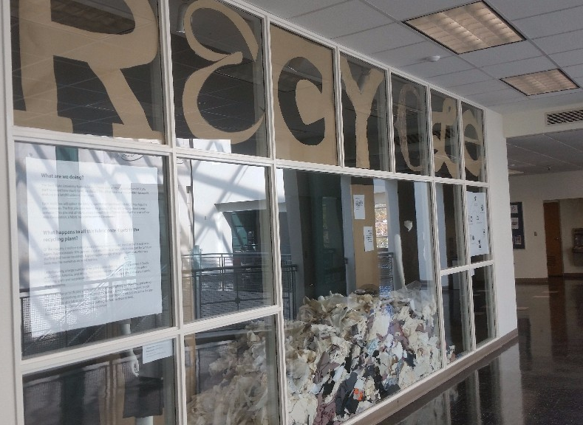
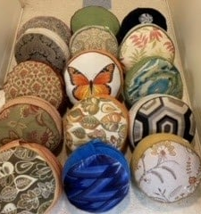
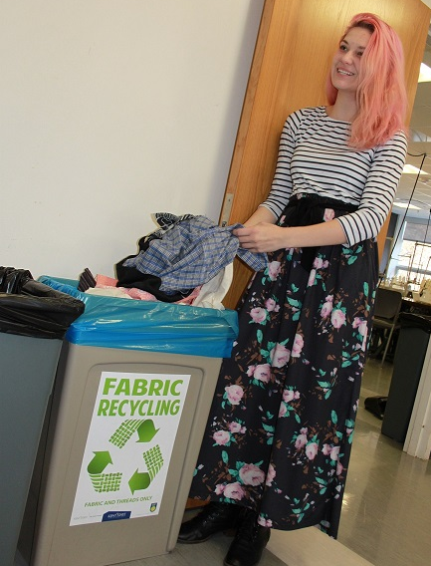
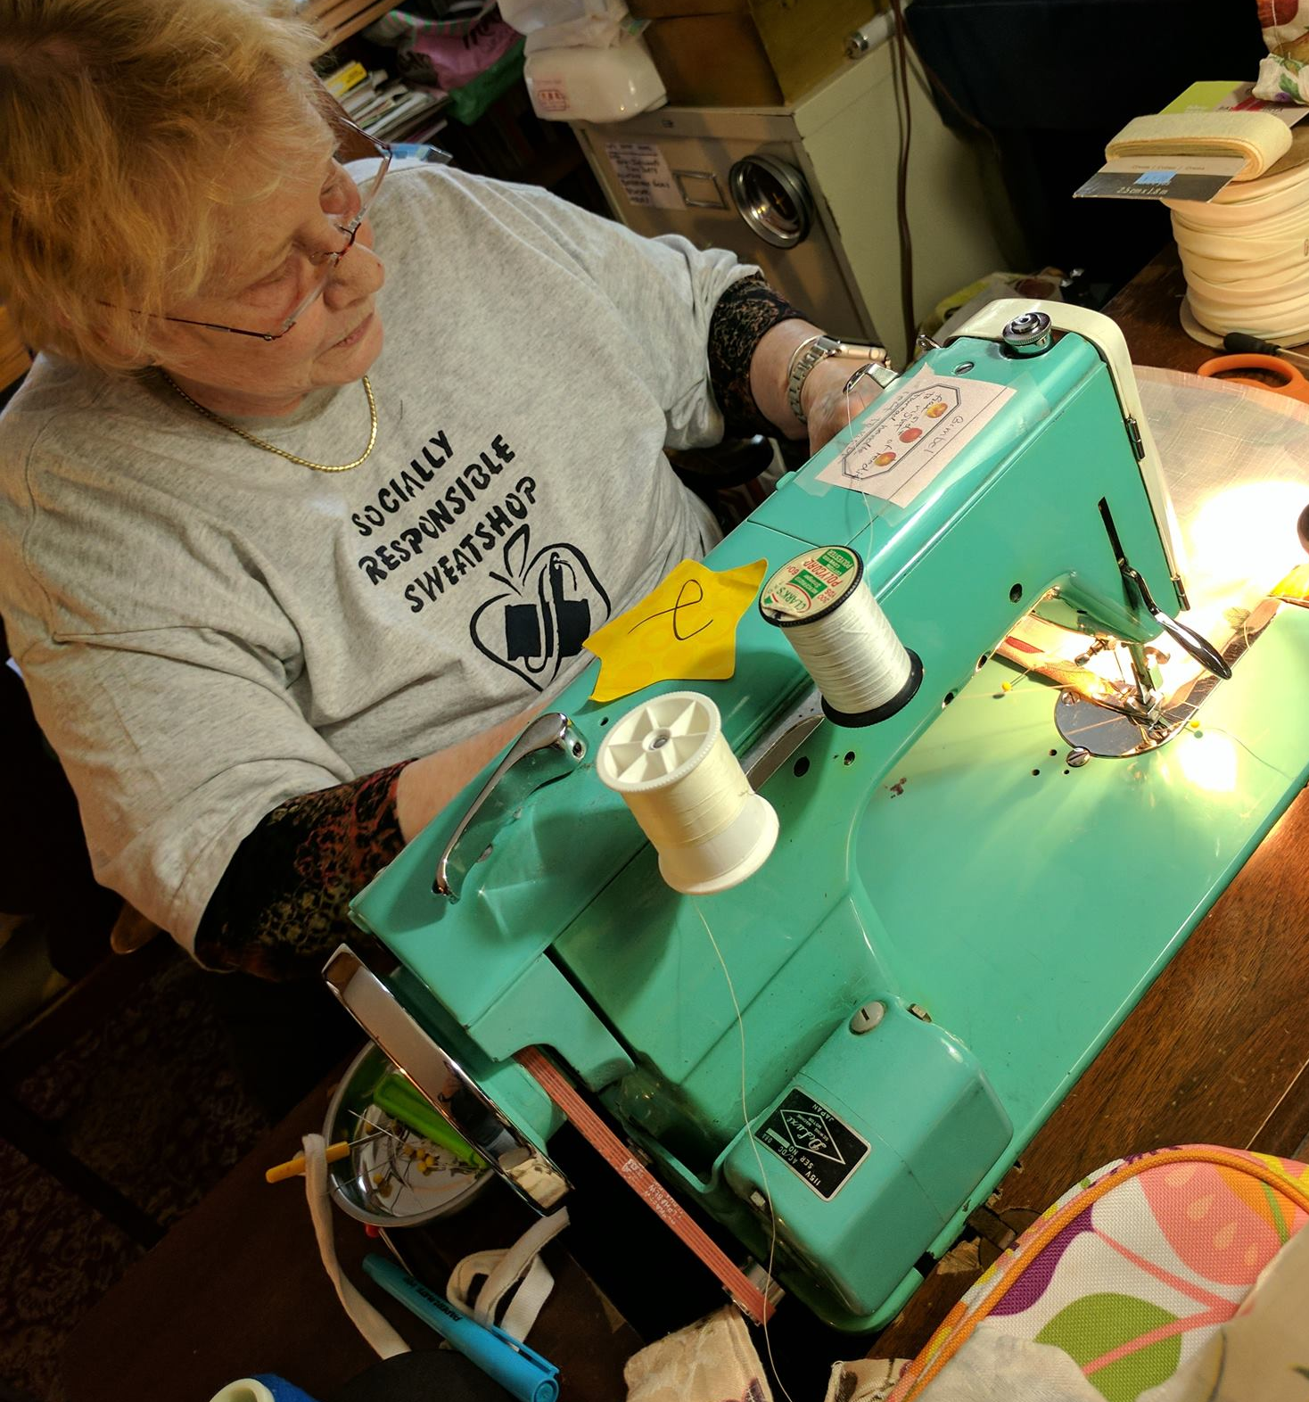
FABRIC SCRAP REUSE & RECYCLING

Slide 26
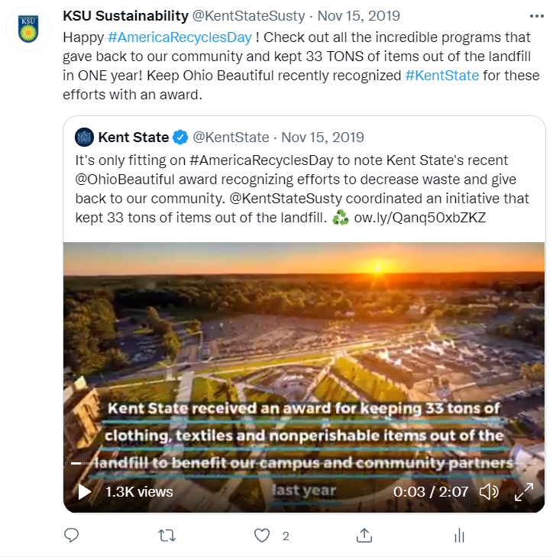
TEXTILE REUSE & RECYCLING
Press Release:
https://www.kent.edu/today/news/kent-state-wins-keep-ohio-beautiful-award-colleges-and-universities
2019 Keep Ohio Beautiful Youth Group Award: College/University
2020 AASHE Sustainability Award Finalist Kent State University’s Textile Reuse and Recycling Programs Case Study

Slide 28
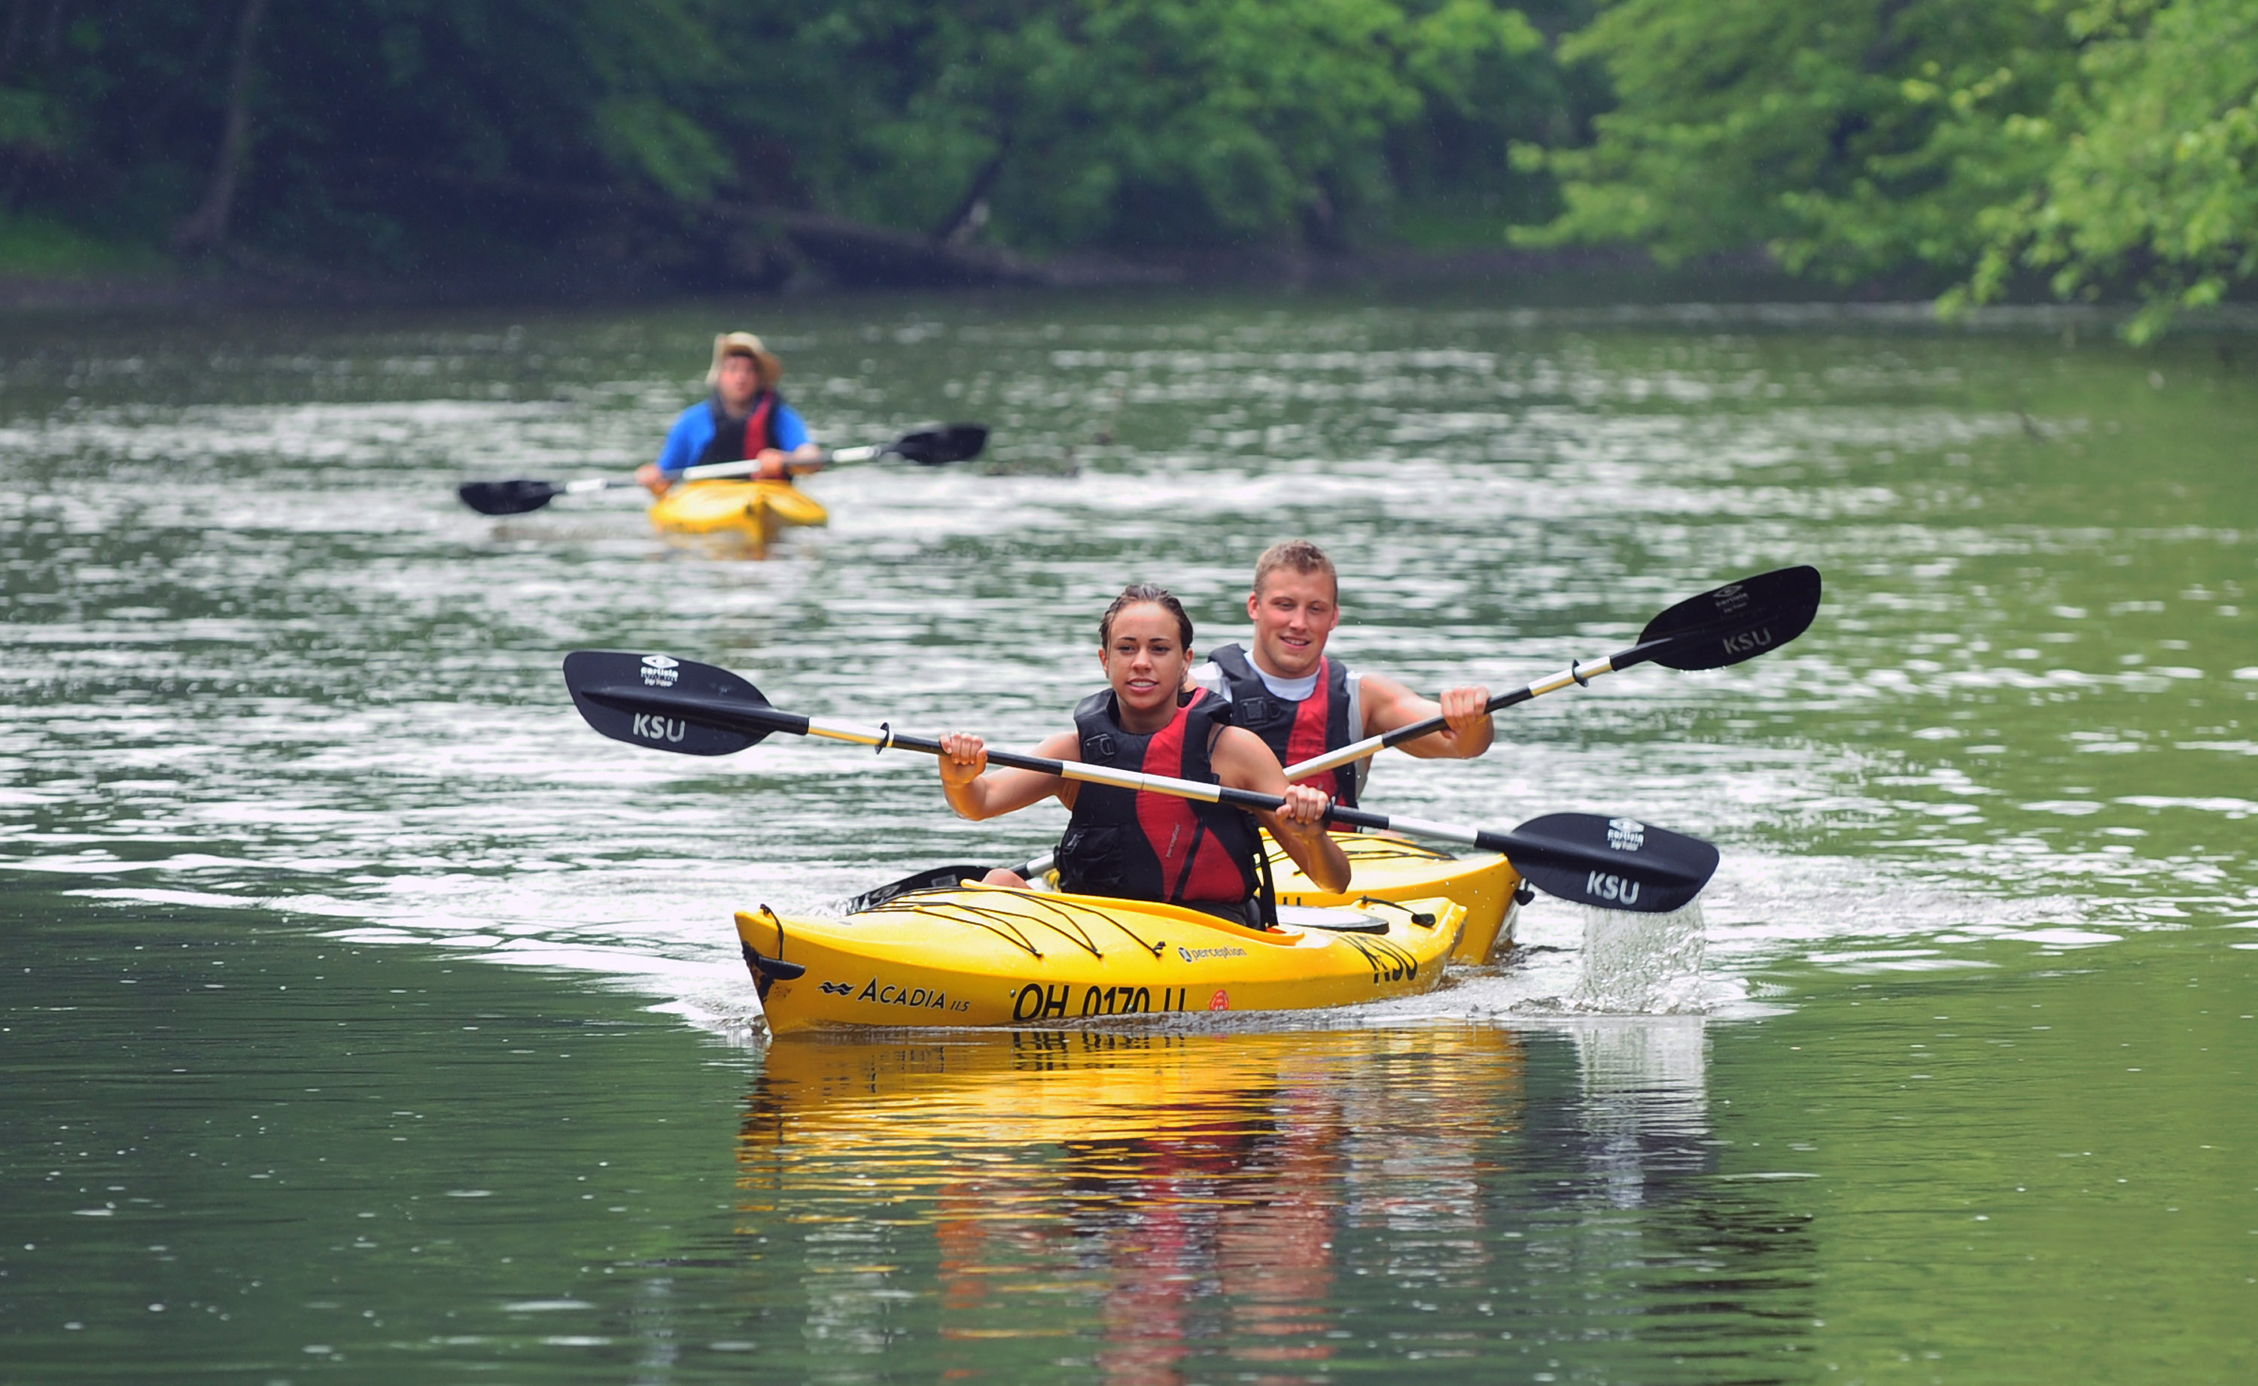
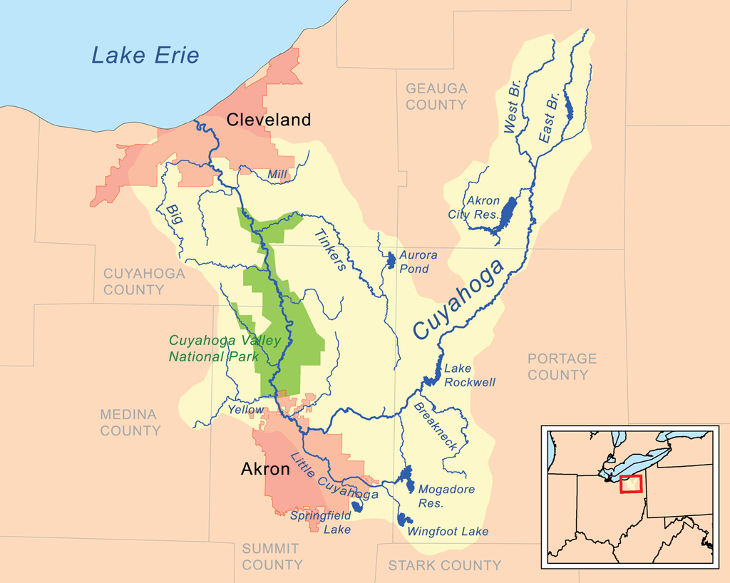
CONCRETE POETRY

Slide 29
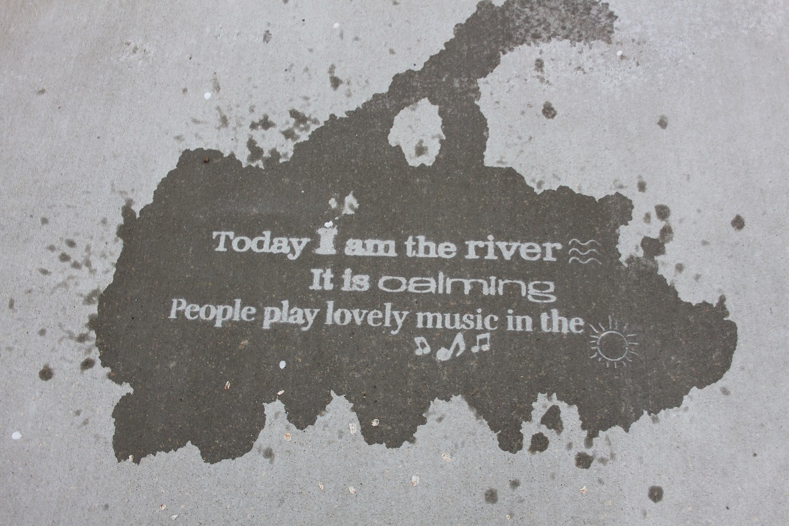

Slide 31
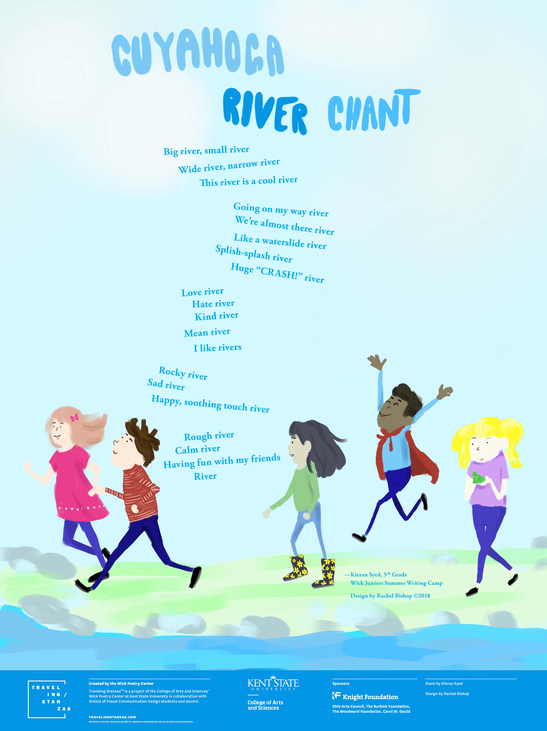
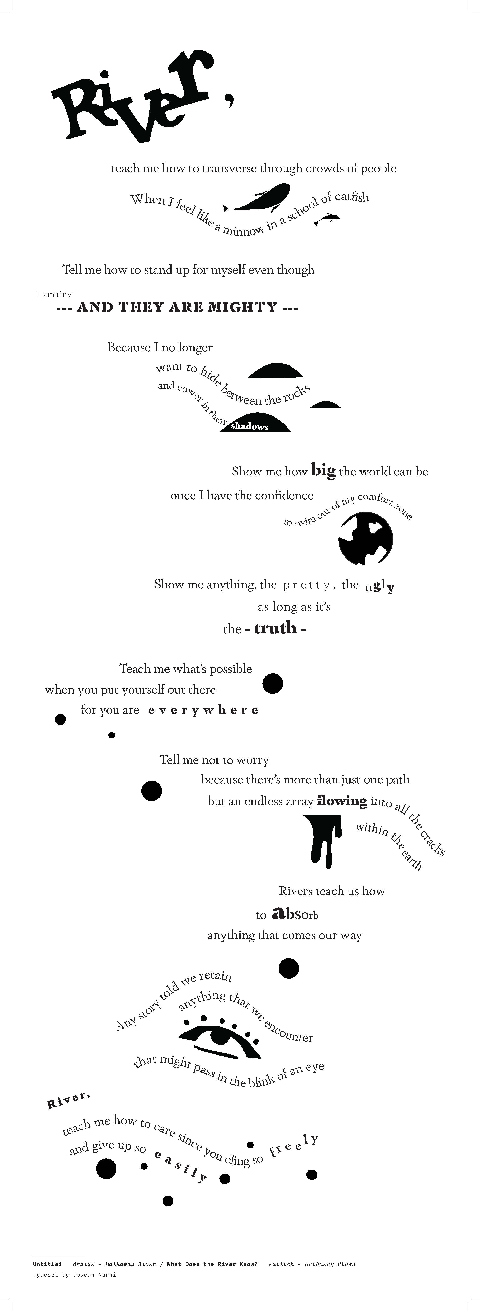
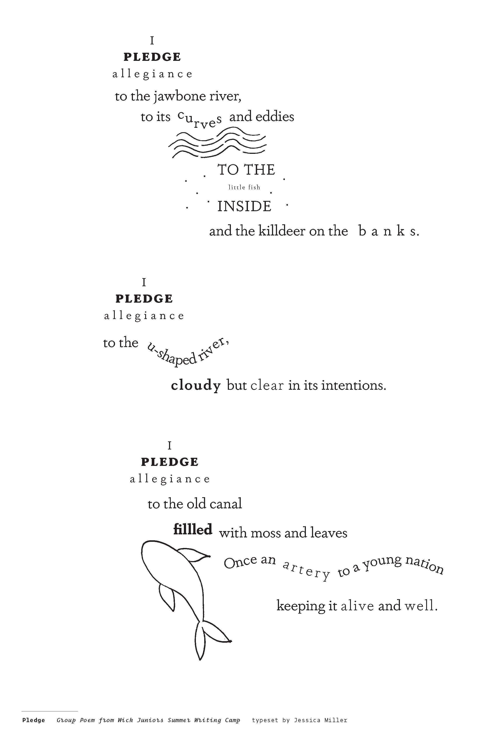
l

Slide 32
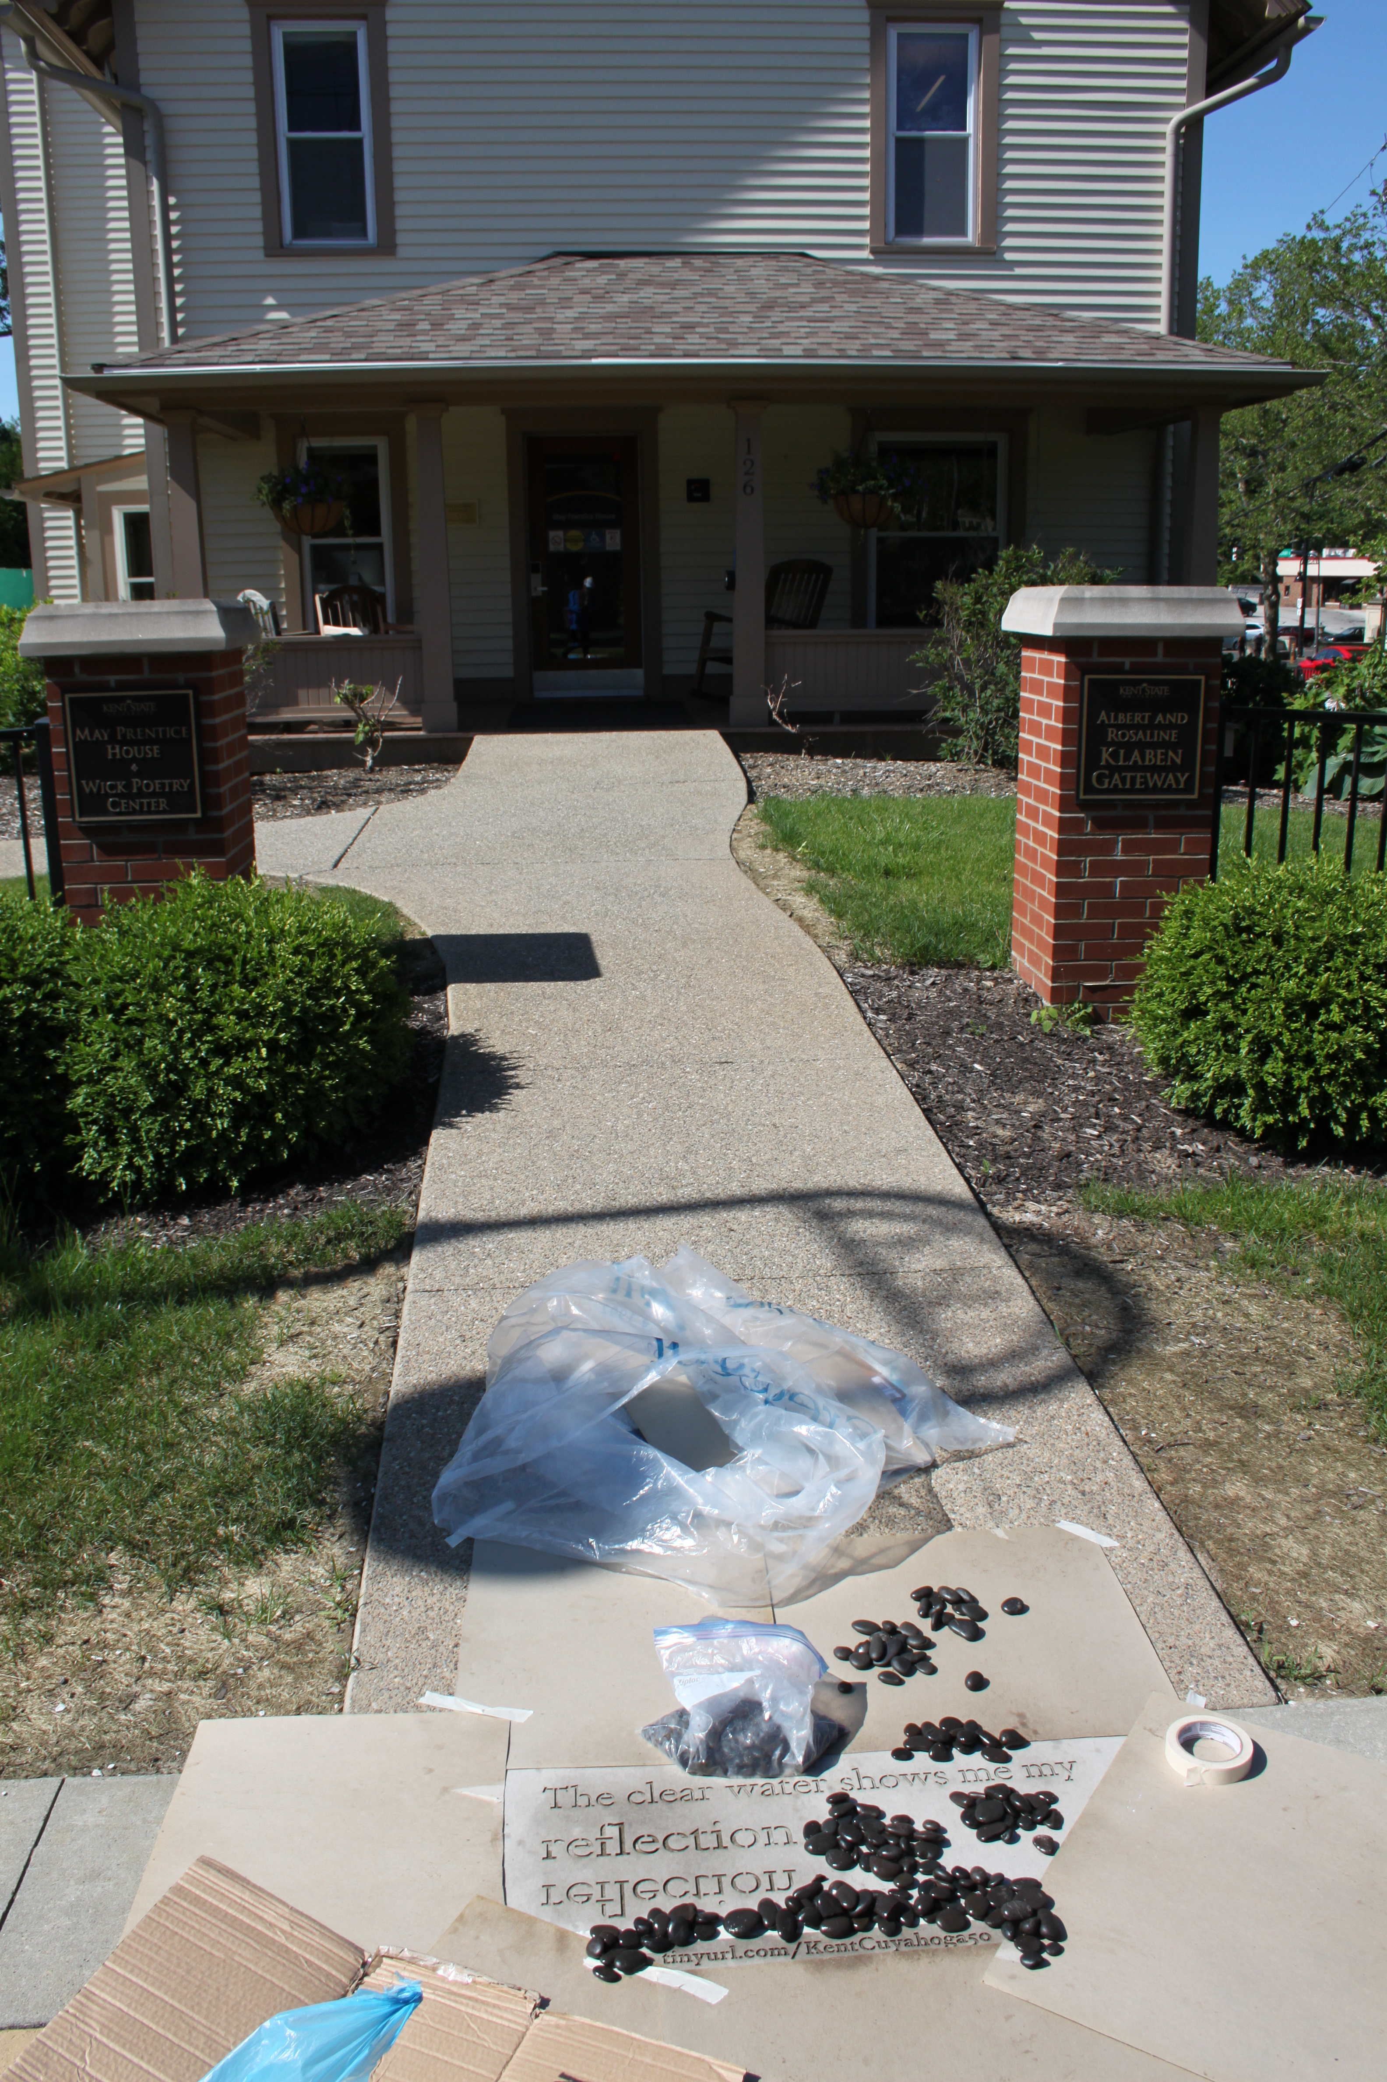
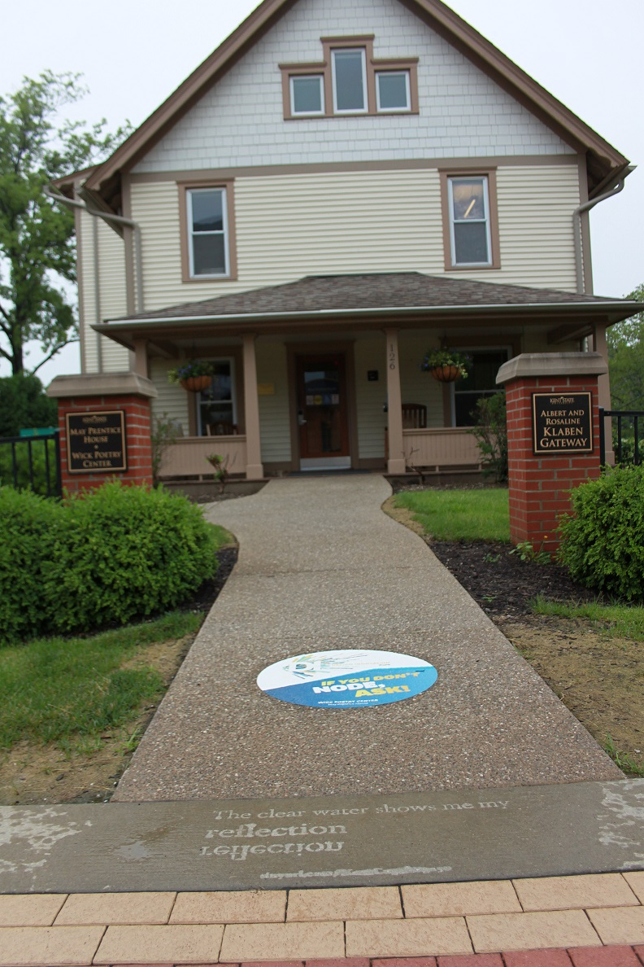

Slide 45
Recap
Message philosophy
Community Based Social Marketing- Peers
Connect to place, community, & gratitude- Place
KAB “I want to be recycled campaign”- Positive
Storytelling- Purpose
Peers, Place, Positive, Purpose
Free information can used to help inform messaging
Princeton Review Survey, Surveys, Waste Audits, Campus Race to Zero Waste & GDC results, social media analytics, website analytics, mailchimp analytics
Traditional website, press release, social media, digital screens, emails, newsletters
Nontraditional trivia wheel, prizes/games, GDC game/tailgating, fabric scraps display, KIC recyclepalooza, Flash, CR2ZW, Concrete Poetry

Slide 46
Thank you!
Leah Graham
Outreach/Recycling Coordinator
Kent State University, Office of Sustainability
Lgraha13@kent.edu
330-672-8023
kent.edu/sustainability
Twitter & FB: @KentStateSusty

Slide 47
kent.edu/sustainability

