Slide 1
Zero Waste Leadership Team
(ZWaLT)
Appalachian State University
Jennifer Maxwell
Sustainability Program Director

Slide 2
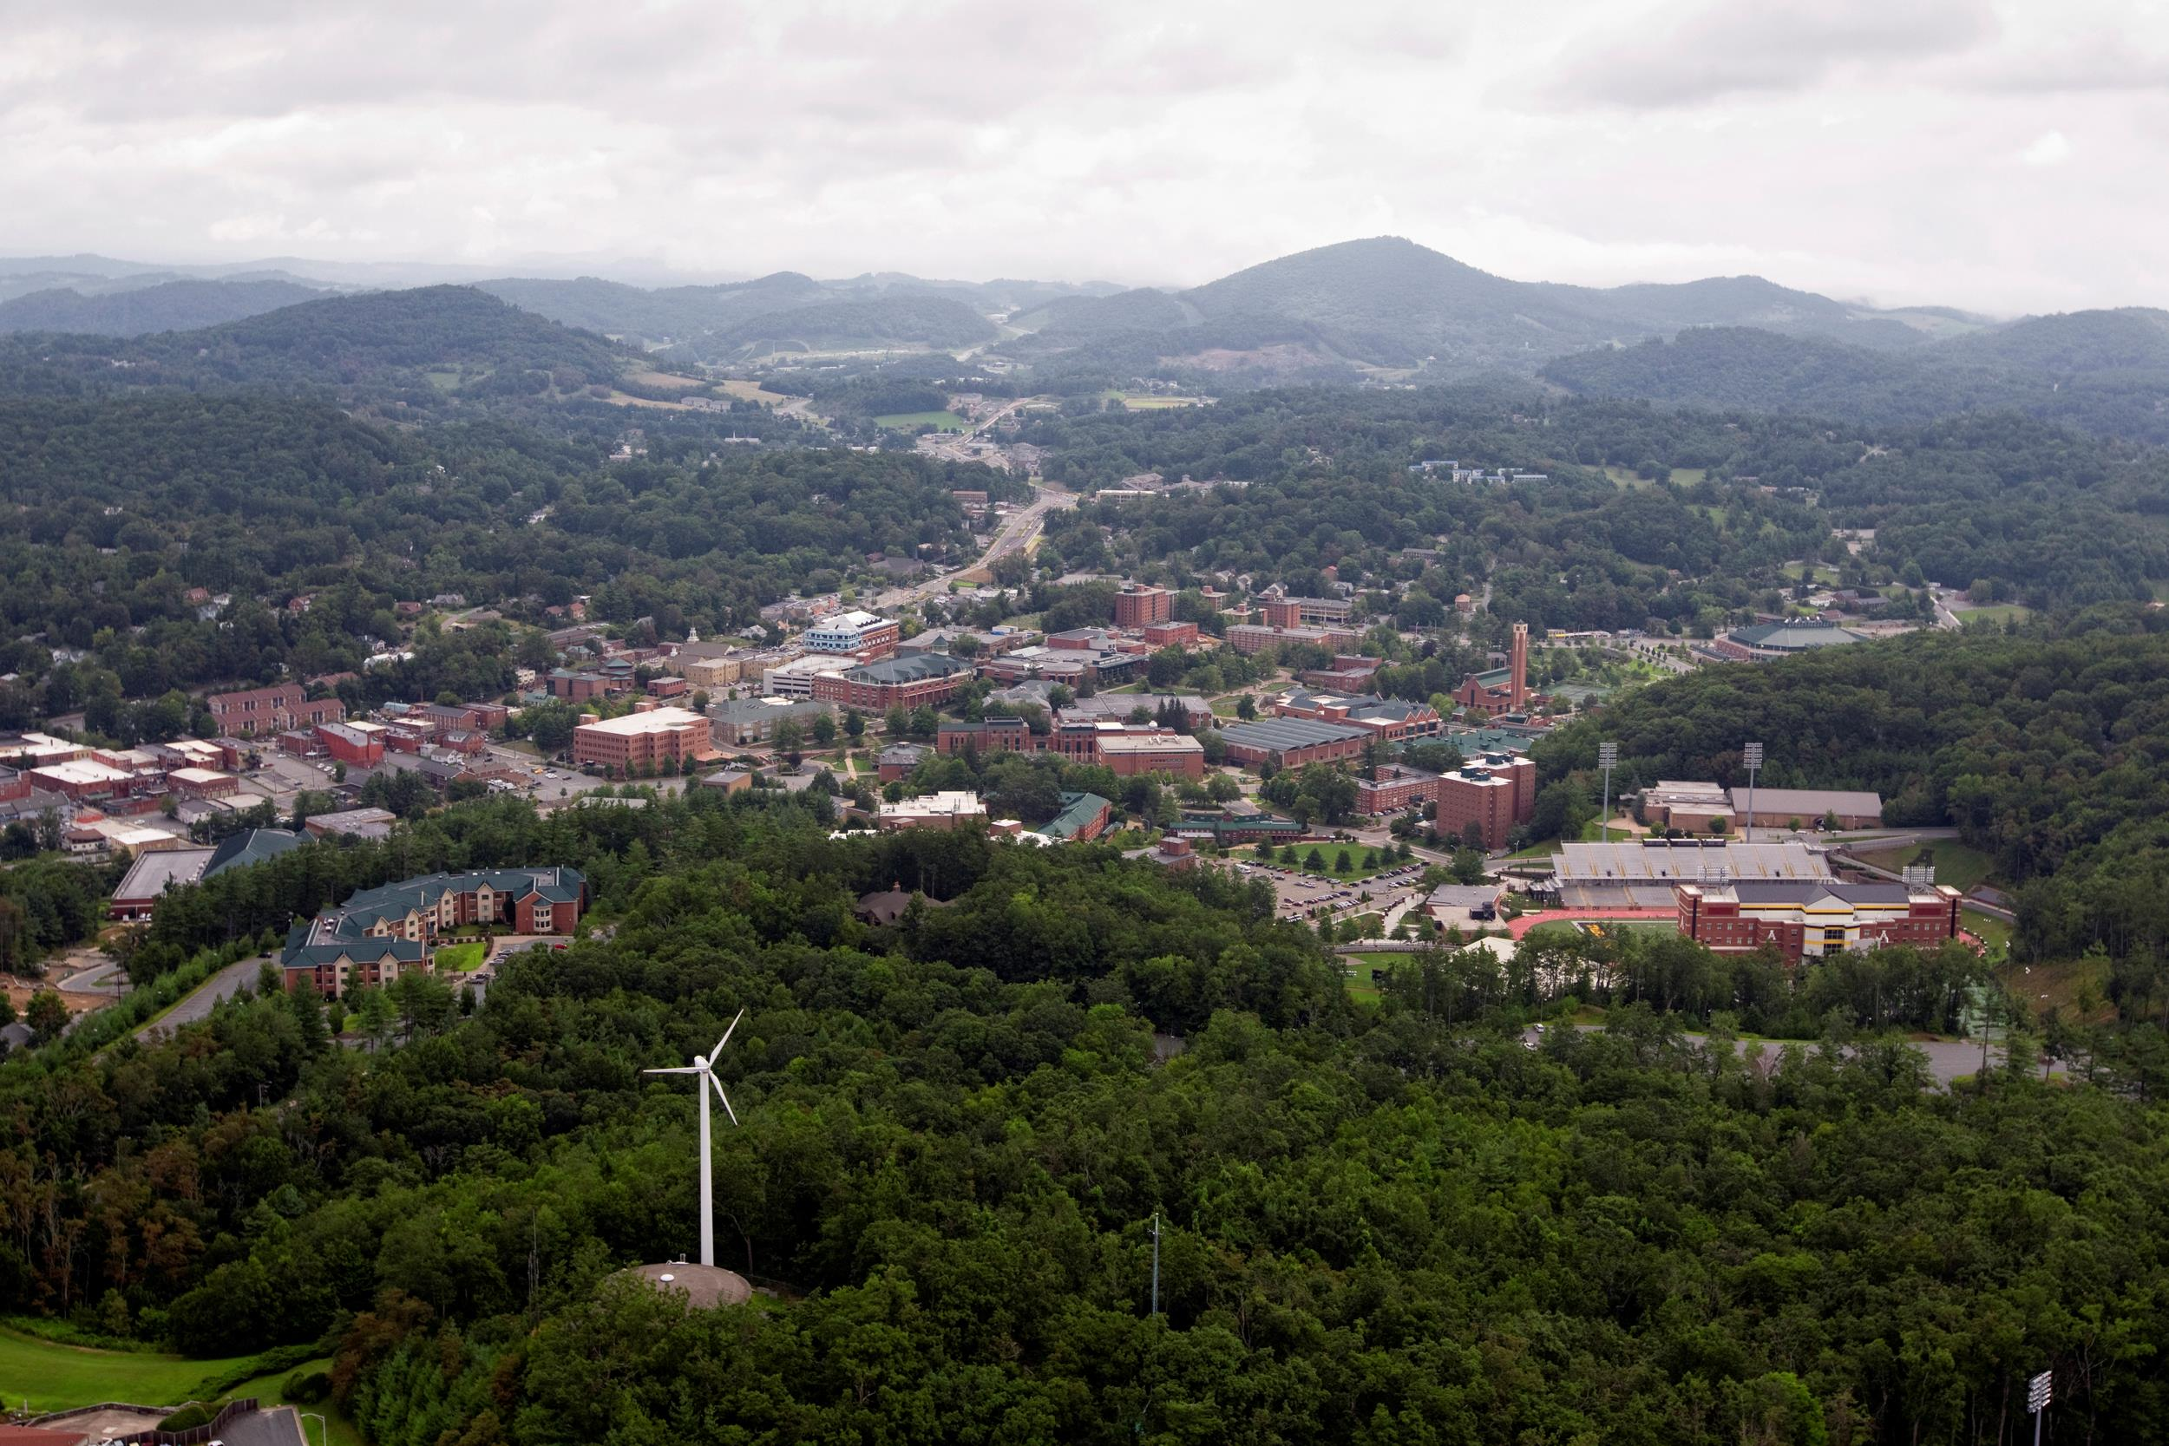
Appalachian State University
Rural Mountain Campus
Boone, NC
20,023 students
1,200 acres, with 375 developed
30 academic buildings
20 residence halls- housing about 5,600 students on campus
3 main dining facilities
11 recreational and athletic facilities

Slide 3
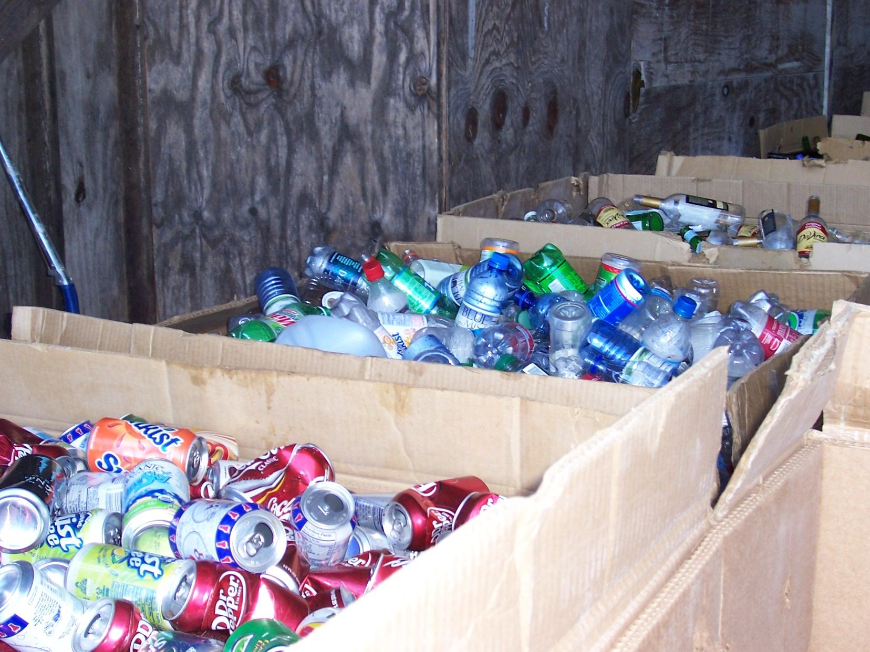
A Little History...
2006-2011- Jen serves as Resource Conservation Manager for Waste Reduction and Recycling Office within Facilities Operations
2008- Office of Sustainability developed through Sustainability Council
2008- 2011- Jen’s position coordinates efforts with Office of Sustainability
2011- Jen’s position transitions to Office of Sustainability to take on more holistic approach and oversee all outreach associated with WRR efforts
2011- Recycling and compost operations are absorbed into Environmental Services and Landscape Services
2011- Indoor collection to env services and outdoor collections to landscape services
2012- Zero Waste commitment made by university
2013- Remove trash cans from classrooms, minibin system, color coded efforts, and so on…
2013- Zero Waste Leadership Team developed

Slide 4
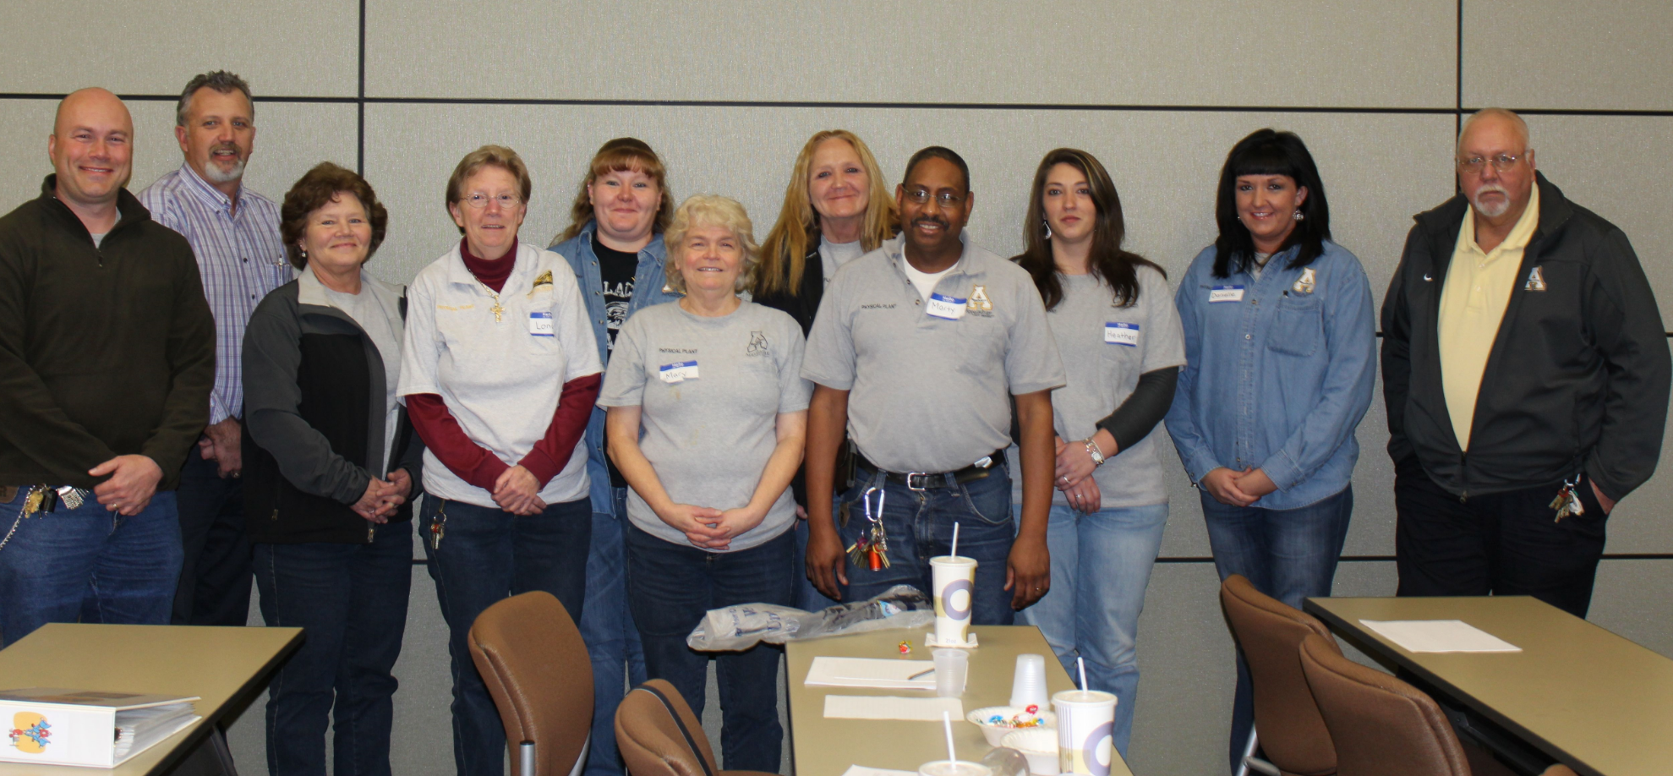
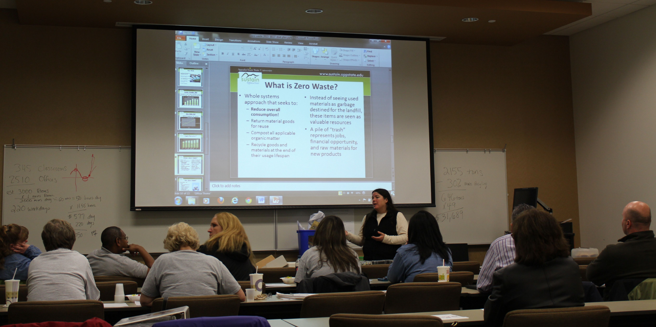
Input from Team Lead Supervisors and Crew Members
Environmental Services
Four supervisors appointed to zero waste committee for all planning purposes through transition
Six additional housekeeping staff appointed to committee for input and planning efforts
Focus groups with entire housekeeping staff
Zero waste training for entire housekeeping staff

Slide 5
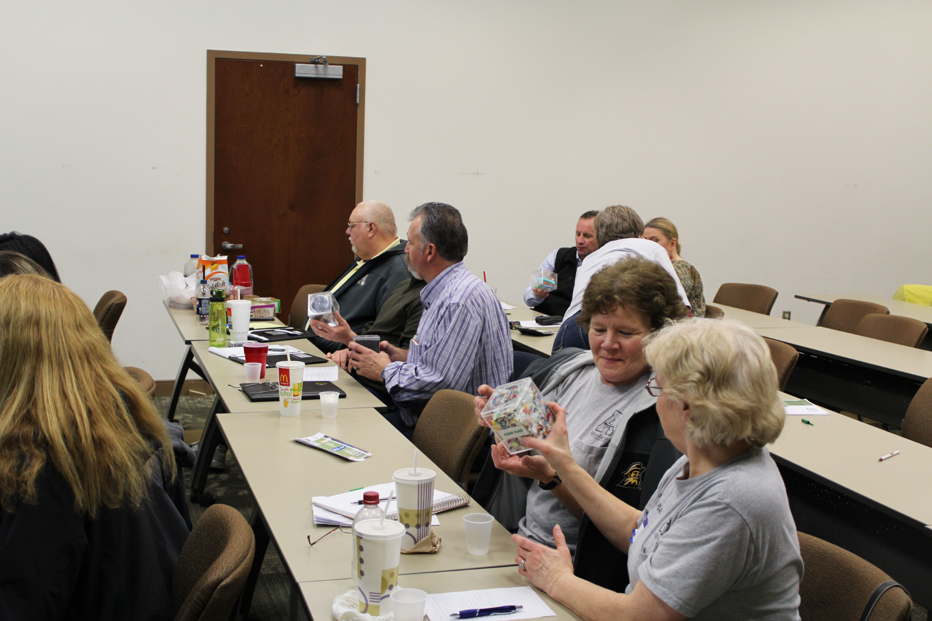
Input from Team Lead Supervisors and Crew Members
Landscape Services
Recycling Coordinator position developed to manage recycling and compost operations efforts
Collections team members positions developed to assist Recycling Coordinator with collections
Compost Operations Coordinator position developed
These positions played role in all planning of zero waste commitments and ZWaLT moving forward
Focus groups with all Landscape Services staff

Slide 6
Zero Waste Leadership Team
Office of Sustainability
Sustainability Program Director
Sustainability Outreach Director
Facilities Operations
Director of Campus Services
Landscape Services Director
Facilities Superintendent
Environmental Services Director
Recycling Coordinator
Compost Operations Coordinator
University Housing
Facilities Maintenance Supervisor
Project Specific
Campus Dining, UREC, Athletics, Student Affairs. Convocation

Slide 7
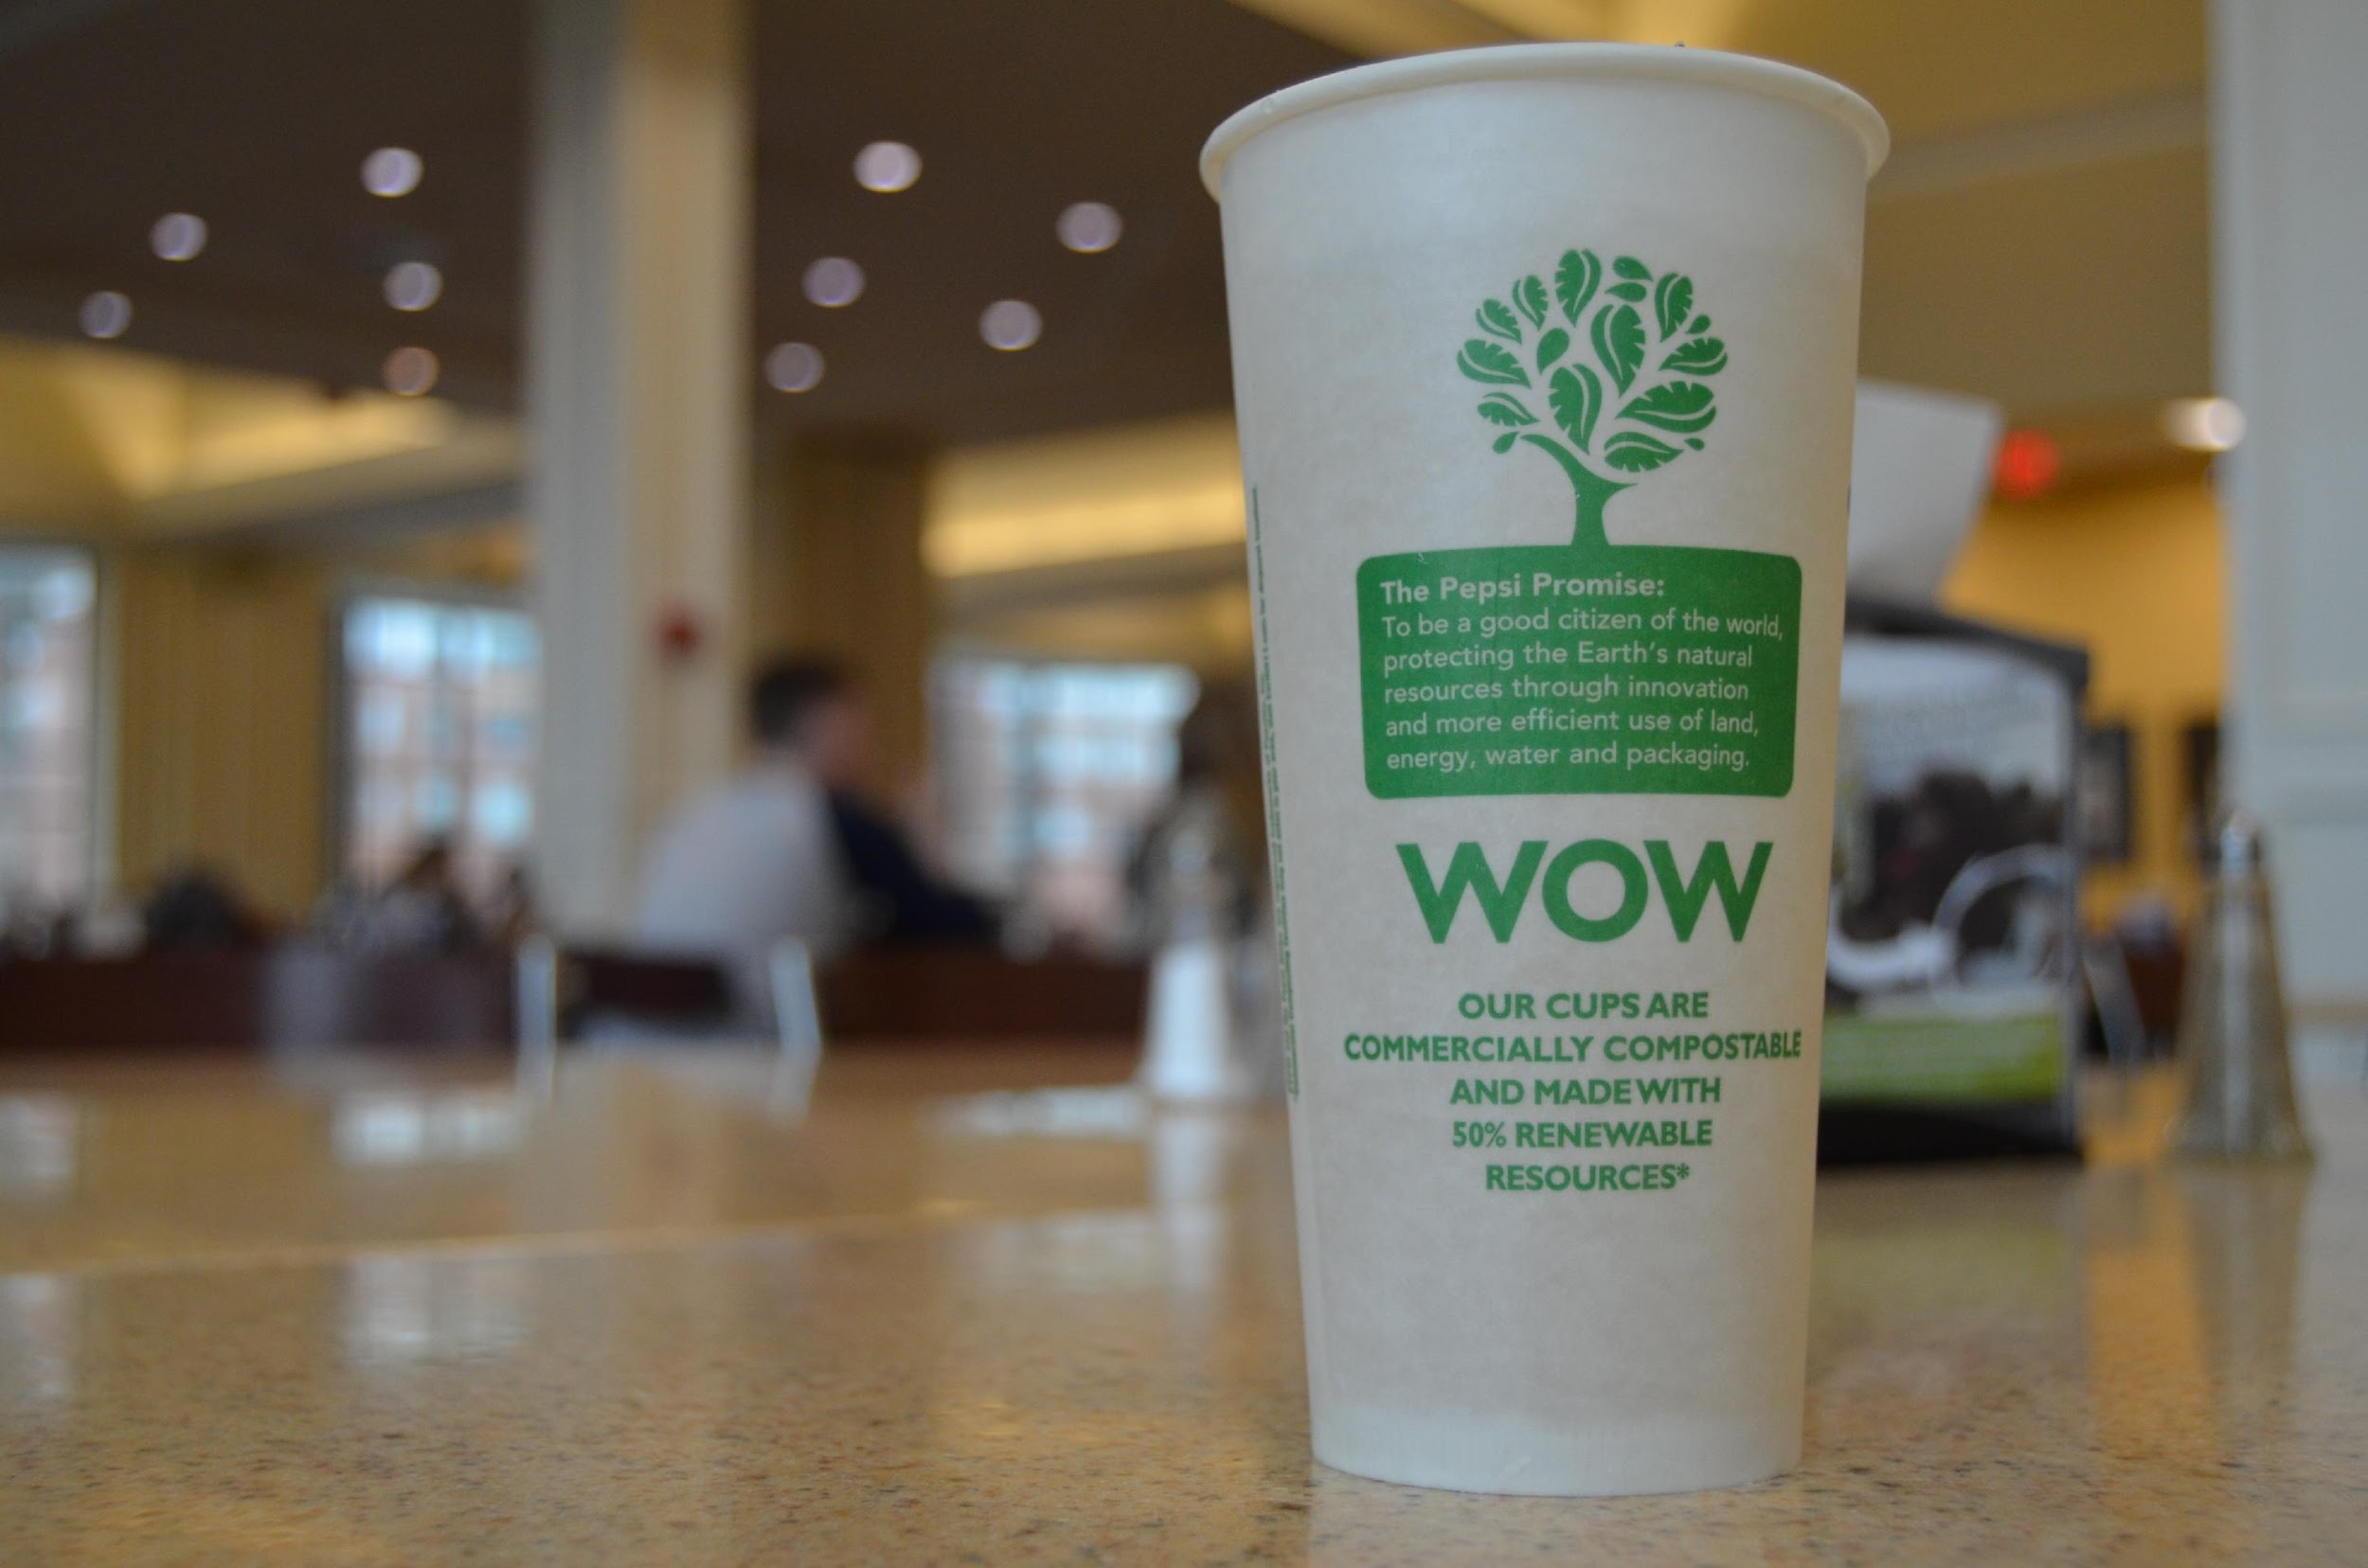
Input from Campus Dining Team Members
Campus Dining
Collaborative planning efforts with management and staff on composting specifically back and front of house
Zero waste training and discussions for campus dining staff
Compost training for all staff within dishroom
Coordinated outreach efforts at the beginning of each semester focusing on zero waste efforts

Slide 8
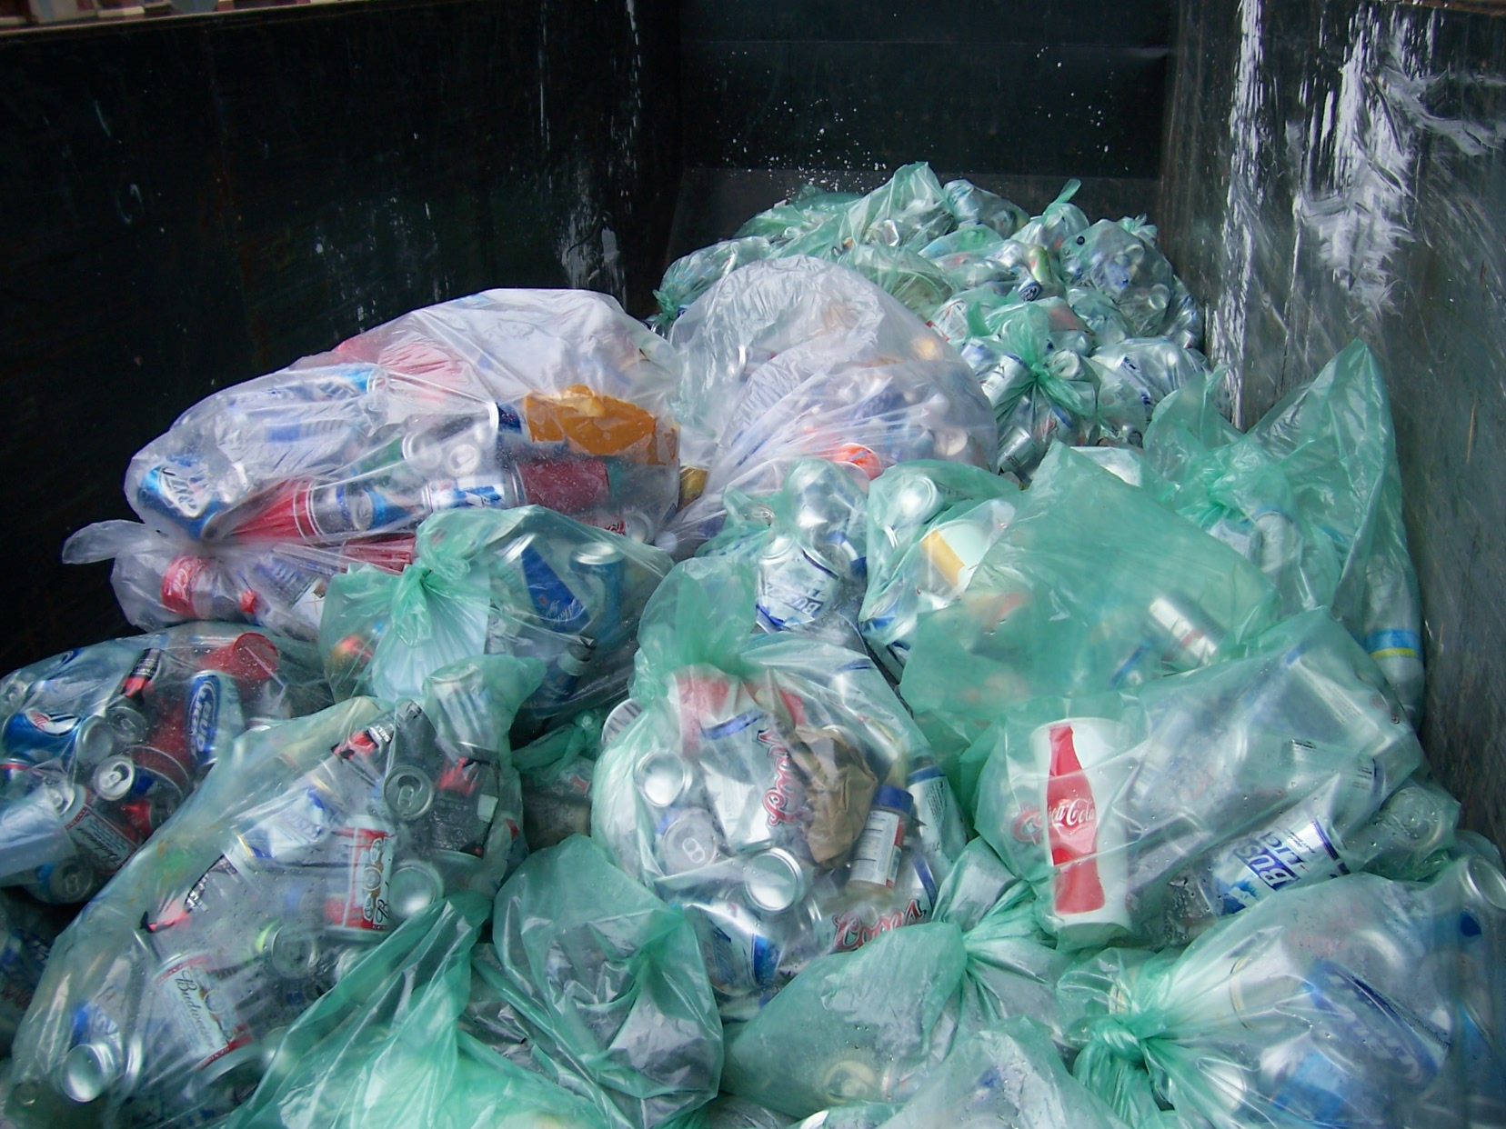
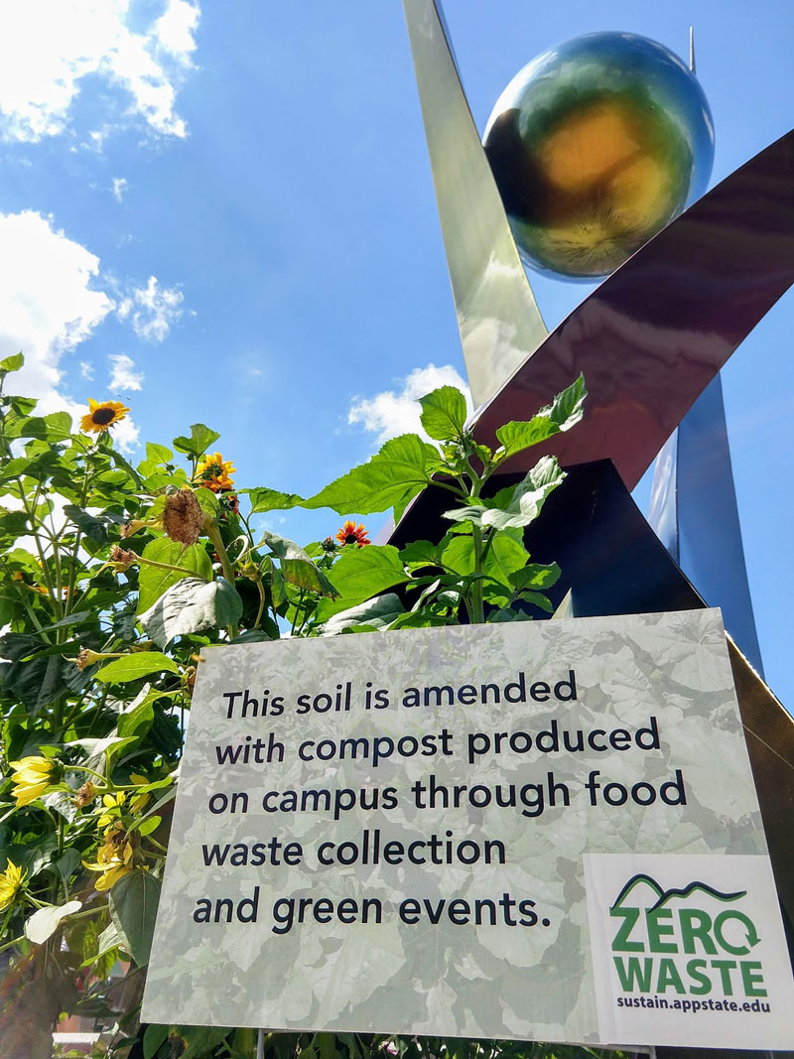
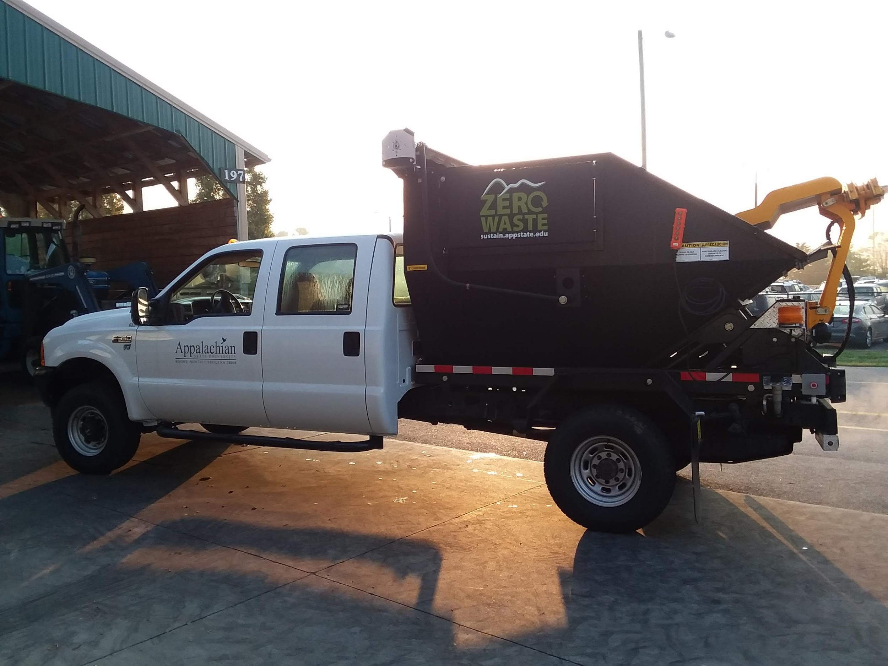
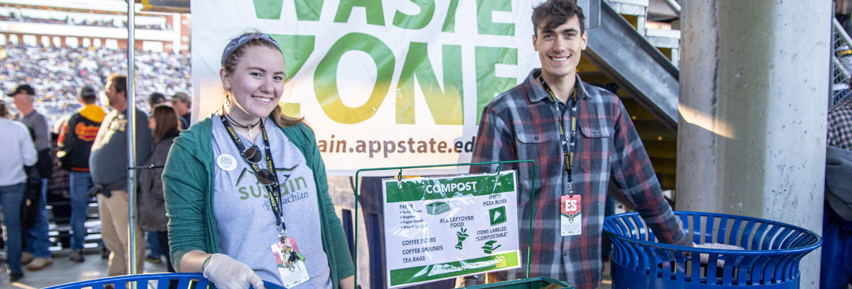
ZWaLT Focus
Waste Reduction Efforts
Recycling Operations and Outreach
Composting Operations and Outreach
Zero Waste Stadium Efforts
Move-In
Move-Out
New initiatives that this team will be involved in:
Zero Waste Ambassador Team- 5 students
Sustainable Purchasing Plan development
Green Labs program development

Slide 9
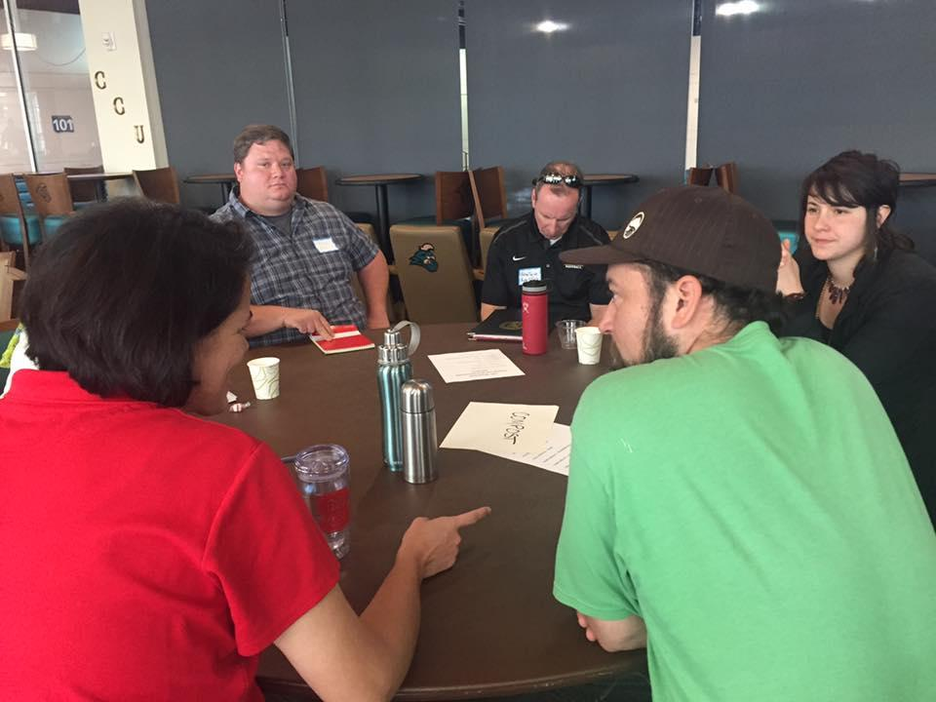
Benefits and Successes
Creates better understanding
Mutual respect
Collective Buy-In
Everyone’s needs are considered
Voices are heard
Strategic Planning
Program Development
Contract Management
Targeted Outreach- inform on focus for Outreach Ambassadors and Eco-reps
Timely follow-up to address challenges and barriers

Slide 10
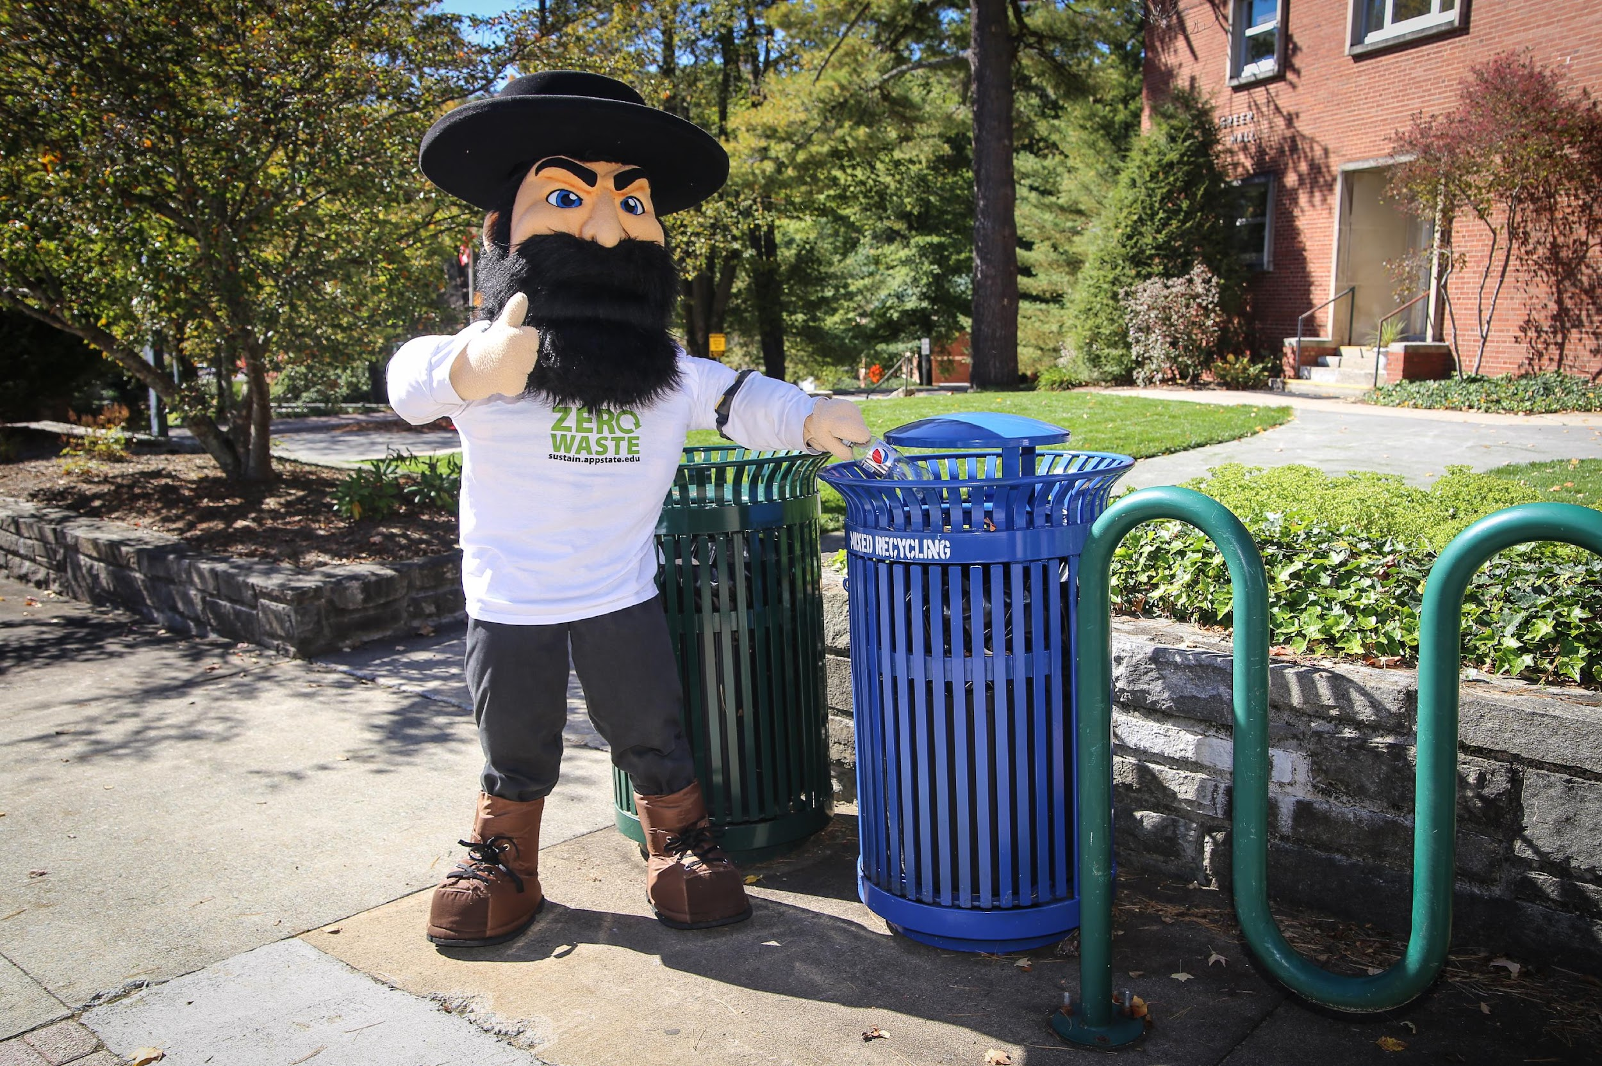
Questions?
Jennifer Maxwell (she/her)
Sustainability Program Director
Appalachian State University
828-262-2667
maxwelljb@appstate.edu
http://sustain.appstate.edu

