Slide 1
Operations & Custodians in Waste Program Planning and Implementation
Recycling & Waste Reduction Program
Daniel Chau
Notes:
Fill out the name of the presenter & Program title
Put the date of your presentation (Either Jan 24th or Jan 25th, 2019)

Slide 2
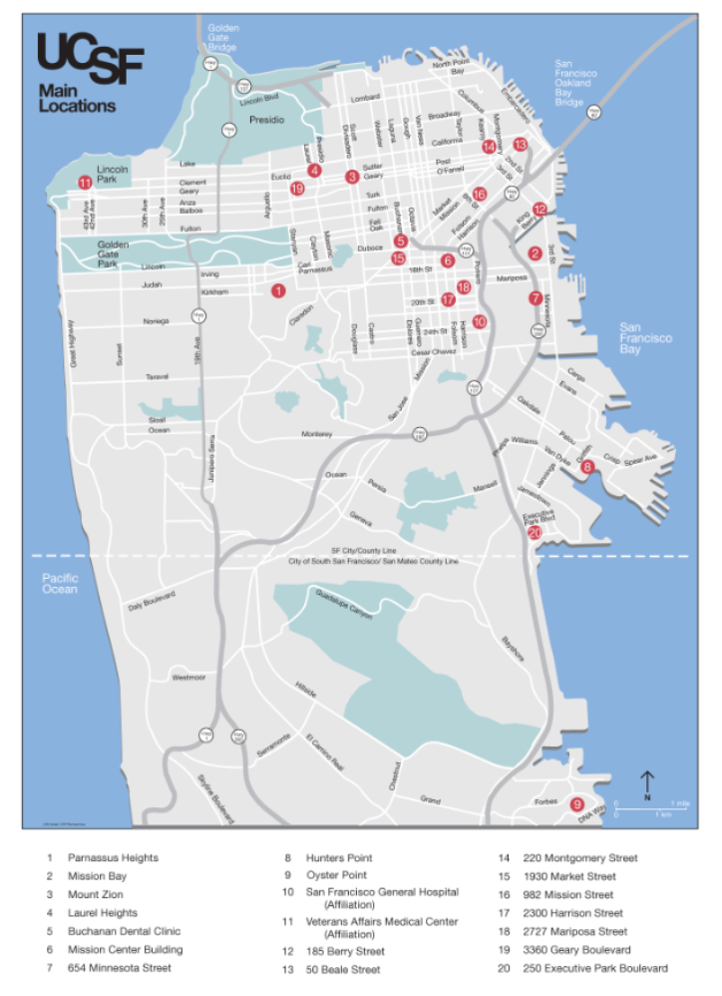
UCSF Background
20 locations around SF
Parnassus
Mission Bay
Population of 30,500
14,500 Campus Faculty and Staff
10,000 Medical Center Staff
6,000 Students and Postdocs

Slide 3
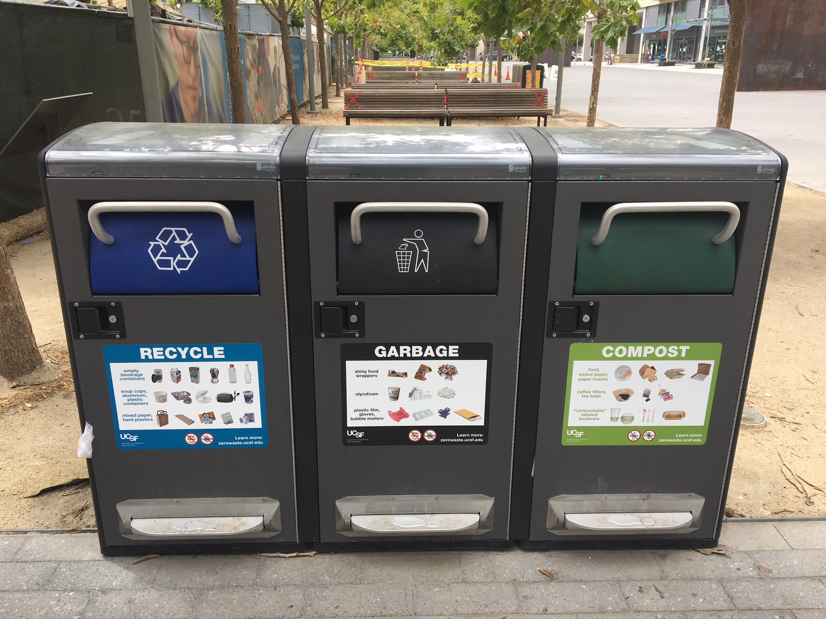
Who are we?
Recycling & Waste Reduction Program
Provide consistent, efficient, and user friendly service for UCSF students, staff, and faculty. Make recycling, composting, reuse, and waste reduction easy to understand and convenient.
Program Scope:
Actively manage solid waste and recycling for the
Campus. Implement solutions that reduce waste to
landfill and overall University costs.

Slide 4
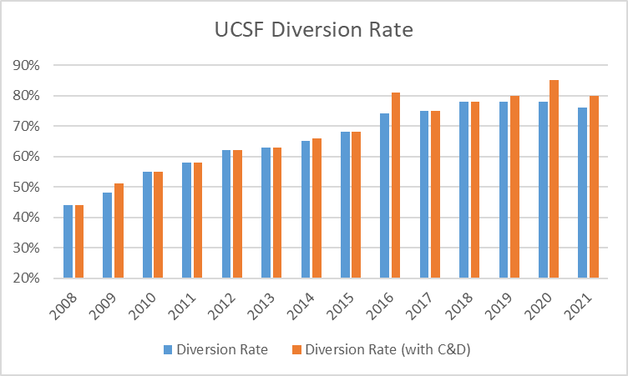
What is our goal?
Achieve zero waste (defined as 90 percent diversion from landfill) by 2020 at all locations other than UC Health locations, which will have separate waste reduction goals.
Reached 78%
Diversion Rate at 2020

Slide 5
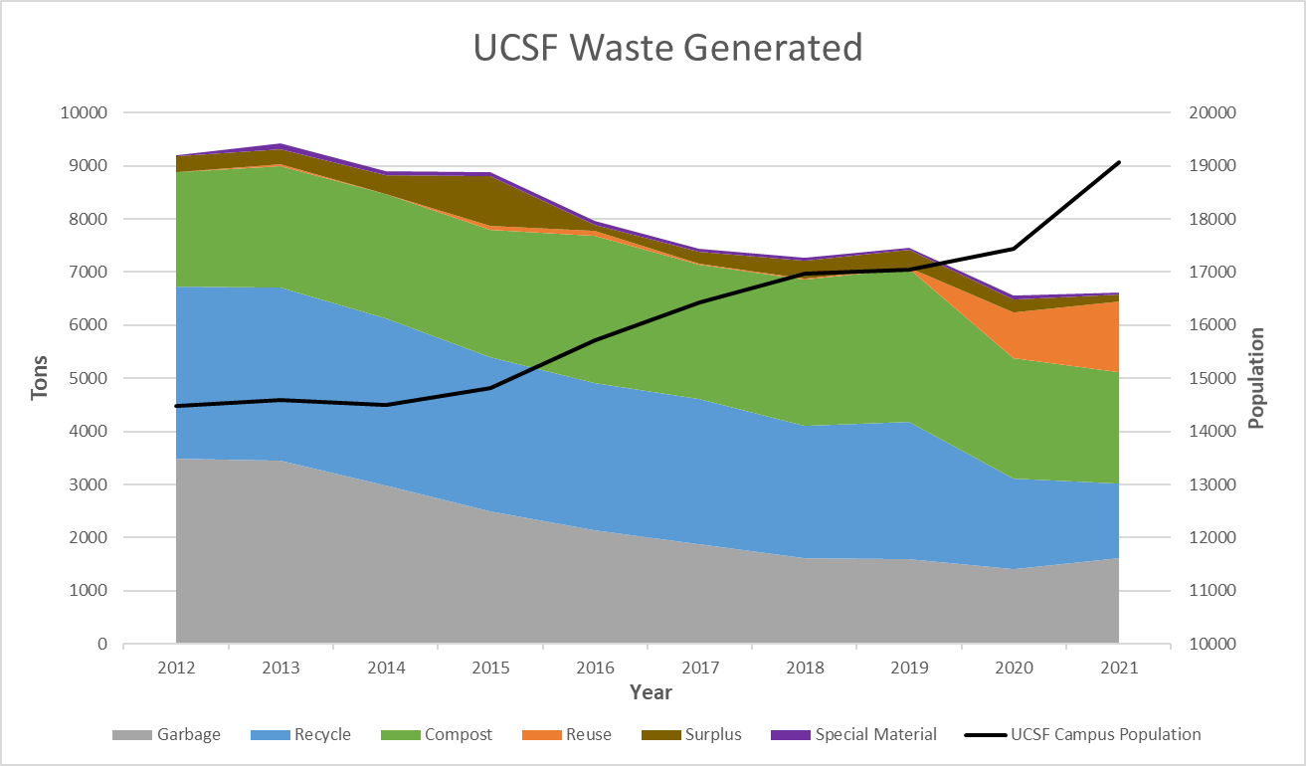
2020 and Beyond
UCOP Zero Waste Policy Goals beyond 2020
Reduce waste generation per capita to FY2015/16 levels by 2020
Reduce waste generation by 25% per capita from FY2015/16 levels by 2025
Reduce waste generation by 50% per capita from FY2015/16 levels by 2030

Slide 6
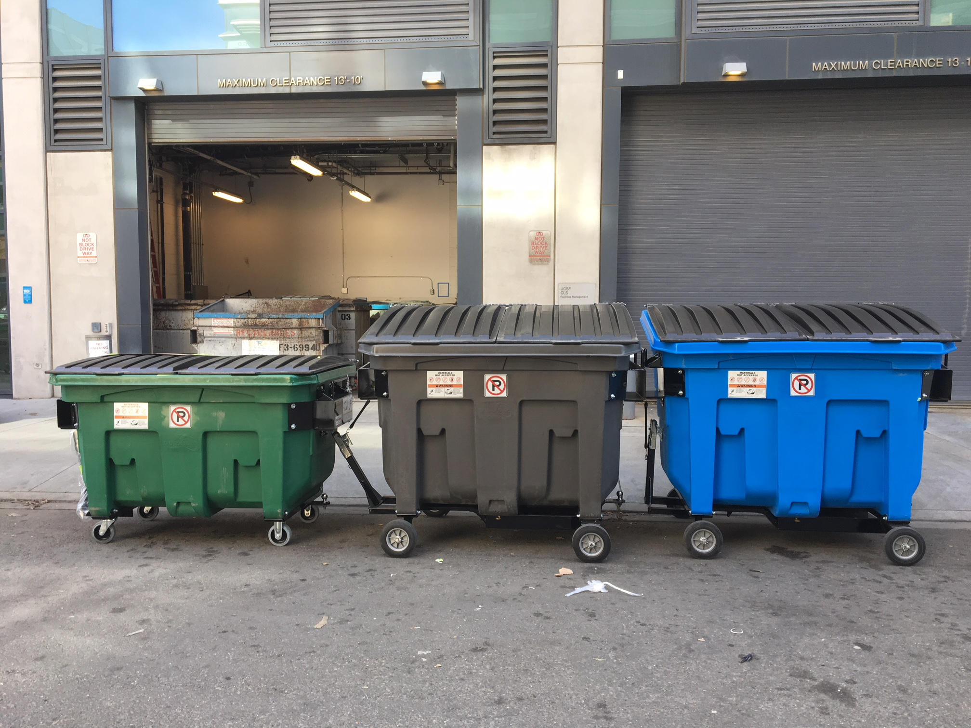
Sorting and Consolidation Program
Started in 2015, the program reduced landfill tonnage by 893 in the first year
Cost avoidance associated with sorting and consolidation = $115,000/year
Use an app to collect all sorting data
Ability to target materials for education
Consolidated open bins to weighed compactors

Slide 7
Refuse Separation Ordinance: Large Generators and Zero Waste Facilitators
Refuse Separation Ordinance (effective July 1, 2019)
Large generators of waste who have more than 40 cubic yards of waste serviced weekly or has a compactor
An audit of the waste stream will happen at least once every 3 years
Levels of allowable contamination
Compost – 5%
Recycle – 10%
Garbage – 25%
No tolerance policy for E-waste/Hazardous waste
If any of the waste streams fail, that property must hire a “Zero Waste Facilitator” for a set period of time or face a daily fine of up to $1,000 per day

Slide 8
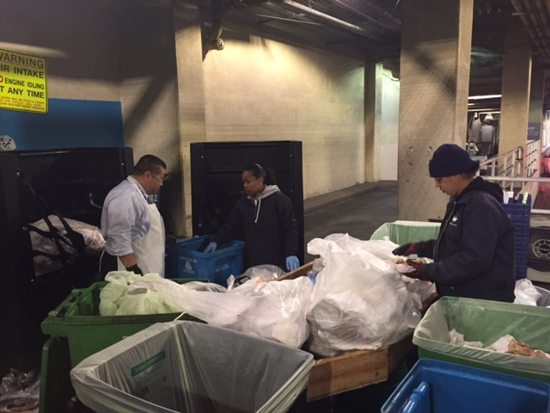
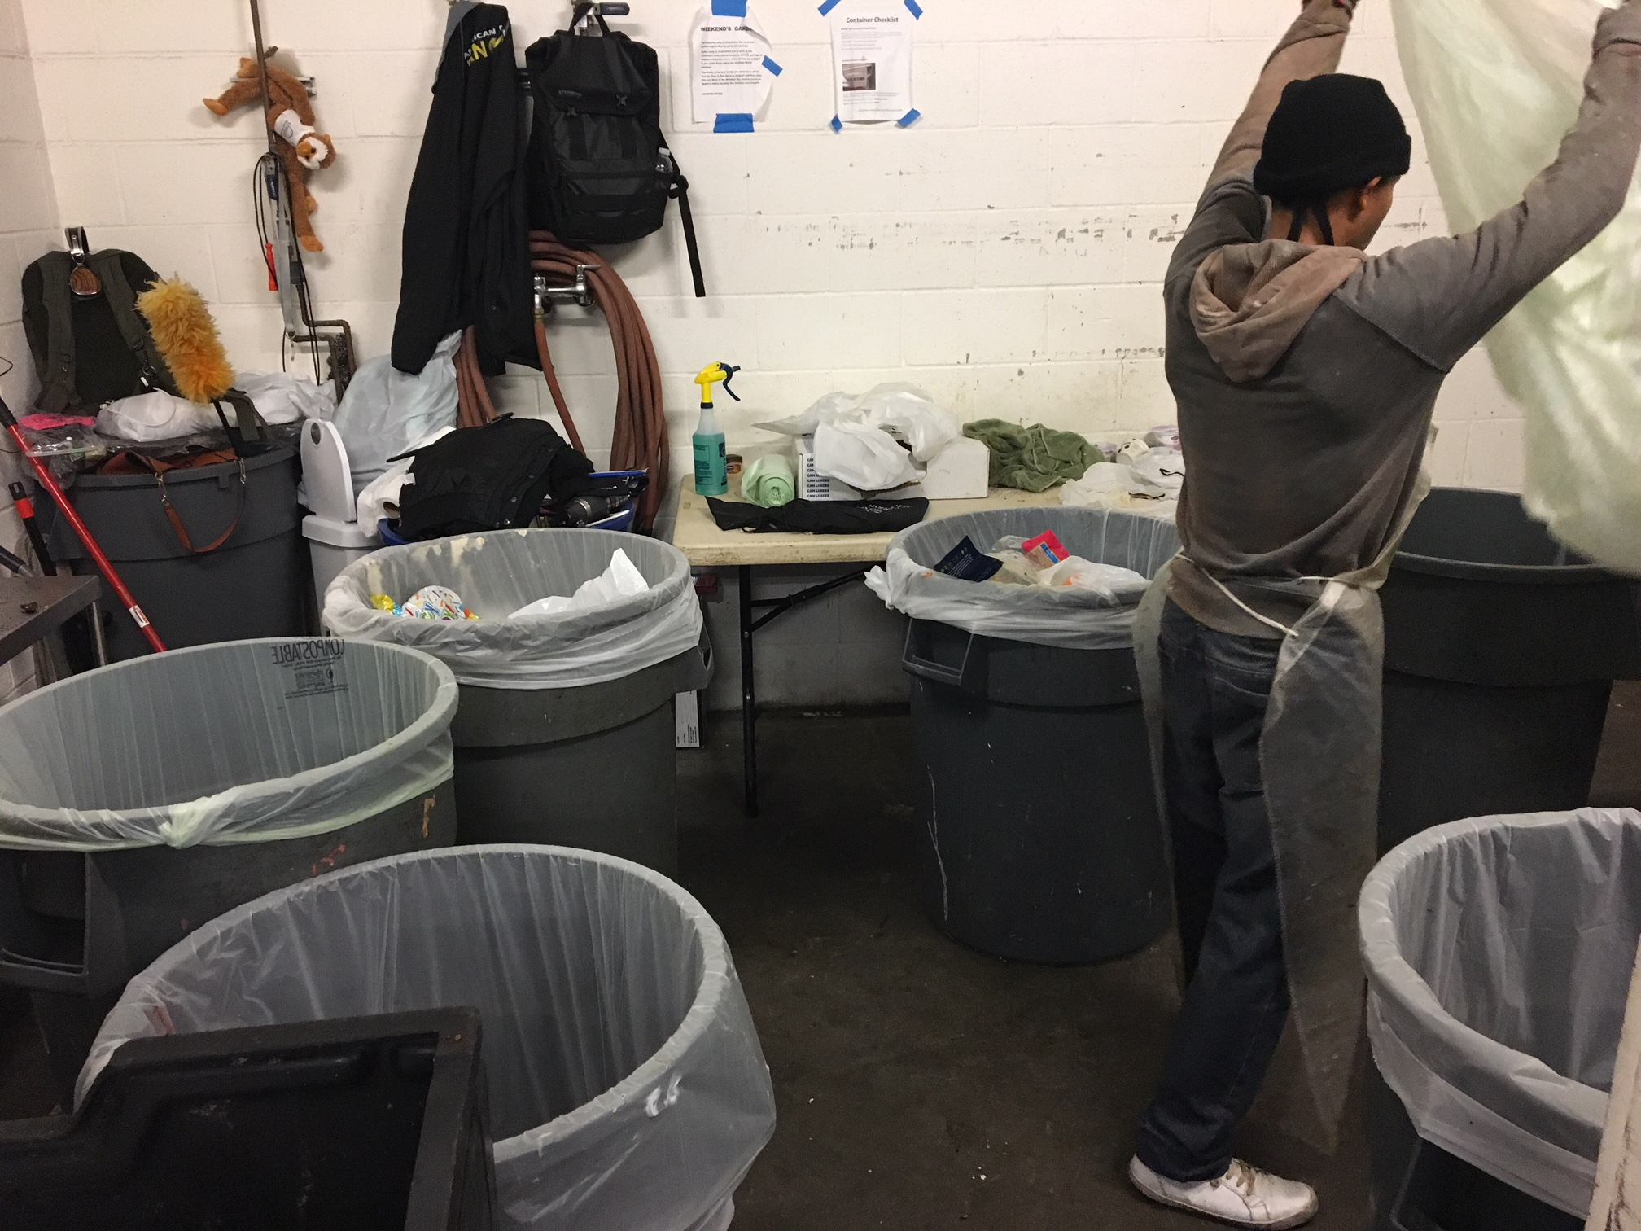
Sorting and Consolidation Program

Slide 9
Centralized Waste Disposal
Partnered with Custodial Services to roll out Centralized Waste Disposal Program
Custodians no longer servicing individual cubicles or offices.
Those who have cubicles or offices must bring their personal waste to a “centralized location” where they can sort their waste.
Centralized locations are typically the breakroom, kitchen, or high traffic location where there are larger sets of bins.

Slide 10
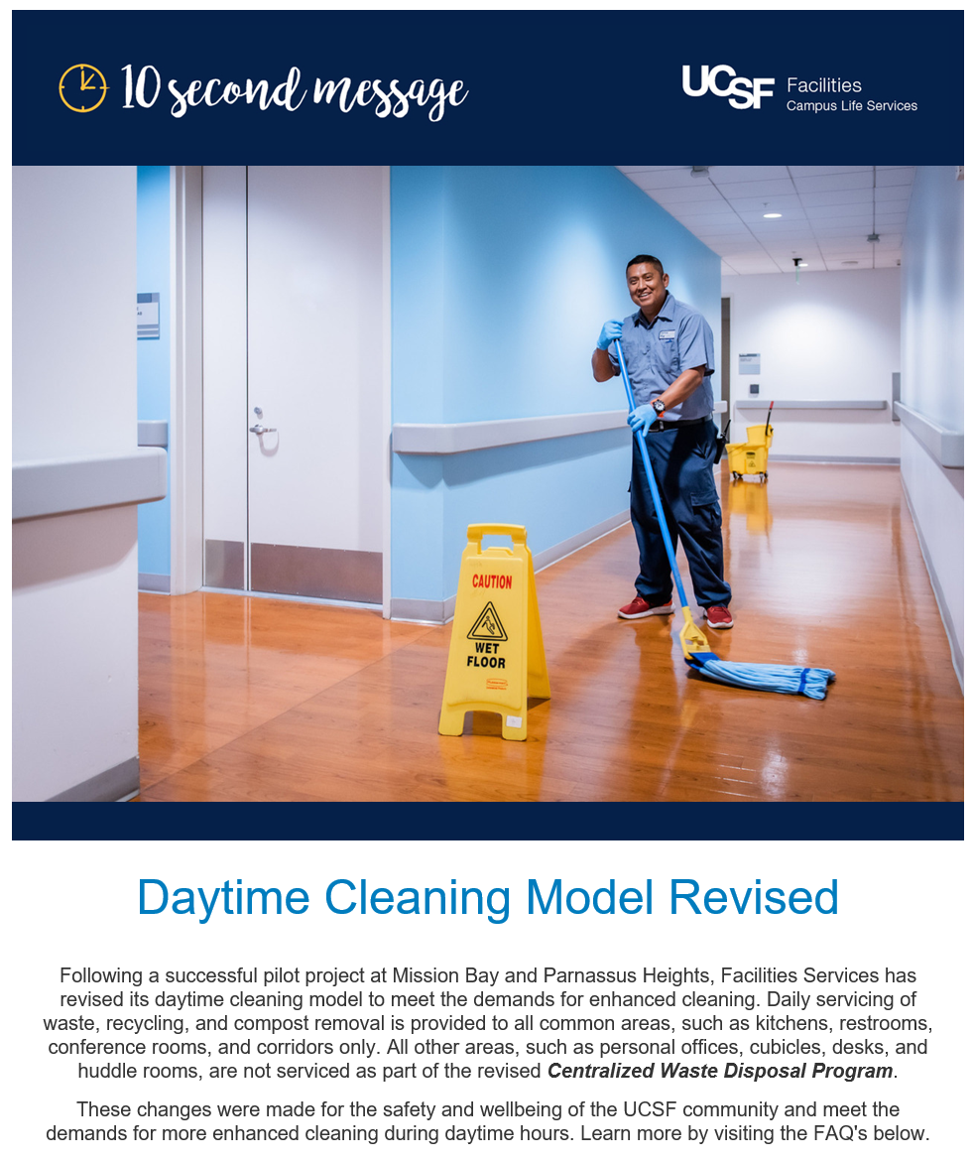
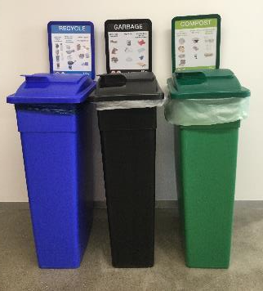
Centralized Waste Disposal
Program helps reduce Custodial injuries and helps redeploy some staff to focus on updated cleaning guidelines due to COVID-19.
Also provides those individuals the opportunity to sort their waste into the correct waste streams.

Slide 11
Waste Bin Design Standards

Slide 12
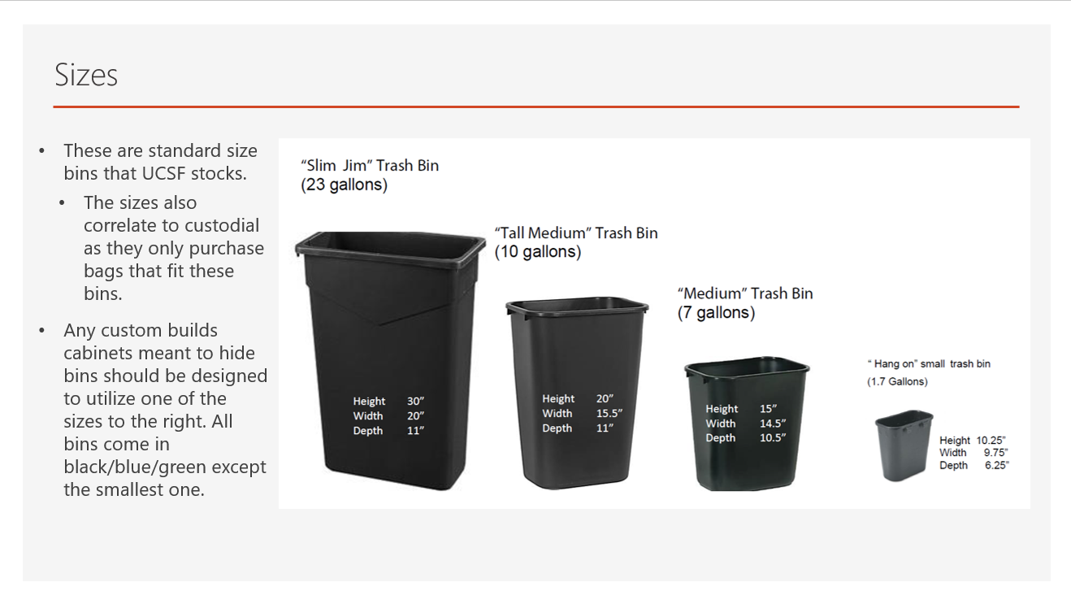
Waste Bin Design Standards

Slide 13
Waste Bin Design Standards

Slide 14
Waste Bin Design Standards

Slide 15
Waste Bin Design Standards

Slide 16
Waste Bin Design Standards

Slide 17
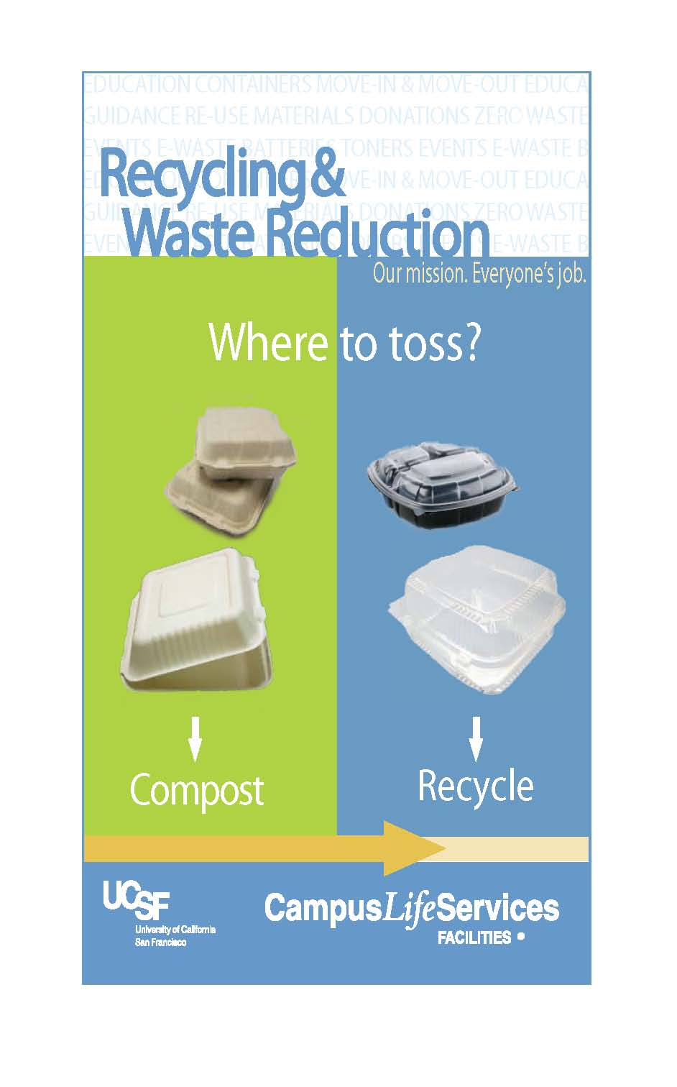
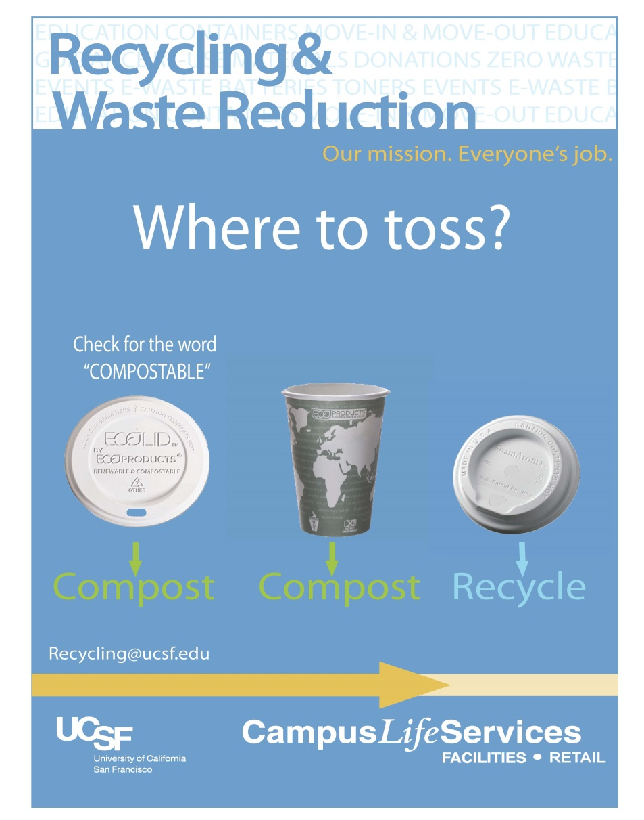
Campus Campaigns

Slide 18
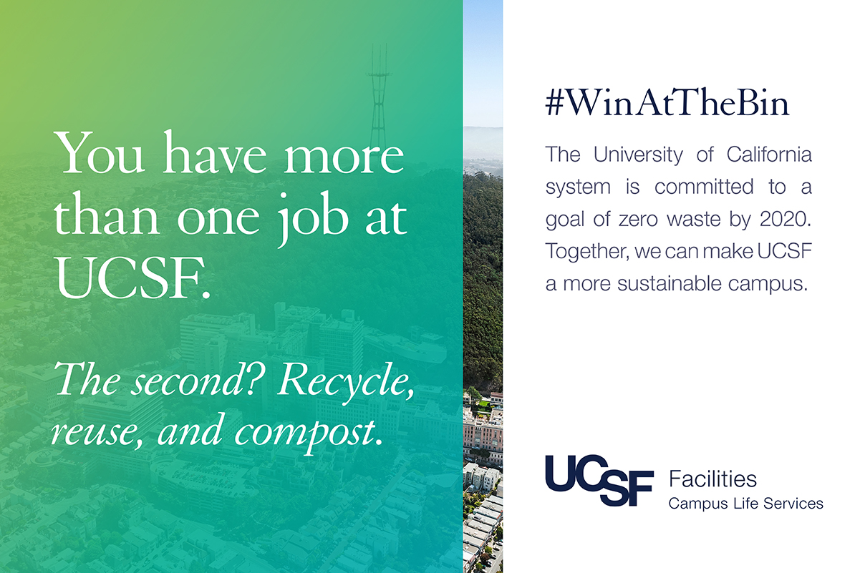
UCSF Campaigns

Slide 19
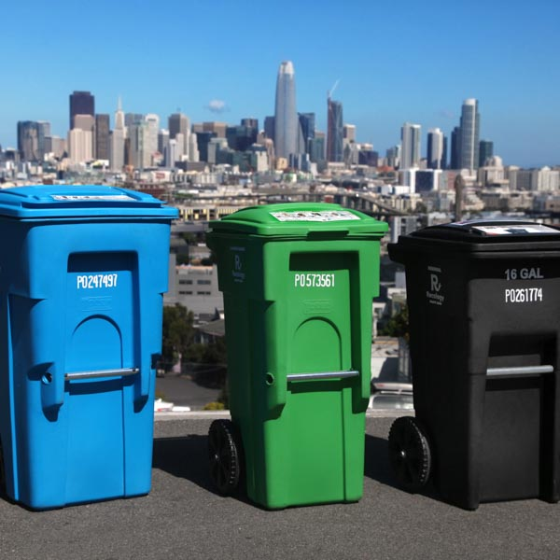
Thanks!!

