Slide 1
Integrating Equity into Sustainability Work
Oregon State University
Campus Recycling and Sustainability Office
Presented by Leticia Cavazos and Carly Werdel

Slide 2
Getting Started
Holistic definition of sustainability
Objective: develop a set of goals and actions for advancing JEDI in sustainability work
Customized OSU’s Strategic Plan for Inclusive Excellence
Reached out to experienced partners at OSU

Slide 3
Goals for 2020-2021
Develop a Longer-Term Plan
Expand Internal Knowledge
Expand External Knowledge
Tell Inclusive Stories

Slide 4
Goal: Developing a long-term plan
Set strategic priorities to develop an action plan every year
Documented core functions of our departments
Reviewed university-wide JEDI priorities
Hosted an internal staff visioning discussion

Slide 5
Goal: Developing a long-term plan
Internal staff visioning discussion
In what ways do you think our work is currently inclusive and advancing equity?
What barriers are / may be faced by OSU community members to participating in sustainability programs and services?
How can our work center the needs of the most marginalized OSU community members?
Unburdened by resource and time constraints, how would equity be centered in each function and process of the unit?
What change is necessary to embed equity in each function and process, and within the unit as a whole?
Imagine sustainability at OSU with diversity, inclusion, and equity prioritized and a part of everything we do. What would look like, sound like, and feel like?

Slide 6
Goal: Developing a long-term plan
Set strategic priorities to develop an action plan every year
Documented core functions of our departments
Reviewed university-wide JEDI priorities
Hosted an internal staff visioning discussion
Reached out to stakeholders to gather input

Slide 7
Goal: Developing a long-term plan
Stakeholder Vision Qs
In what ways do you think OSU sustainability programs and services are currently inclusive and advancing equity?
What barriers are / may be faced by OSU community members to participating in sustainability programs and services?
What would sustainability programs and services look like, sound like, and feel like when they center the needs of the most marginalized OSU community members?
What would sustainability programs and services look like, sound like, and feel like when equity is embedded within them?
Do you have any further comments regarding envisioning inclusive excellence in sustainability programming?
Stakeholder Action Plan Qs
What ideas do you have regarding how to address barriers to inclusion in sustainability programs and services?
What ideas do you have regarding how to embed equity in sustainability programs and services?
What actions would you like to see our departments take to advance diversity, inclusion, and equity?
What metrics do you suggest we track to see how well we are doing in terms of diversity, inclusion, and equity?
Do you have any further comments regarding how to achieve inclusive excellence in sustainability programming?

Slide 8
Goal: Developing a long-term plan
Set strategic priorities to develop an action plan every year
Documented core functions of our departments
Reviewed university-wide JEDI priorities
Hosted an internal staff visioning discussion
Reached out to stakeholders to gather input
Synthesized into strategic priorities

Slide 9
Goal: Developing a long-term plan
Synthesized into (draft) strategic priorities
Build a sense of belonging for all who we employ or serve, to support the retention and success of people of diverse and underrepresented identities.
Expand employee expertise of JEDI topics as well as comfort and skills in discussing and contemplating applications.
Integrate and advance equity and inclusion within all aspects of our work.
Engage with underrepresented communities to cultivate mutually beneficial relationships, co-create programs, and/or provide support needed to advance their sustainability efforts.
Attract and recruit volunteers and employees from communities underrepresented in sustainability programming.
Share our JEDI commitments, challenges and accomplishments internally and externally.

Slide 10
Goal: Developing a long-term plan
Set strategic priorities to develop an action plan every year
Documented core functions of our departments
Reviewed university-wide JEDI priorities
Hosted an internal staff visioning discussion
Reached out to stakeholders to gather input
Synthesized into strategic priorities
NEXT STEPS: Connect work with strategic priorities

Slide 11
Goal: Expand Internal Knowledge
“Eco-Justice Trainings” learning outcomes:
Be able to define and understand core terms related to Eco-Justice
Be able to articulate - and reflect on your own individual - multiple dimensions of identity in the context of power, privilege and oppression
Be able to recognize historical and present inequities in environmental impacts, programs, and movements

Slide 12
Goal: Expand External Knowledge
Objective: Share information related to Eco-Justice and JEDI with a wider university audience
Review other universities’ Eco-Justice pages
Review articles and definitions to determine what to share
Create, publish, and market a webpage as a central location for Eco-Justice learning
https://fa.oregonstate.edu/sustainability/environmental-justice

Slide 13
Goal: Telling Inclusive Stories
Objective: Share stories of BIPOC people engaged in sustainability and environmental justice
Increase social media posts related to JEDI
Interview BIPOC alumni for the Alumni Profiles Project
Track number of social media posts and engagement

Slide 14
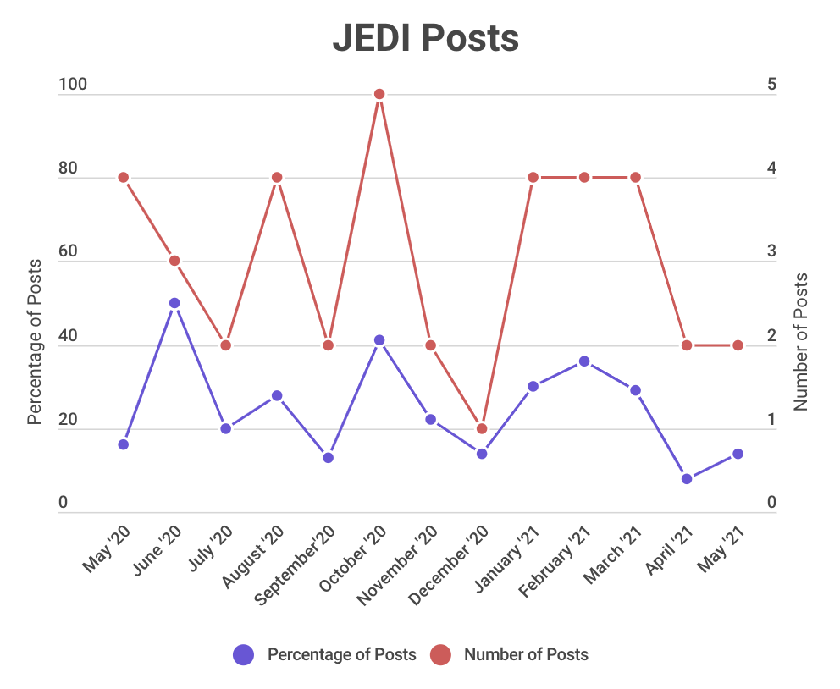
Goal: Telling Inclusive Stories

Slide 15
Goal: Telling Inclusive Stories
Criteria for the metric
Does this post provide recognition or affirmation to the work of underrepresented people?
Does this post provide information or news focusing on the experiences of underrepresented people?
For events: Is the event hosted by a group that is explicitly run by or specializes in inclusion of underrepresented people? Is the event focusing on topics related to JEDI?

Slide 16
Questions?
Leticia Cavazos, Leticia.Cavazos@oregonstate.edu
Carly Werdel, Carly.Werdel@oregonstate.edu
Andrea Norris, Andrea.Norris@oregonstate.edu

