Slide 1
CURC Survey

Slide 2
Questions answered with the survey data
How does our school compare to similar schools?
What are the average national and regional diversion rates?
Do we generate more, less, or similar amounts of waste as other schools?
What programs do other schools have?
What types of materials do other universities recycle?
What are high diversion programs doing differently?

Slide 3
Keep in mind the following:
University provided diversion rates are not all calculated using the same metrics.
E.g. some include C&D and/or waste to energy numbers
We used the STARS diversion number to try to be as consistent as possible, however the rates were not all reported in the same year
We did not perform any statistical analysis to show whether or not there is a significant relationship between data
Means are not the best representation of data, but they provide a general idea of what the data are
Following data only includes 4 year universities

Slide 4
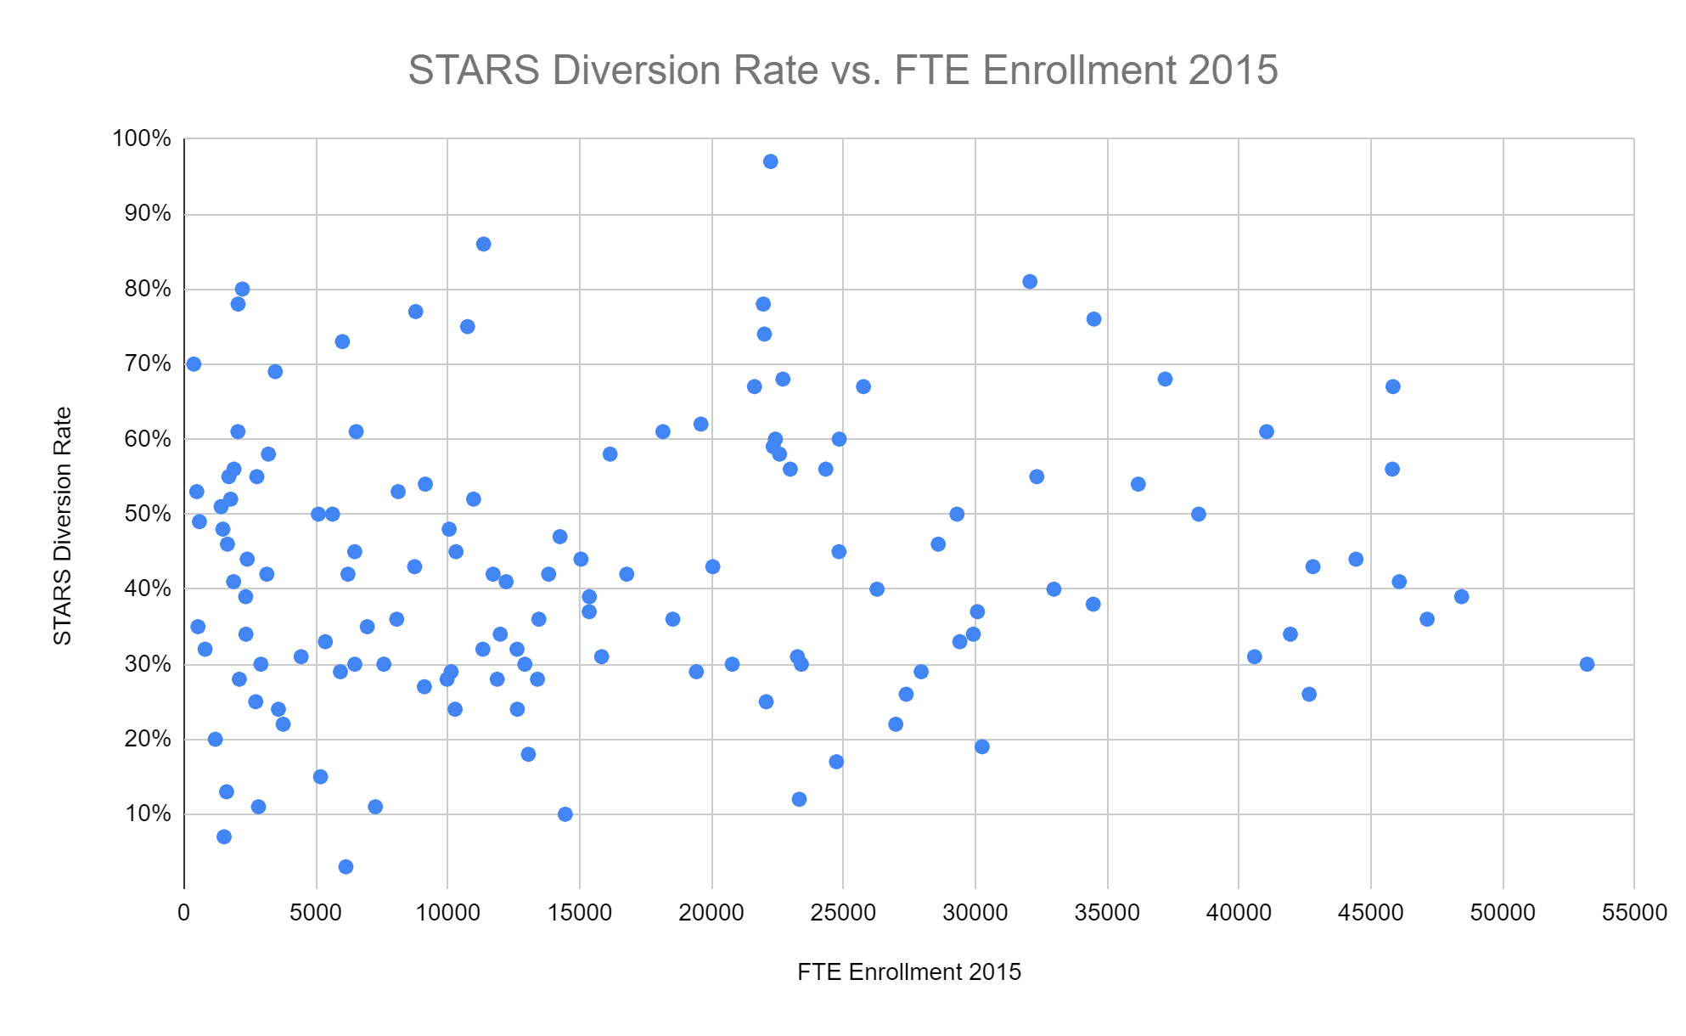
National Diversion Rate

Slide 5
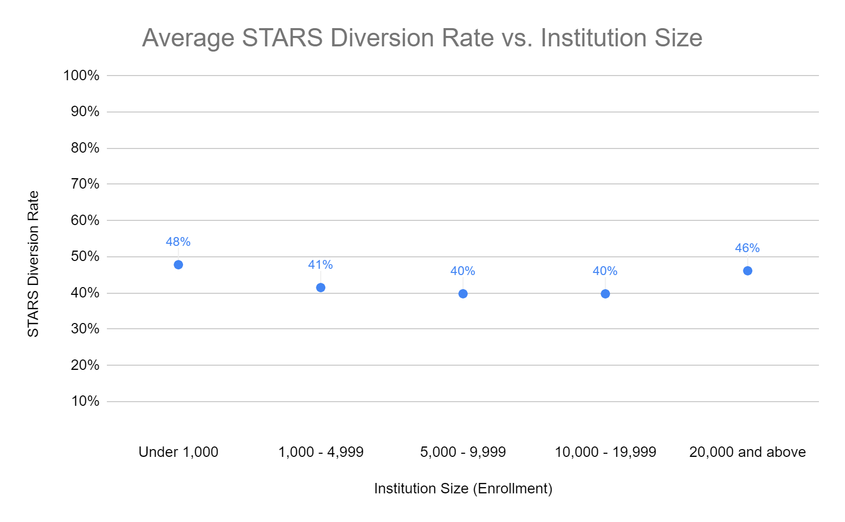
Average National Diversion Rate = 43%

Slide 6
Diversion Rate by Region
Far West | Great Lakes | Mid East | New England | Plains | Rocky Mountains | Southeast | Southwest
AK | IL | DC | CT | IA | CO | AL | AZ
CA | IN | MD | MA | KS | ID | AR | OK
NV | MI | NJ | ME | MN | UT | FL | OK
OR | OH | NY | NH | MO | WY | GA | TX
WA | WI | PA | RI | ND |  | KY
 |  |  | VT | NE |  | LA
 |  |  |  | SD |  | MS
 |  |  |  |  |  | NC
 |  |  |  |  |  | SC
 |  |  |  |  |  | TN
 |  |  |  |  |  | VA

Slide 7
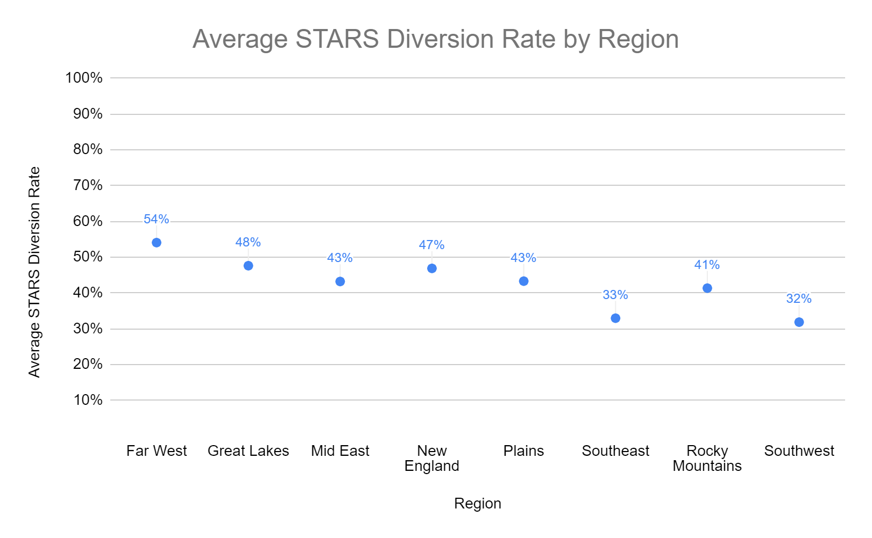
Diversion Rate by Region

Slide 8
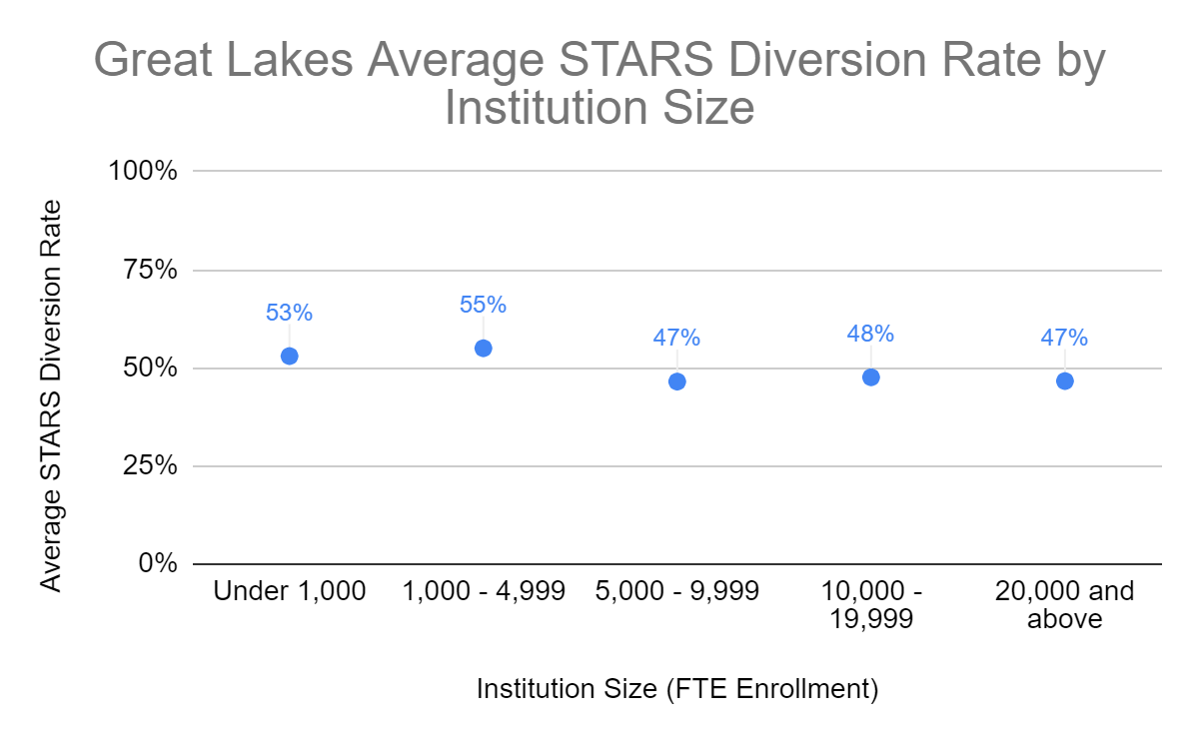
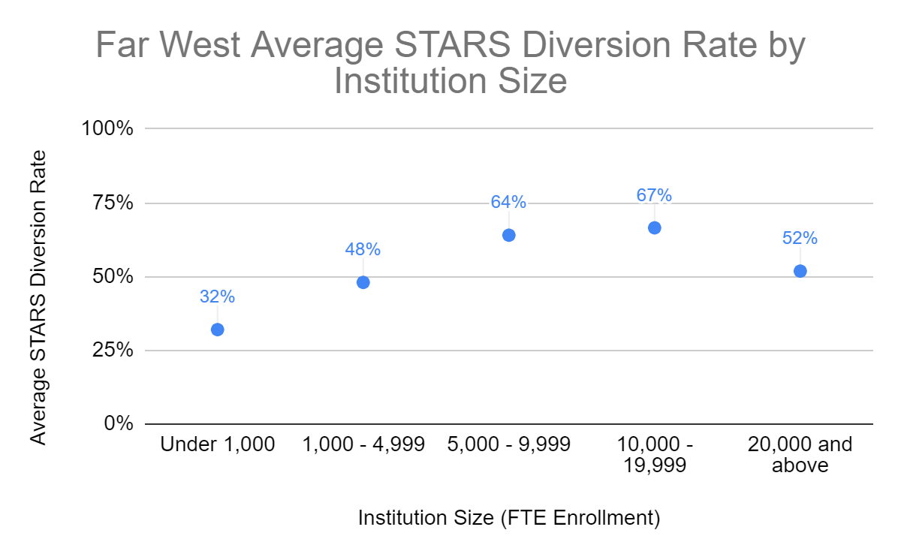
Diversion Rate by Region

Slide 9
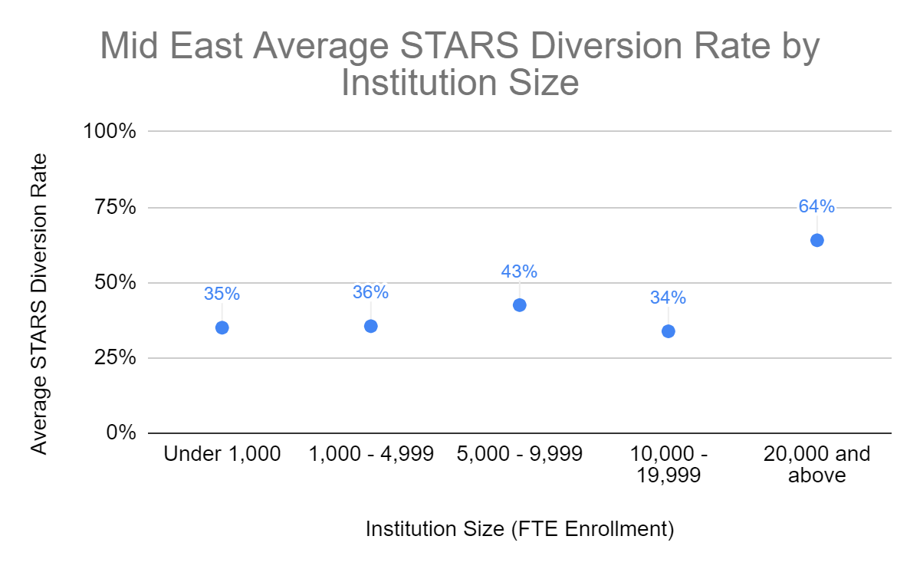
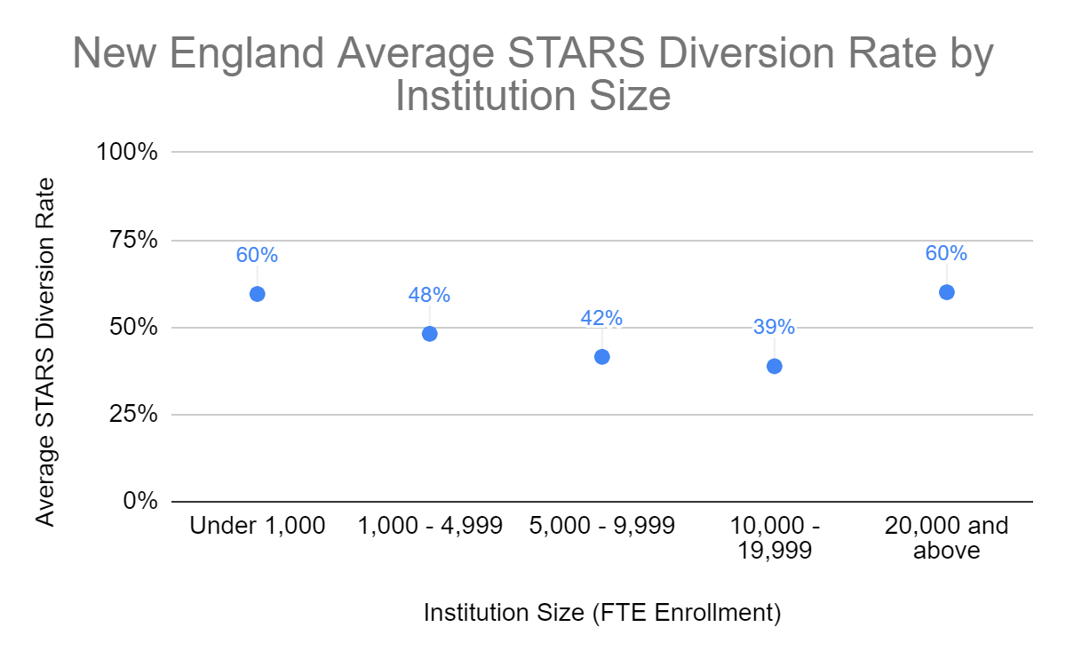
Diversion Rate by Region

Slide 10
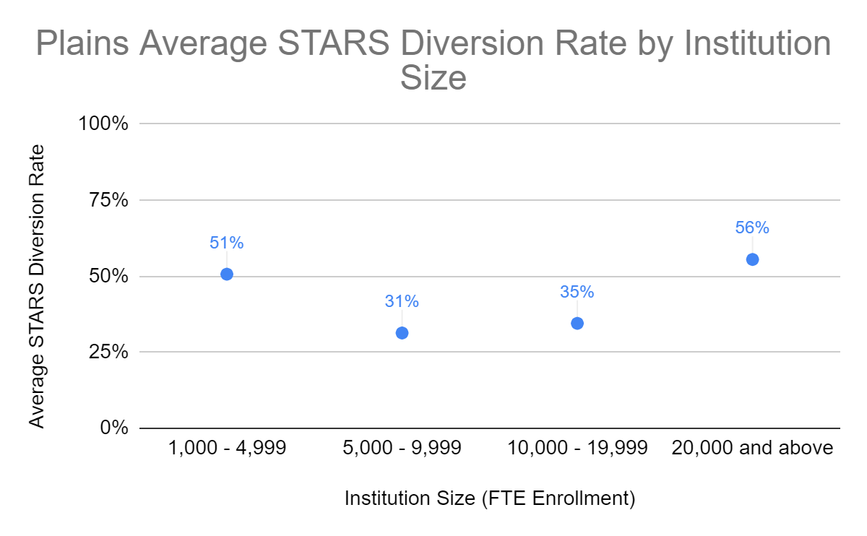
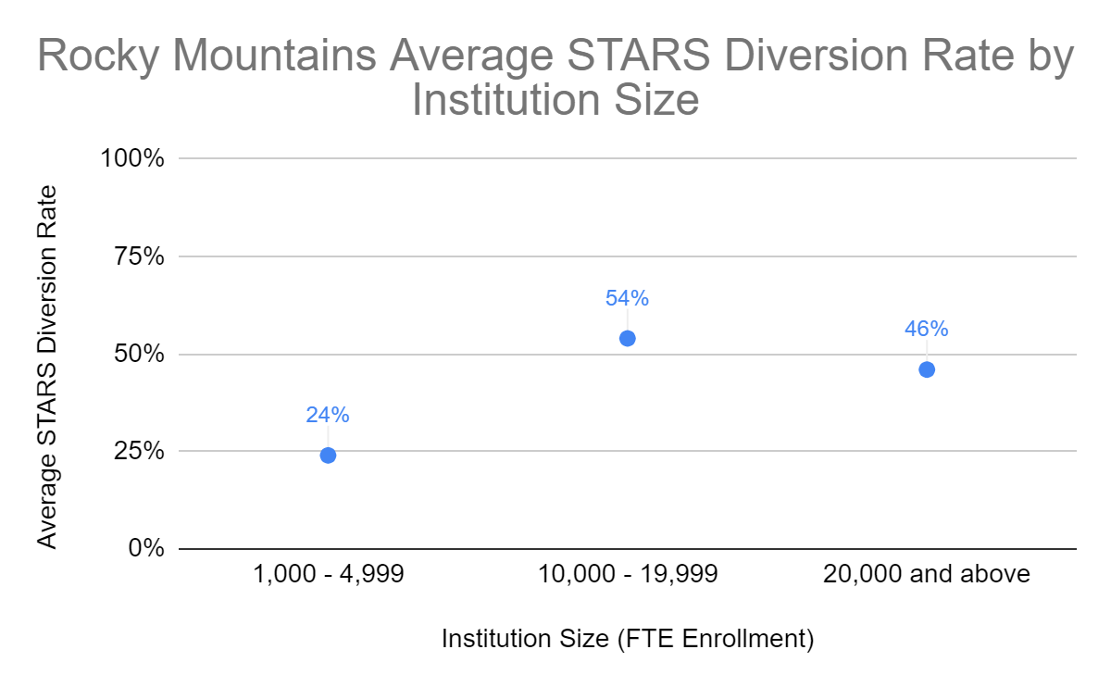
Diversion Rate by Region

Slide 11
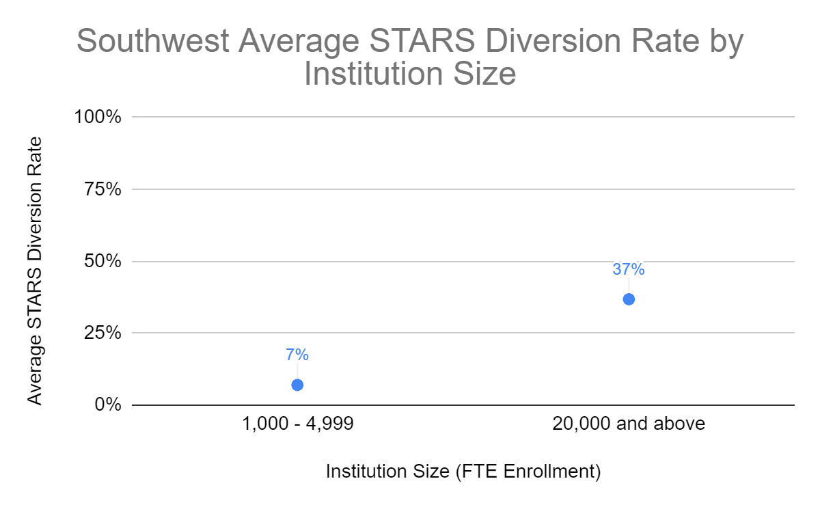
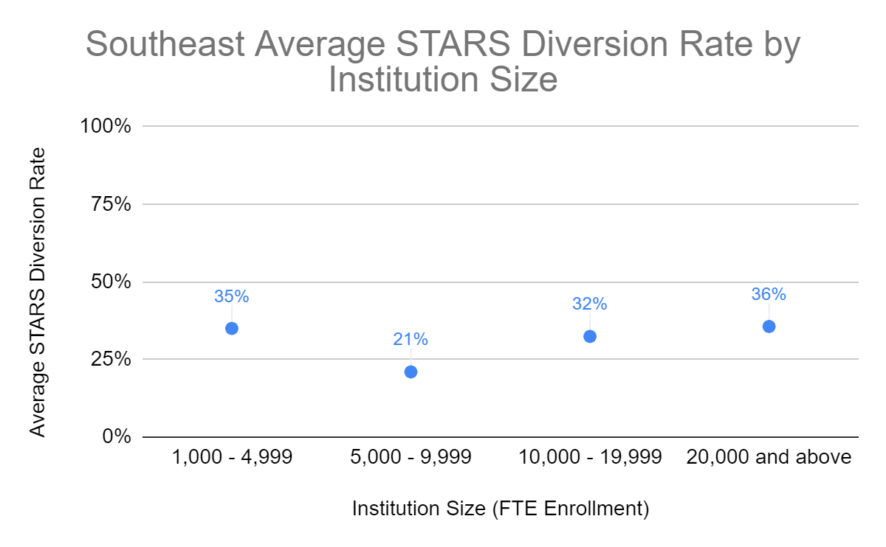
Diversion Rate by Region

Slide 12
Waste Recovery

Slide 13
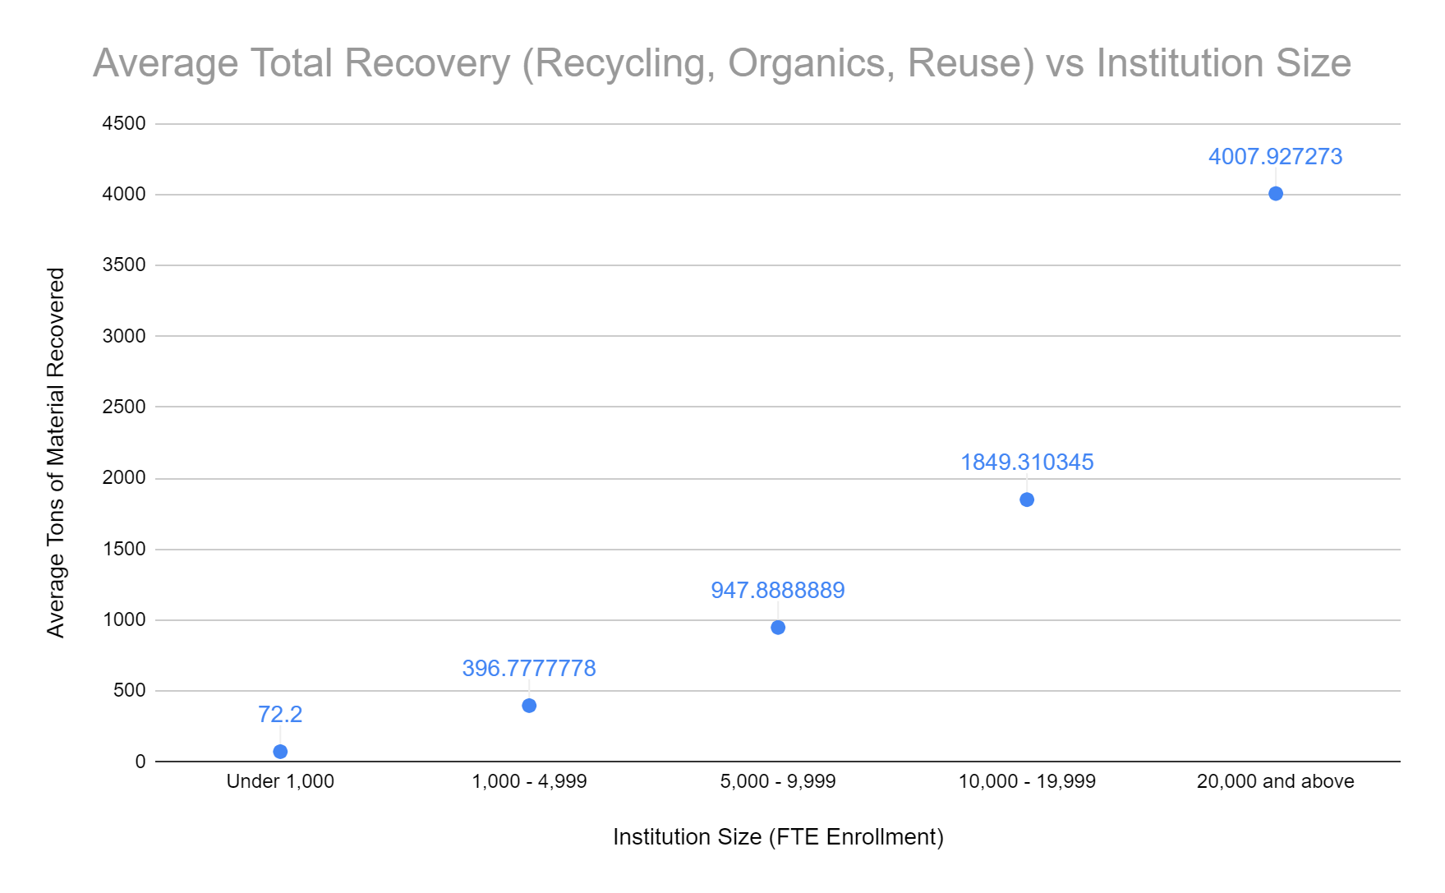
Average Waste Recovery

Slide 14
Waste Generation

Slide 15
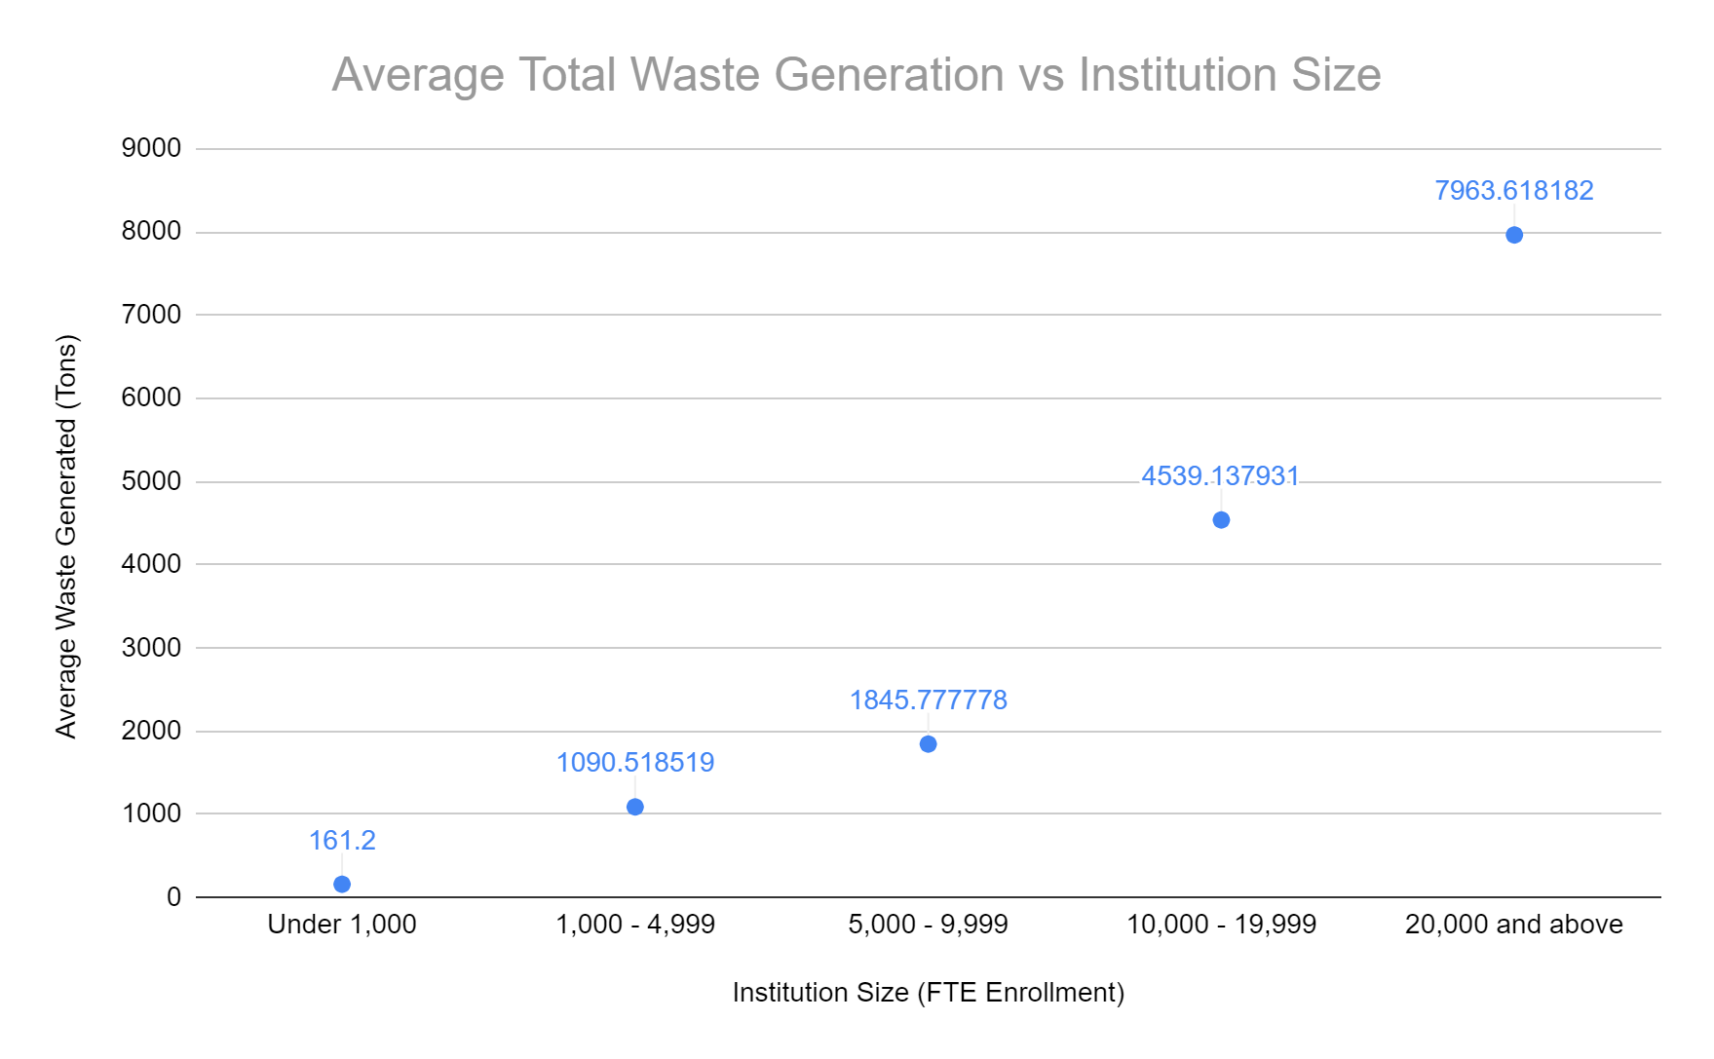
Average Waste Generation

Slide 16
Waste Per Capita

Slide 17
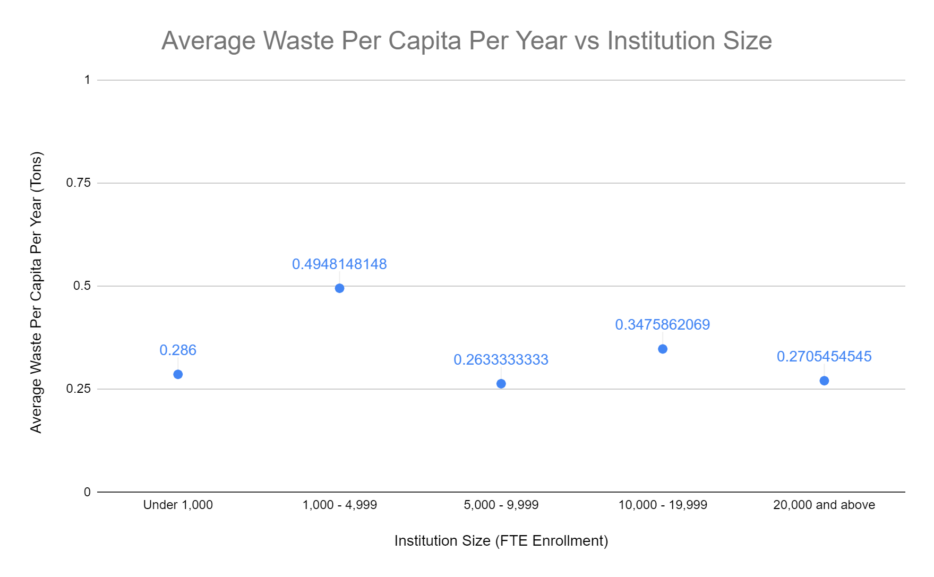
Waste Per Capita

Slide 18
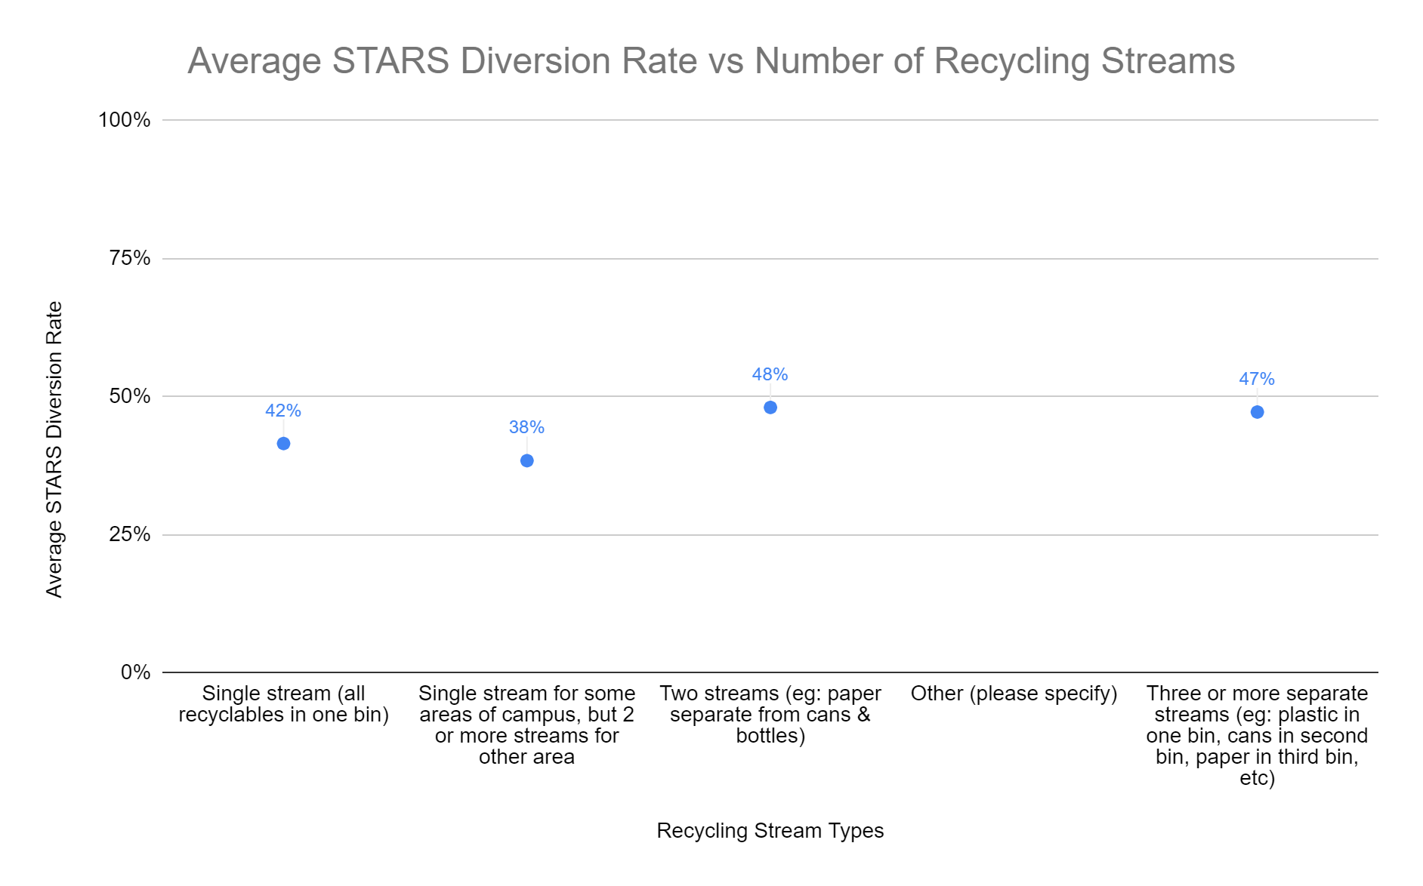
Programs

Slide 19
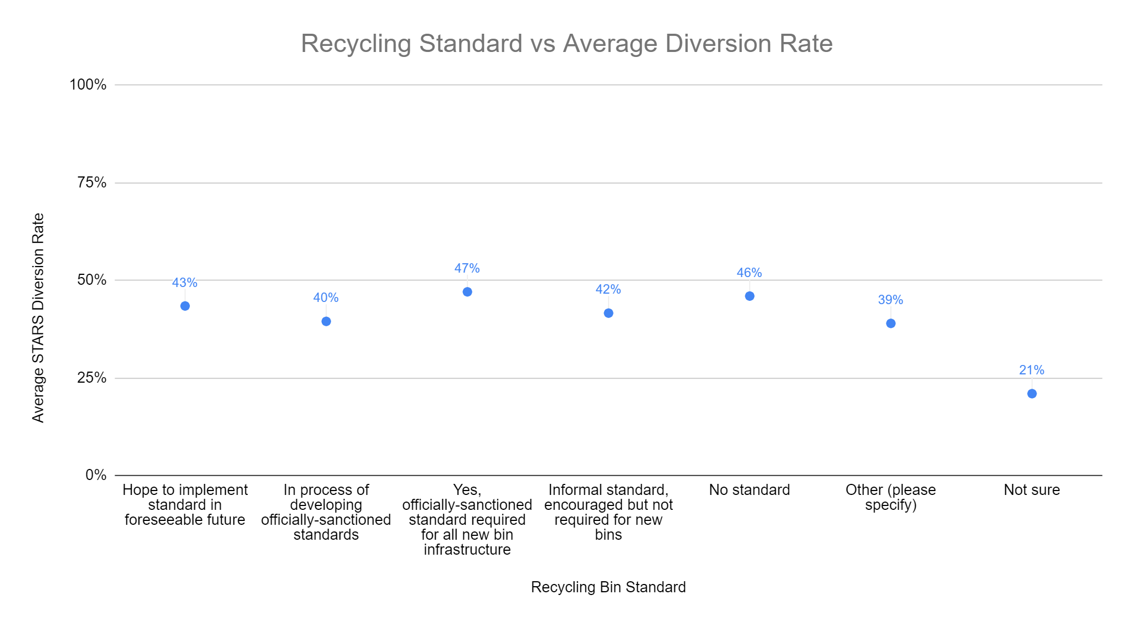
Programs

Slide 20
Materials Recycled

Slide 21
Materials Recycled

Slide 22
What are high diversion/very successful programs doing differently?
More comprehensive programs
Almost twice as likely to have completed a formal waste characterization study of all or part of campus

Slide 23
Lessons for Next Time
Full research protocols
Signed permission for distribution from universities
Possible need for IRB approval
Question formats designed so the results are easy to analyze

Slide 24
Thanks! Questions?

