Slide 1
Procurement for the Common Good
February 18, 2021
Notes:
Tony - summary why we are doing what we are doing

Slide 2
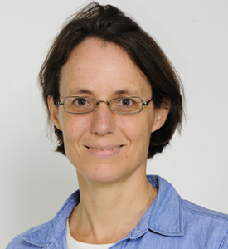
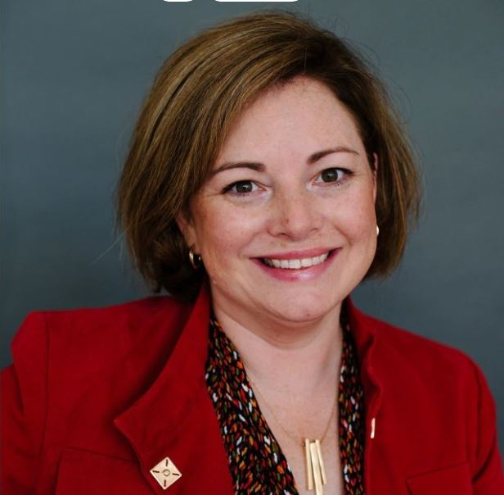
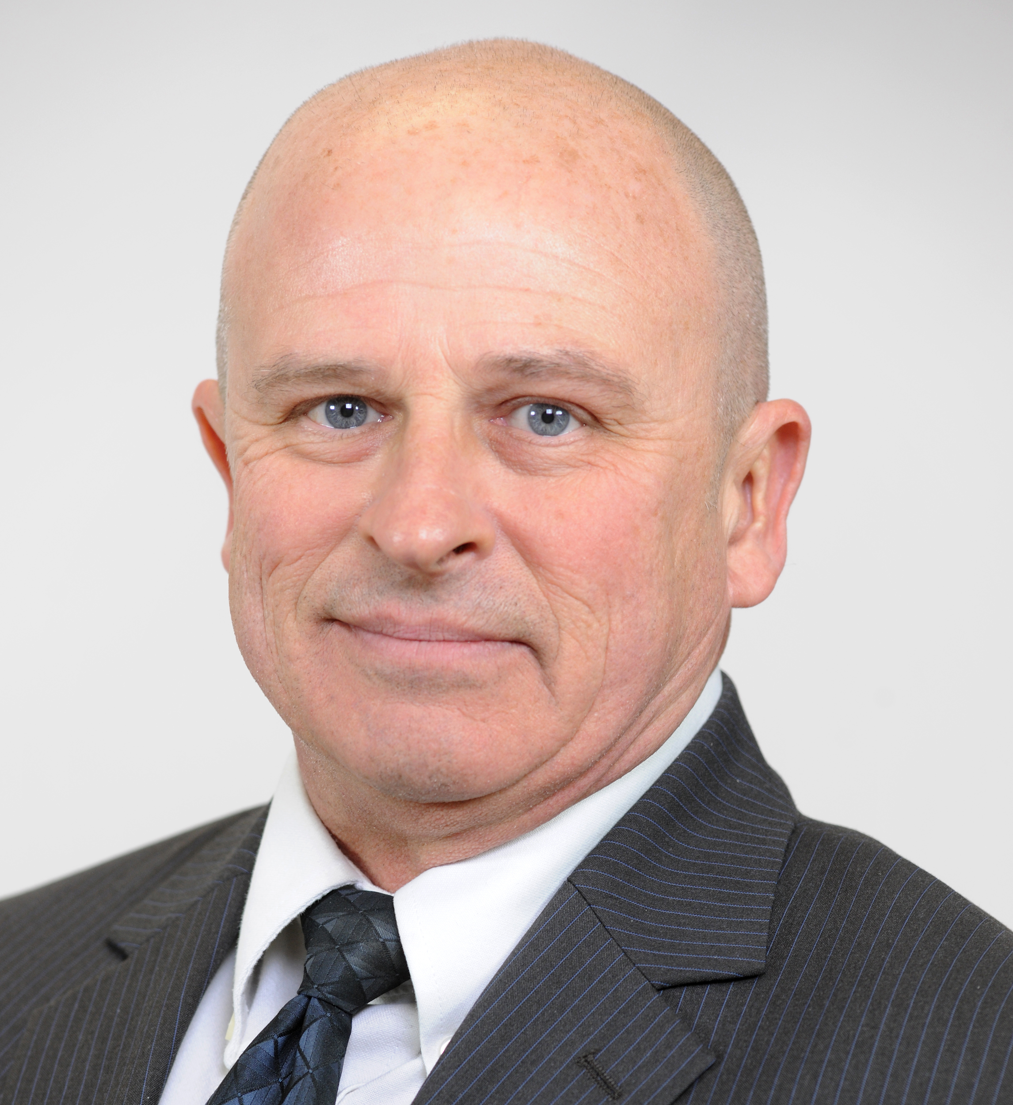
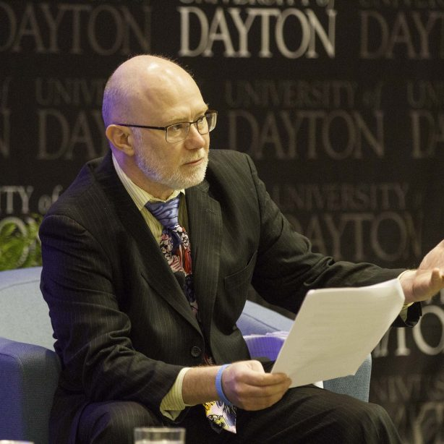
Integrated Team
Leah Ceperley
Sustainability Planning & Evaluation Manager
Sara Harrison
Executive Director, Procurement & Payable Services
Steve Kendig
Executive Director, Energy Utilization & Environmental Sustainability, Facilities Management
Anthony Talbott
Director of Advocacy, Human Rights Center
Director, Abolition Ohio
Notes:
5 min

Slide 3
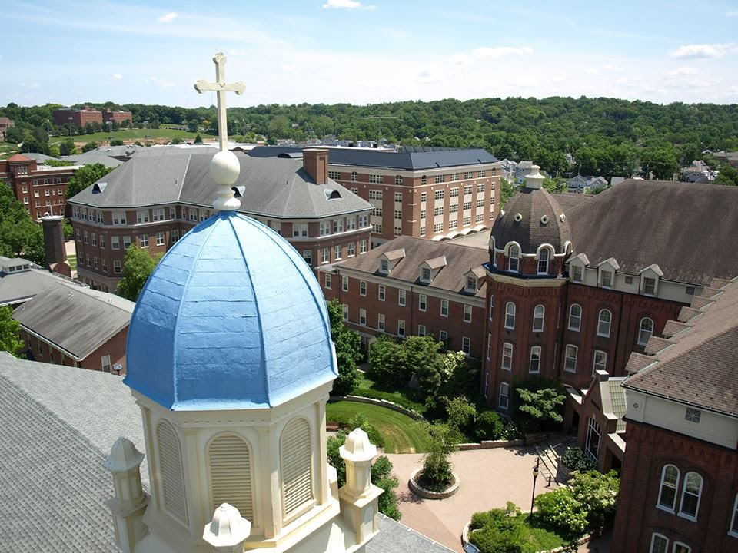
University of Dayton
Dayton, Ohio (pop 140,489)
Founded 1850
Private, Catholic University
388 Acre Campus
80 Majors, BA to PhD
8500 Undergraduate
2400 Graduate
3000 Faculty, Staff and Researchers
Notes:
Overview of our university history and mission only so that you can be thinking of your own and how they can be leveraged for advancement of human rights and sustainability.
Mid size private university located in Dayton, OH. We have about 11,000 students including grad and undergrad. Founded in 1850 by Mariantist, Catholic brothers and therefore mission closely tied to Catholic Social Teaching

Slide 4
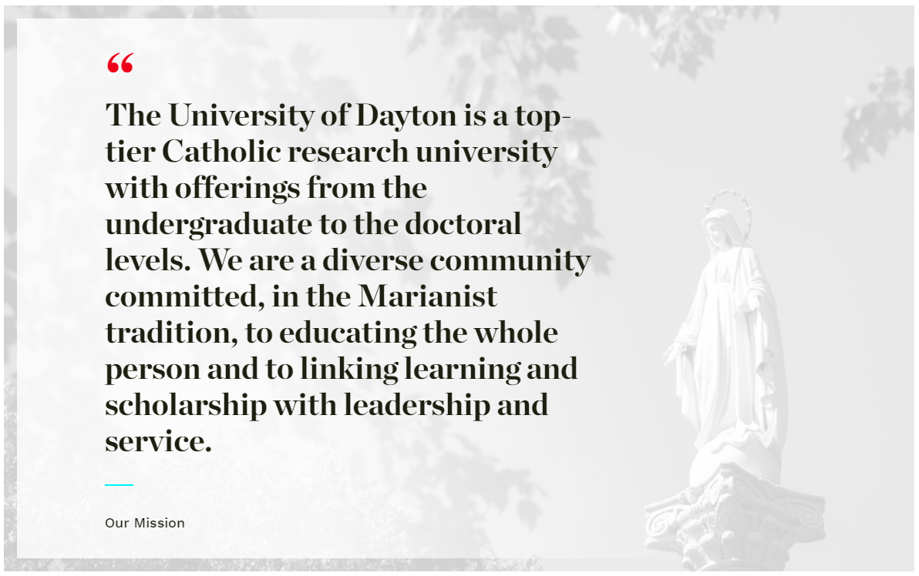
LEARN. LEAD. SERVE.
Notes:
This Marianist mission is compelling and is a huge asset as a backdrop. It drives the decisions that are made at the University

Slide 5
#FortheCommonGood
Notes:
Educating whole person through liberal arts education rooted in creating future leaders who integrate service into their personal and professional lives…...also we can use this commitment from institutional leadership to really make progress - certainly drives goals of human rights center and sustainability institute but really requires all departments to focus on

Slide 6
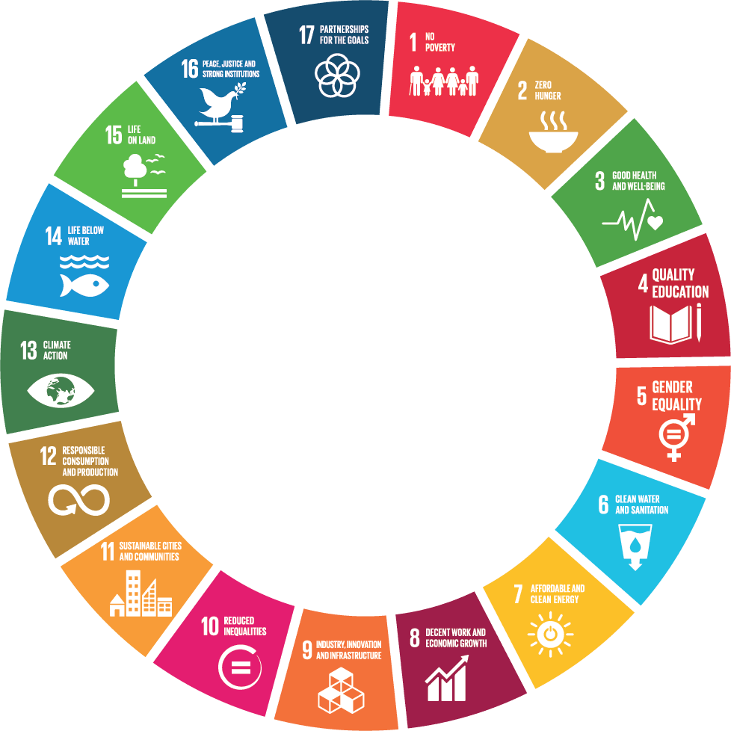
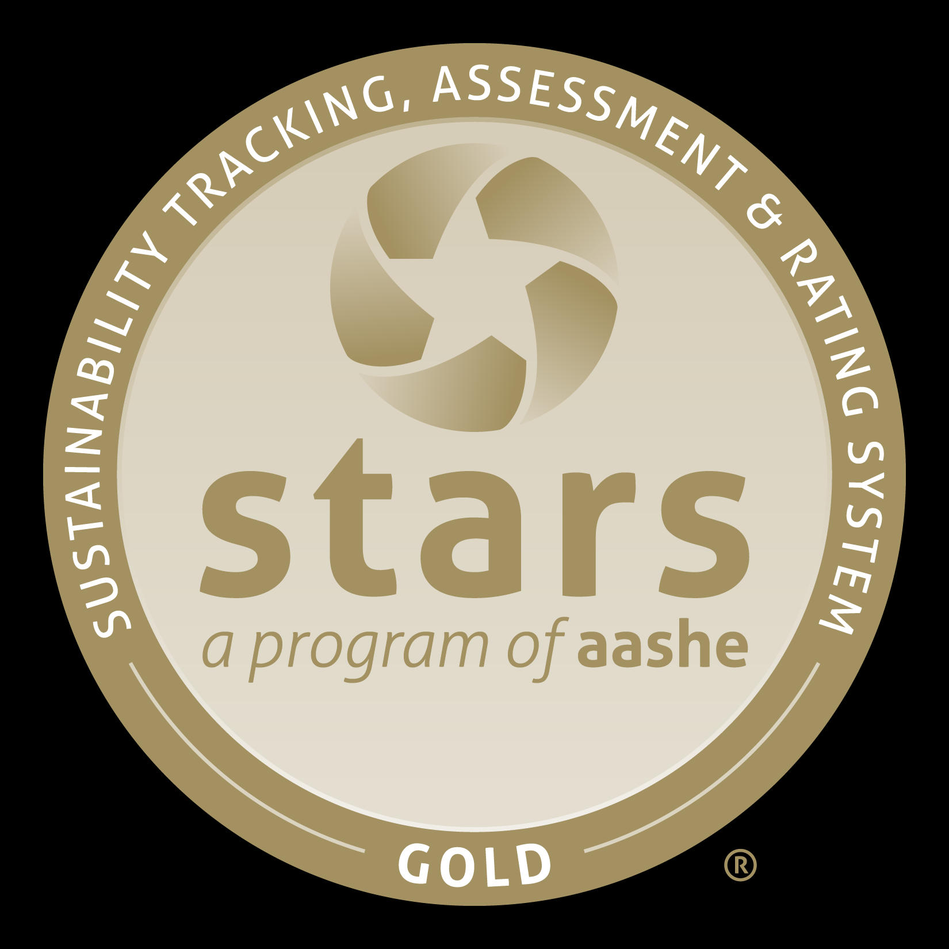
Indicators for the Common Good
Notes:
Able to use the 17 sustainable development goals as the basis for establishing goals and projects that help us fulfill this mission for the common good. They certainly unite human rights and sustainability through their social and environmental goals as well as the include the economic component. So drawing upon the SDGs, our call from leadership, and our mission that was founded in Catholic social teaching we have been able to achieve a unique collaboration across functions. Using this framework, we have been able to connect several pieces of work and challenge our measure of success against our goal to advance the common good.

Slide 7
1998
2014
2016
2017
2018
2019
2020
First undergrad human rights studies program
Divested from fossil fuels
Sust
Campus Sustainability Research Award: Carbon Neutrality Lifecycle Cost Analysis
2013
Procurement and Payable Services Policy
Renewal
Sustainable Procurement Evolution
Notes:
So drawing upon the SDGs, our call from leadership, and our mission that was founded in Catholic social teaching we have been able to achieve some of these accomplishments. To name several key moments in UD’s commitment to human rights and sustainability over the twenty years, UD has had the first undergraduate human rights studies program since 1998 and a Human Rights Center operating at the intersection of education, research, and advocacy since 2013. In 2014, UD divested from fossil fuels, and a $12.5 million dollar contribution in 2014 created the Hanley Sustainability Institute. In only 6 months, UD became designated a Fair Trade University in 2016. After joining the UN Global Compact last year, UD is currently implementing support for the SDGs throughout the university.

Slide 8
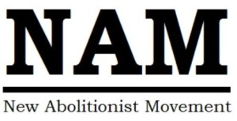
Procurement
Human Rights Center
For the Common Good
Dining
Facilities & Planning
Sustainability Studies
Web of Relationships for the Common Good
Notes:
So drawing upon the SDGs, our call from leadership, and our mission that was founded in Catholic social teaching we have been able to achieve some of these accomplishments. To name several key moments in UD’s commitment to human rights and sustainability over the twenty years, UD has had the first undergraduate human rights studies program since 1998 and a Human Rights Center operating at the intersection of education, research, and advocacy since 2013. In 2014, UD divested from fossil fuels, and a $12.5 million dollar contribution in 2014 created the Hanley Sustainability Institute. In only 6 months, UD became designated a Fair Trade University in 2016. After joining the UN Global Compact last year, UD is currently implementing support for the SDGs throughout the university.

Slide 9
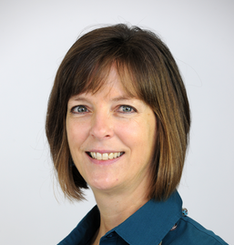
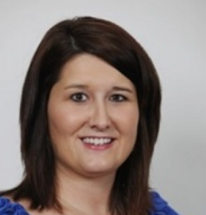
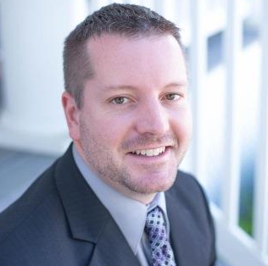
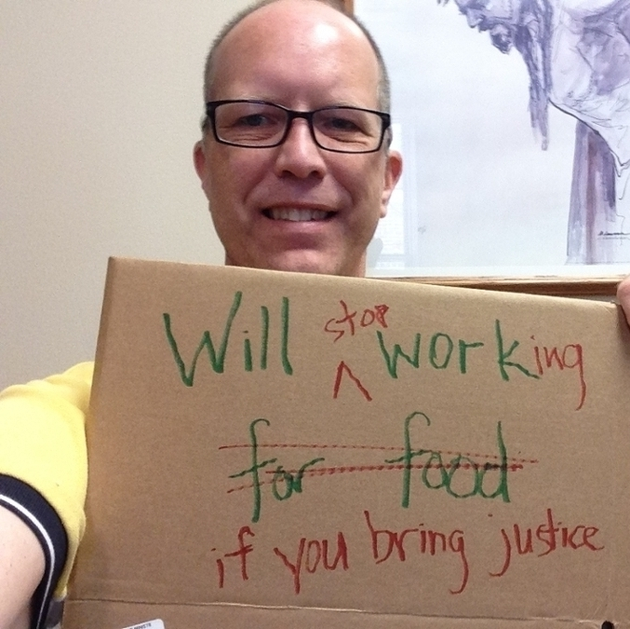
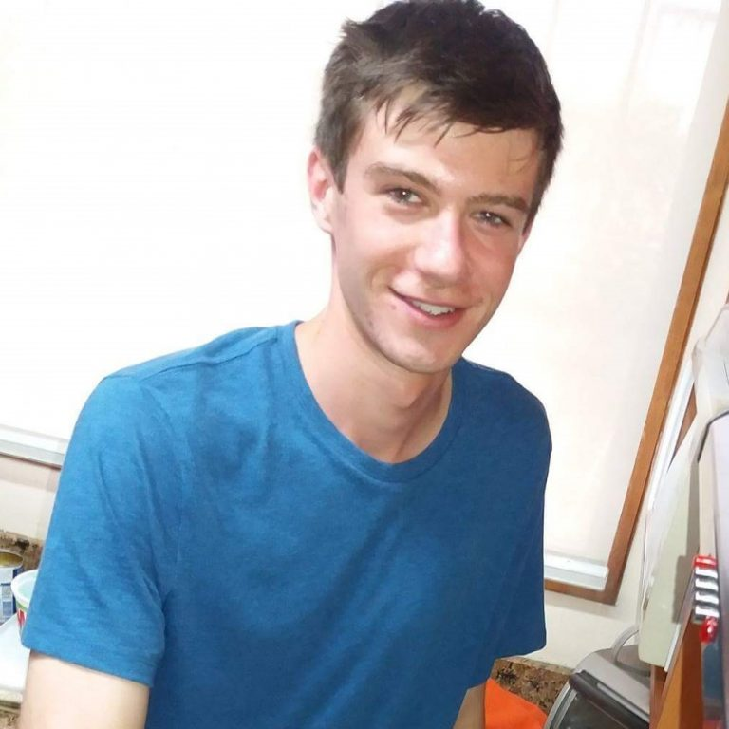
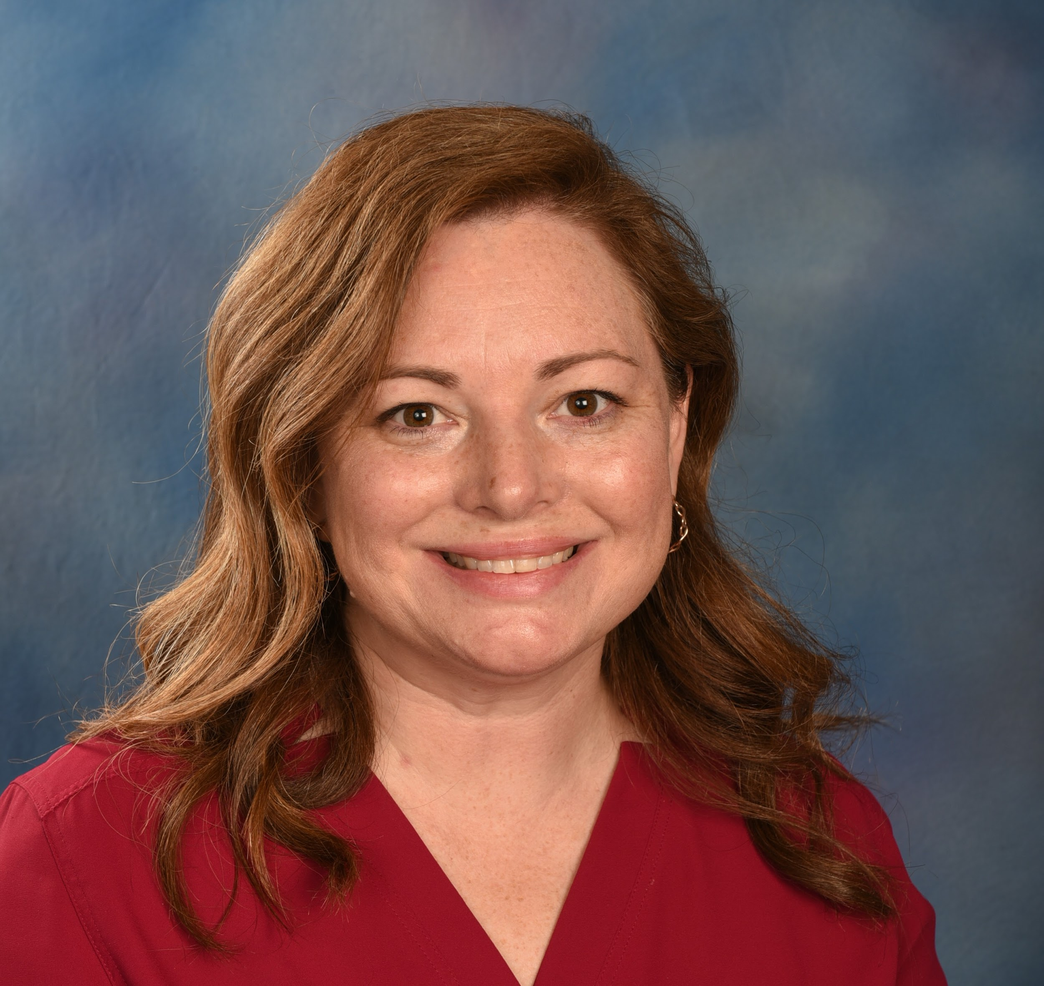
Fair and Ethical Sourcing President’s Working Group
Bookstore
Campus Ministry--Center for Social Concern
Dining
Facilities Management
Fair Trade Coalition Student Rep
Human Rights Center
Procurement
School of Business
Crossing Boundaries
Students > Staff > Faculty
Vice Presidents > Students
Campus Ministry > School of Business > Finance and Administration
Notes:
Find allies and champions. Who else on your campus is looking at the bigger picture of the global goals, of interdisciplinary work? Student interest can inspire bringing people of different units together.
History of one UD example -- e.g. Fair and Ethical Sourcing working group?

Slide 10
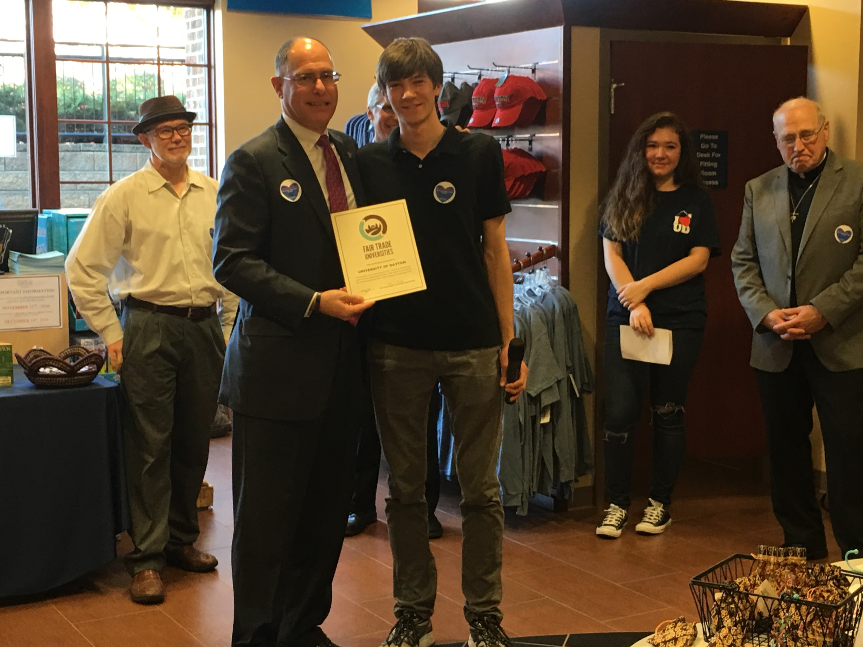
#ForTheCommonGood
Notes:
First outcome was becoming a Fair Trade University -- in record time -- but more importantly -- created a coalition across the boundaries of human rights and sustainability to consider the impact of our purchasing -- both the “green” and the social justice -- care for creation and human dignity
Now there is a structure in place that evaluates our purchasing decisions.

Slide 11
Overview of Lessons Learned
Link to mission
Find your allies
Set achievable goal
Use SDGs and STARS as framework
lessons continue...
Notes:
Lessons learned (3 min)
List all 4 and case studies
Explain how all 4 cases embody all 4 lessons, but will highlight one of the lessons with each case.

Slide 12
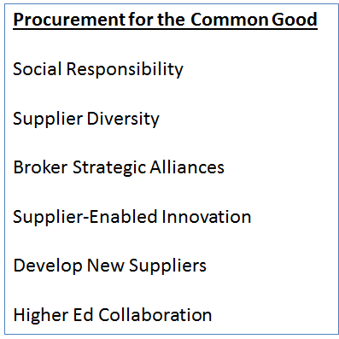
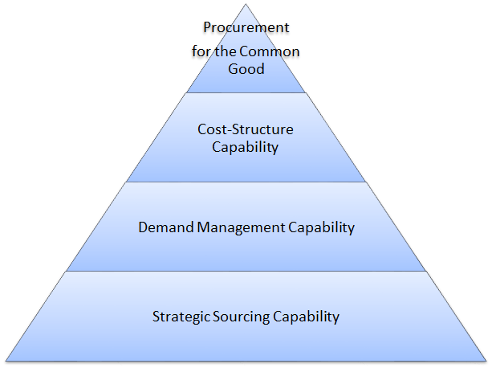
Aligning Procurement and Mission
Notes:
Mission and values inspires and guides the work towards environmental- and social justice-focused procurement. We feel it’s important to integrate the University missions into the day-to-day priorities in Procurement and Payable Services.

Slide 13
External Allies
MBE Suppliers
Supplier RFx
WBE Suppliers
Chamber of Commerce
Notes:
A key enabler for the progress we are making is our e-procurement tool. As of Nov 2016, University of Dayton manages all procurement activities including Approved Suppliers in Runway, a Jaggaer e-procurement tool.
For Information and link to the Supplier Portal
go.udayton.edu/supplier
Important Information: NAICS, Business Classification

Slide 14
Journey Towards Sustainable Purchasing Goals
Renewed the Procurement and Payable Services Policy
Updated website with Sustainability accomplishments
Established Scorecard that includes “Common Good” metrics
Local, Small Business, Diverse and Green Spend
Recognized Suppliers with Fair and Ethical Supply Chains
New COVID supply chains
-

Slide 15
Supplier Initiatives Beyond STARS
2019 Recipient of Office Depot’s Leadership in Greener Purchasing Award
Vehicle Fleet Management initiatives to reduce carbon footprint
Steelcase Furniture Visit to Grand Rapids in part to understand how to define Social Life Cycle Assessment of a product as well as how office design and furniture links to employee and student health goals
Notes:
The OD award is based upon several factors such as green spend, participation in the TreeUp program etc. UD is one of 22 customers chosen

Slide 16
Contact:
Leah Ceperley (lceperley1@udayton.edu)
Sustainability Planning and Evaluation Manager
Sara Harrison (sharrison2@udayton.edu)
Executive Director, Procurement and Payable Services

