Slide 1
Communicating for Connection and Education
June 18, 2020

Slide 2
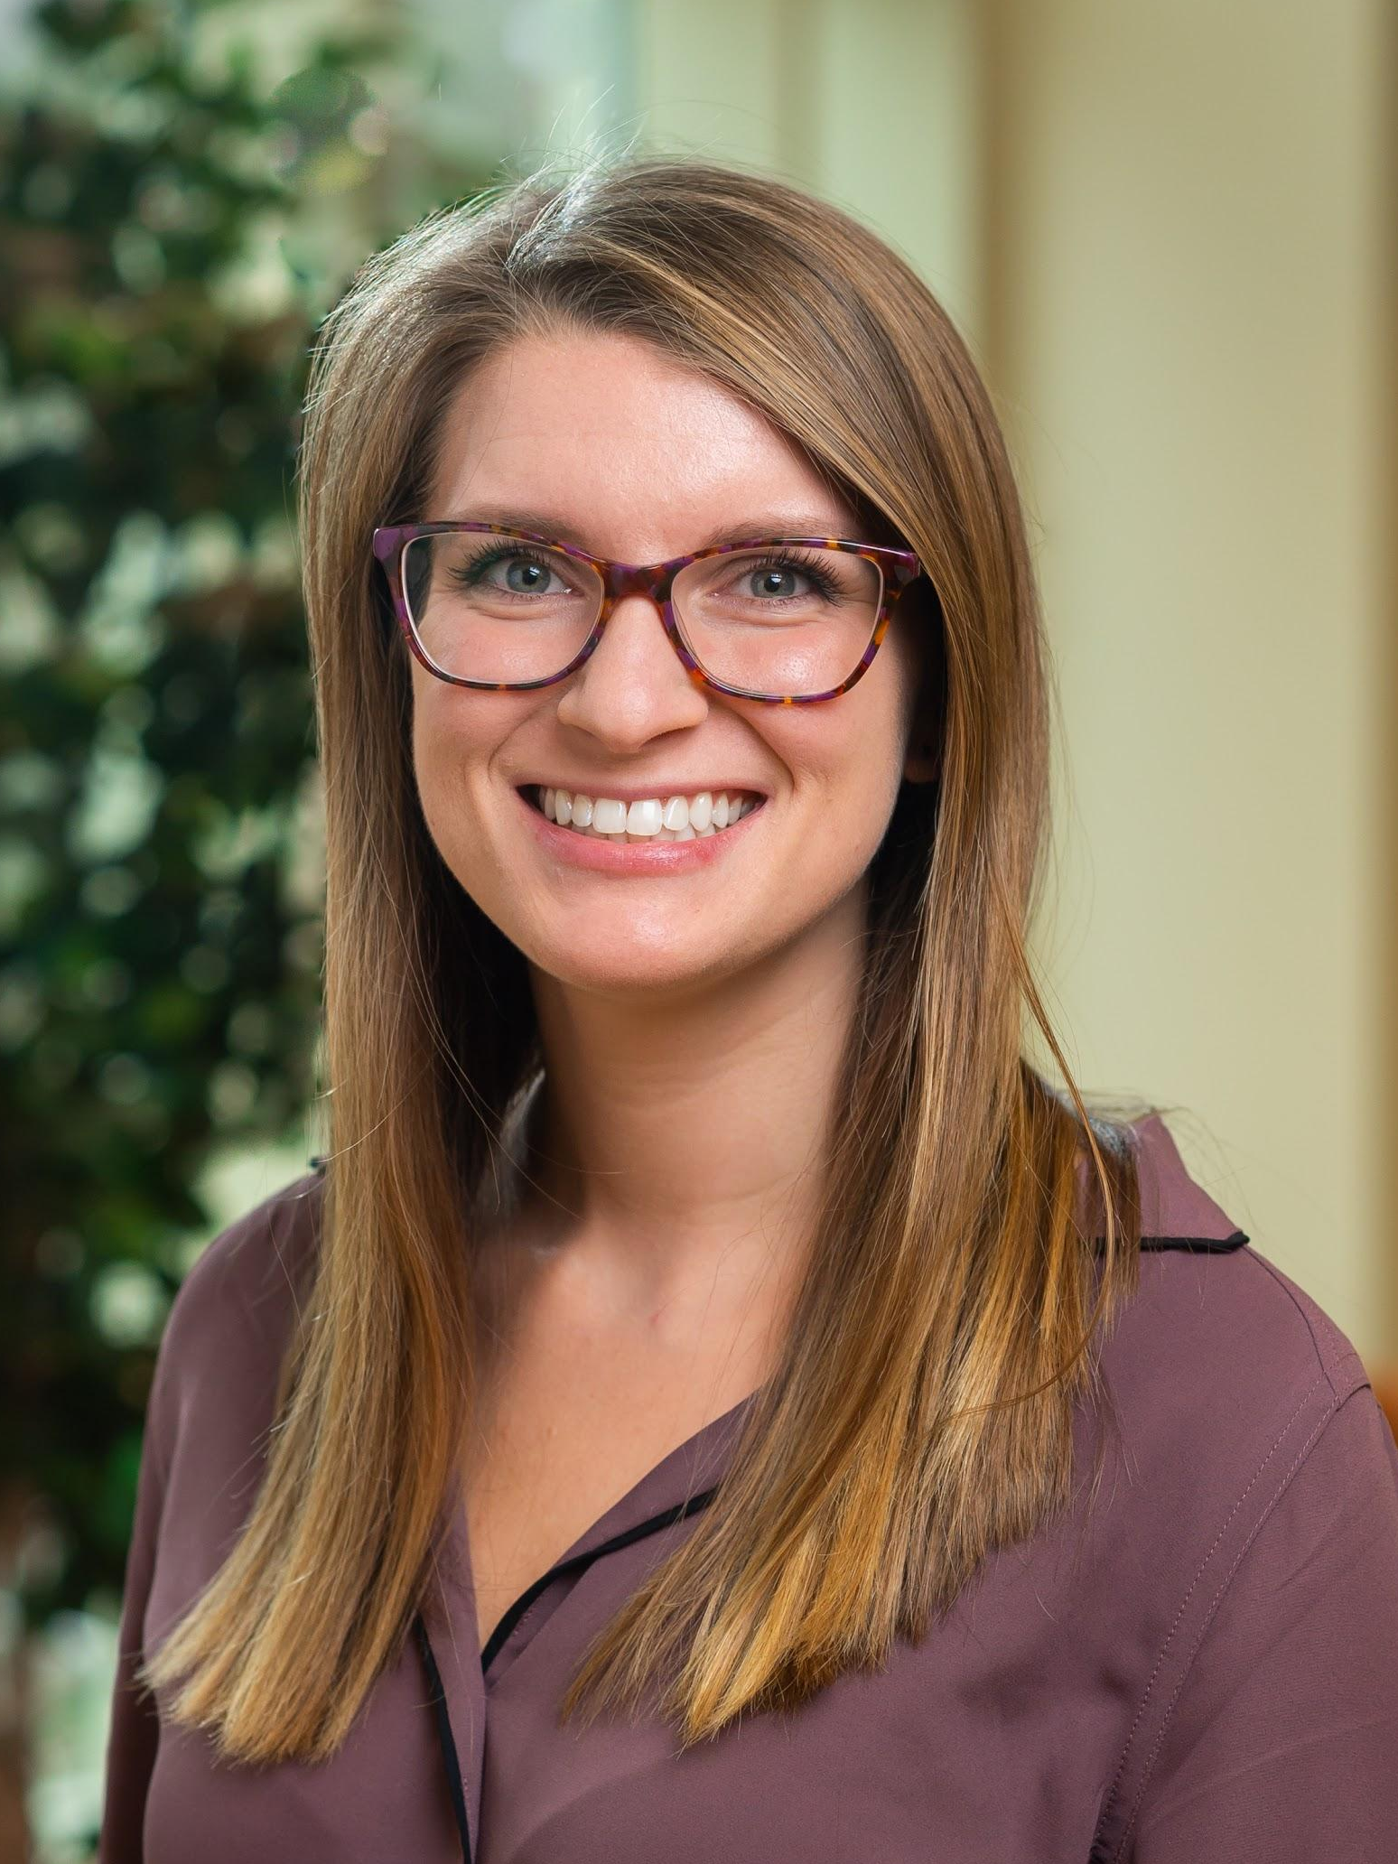
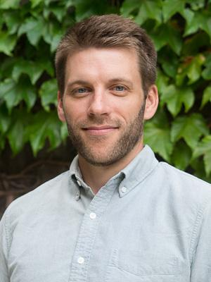
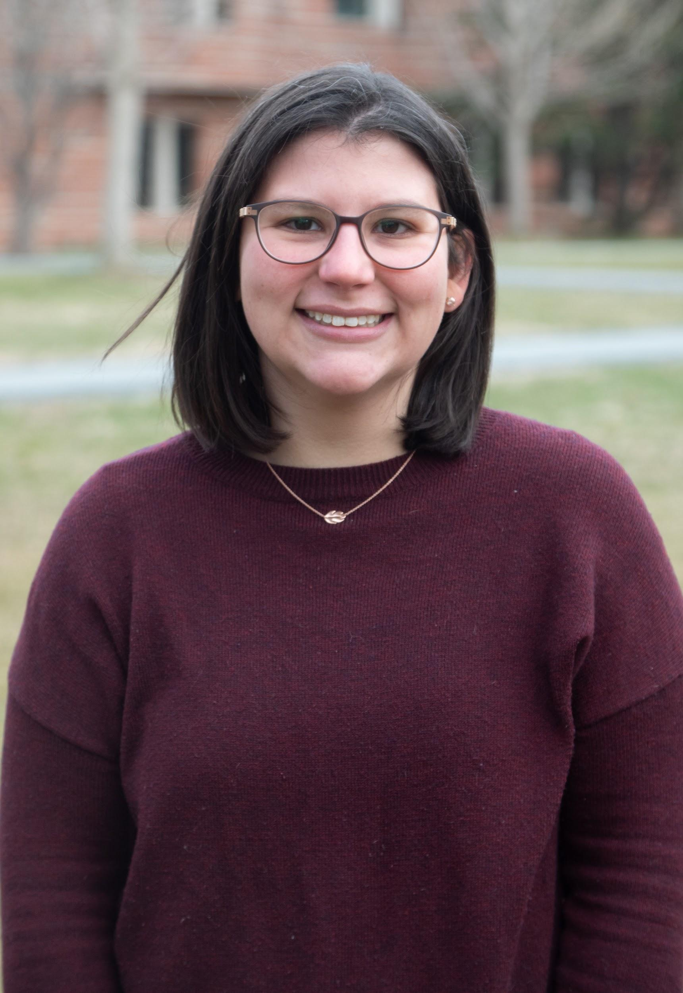
Presenters
Pamela Gramlich (she/her)
Assistant Director, Sustainability
Program Coordinator, Environmental Studies
Colgate University
Nathan Jandl (he/him)
Assistant Director,
UW-Madison Office of Sustainability
Lisa Nicolaison (she/her)
Engagement and Communications Coordinator,
Office of Sustainability
Princeton University

Slide 3
Crafting Campaigns

Slide 4
Campaigns vs. Strategies
Does one require the other?
Should all campaigns fall within a single strategy?
What does that mean if they do?
For the sake of this webinar...
Campaign = Audience + Topic/Project/Event + Platform(s)

Slide 5
Teasing out the terms
Audience: not just categories of people, but qualities - individual behaviors, social norms, cultural and institutional context(s), expectations
Topic: The idea or the event, but also abstract qualities like learning, engagement, investment, interaction
Platforms: The where and what of your campaign, but also how and the in what manner

Slide 6
Key questions
Who is your audience? Who are your stakeholders?
What are you trying to communicate (topic + take-away)?
What is the behavior/attitude you’re trying to change?
Via norm, value, and/or motivation, e.g. psychology!
What is the intended outcome of your communications?
What are the platforms/mediums, and why?
How will you recognize success?

Slide 7
Waste Wednesdays
Princeton University

Slide 8
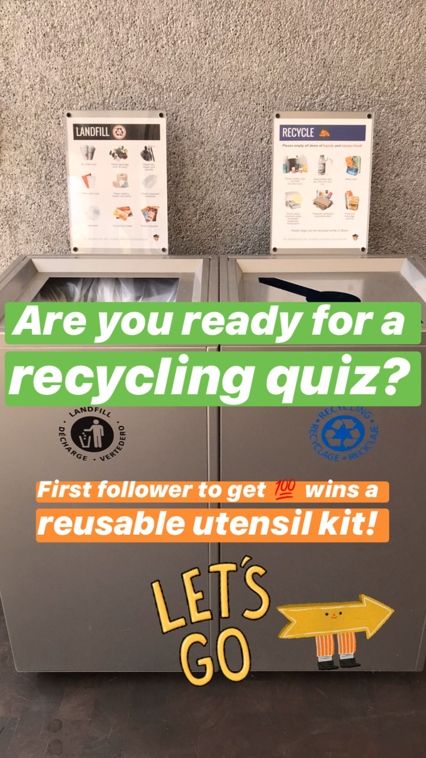
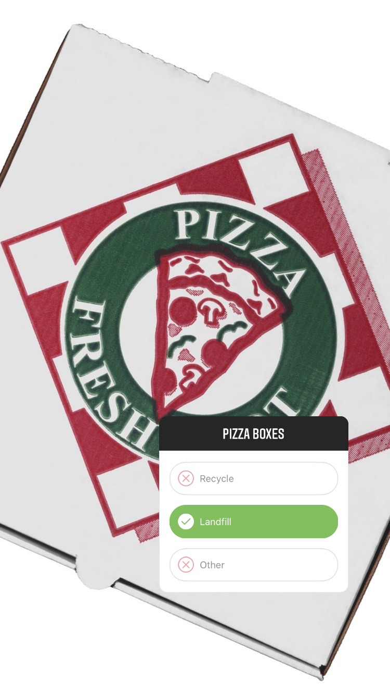
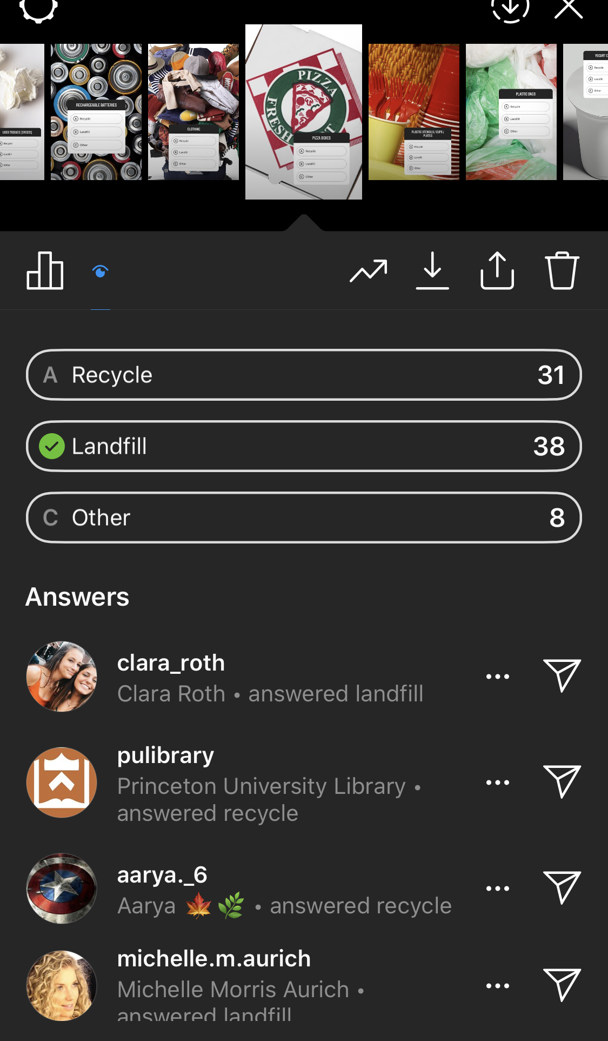
Instagram Story Recycling Quiz
Notes:
300 impressions, 232 accounts, 217 continued

Slide 9
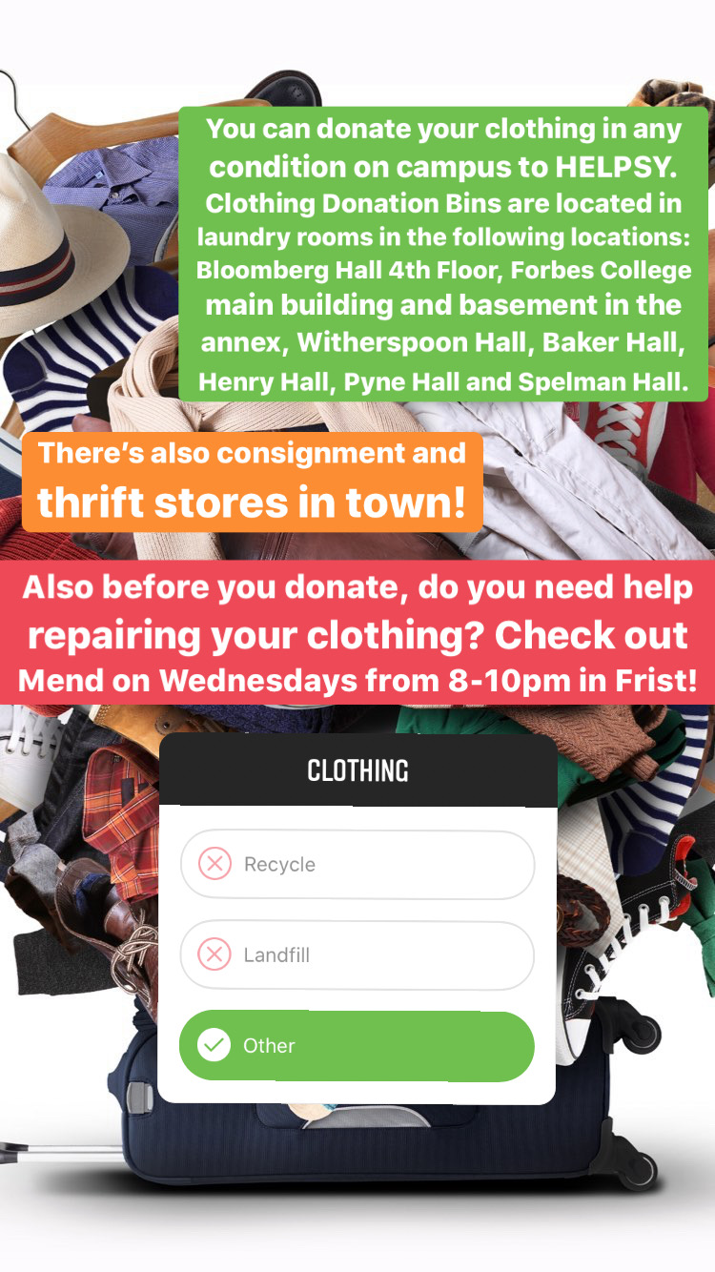
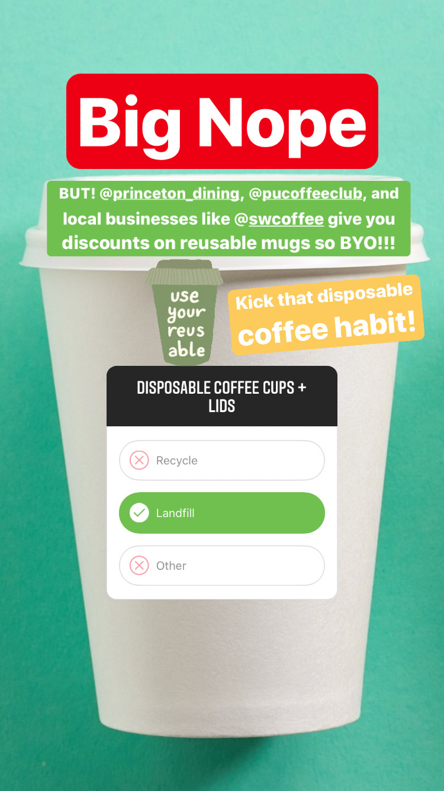
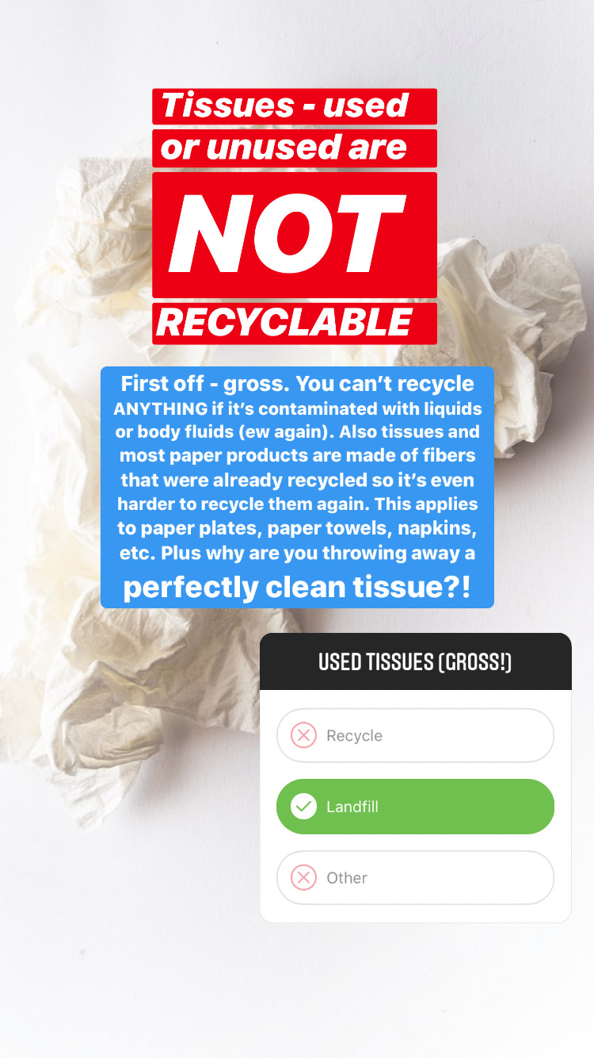

Slide 10
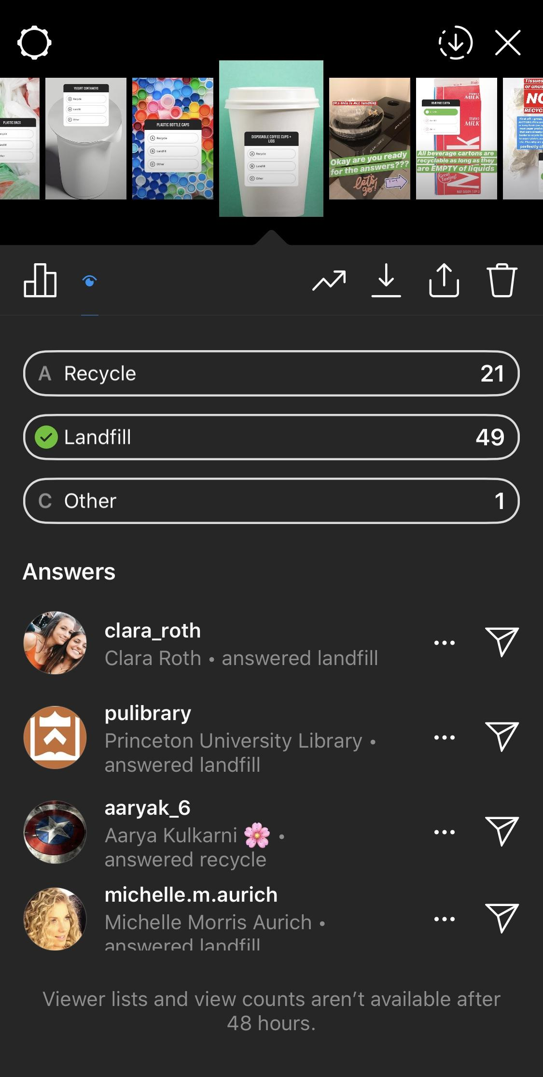
Takeaways
Which items are most confusing (i.e. coffee cups)
Focused education around those items
Need to explain the “why”
Promote collections for special items (i.e. batteries)
Promote reusables

Slide 11
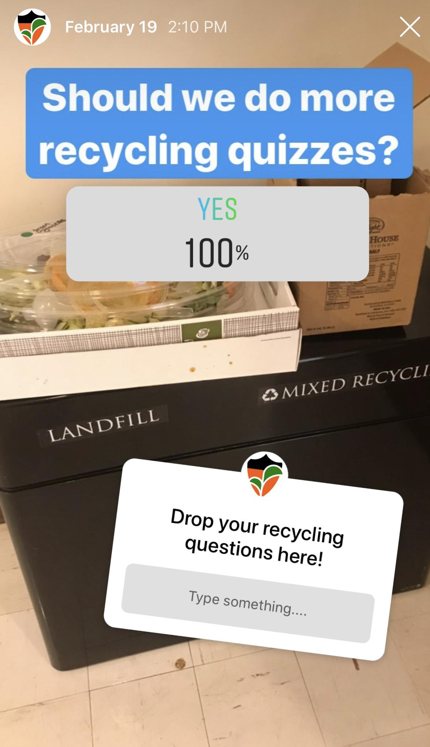
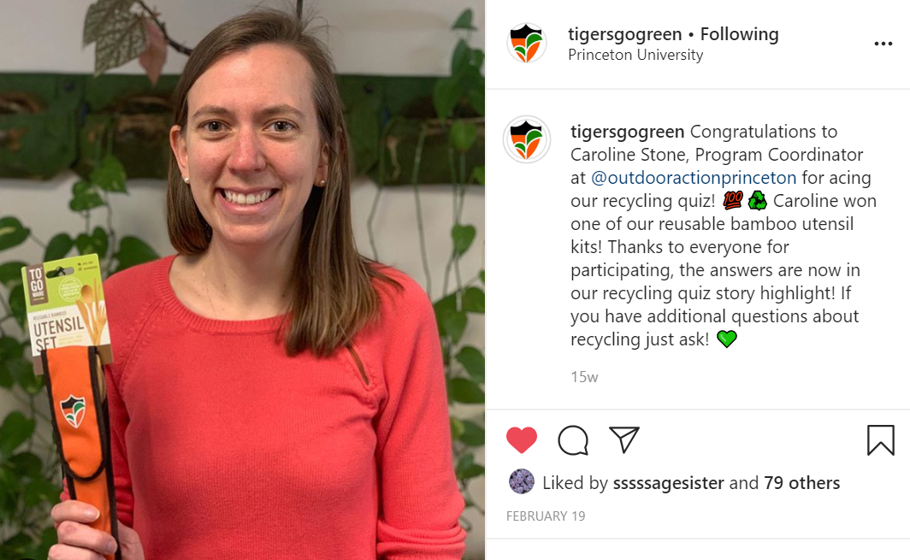
Follow-up
Notes:
6 interactions with tags, 160 accounts

Slide 12
Waste Wednesday Key questions
Who is your audience? Who are your stakeholders?
Students, campus community
What are you trying to communicate (topic + take-away)?
What is recyclable, various waste education
What is the behavior/attitude you’re trying to change?
Via norm, value, and/or motivation, e.g. psychology!
Improved recycling, reduce contamination
What is the intended outcome of your communications? Students understand different waste concepts
What are the platforms/mediums, and why? Instagram stories - Student focus, interactive features, story highlights
How will you recognize success? Analytics, contamination rates, student engagement in office programming

Slide 13
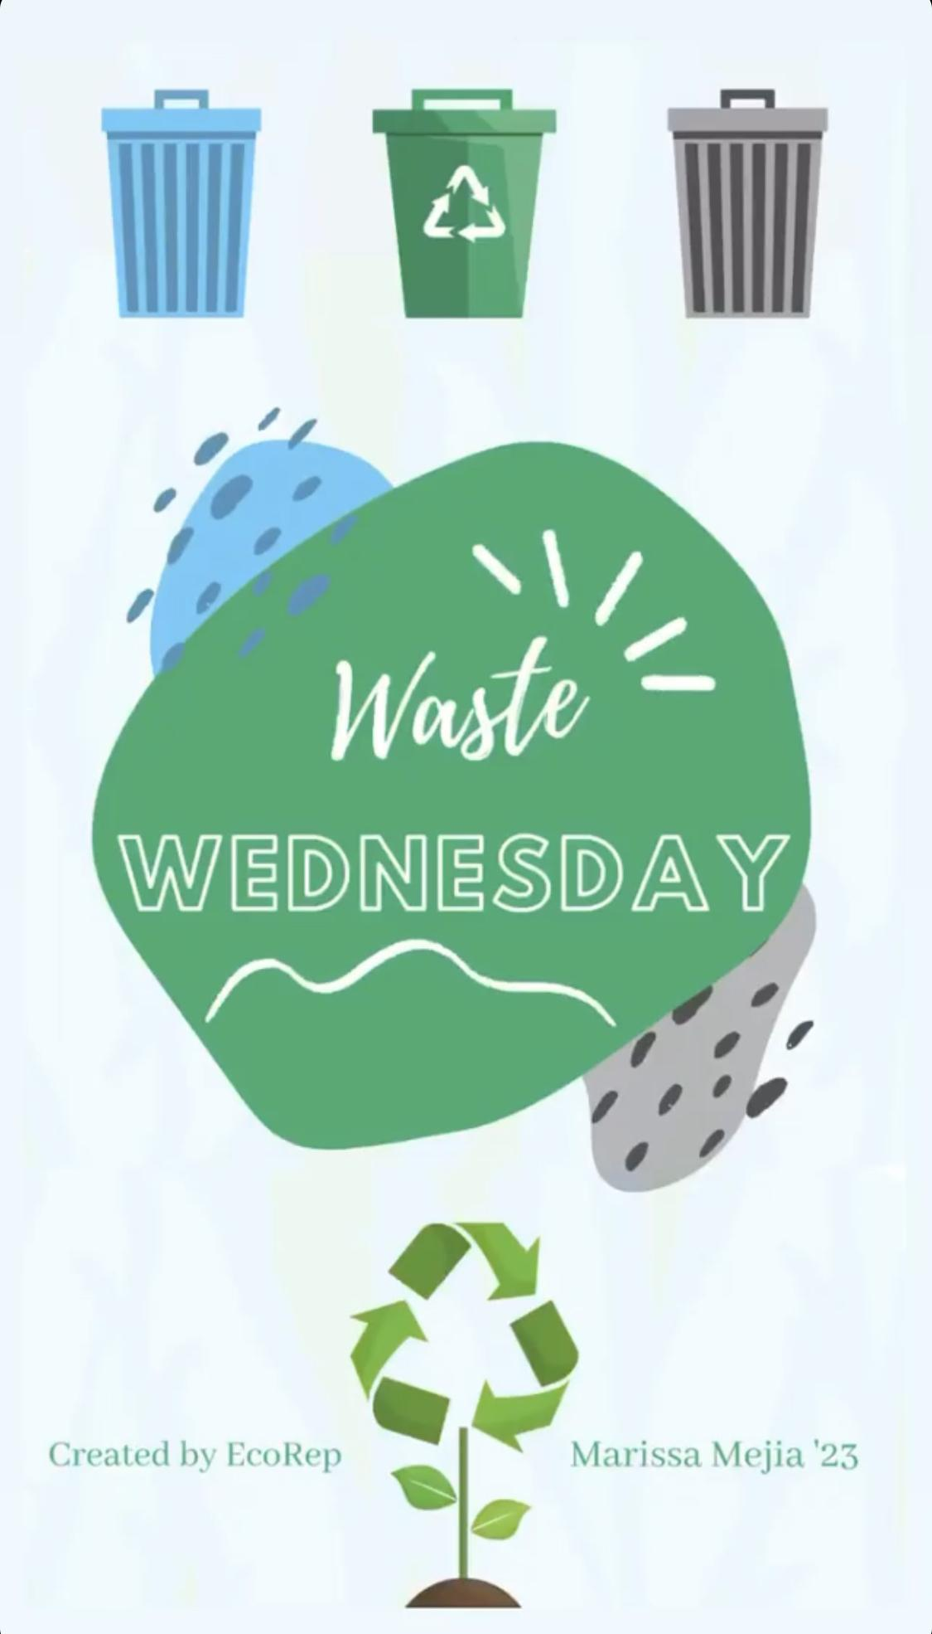
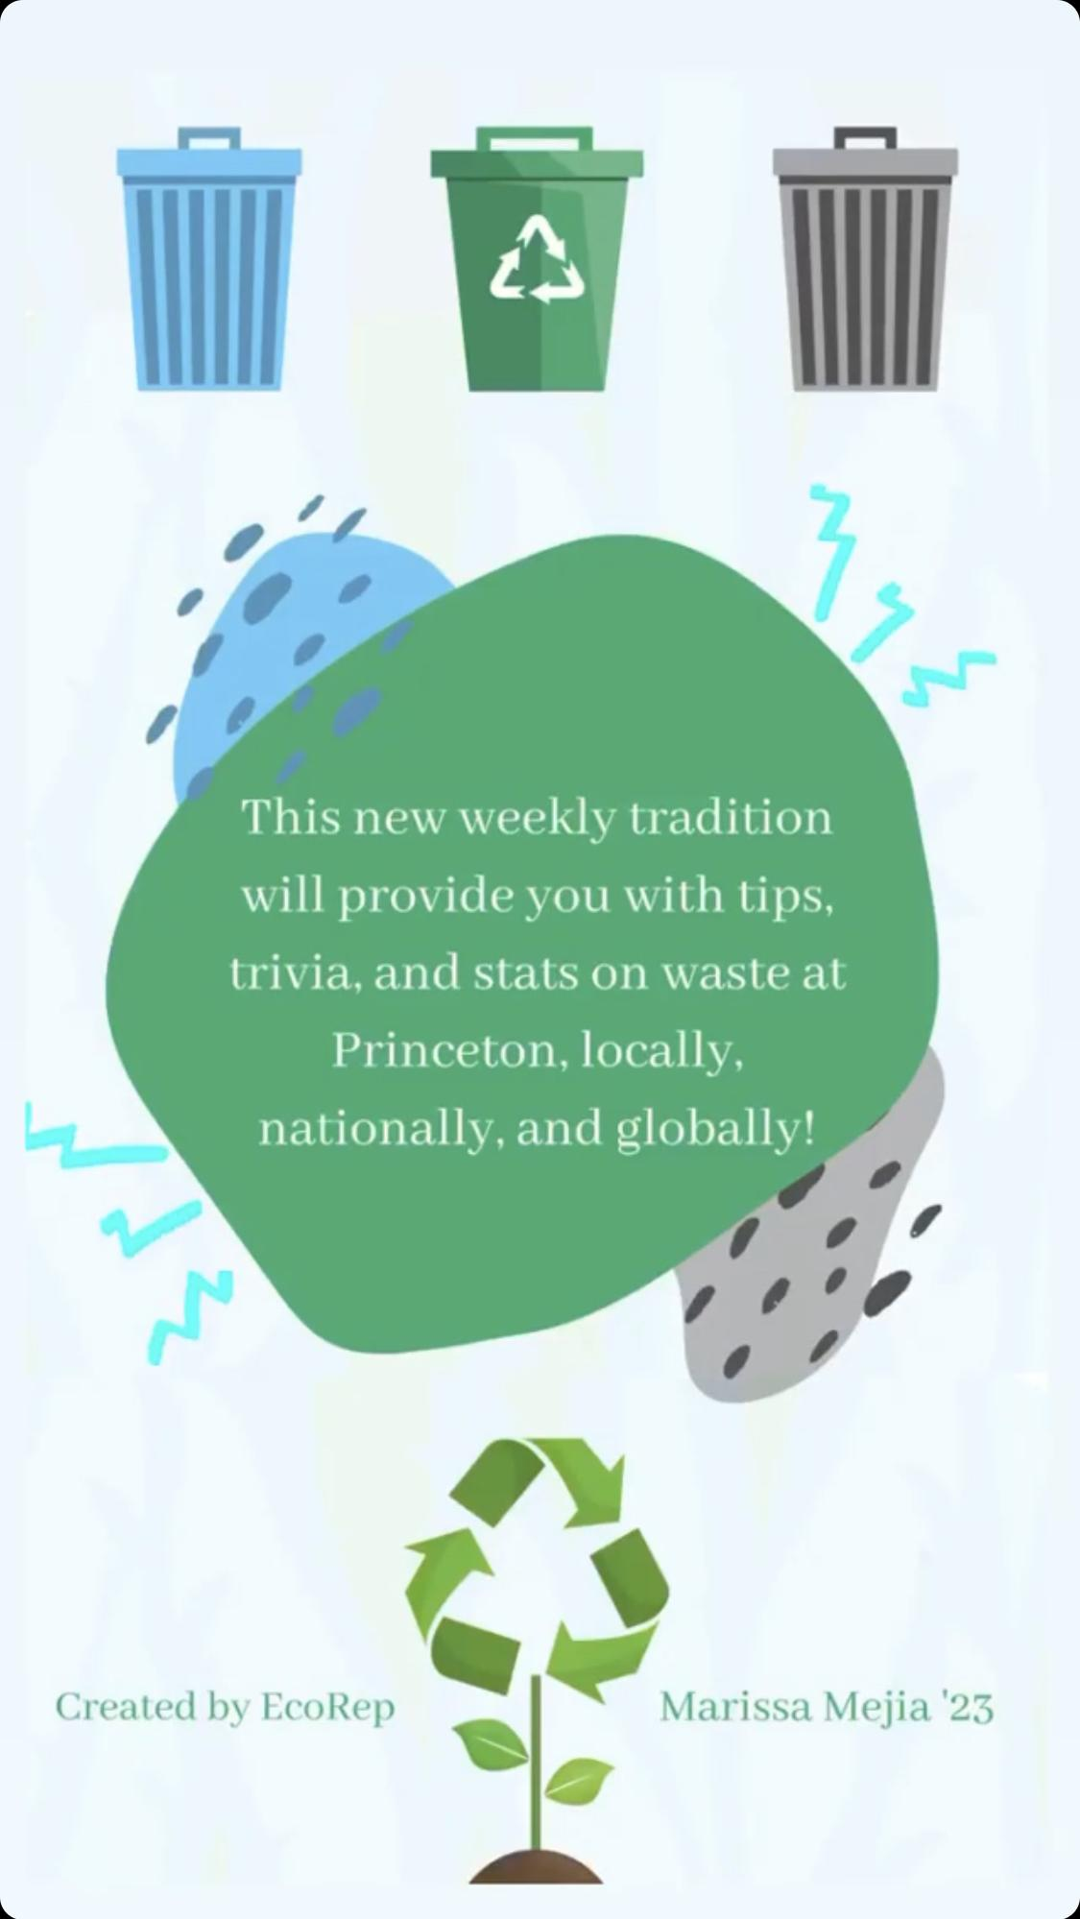
Waste Wednesday
Local - Princeton
Regional - New Jersey
Global

Slide 14
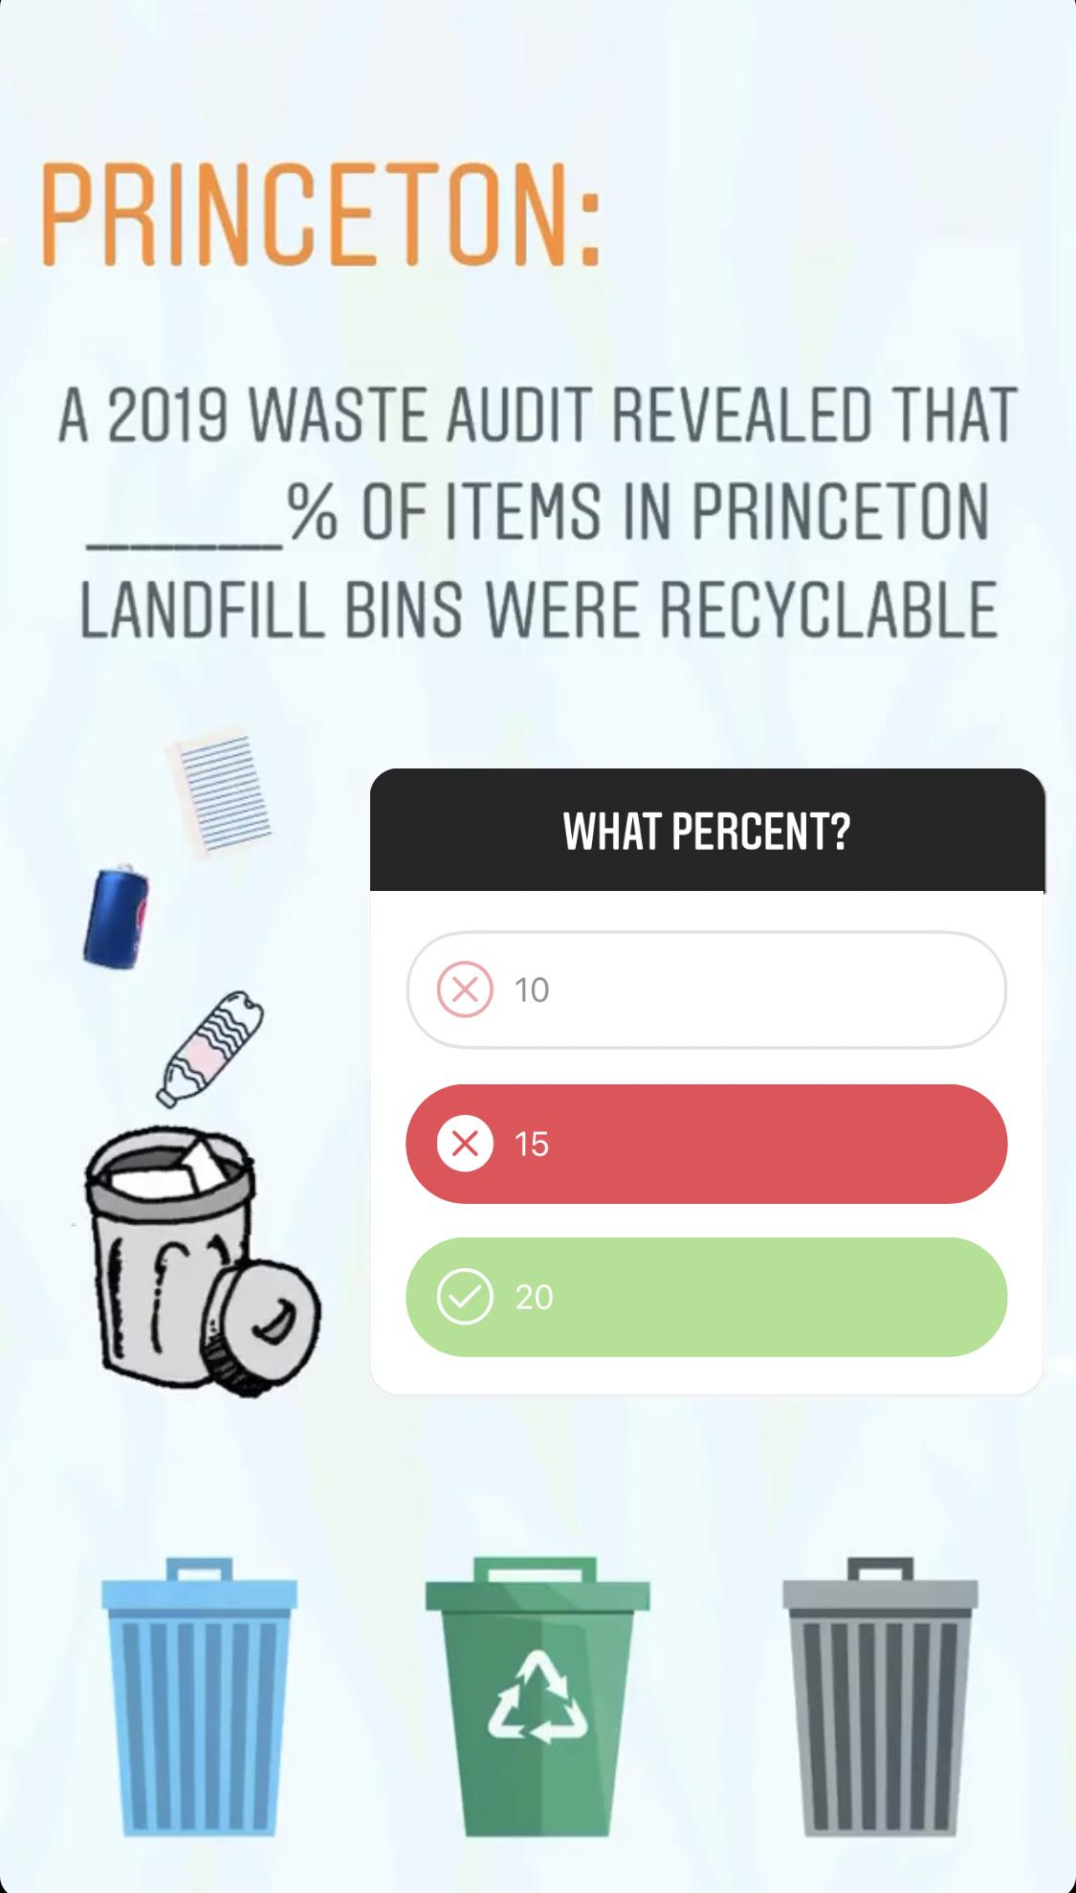
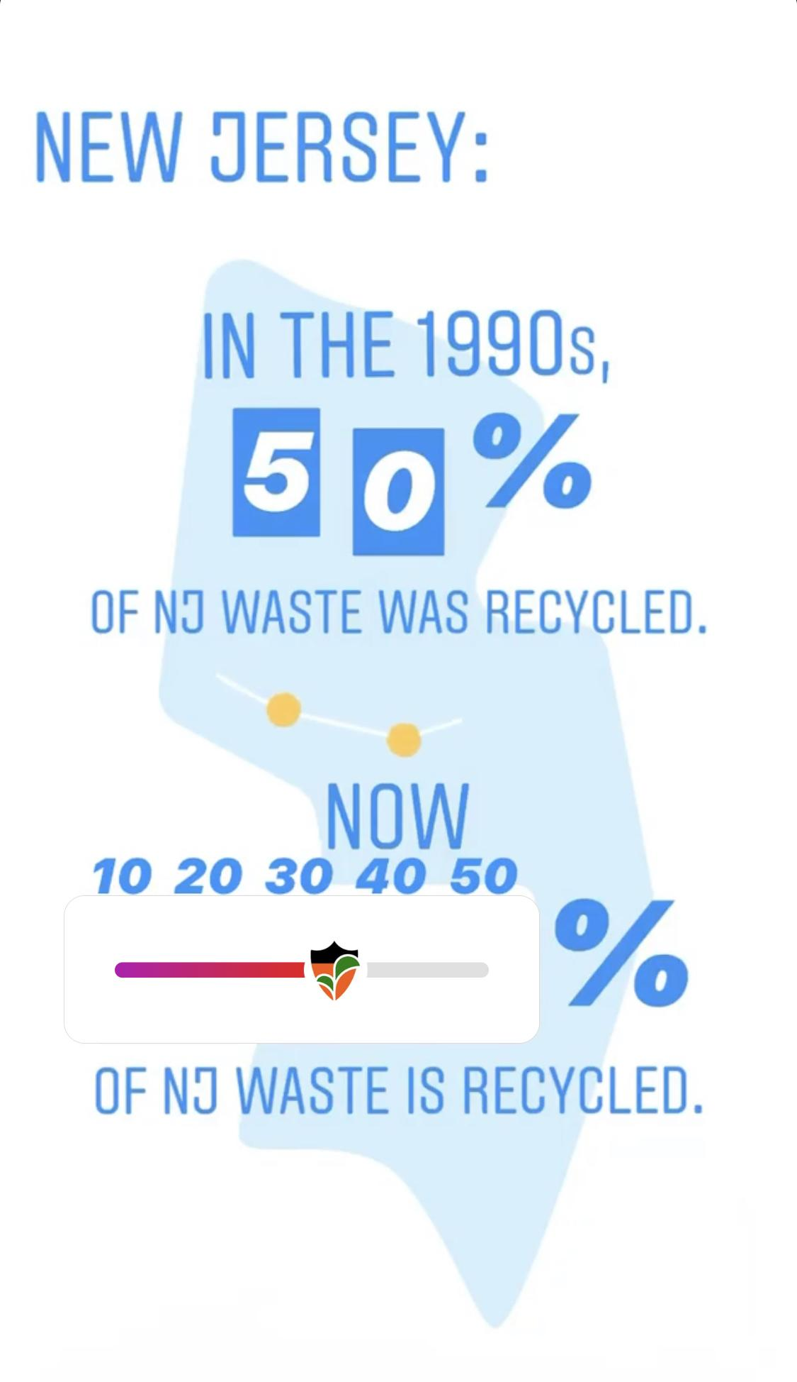
Interactive stories:
Quiz
Poll
Slider
Questions

Slide 15
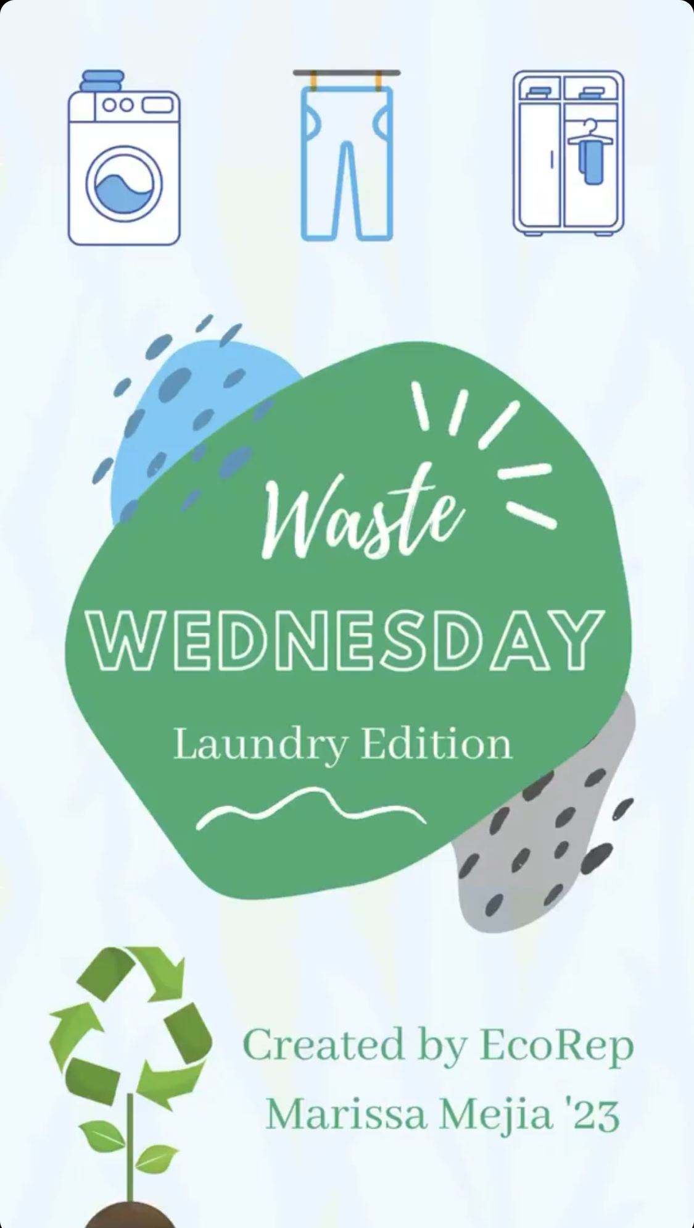
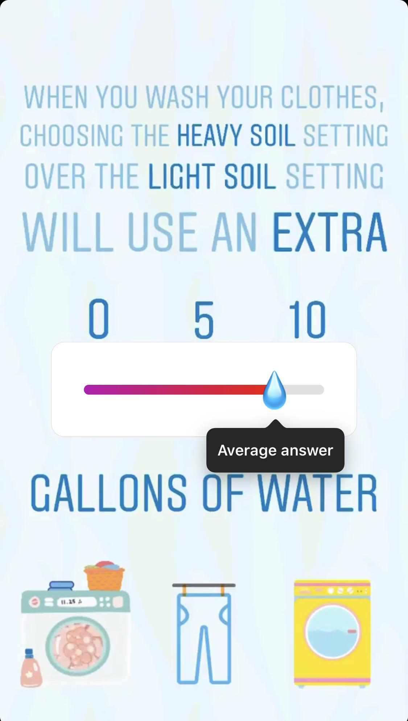
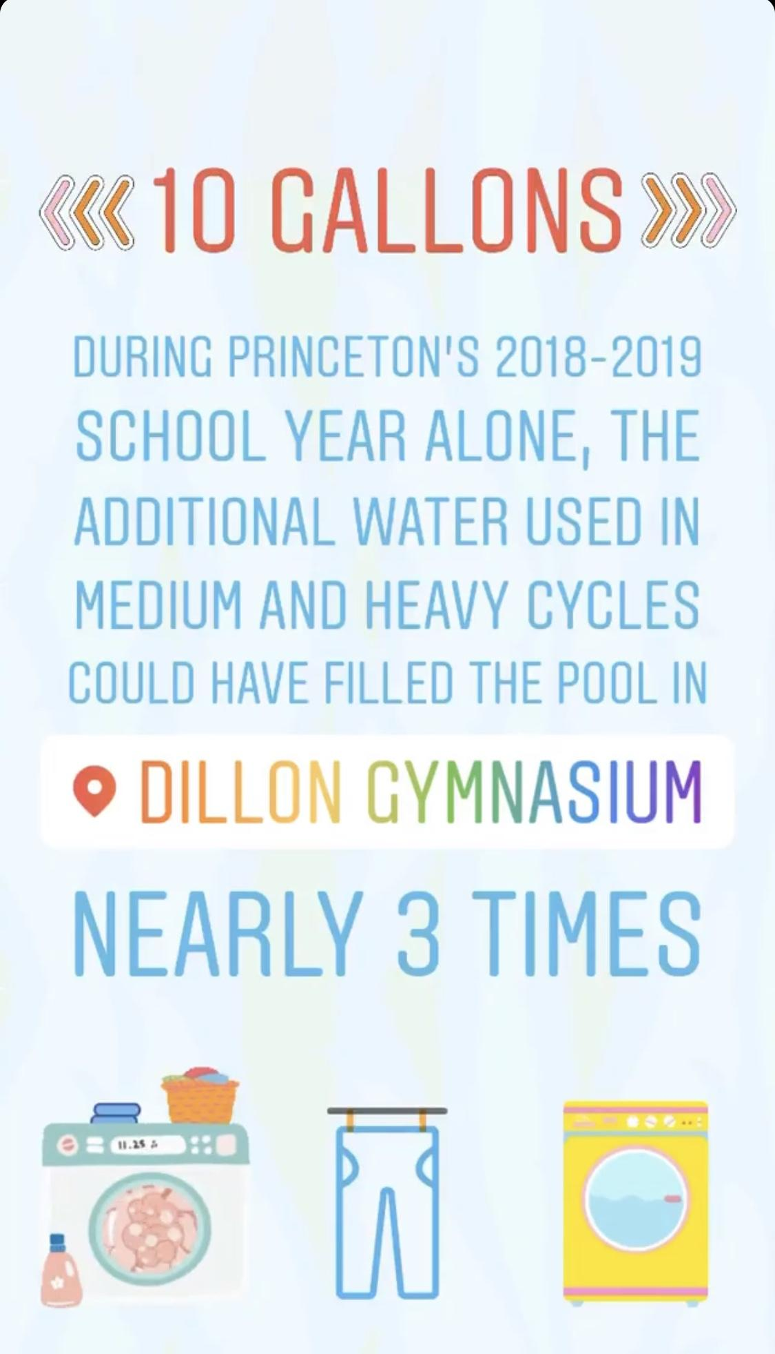
Waste Themes - Laundry
Water
Energy

Slide 16
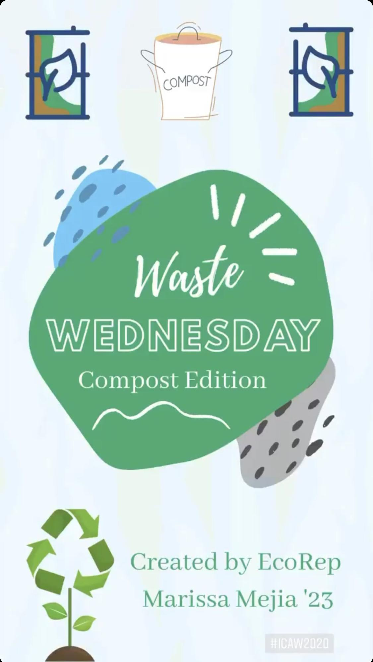
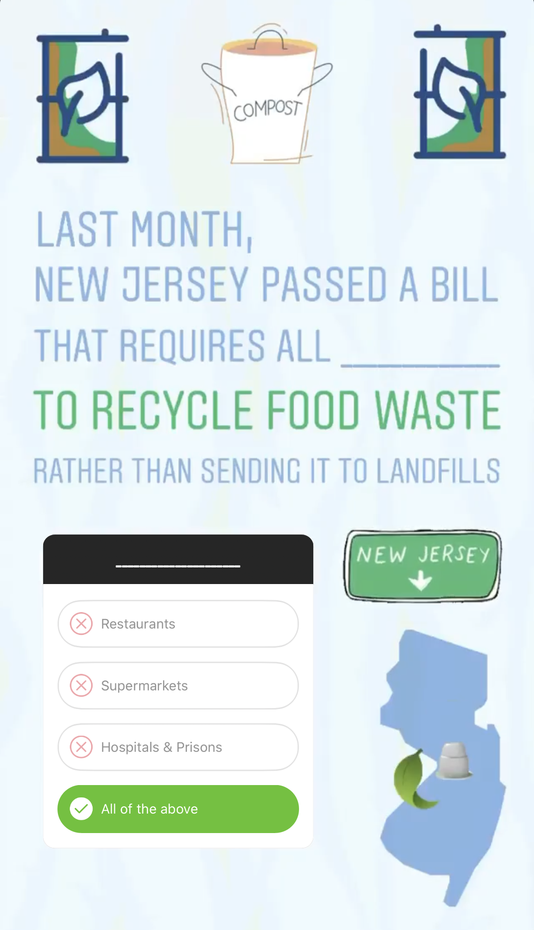
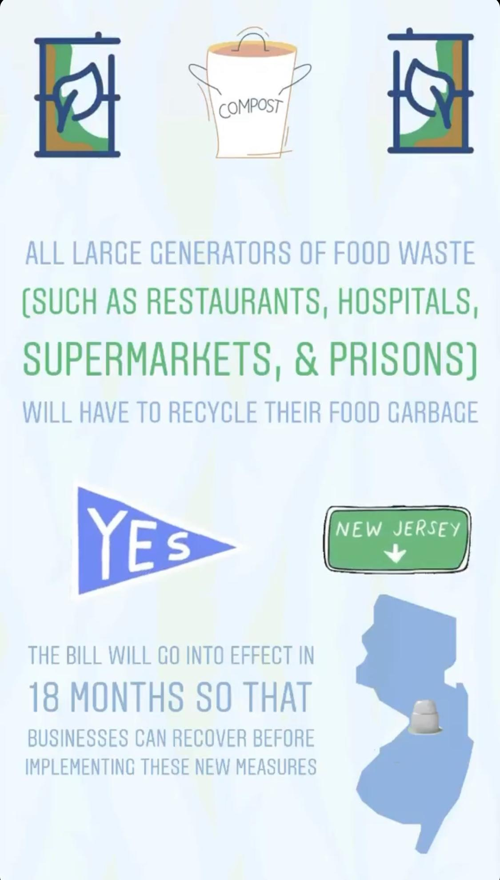
ICAW 2020 - Compost

Slide 17
Future Plans
Topics
Reusables
Hard to recycle items and collections
Event specific: Move-In, Move-Out, Vampire energy (Halloween)
S.C.R.A.P. Lab (on campus composter)
Partnerships
Coffee cup posters in the Student Coffee Club
Giveaways
Waste Wednesday beyond Instagram

Slide 18
#RecycleRight
Project partners:
Nathan Jandl, Ally Burg, Hannah Kasun, Office of Sustainability
Prof. Bret Shaw, Dept. of Life Sciences Communication
Carrie Kruse, College Library
Brooke Weiland, designer

Slide 19
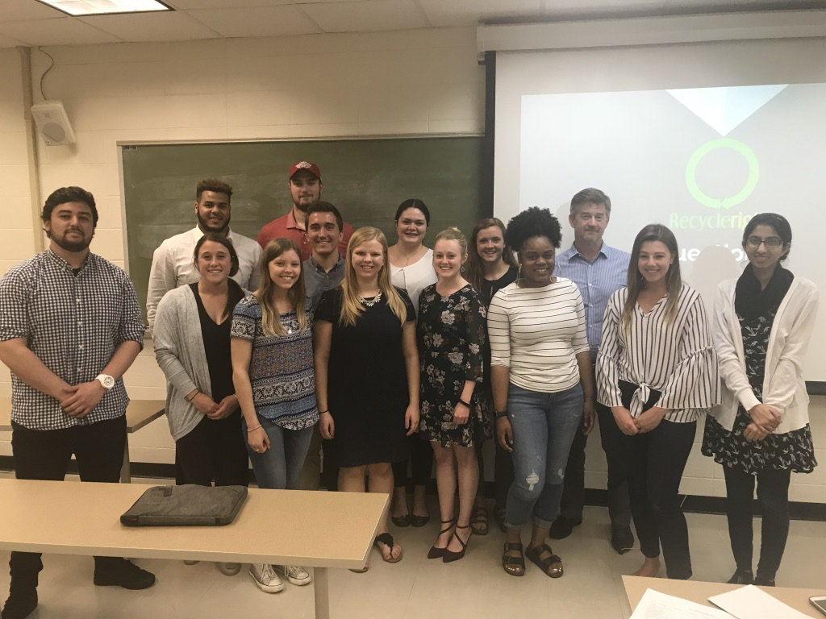
Life Sciences Communication
Senior Capstone Class Learning Objectives
Pedagogical objectives
Learn principles of social marketing
Conduct qualitative and quantitative research
Use persuasion and behavioral principles to inform campaign planning
Strategic and creative thinking, writing, and message production
Service learning goals
Focus on student behavior change campaign for real-world client on campus

Slide 20
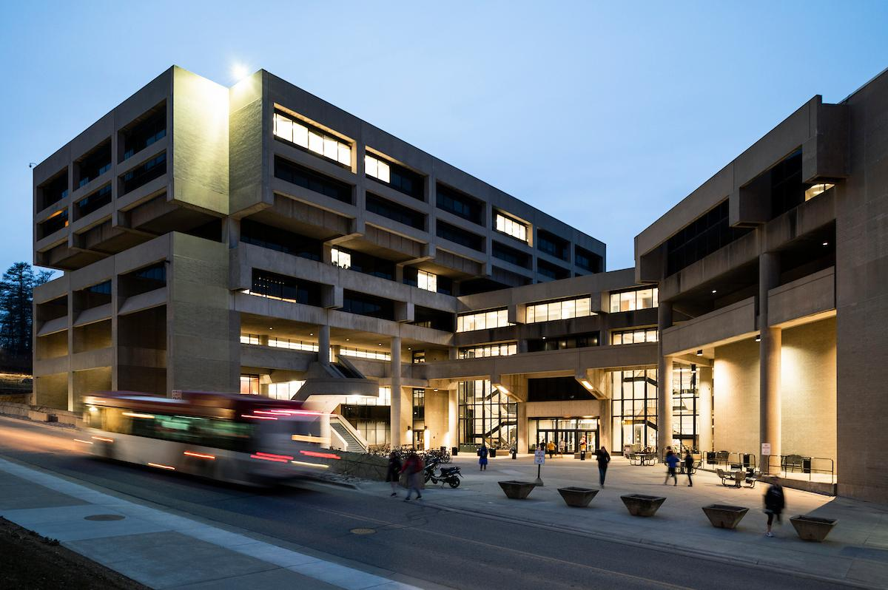
Client background: College Library
Busiest library on campus
Food & drink allowed
Café and food delivery
24 hours
Custodial challenges
Janitors less available later at night when needed most

Slide 21
Key Insights: Observations and Qualitative Interviews
Method
Students conducted on-site observations at library and in-depth interview with library patrons
Student Findings
Students often distracted and not thinking about where they sort waste
Attitudes toward recycling generally positive
Signage needs to be easier/faster to read

Slide 22
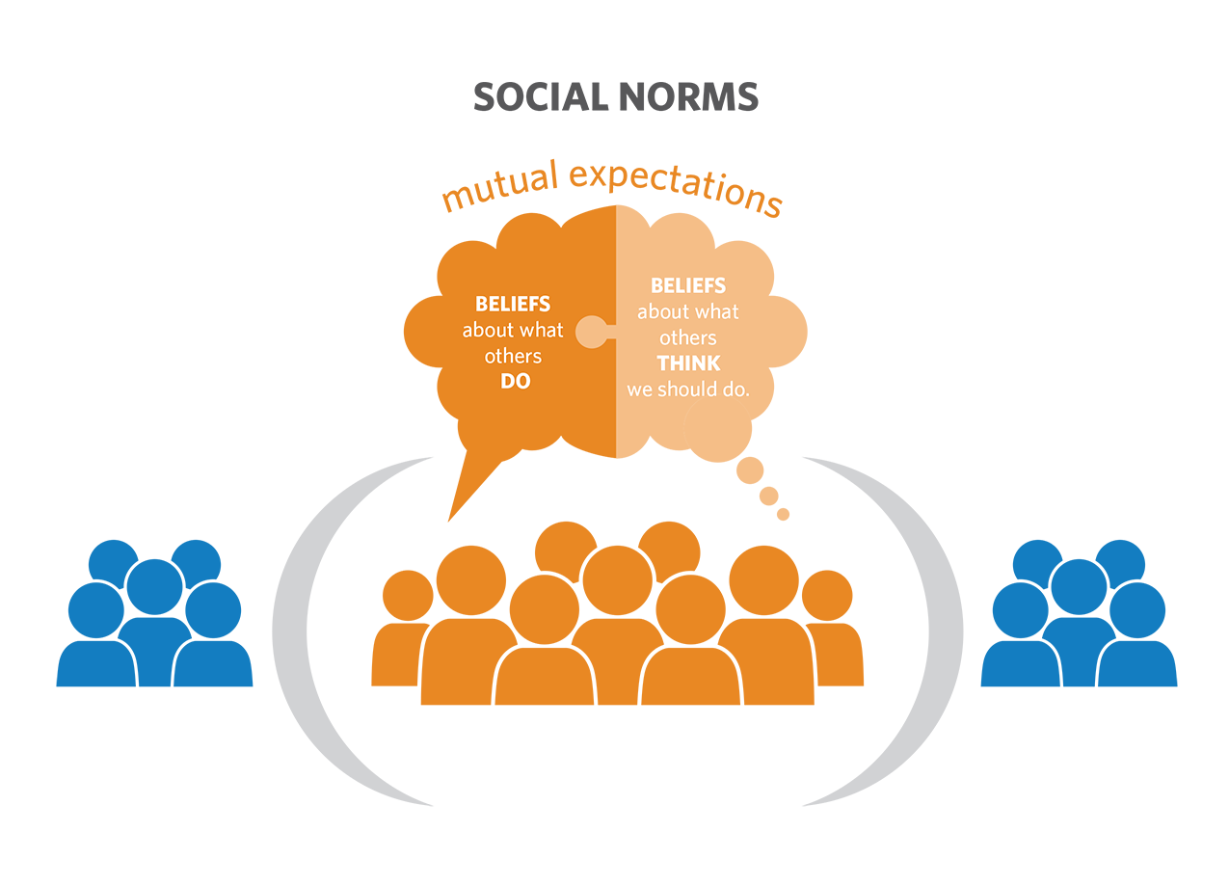
Key Insights: Quantitative survey
Students developed survey; fielded via iPads at College Library (n=194)
Incentive = Free beverage coupon
Social norms not favorable
Students tend to think others care less about recycling than they do, so they may make less effort

Slide 23
Competition:
Winning Campaign

Slide 24
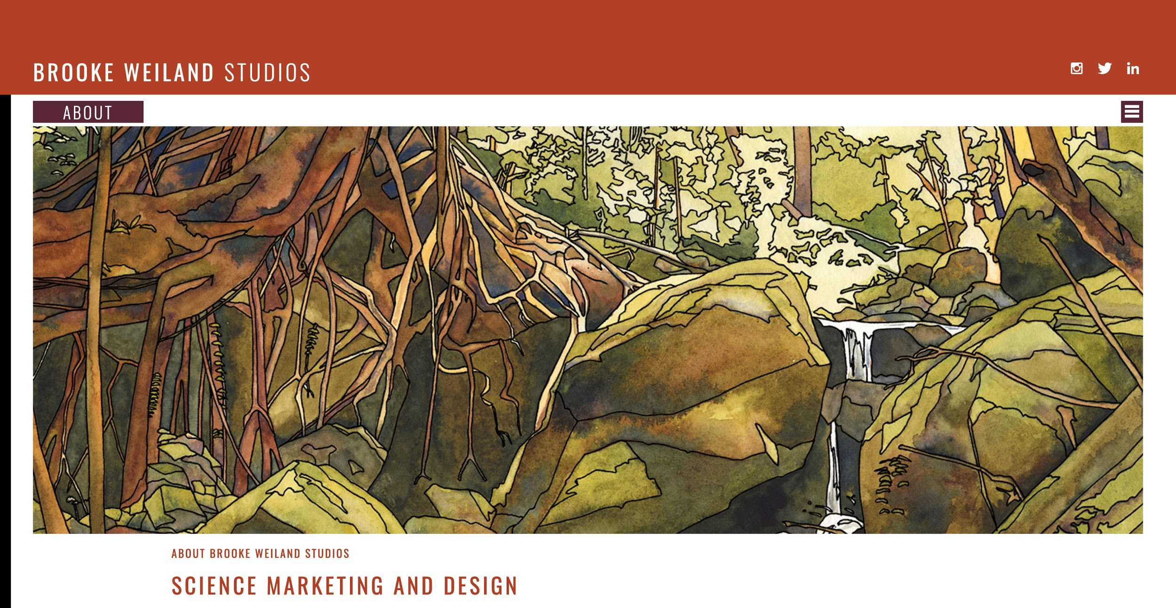
Brooke Weiland: designer
http://www.brookeweiland.com/
Notes:
Brief shout-out to our designer, Brooke Weiland:
Got her Scientific Illustration Certificate at California State University – Monterey Bay, followed by Masters in Life Sciences Communication at UW-Madison

Slide 25
Key questions
Who is your audience? Who are your stakeholders? Students, library patrons
What are you trying to communicate (topic + take-away)? Recycle intentionally
What is the behavior/attitude you’re trying to change? Wishcycling, negative social norms
What is the intended outcome of your communications? Education & engagement with initiative
What are the platforms/mediums, and why? Social media (duh), newsletter, radio (broad reach)
How will you recognize success?
Reduced contamination of waste streams

Slide 26
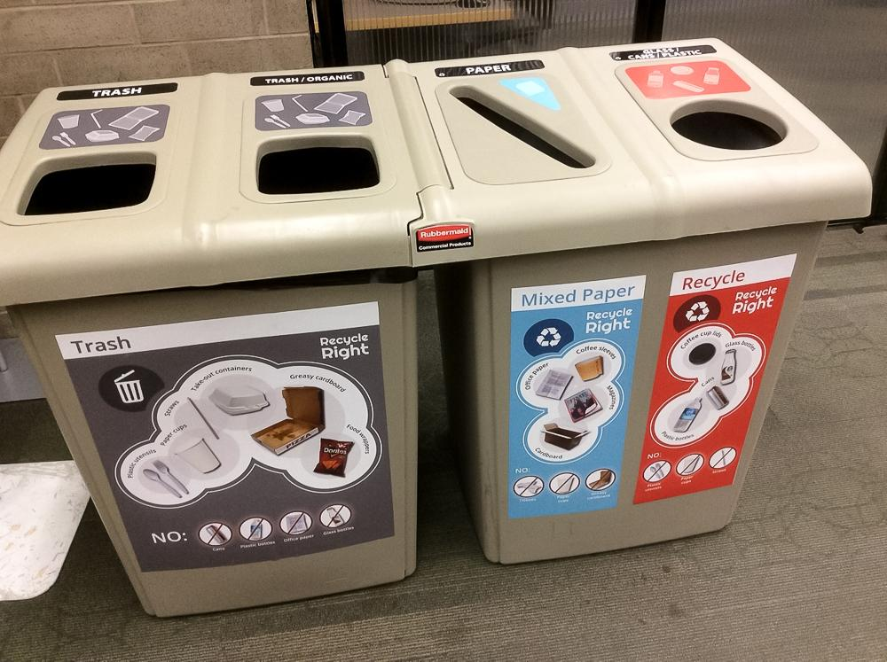
Implementing #RecycleRight
Variables: height, size, point and method of attachment
No consistent wall space behind the bin sets
Real estate on the top of the bins helps reinforce the message
Notes:
Height, size, point and method of attachment
Didn’t have consistent wallspace behind the bin sets
We made use of the real estate on the top of the bins to reinforce our message

Slide 27
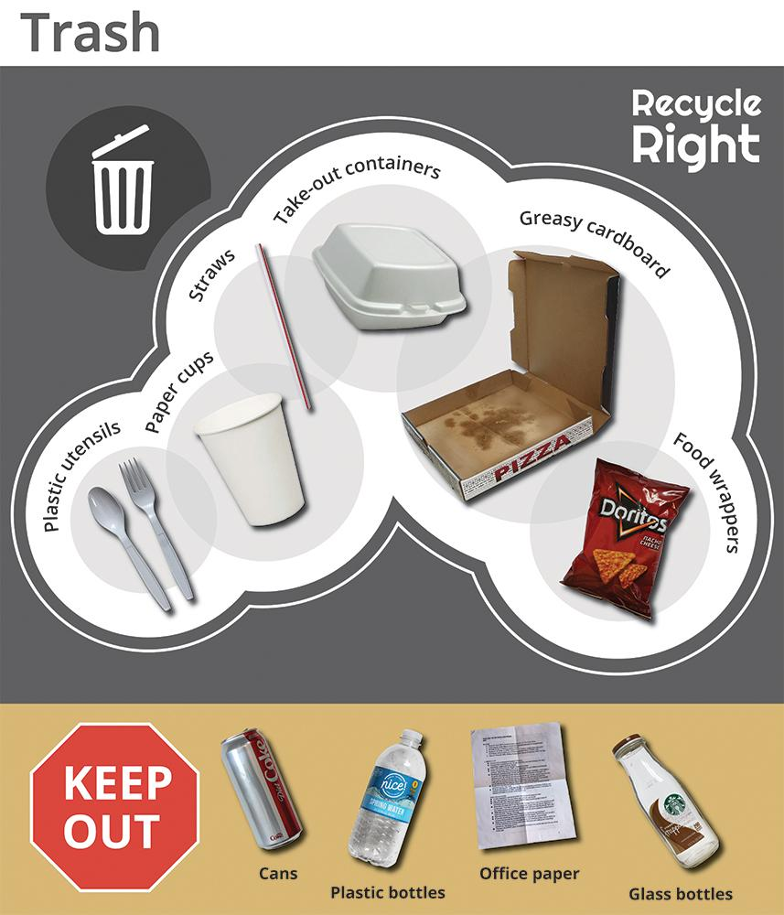
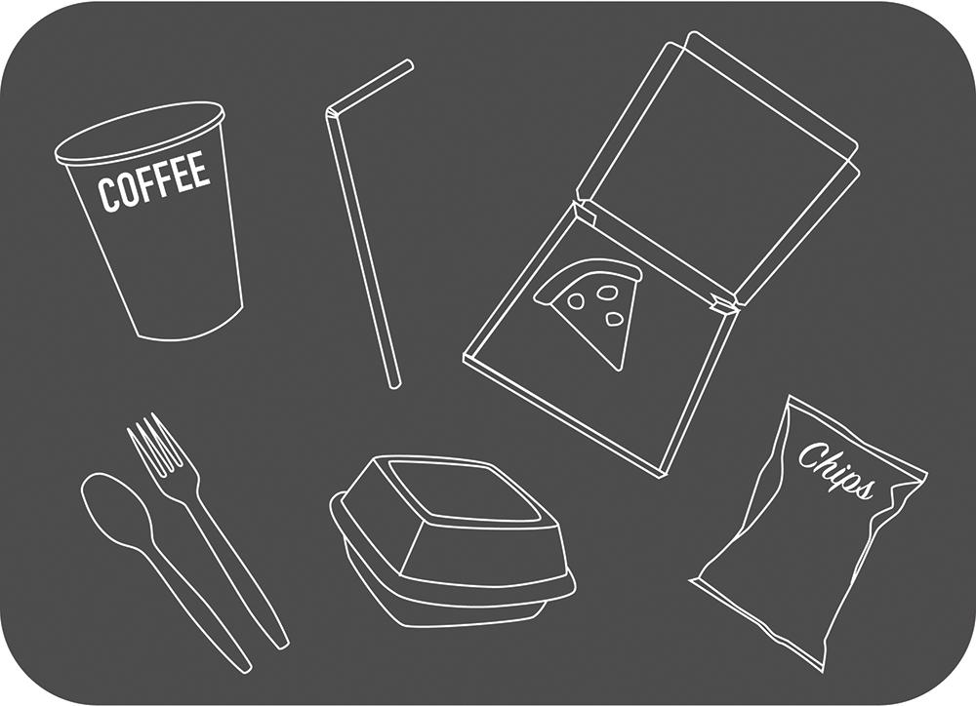
Final* design
Photos (where possible)
Associated text
Obvious “Keep Out”
Aesthetic appeal and coherence
*not at all/never final
Notes:
Strive for a balance between clarity/readability and aesthetic appeal
Use actual images of items--inspired by difficulty in distinguishing between cup and container types (plastic/paper/plastic look-alike?)
Emphasize what should be kept OUT

Slide 28
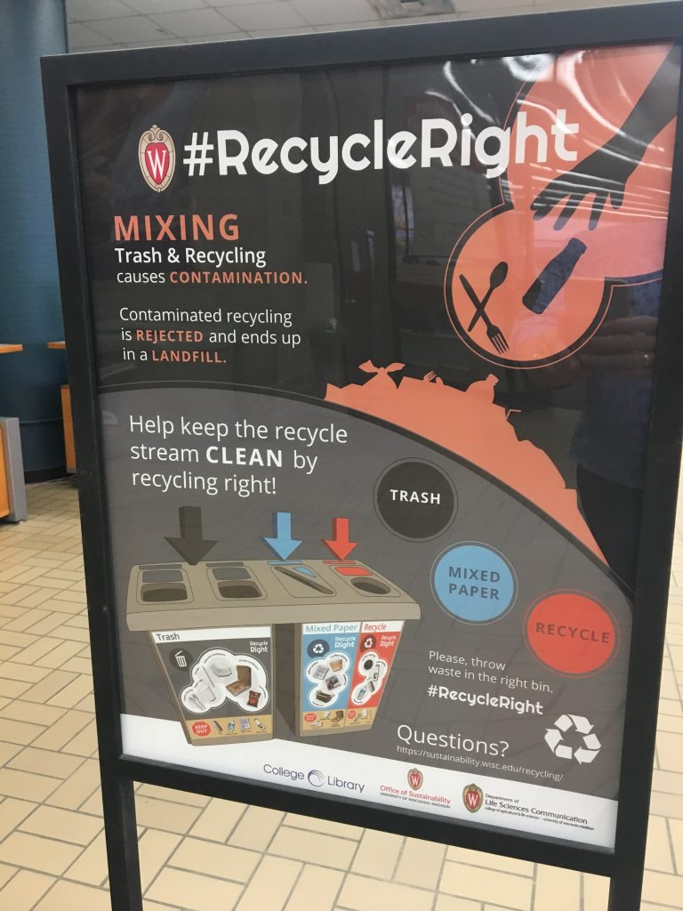
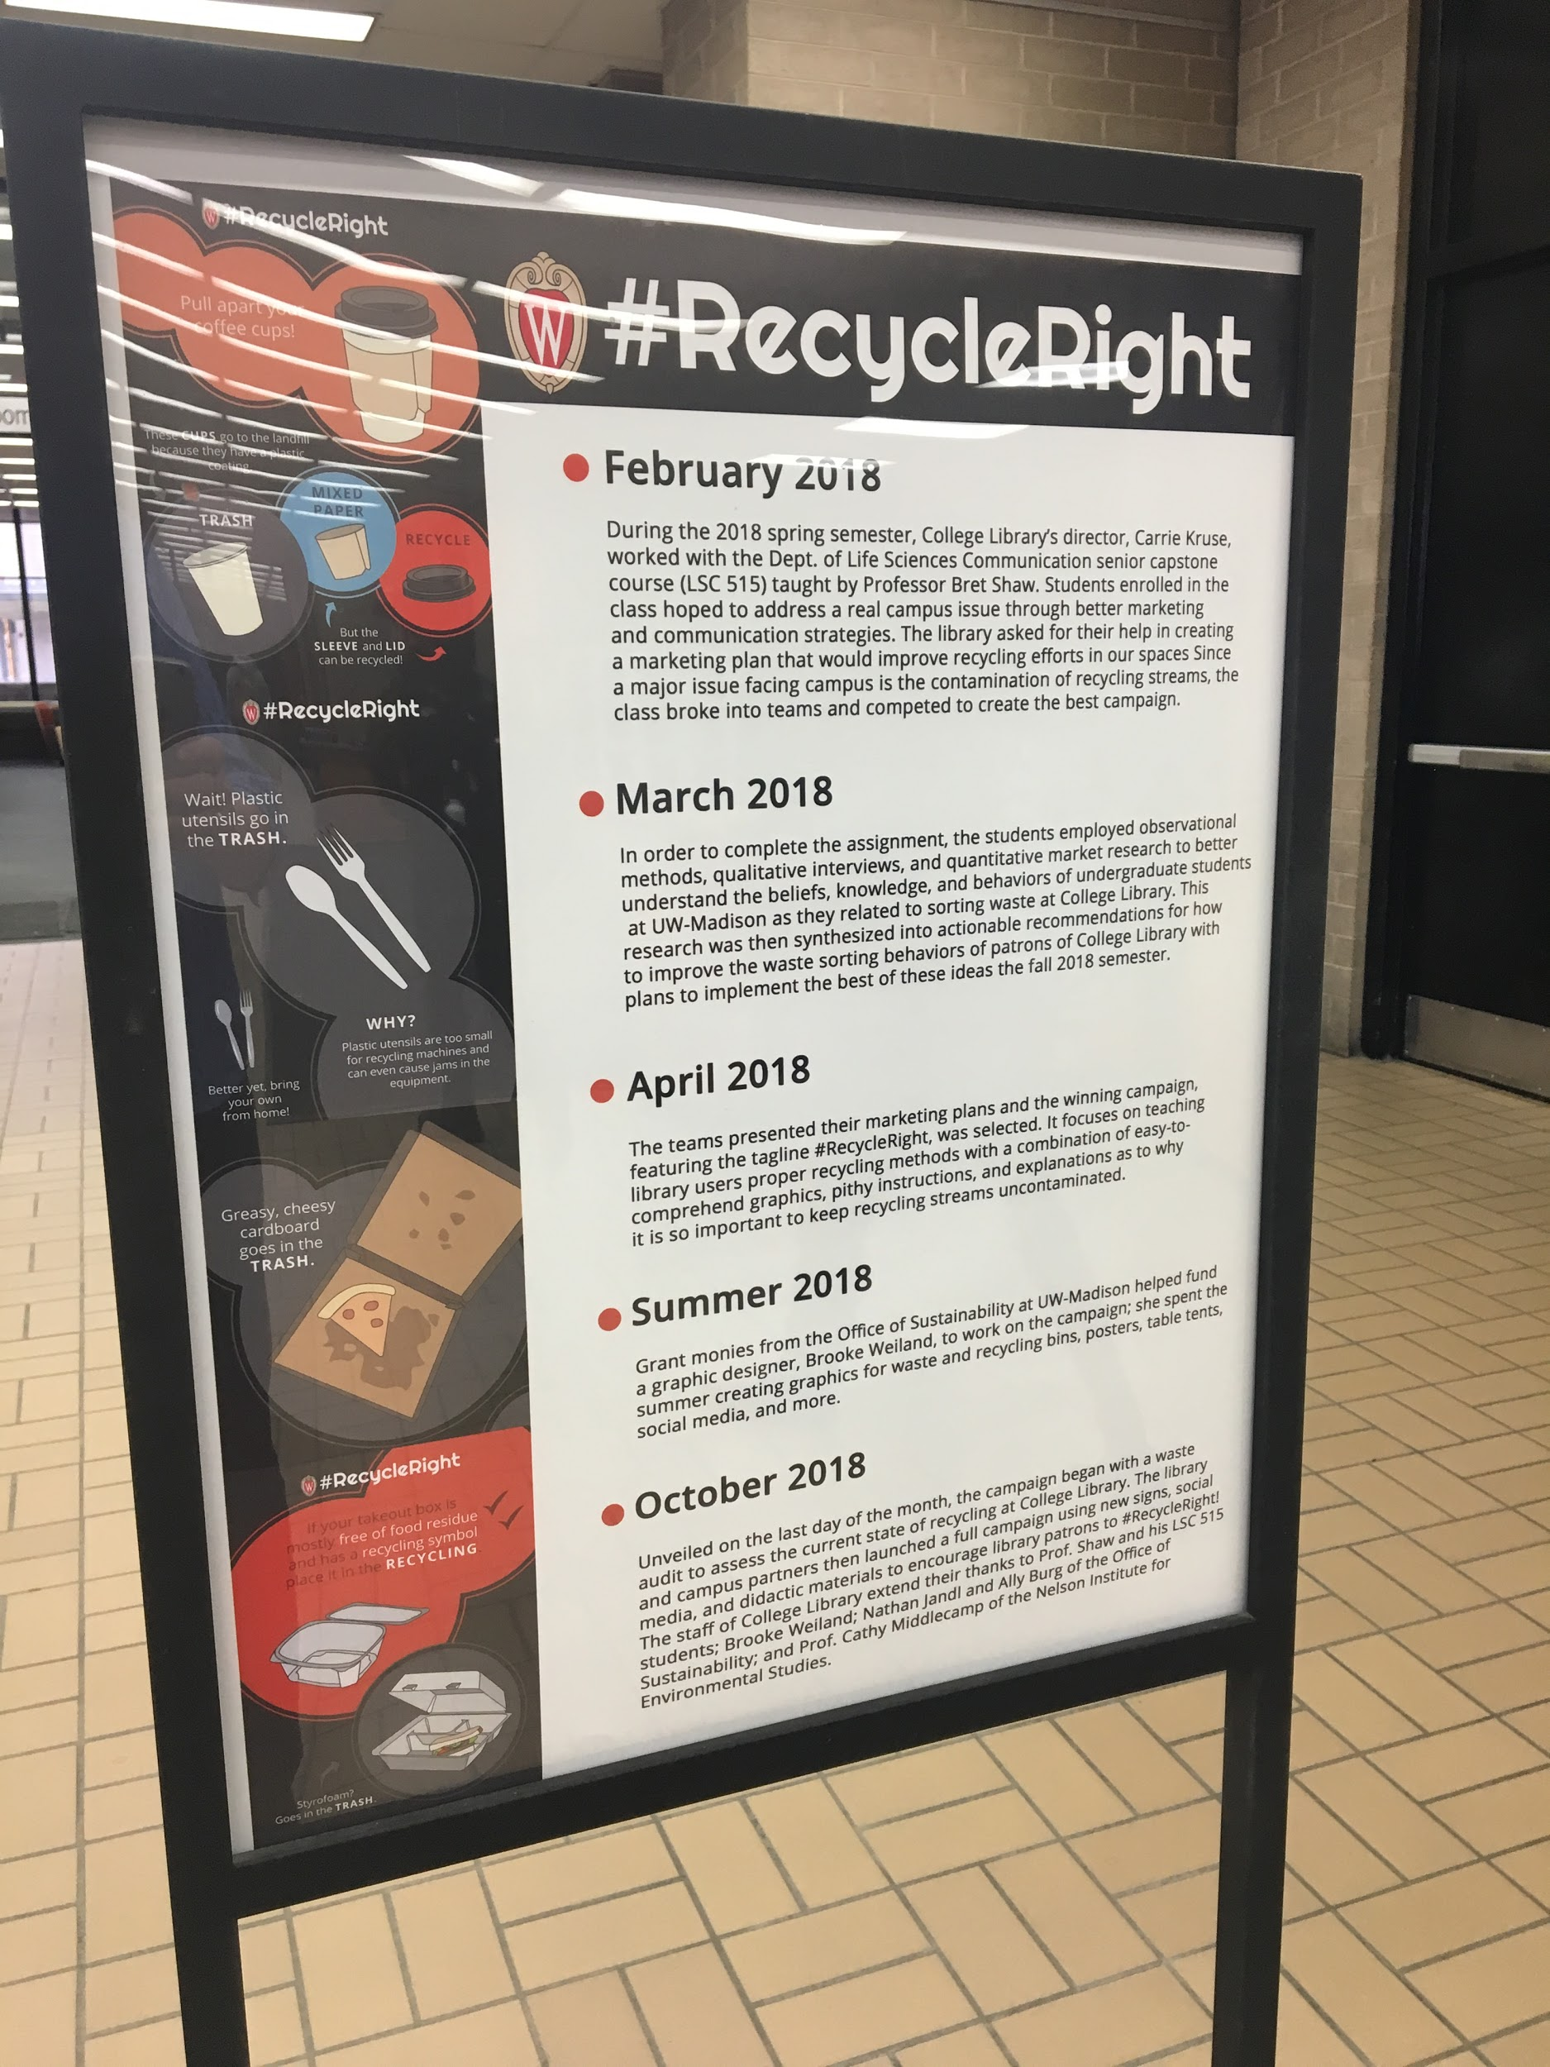
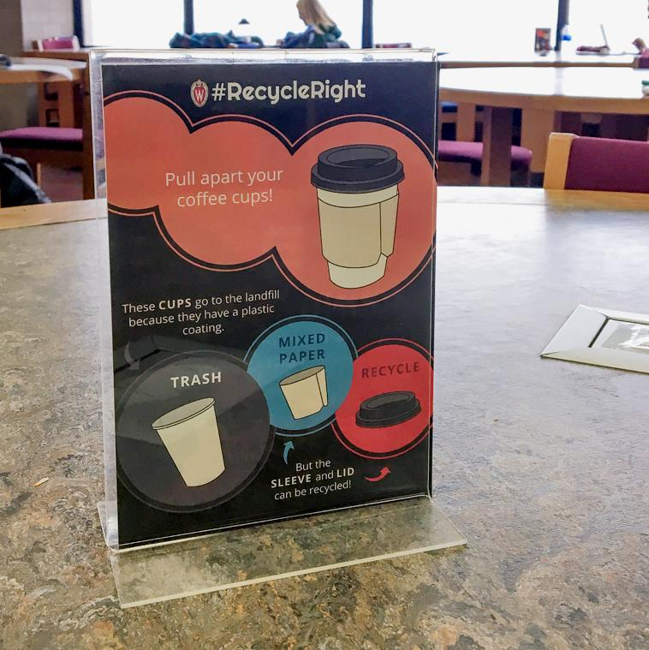
Supporting prompts and education
Campaign education
3. Project timeline & information
2. Table tents about problem items, aka “prompts”
Notes:
Supplemented the signs with posters
Table tents helped patrons understand what to do with problem items
Together these prompts helped clue patrons into the project, rather than relying on the point-of-interaction with the bin sets

Slide 29
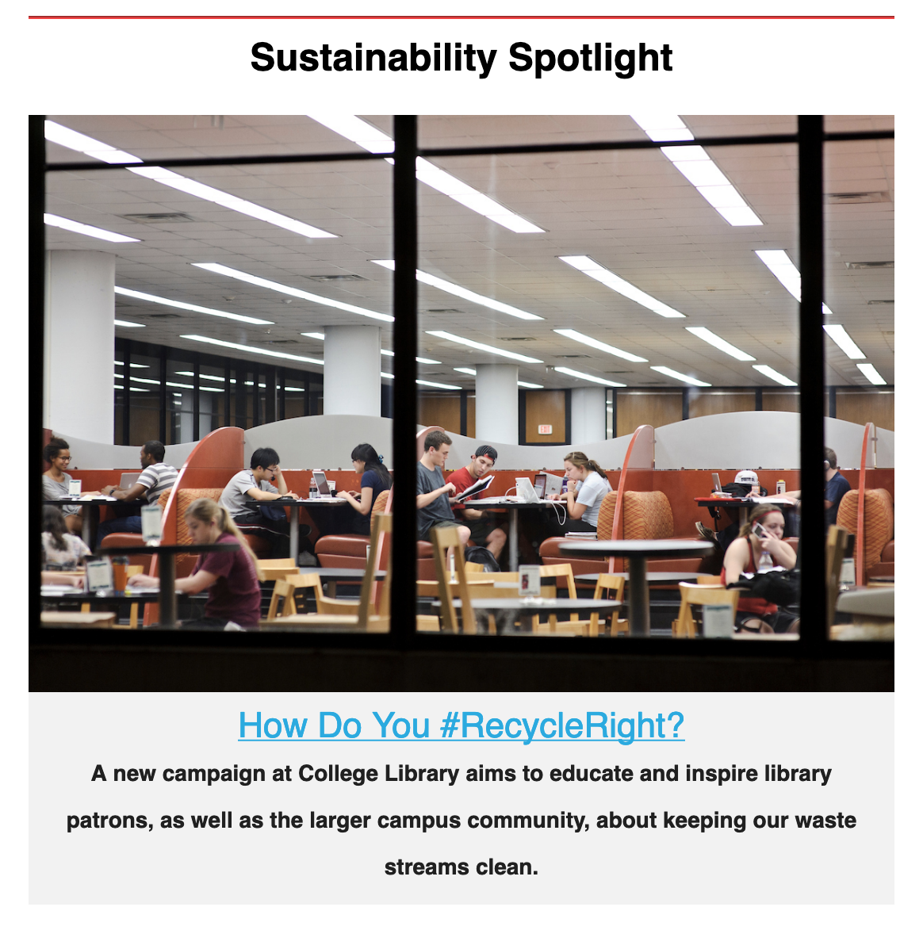
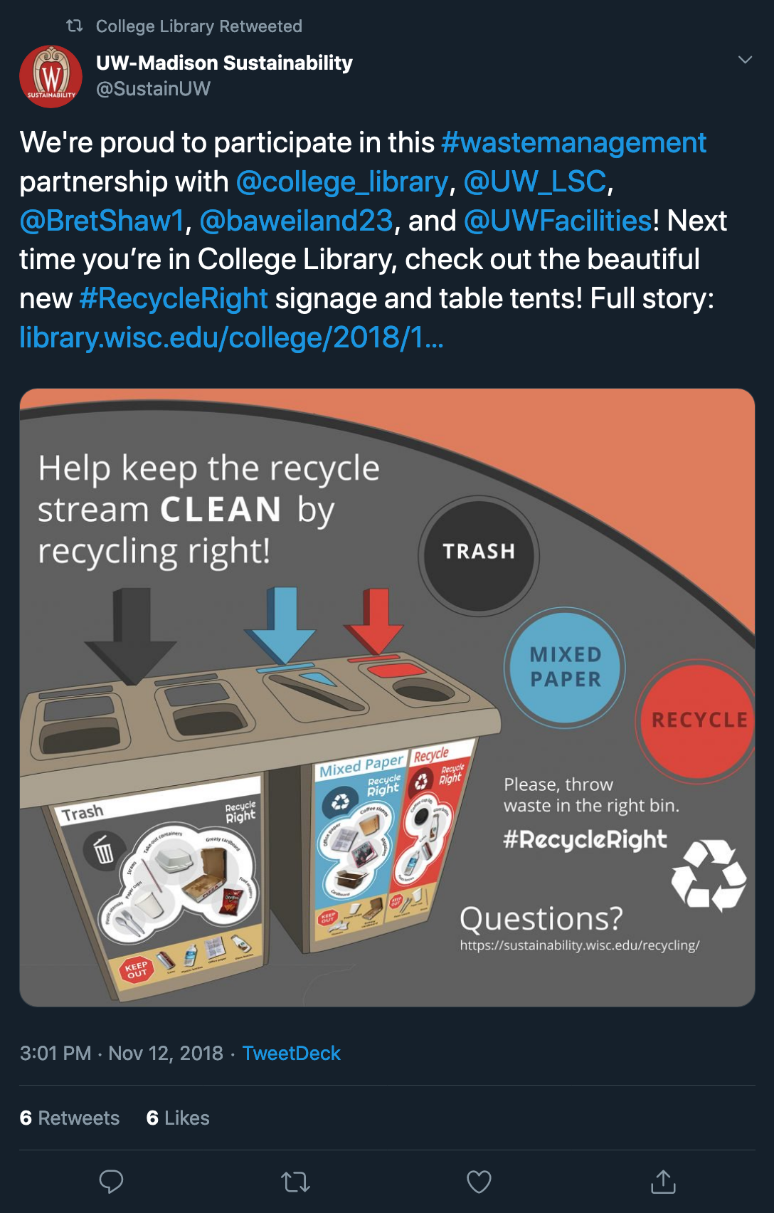
Communications campaign
Social media + newsletter +
radio feature
Notes:
Social media campaign mirrored the physical campaign by focusing on general announcement info & problem items
Newsletter articles published during and following implementation
Cross-promotion with College Library’s feeds
Sought a different audience and offered more detail with a radio interview/podcast

Slide 30
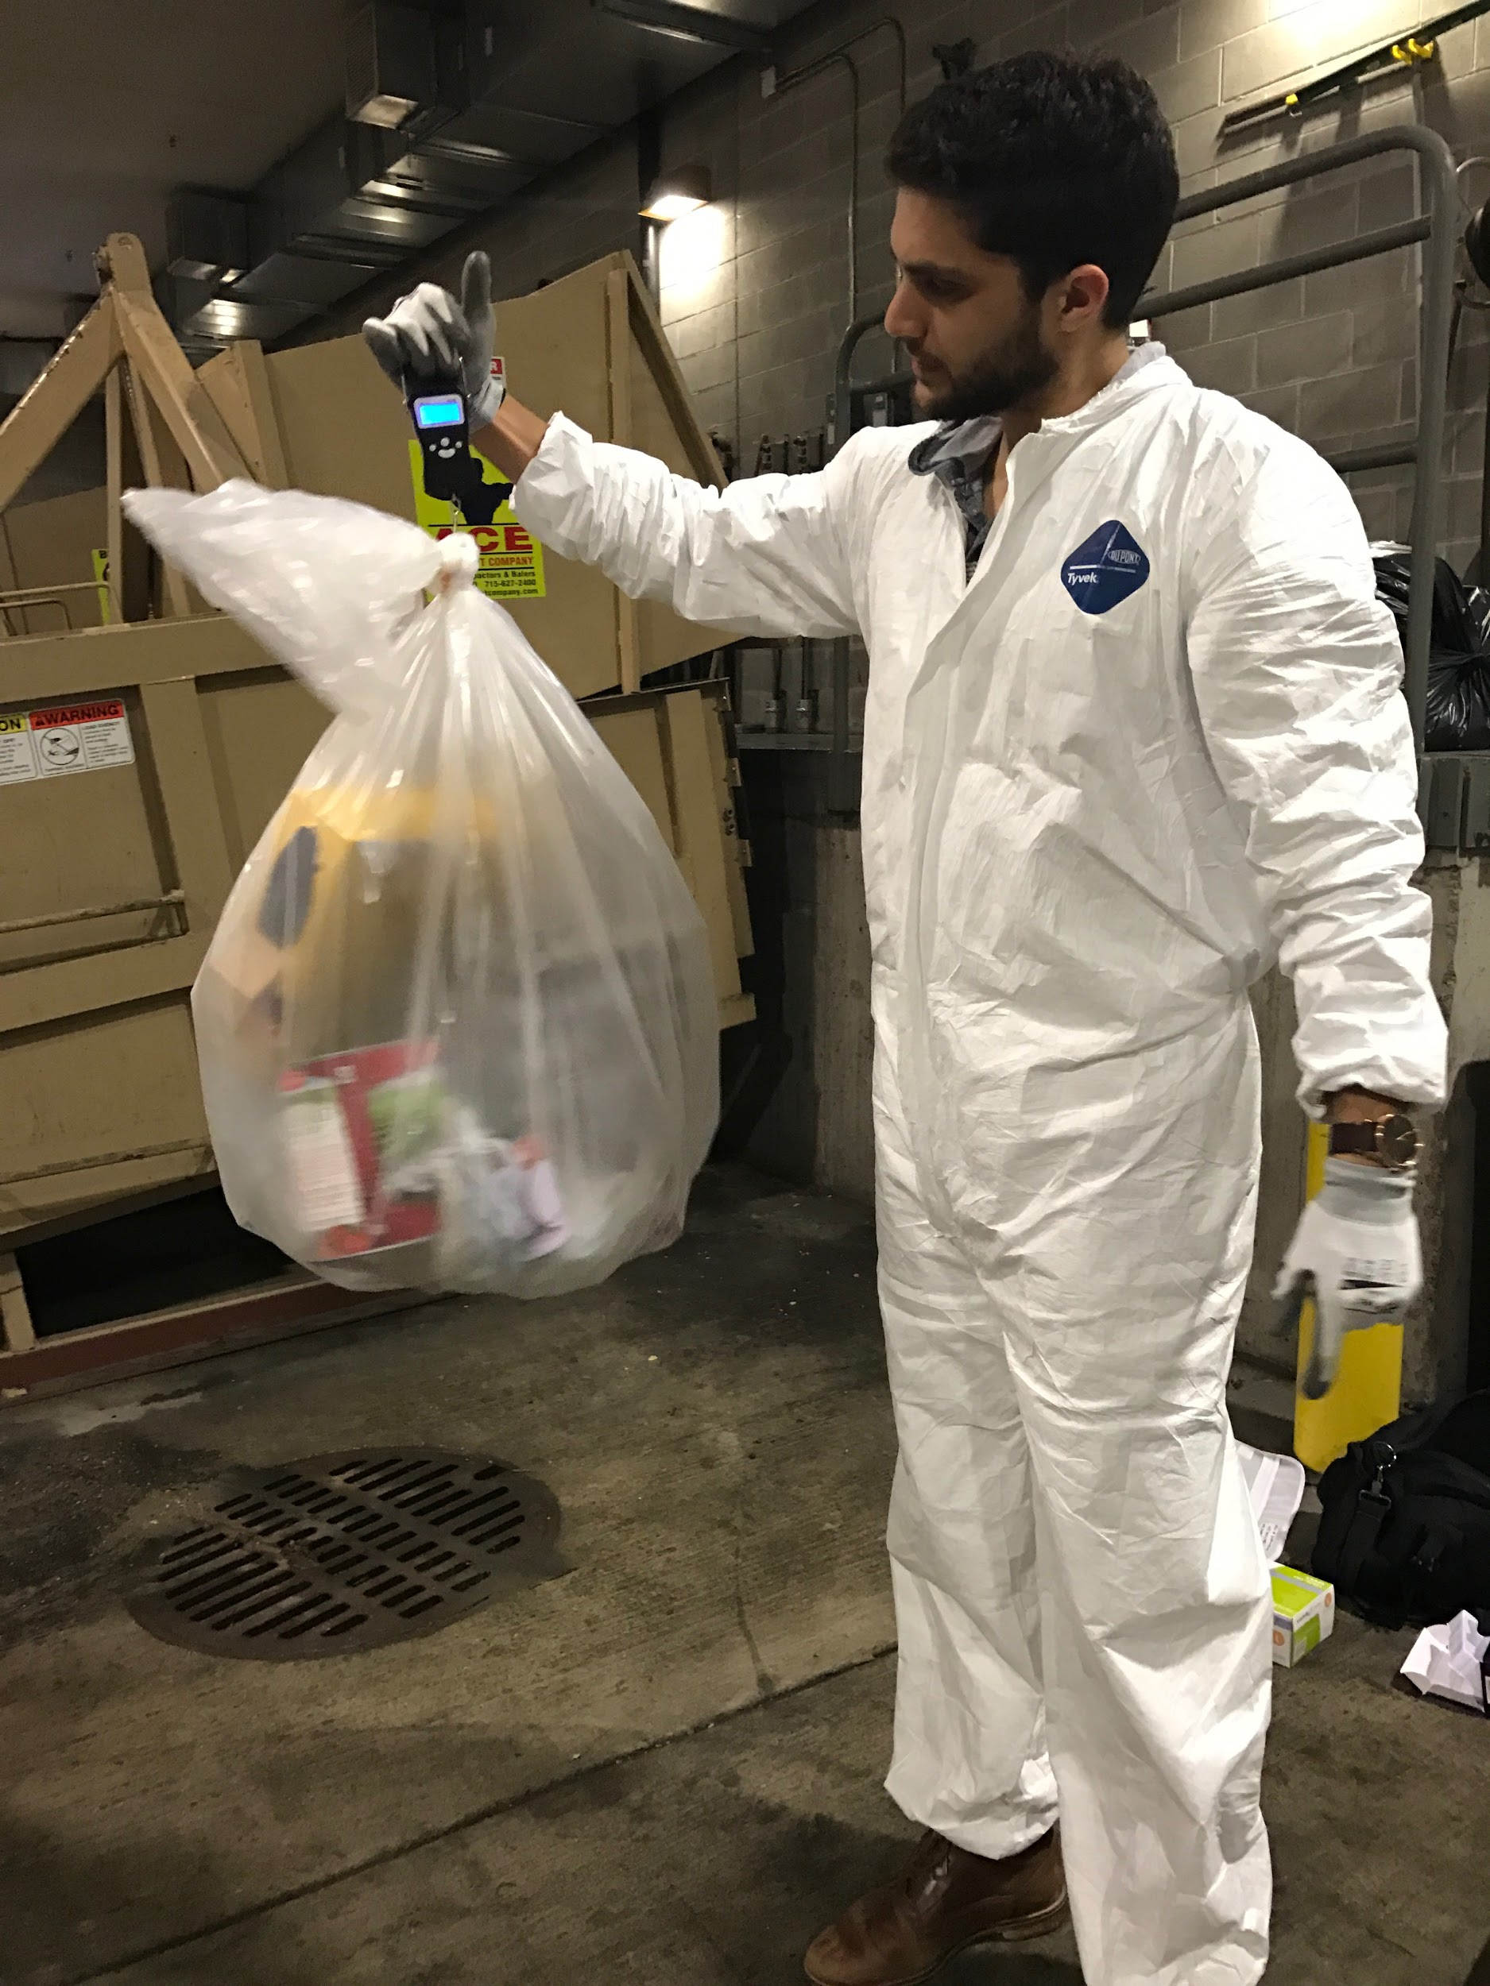
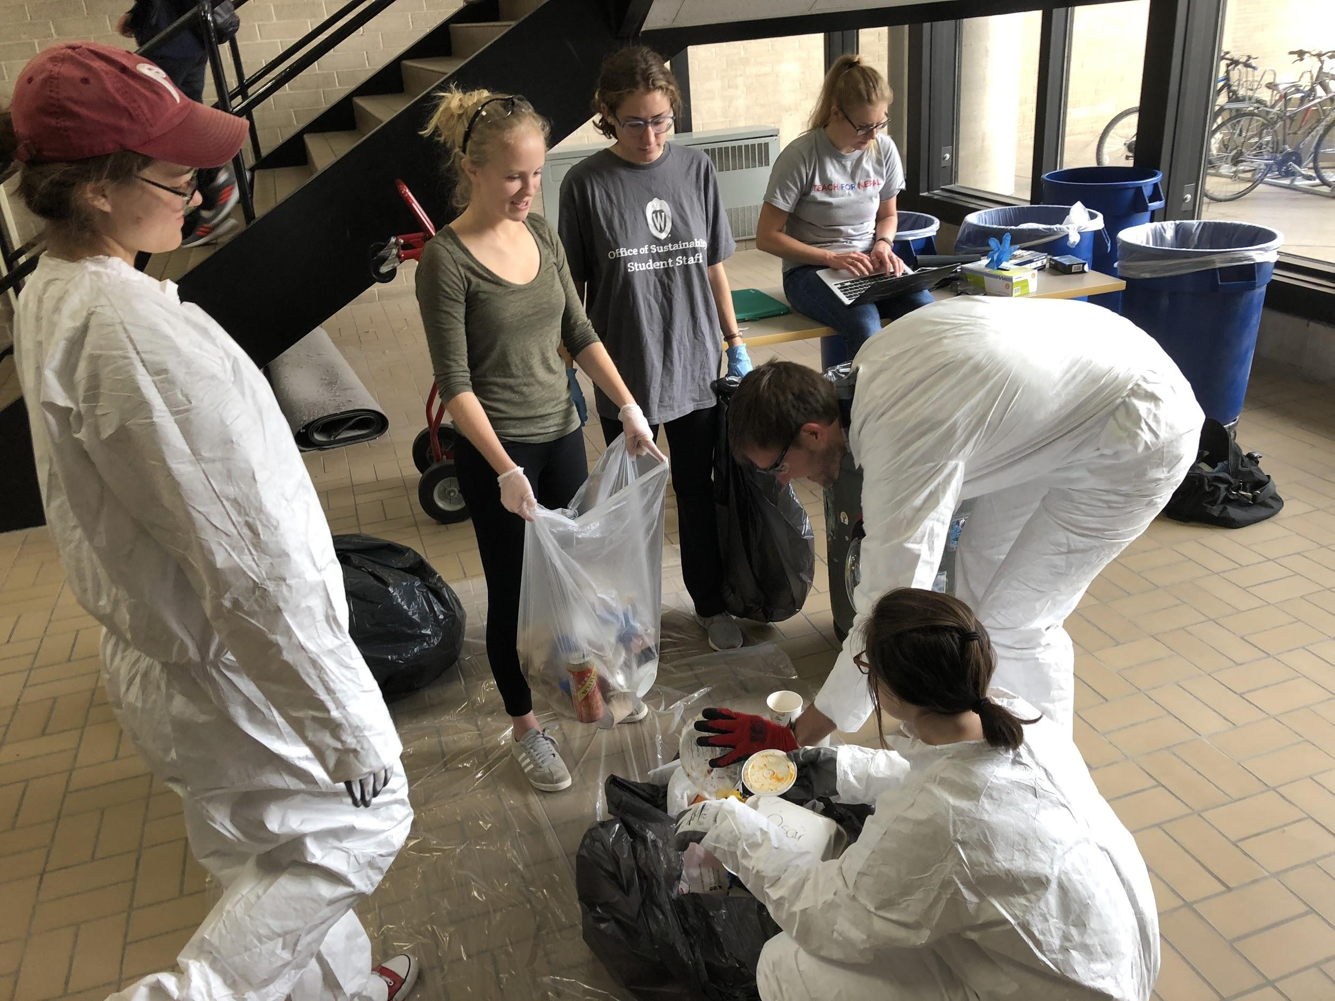
Trash Audits
2 audits were completed before and after the campaign
Notes:
Audits were done before and after implementation. Our office does trash audits by weight - so we take bags of trash and recycling, sort out the contamination and weigh it, and analyze the results.
Initial trash audit was helpful in identifying key contaminants in the streams
Reinforced survey data from the students
We asked custodial staff to set aside bags for us to audit from multiple levels of the building
Sorted the materials, weighed different streams (not by item), analyzed data

Slide 31
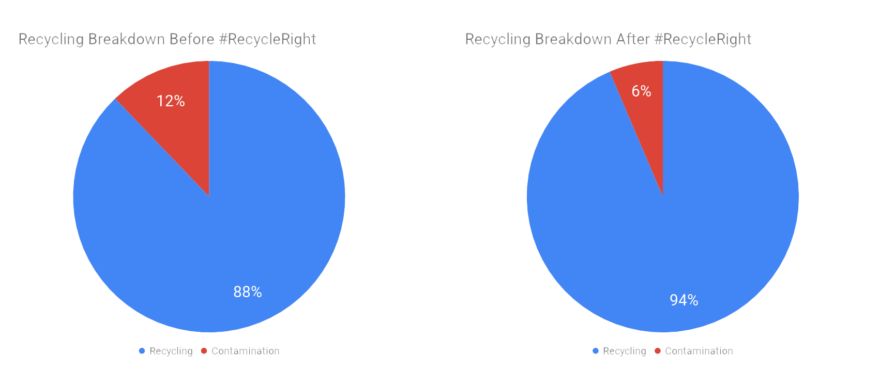
Results
50% weight reduction in recycling contamination
Contaminants are often lightweight items
12% by weight: doesn’t reflect volume
Notes:
Reflect on the fact that it’s a 50% weight reduction (12%->6%)
Contaminants are often light-weight items
Underscores how visual that 12% of contamination really is (the pictures from before)
12% doesn’t look like a lot of contamination, but the weight doesn’t reflect the volume in a sense that
6% contamination is a great improvement, but it doesn’t meet the community recycling standards

Slide 32
Our takeaways
Social marketing techniques and user-centered design (colors, images, etc.) are effective
Students are experts on themselves: use them!
Campus relationships are key
Pilot test materials before launch
Notes:
From a research standpoint, who knows better about students than students??

Slide 33
#cupsaretrash
Colgate University
Notes:
5-7 minutes

Slide 34
Background
In the Spring of 2019 Madison County, NY changed its recycling guidelines
Before: All plastics 1-7, very inclusive
After: Who is to say really??
The Cup Catastrophe of 2019

Slide 36
What the heck do you mean by a neck?

Slide 37
But wait… it still has a little triangle!!

Slide 38
But what about paper cups?

Slide 39
Big changes + Vague guidelines
= Contamination
The Cup Catastrophe of 2019

Slide 40
Big changes + Vague guidelines
= Contamination
The Cup Catastrophe of 2019
YIKES!
Notes:
Cups were one of our biggest sources of contamination so we decided to focus on them first. We figured, rather than focusing on EVERYTHING, let’s start with this

Slide 41
So here is what we did:
Who is your audience? Who are your stakeholders?
Primary audience: Students; Campus and County stakeholders.
What are you trying to communicate (topic + take-away)? Don’t contaminate the recycling. Cups are not recyclable.
What is the behavior/attitude you’re trying to change?
Put cups in the trash.
What is the intended outcome of your communications? Reduced recycling contamination
What are the platforms/mediums, and why? Peer-to-peer, social media, signage, stickers (almost).
How will you recognize success?
Survey to gauge awareness.
Notes:
Staff and faculty were a secondary audience - engaged through our employee educators program.
Custodial staff was a stakeholder
Survey was the most practical for us - we don’t do the best job of keeping track of recycling metrics because of turnover in B&G - didn’t have the work pewer to do waste audits either

Slide 42
Tactics
Peer-to-peer
Developed a short and easy-to-remember tagline #cupsaretrash
Told student leaders that cups are trash and explained why during orientation. Told them to act as ambassadors and share with constituents. (Outdoor education leaders, orientation leaders, RAs, etc.)
Told sustainability interns and volunteers and created a #cupsaretrash student taskforce
Media:
Signage
Social Media
Stickers/ Graphics
Notes:
HIghlighted the why with peer-to-peer / my presentations so that they could communicate this to their peers
Kahoot quizzes during trainings

Slide 43
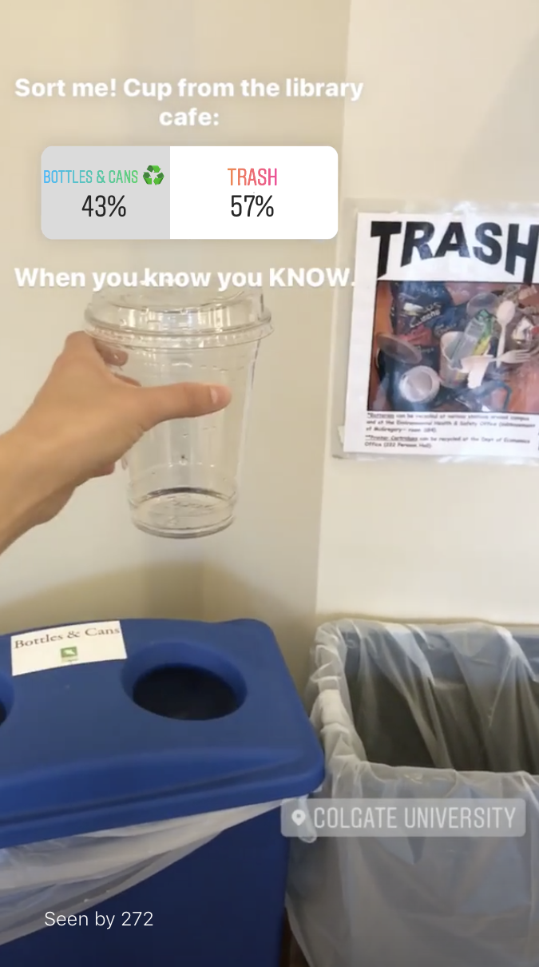
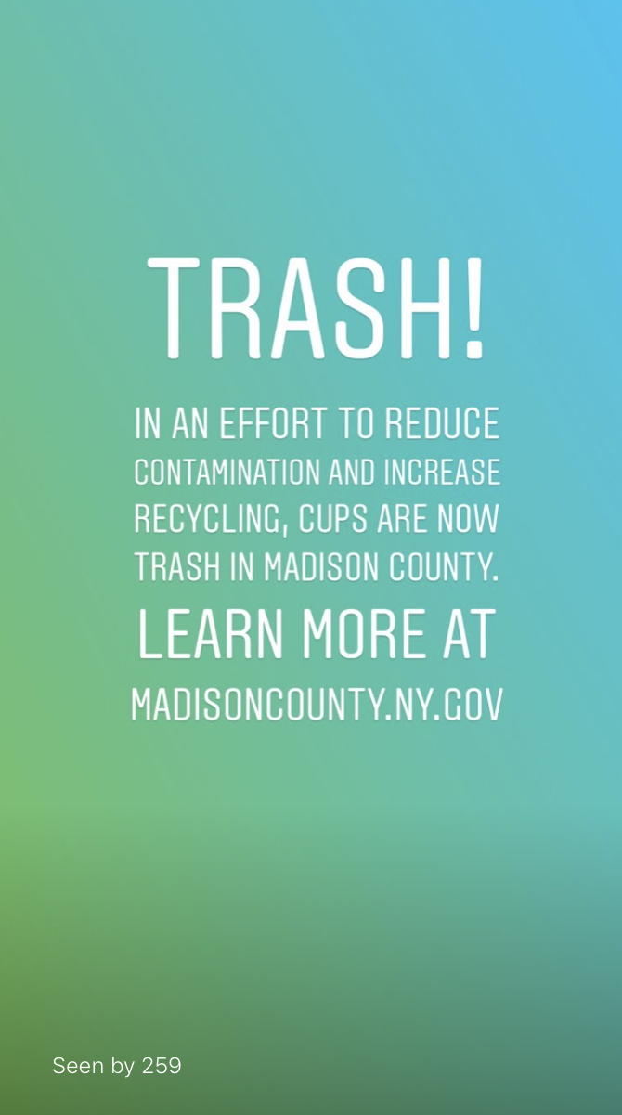

Slide 44
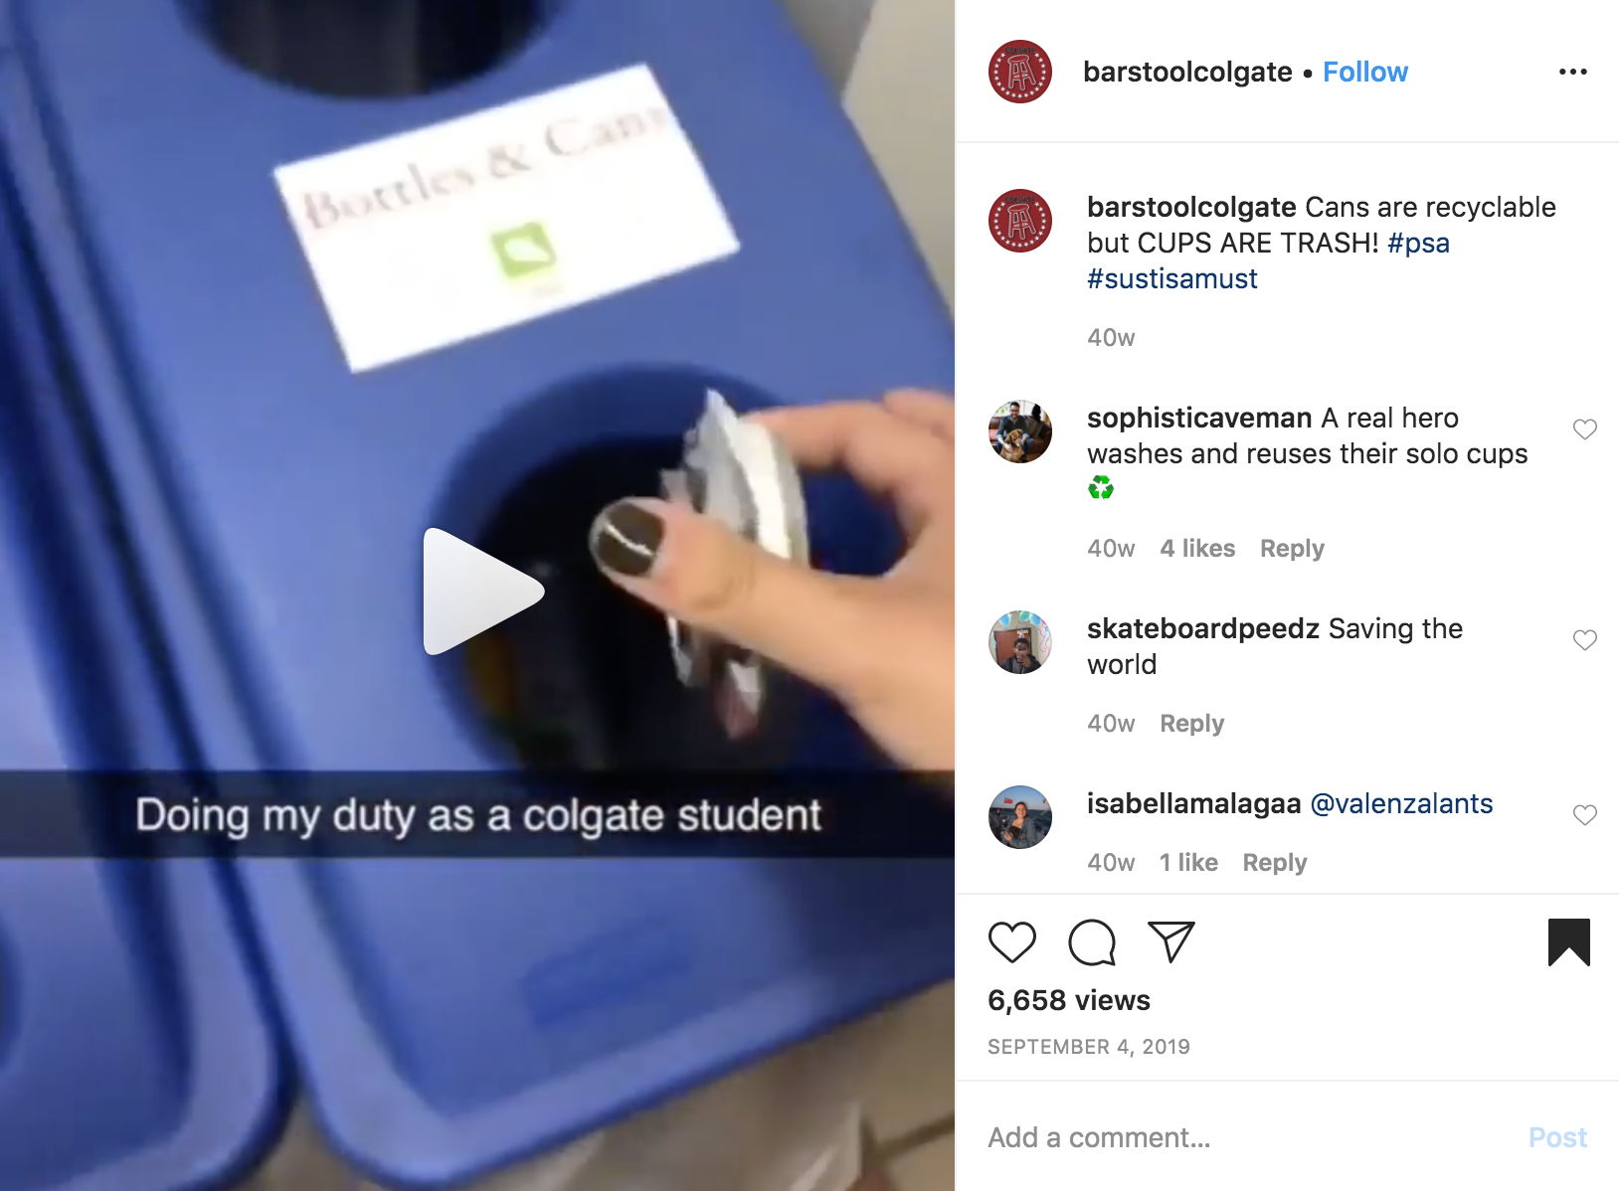

Slide 45
Notes:
We did NOT POST THIS - our office had nothing to do with this, but this was kind of an important moment for us -this is when we knew we made it. This was the result of peer-to-peer and a few social media posts. This helped us to expand our reach

Slide 46
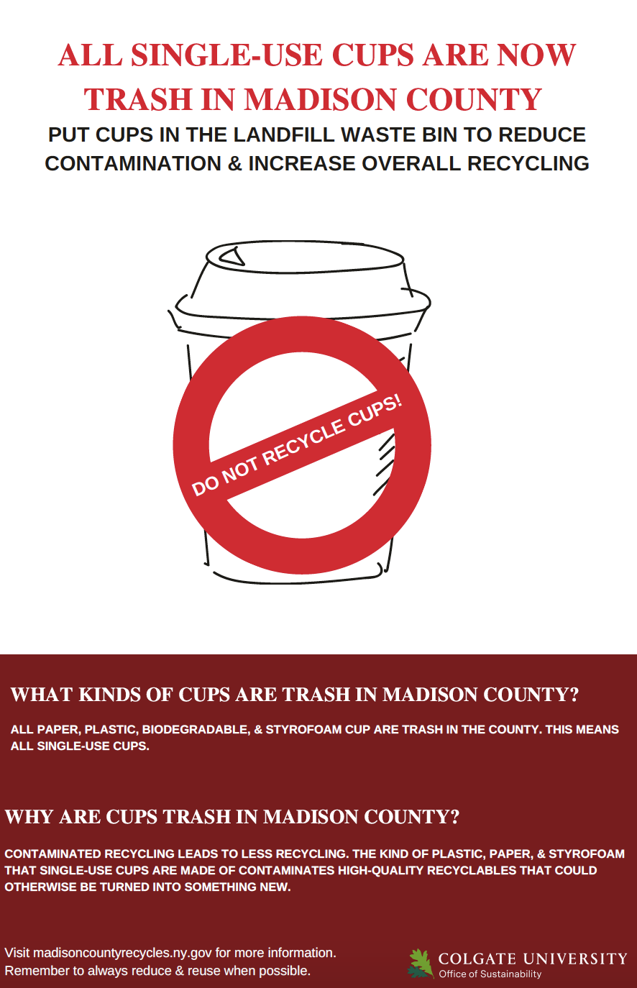
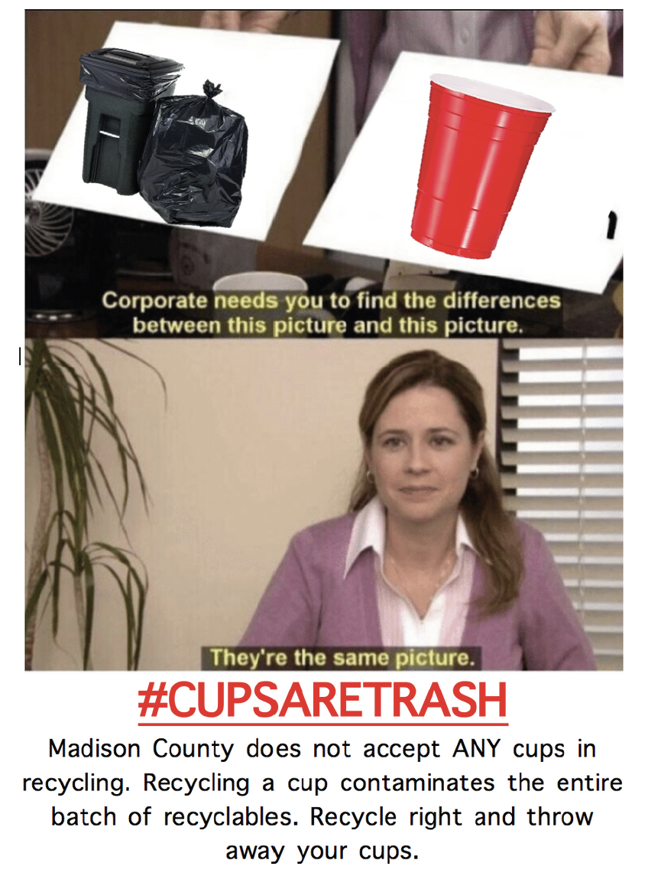

Slide 47
Credit: Katriel Pritts, the real MVP
www.katrielpritts.com
Notes:
Engaged Madison County Recycling coordinator - Important to encourage dialogue - ask me why

Slide 48
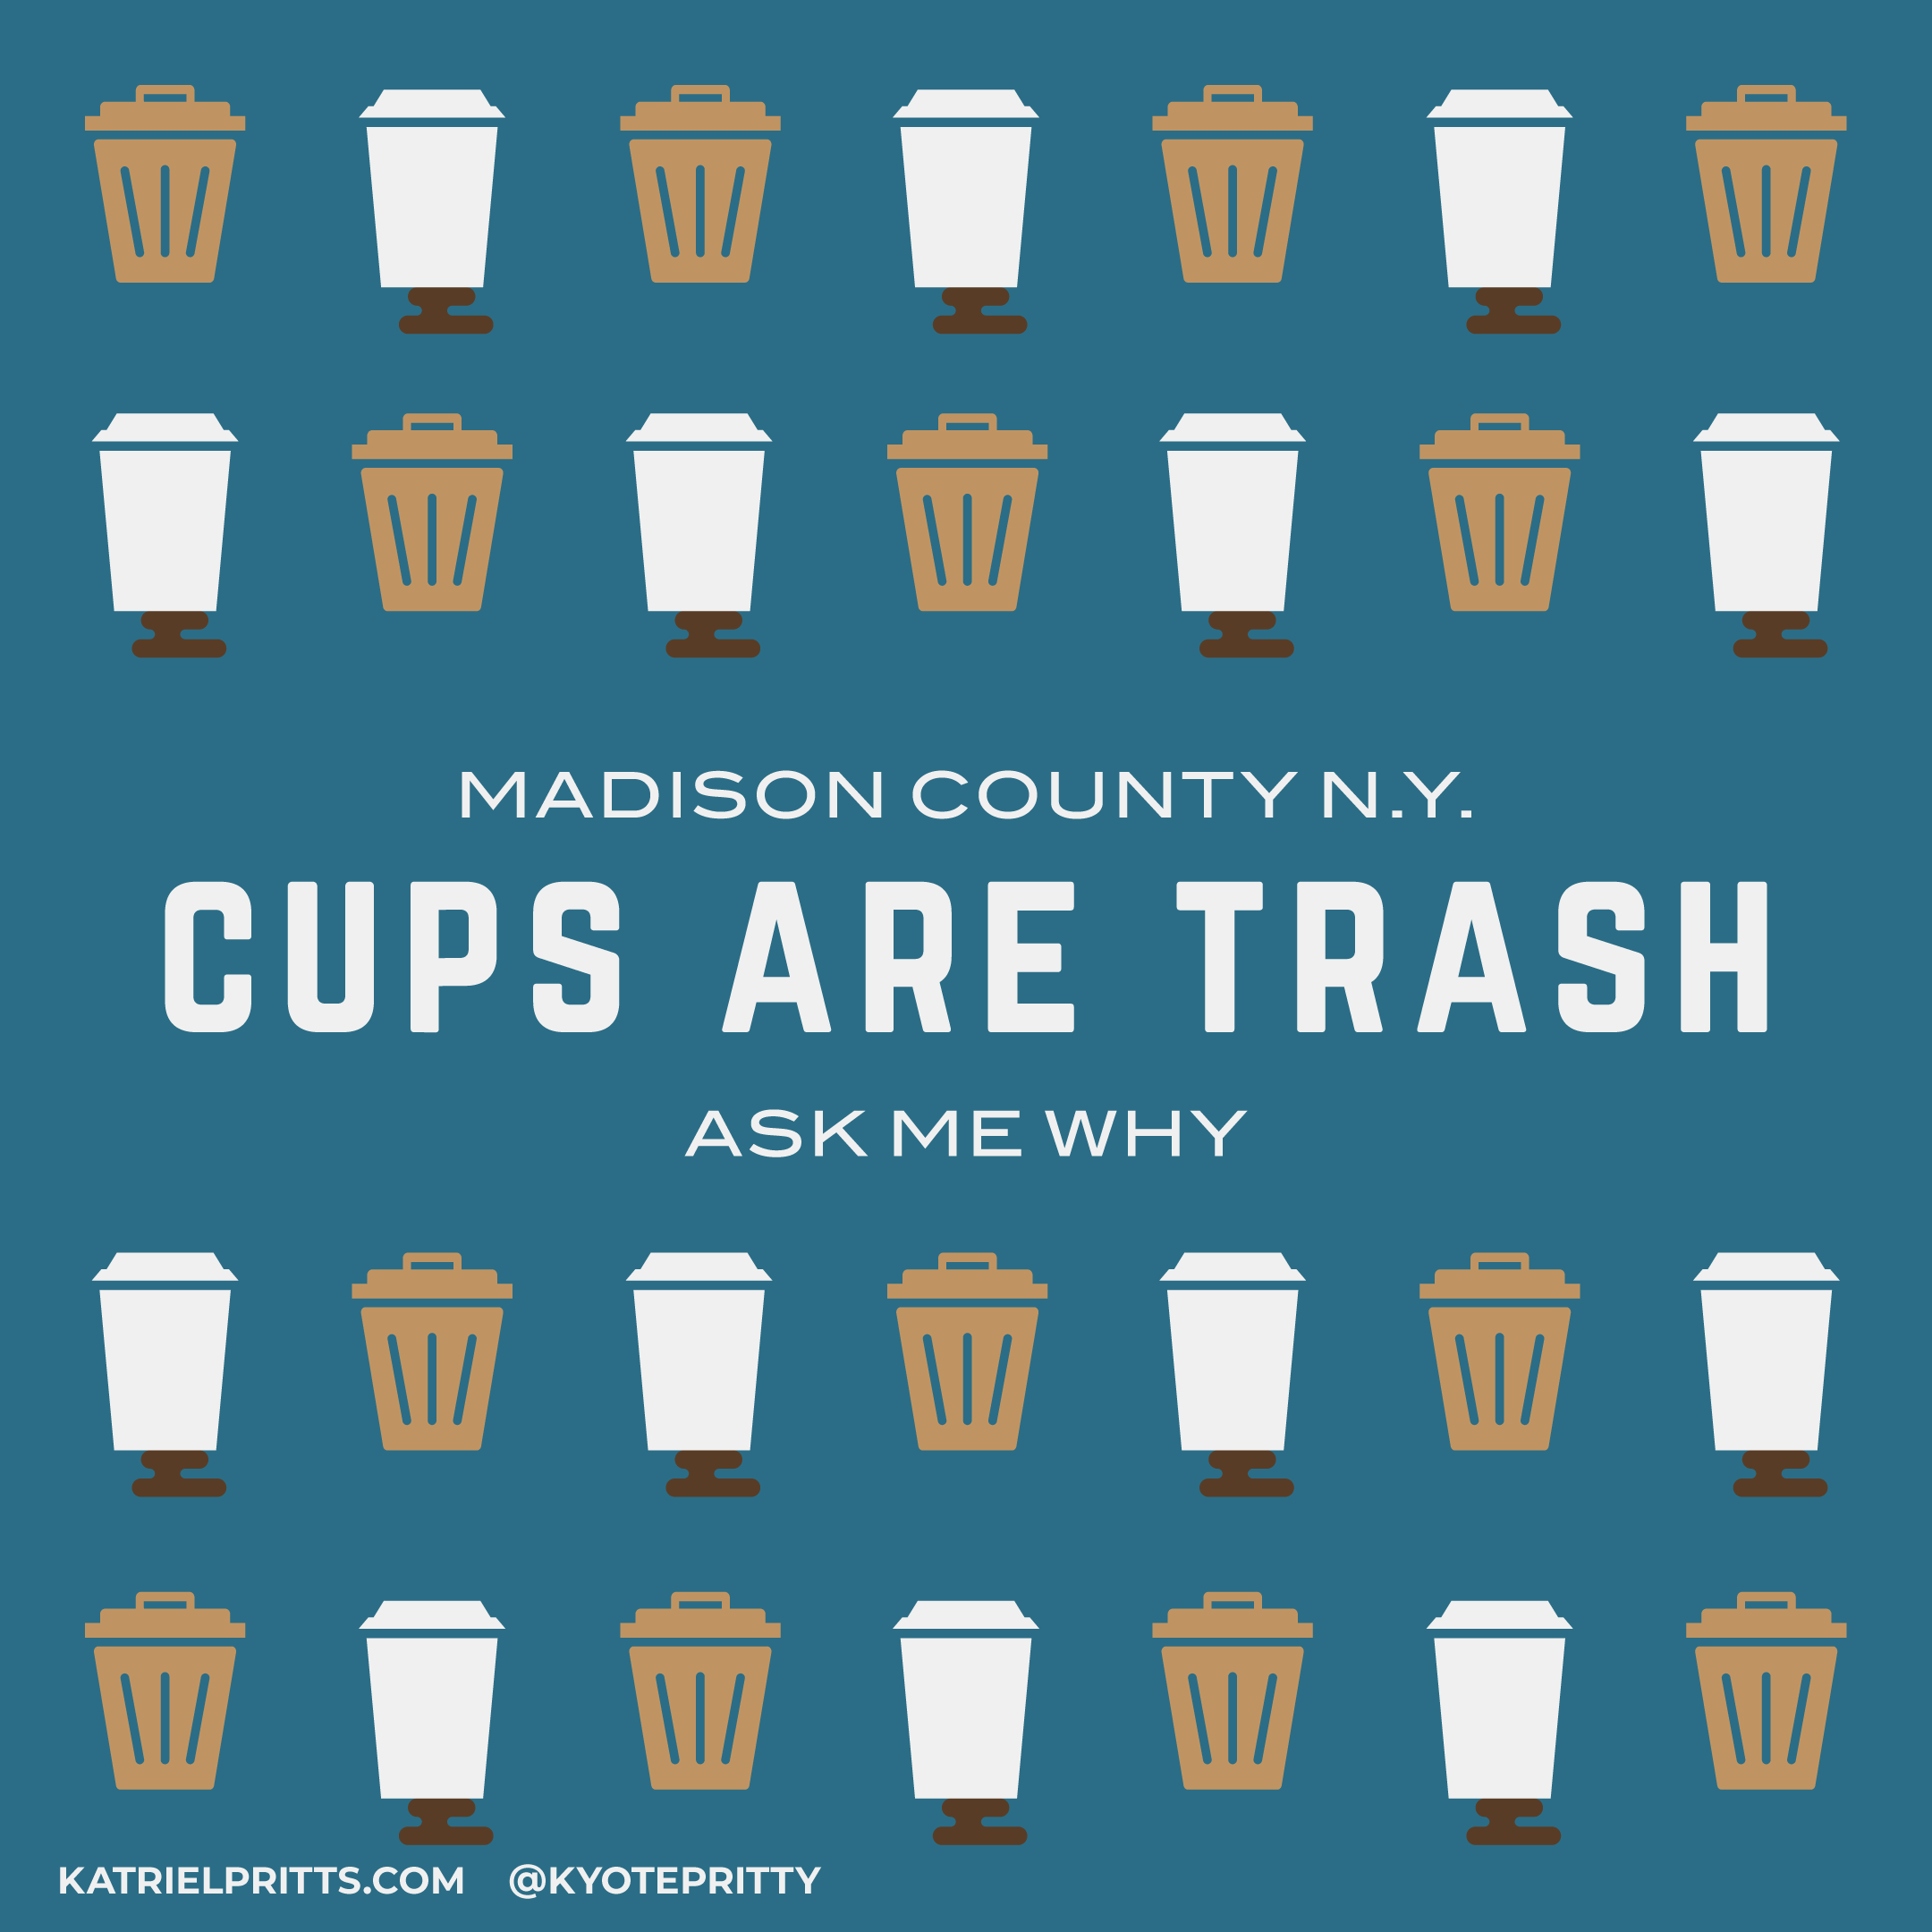
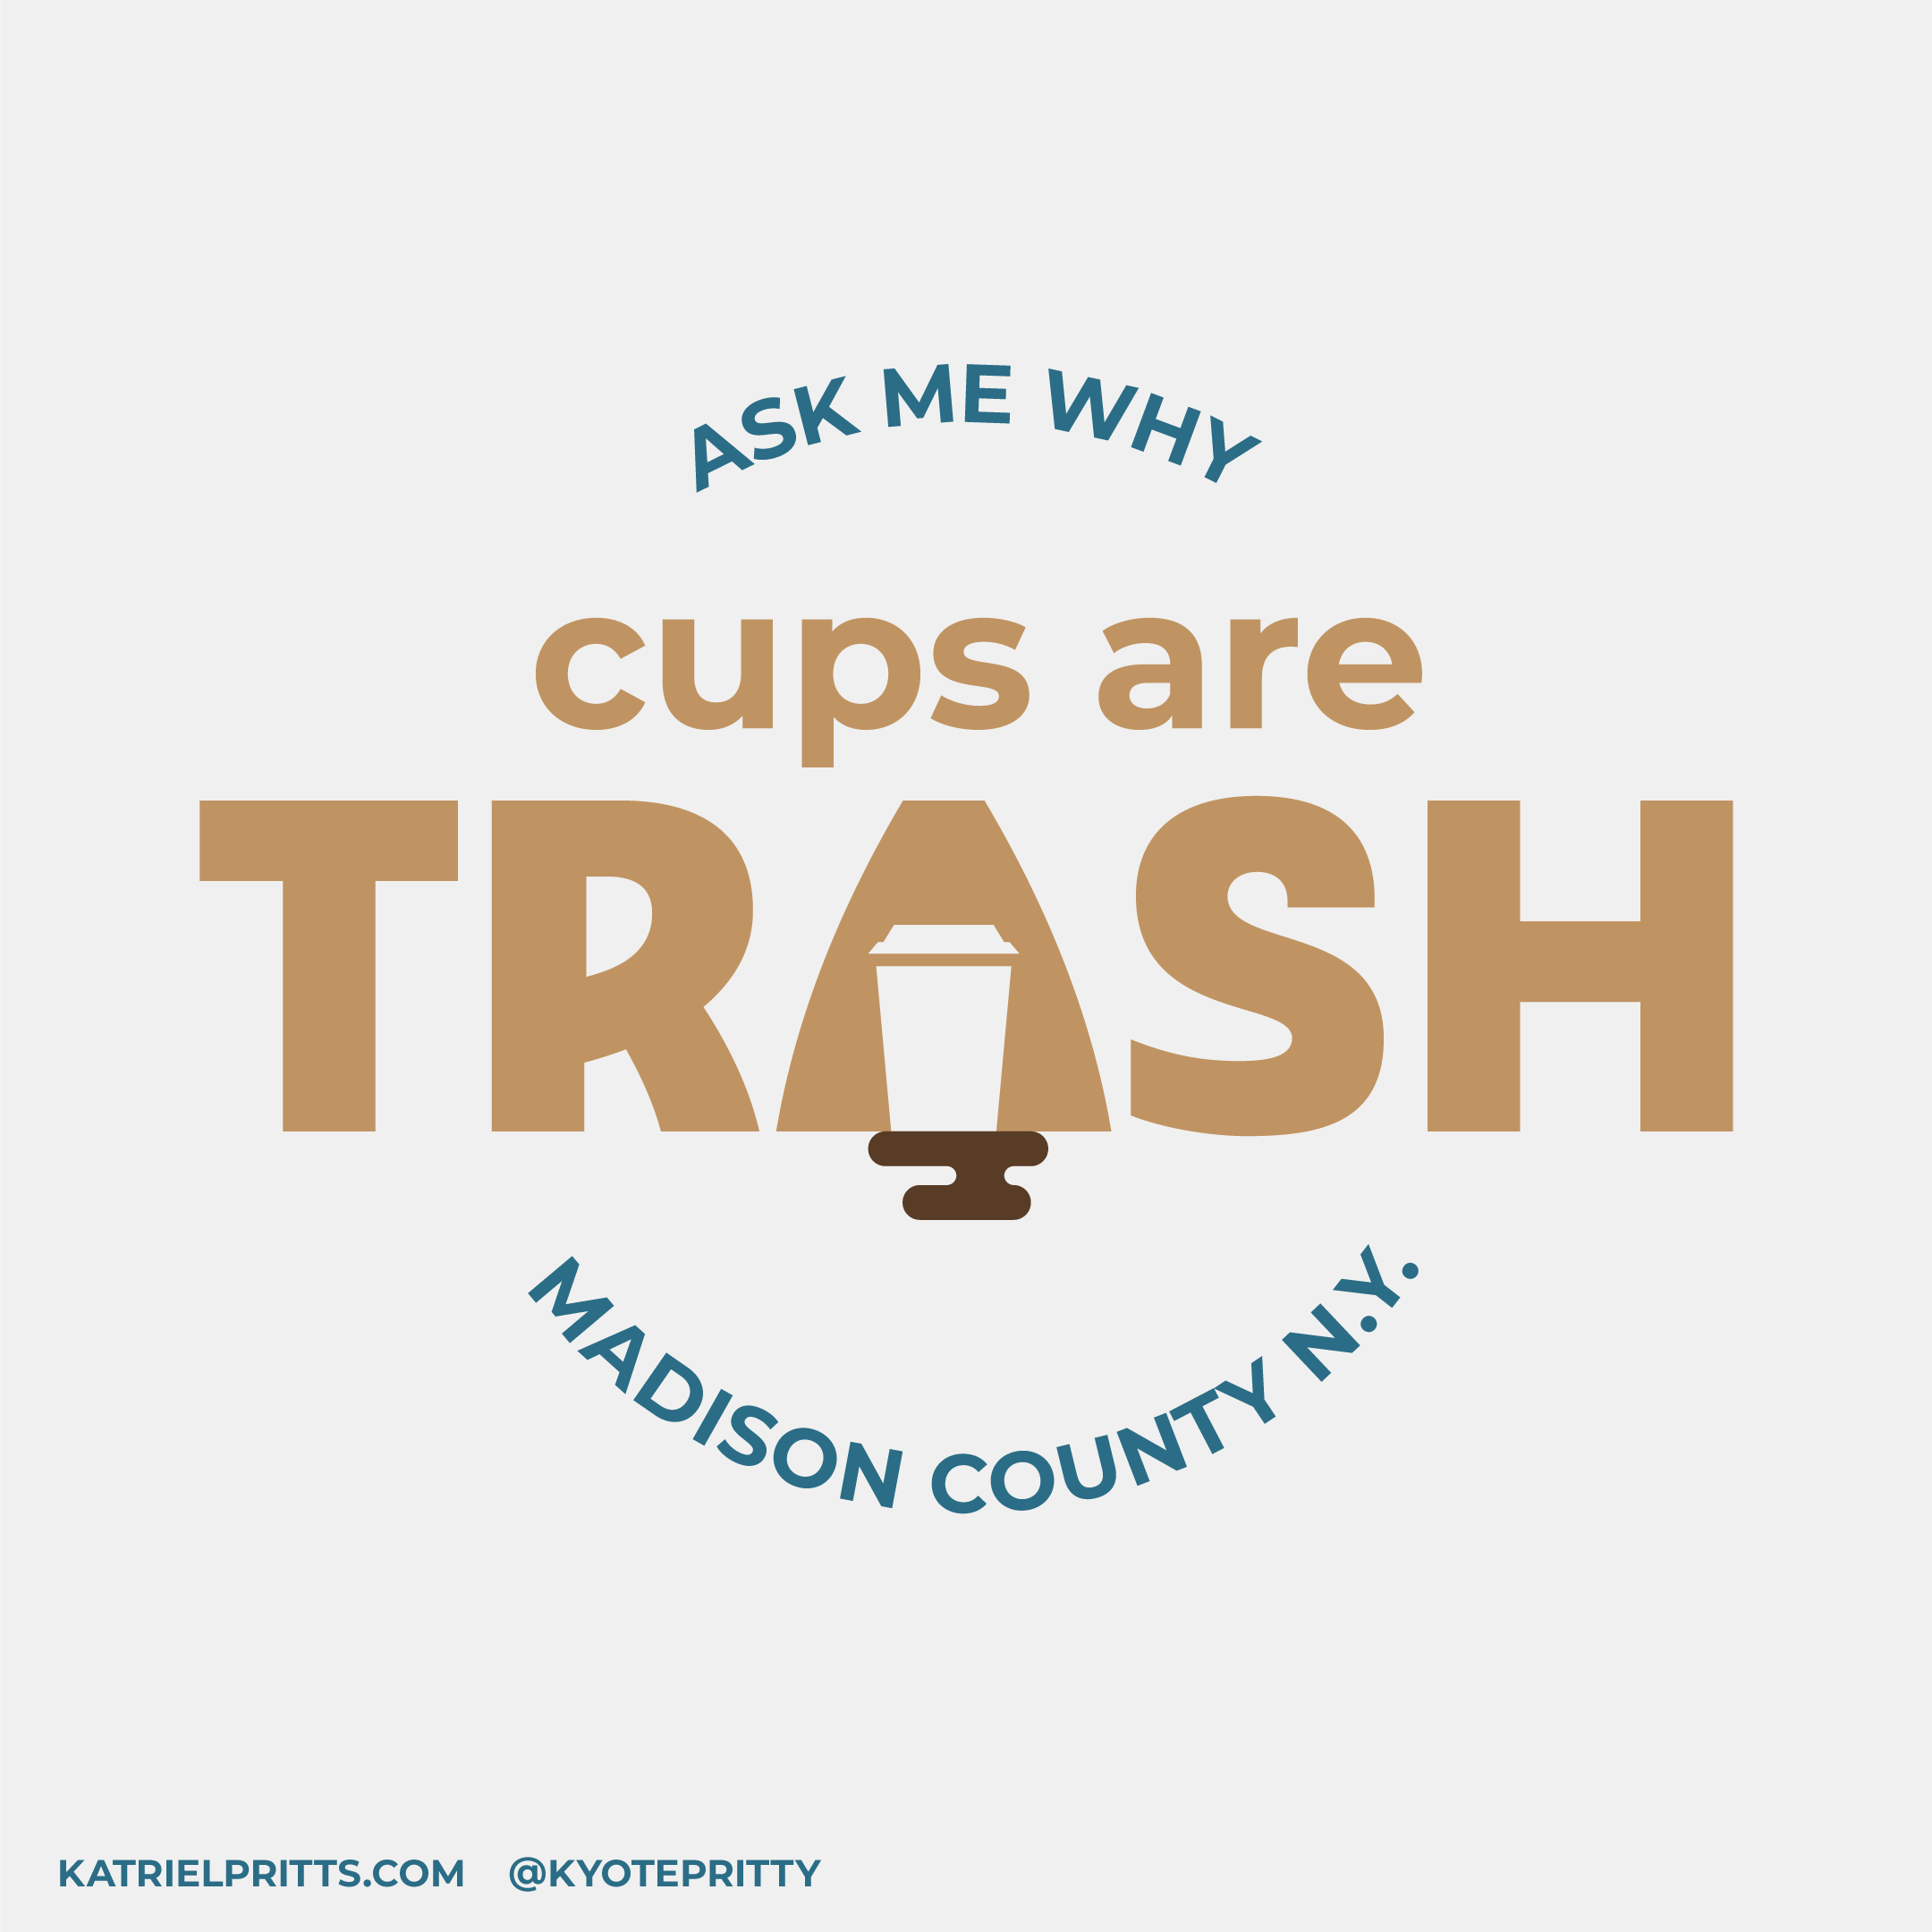
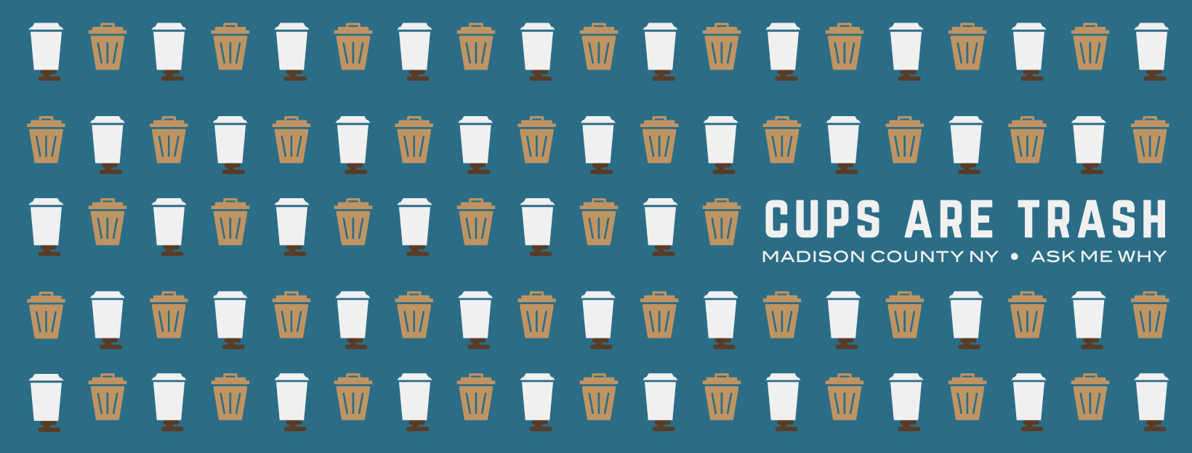
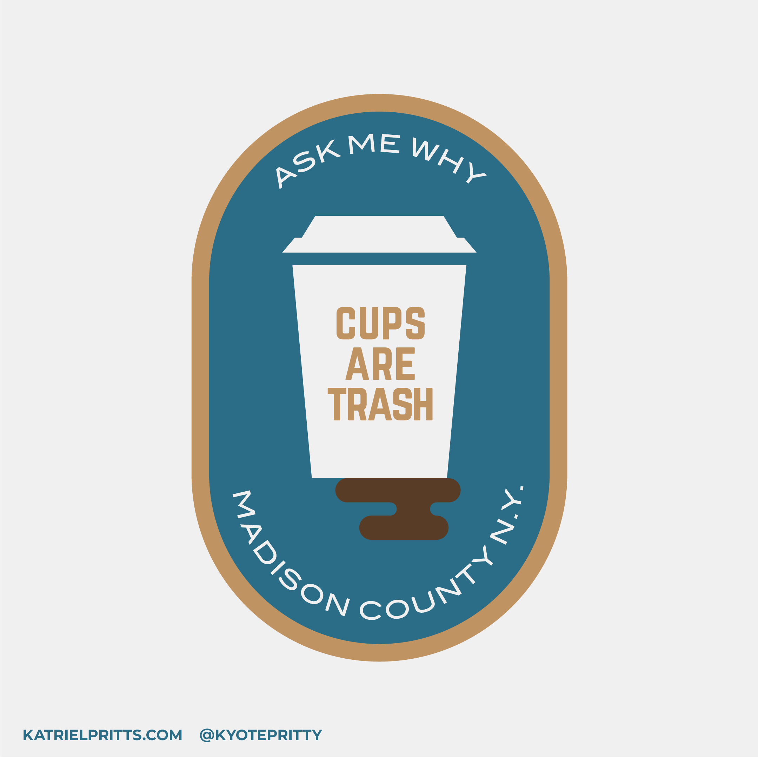
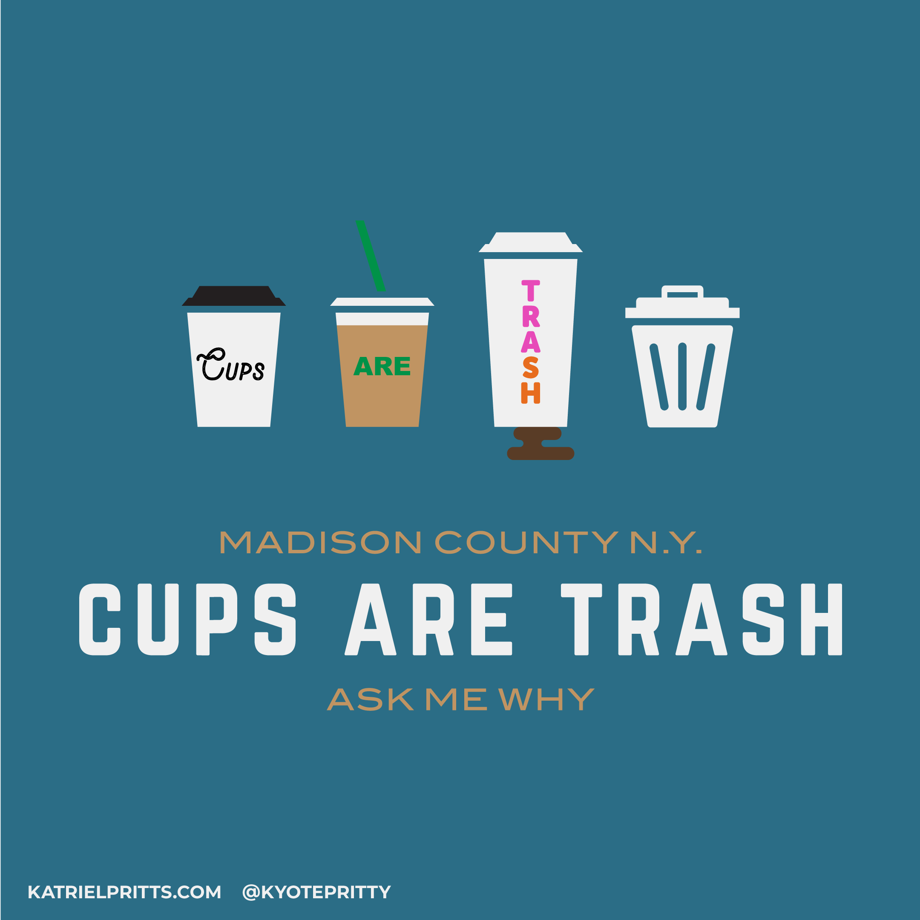

Slide 49
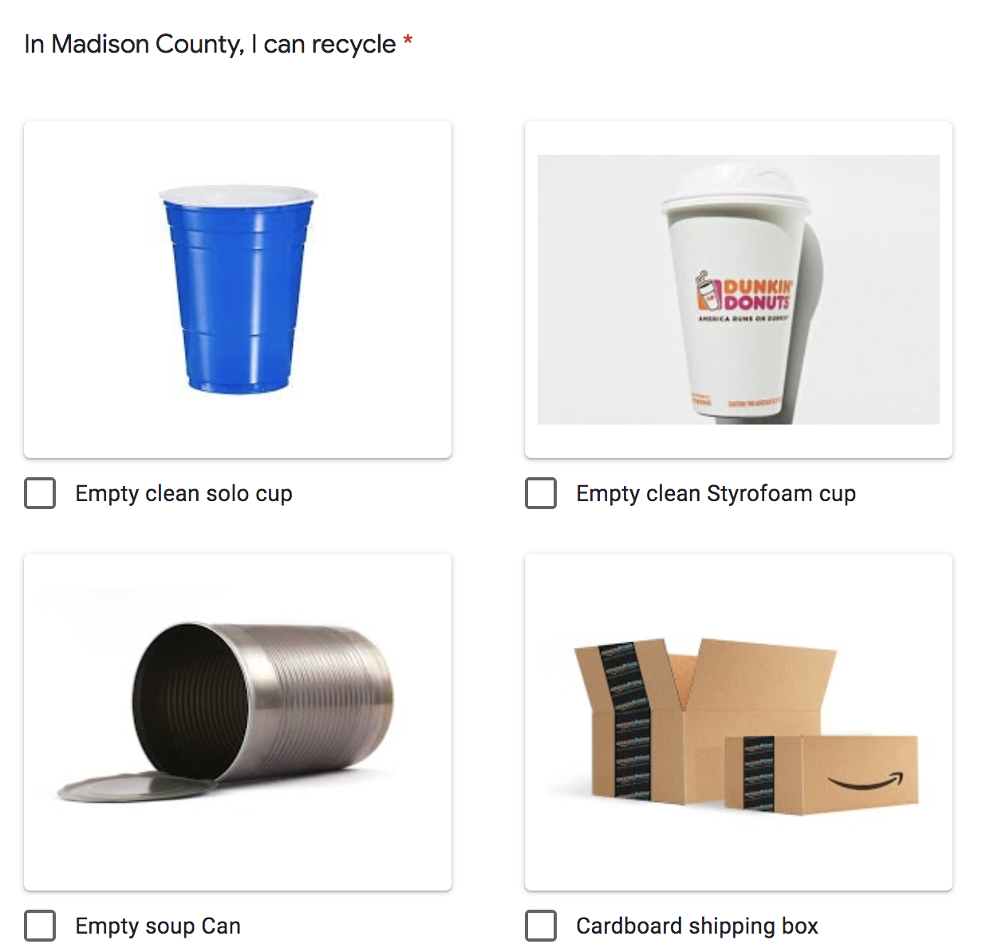
Results:
“Consumption and Disposal Habits Survey”
Sample Size: 254 (9% of students)
Potential bias in the sample
In Madison County I can recycle…
Checkboxes with images and descriptors
75% of respondents knew that cups were not recyclable
(Goal was 80% - we fell short, but 2020 also fell short so ¯\_(ツ)_/¯ )

Slide 50
Thank you!
Pamela Gramlich/Colgate, pgramlich@colgate.edu @colgatesust
Nathan Jandl/UW-Madison, njandl@wisc.edu @sustainuw
Lisa Nicolaison/Princeton, ln2@princeton.edu @tigersgogreen

