Slide 1
Welcome to the CURC Members Meeting

Slide 2
Meeting Housekeeping
This meeting will be recorded
Please remain muted during presentations
Feel free to post questions in the chat at any time and we’ll go through them during the open discussion time
During the discussion, also feel free to unmute your audio and video to ask questions
You have all been pre-assigned to a breakout room based on your registration
You can switch rooms by coming back into the main room and asking the host to move you
Any issues? Text: (860)259-2881
Recording will be available on the CURC website soon: www.curc3r.org.

Slide 3
Agenda
1:00 - 1:15 – Welcome & CURC 2020 Year in Review
1:15 - 1:20 – 2020 Celebration slideshow of photos from members successes in this challenging year
1:20 - 1:30- CURC survey review
1:30 - 1:50 What is in store for CURC in 2021?
1:50 - 2:15 Open discussion
2:15 - 2:30 Regional breakout rooms to discuss opportunities for engagement

Slide 4
College and University Recycling Coalition (CURC)
CURC represents over 900 recycling and sustainability professionals in higher education.
BOD made up of recycling, zero waste and sustainability managers in North America.
Facilitating the exchange of technical knowledge and best practices for waste reduction and recycling programs.

Slide 5
2020
YEAR
IN
REVIEW

Slide 6
2020 Webinar Series
February 20- Collaborations with Academics: Student Projects and Campus Engagement
April 16- Plastic Policy: Innovations on Water Bottle Bills, Bans and Behavior Change
June 18- Reaching Your Collaborators: Communicating for Connection and Education
August 20- Managing Surplus Property for Zero Waste
October 15- Food Waste Reduction, Recovery and Composting on Your Campus
December 17- Zero Waste Marketing Your Program: Strategies for Giveaways

Slide 7
2020 Events and Activities
CURC Membership Survey- listening to our membership
Covid Reopening Survey- USCC and Elevate Packaging partnership
AASHE Session- CURC Campus Recycling Program Session- USCC and Elevate Packaging partnership reopening survey
Long Term Impacts Survey- Zero Waste Campus Council, NRC Campus Council, Busch Systems Consulting and the US Composting Council

Slide 8
2020 Events and Activities
Newsletters- Increased frequency to monthly and this year we will move to stagger between webinar months
Social Media- Expanded Presence- added to Instagram- curc3r
Developed New Partnerships- HIghlighted on our partnerships page
Resources- Expanding and growing our resources to include case studies from peer institutions
Sponsorships- Continue to strengthen our sponsor relationships

Slide 9
New Committee Development
JEDI- Justice, Equity, Diversity and Inclusion

Slide 11
CURC Survey Results!!!

Slide 12
44 respondents
representing 32 schools
2 HBCUs

Slide 13
Racial Identity
Gender Identity
Title

Slide 14
CURC Resources YOU find valuable!

Slide 15
How can CURC provide greater value?
A
Recycling Hotline
Grant funding
Toolkits
Focus on Inclusivity &
Environmental Justice
Members Only Webinars
Regional Networking

Slide 16
You want to engage more. Here’s how...

Slide 17
77% of you are “satisfied” or “very satisfied” with the webinars

Slide 18
Future webinar topics
February - Government Recycling Demand Champion Program presented by the NERC
April - Justice, Equity, Diversity and Inclusion training
June - Implementing Reusable Takeout Programs in the Midst of Covid- Case Study

Slide 19
Future webinar topics
You get to choose the remaining 3 webinar topics for 2021!!!!

Slide 20
Is CURC adequately addressing equity?

Slide 21
How can CURC be more diverse and inclusive?

Slide 22
15 people volunteered to join the JEDI Ad Hoc Committee

Slide 23
curc3r@gmail.com

Slide 24
Justice Equity Diversity & Inclusion Committee
Internal JEDI meeting outlining purpose & resources
Self-reflection during annual board retreat
Meetings with consultants
Next Steps:
Create Strategy with consultant
Start full Ad Hoc Committee
JEDI April webinar
Get involved: lizg9@uw.edu
Awareness
Reflection
Information Gathering
Action
Analysis
Planning
Center for Diversity & the Environment

Slide 25
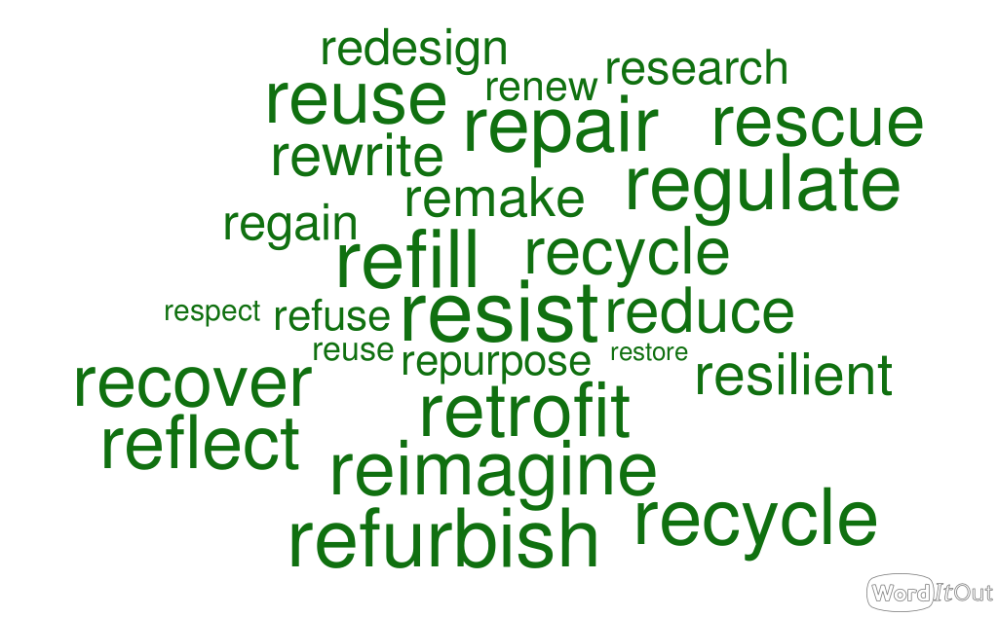
CURC Rebranding

Slide 26
What’s on your mind?

Slide 27
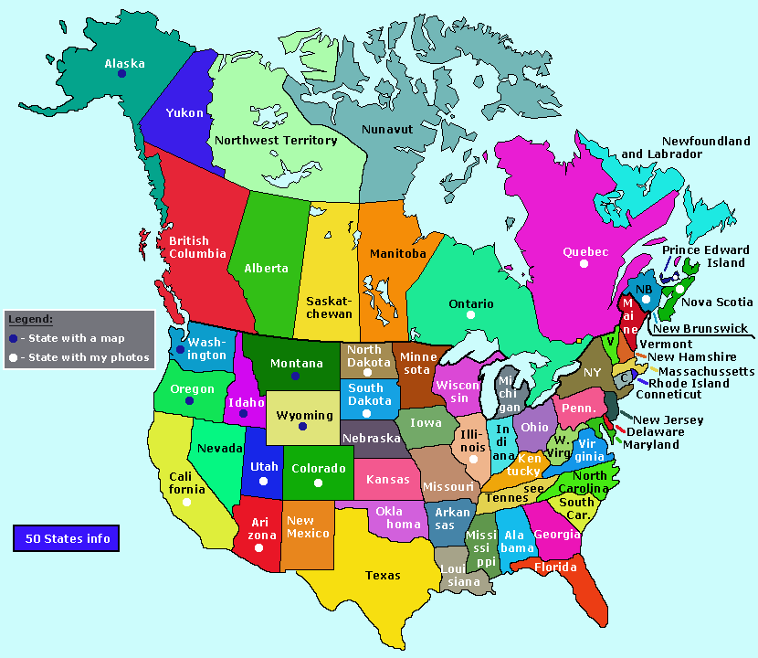
Regional “Meet Ups”

Slide 28
Zoom Breakout Sessions
Southeast
Northeast
Midwest
Southwest
Pacific Northwest
West
Canada

Slide 29
Connect with CURC
Website
www.curc3r.org
Register as a member and access archive event and webinars
LinkedIn Group
www.linkedin.com and search for the group College and University Recycling Coalition (352 group members)
Facebook
www.facebook.com/CURCRecycling
Twitter
twitter.com/curc3r
Instagram
https://www.instagram.com/curc3r/
Recyc-l Listserv
message to LISTSERV@listserv.brown.edu with the message text: “SUBSCRIBE RECYC-L FirstName LastName.”

Slide 30
Get Involved
Did you know you don’t have to be on the Board to be on a committee?!?!
Committees
Justice, Equity, Diversity and Inclusion Committee (JEDI)
Finance and Sponsorships
Board Development
Marketing and Programs

Slide 31
Thank you for attending!
Webinar recordings will be available on www.curc3r.org
See you all in the breakouts!

