Slide 1
Sustainable Swag

Slide 2
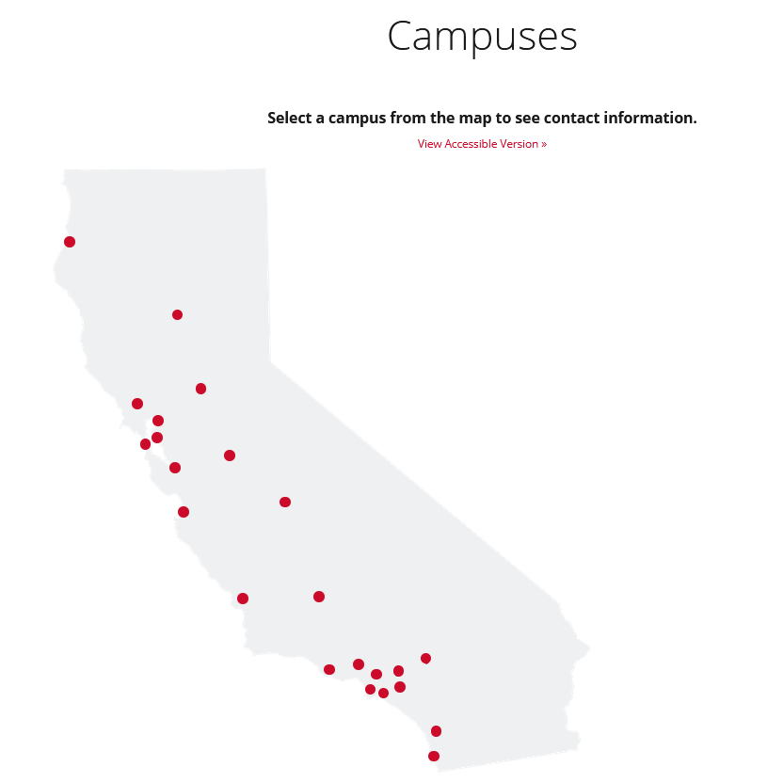
About CSUSM
CSUSM is one of the newer campuses in the CSU system, established in 1989
Roughly 300 acres holding 20 buildings with on & off campus dormitories
Fall 2020 over 16,000 students enrolled
Undergraduate population mainly in 17 – 22 age group
53% of graduates are first in their family to earn a BA degree

Slide 3
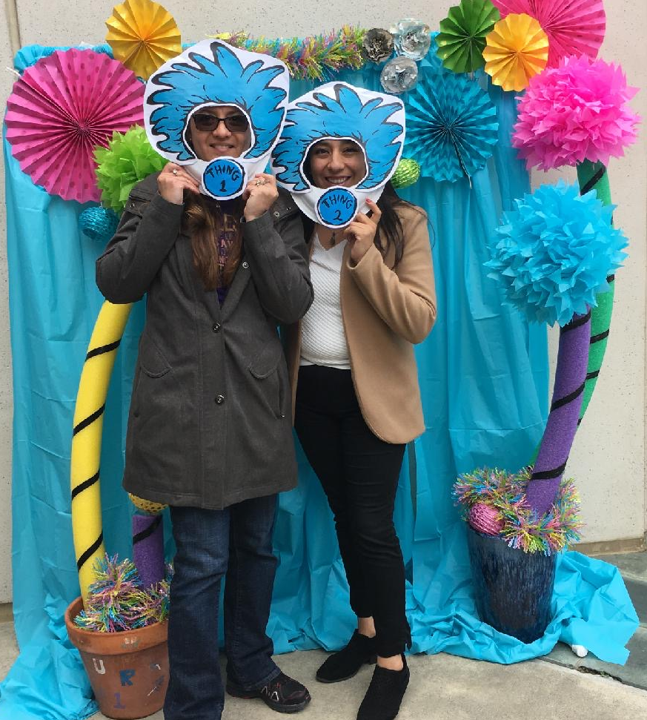
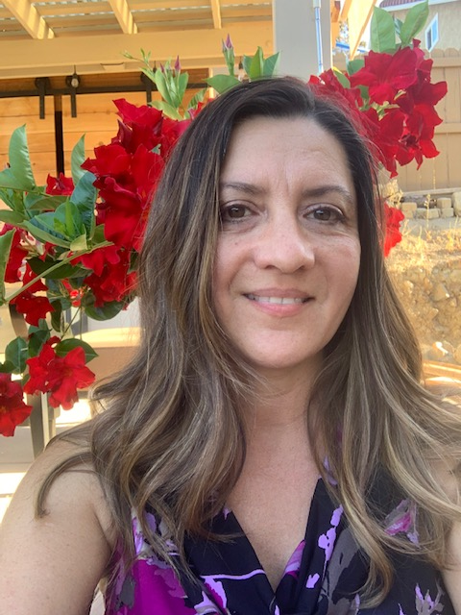
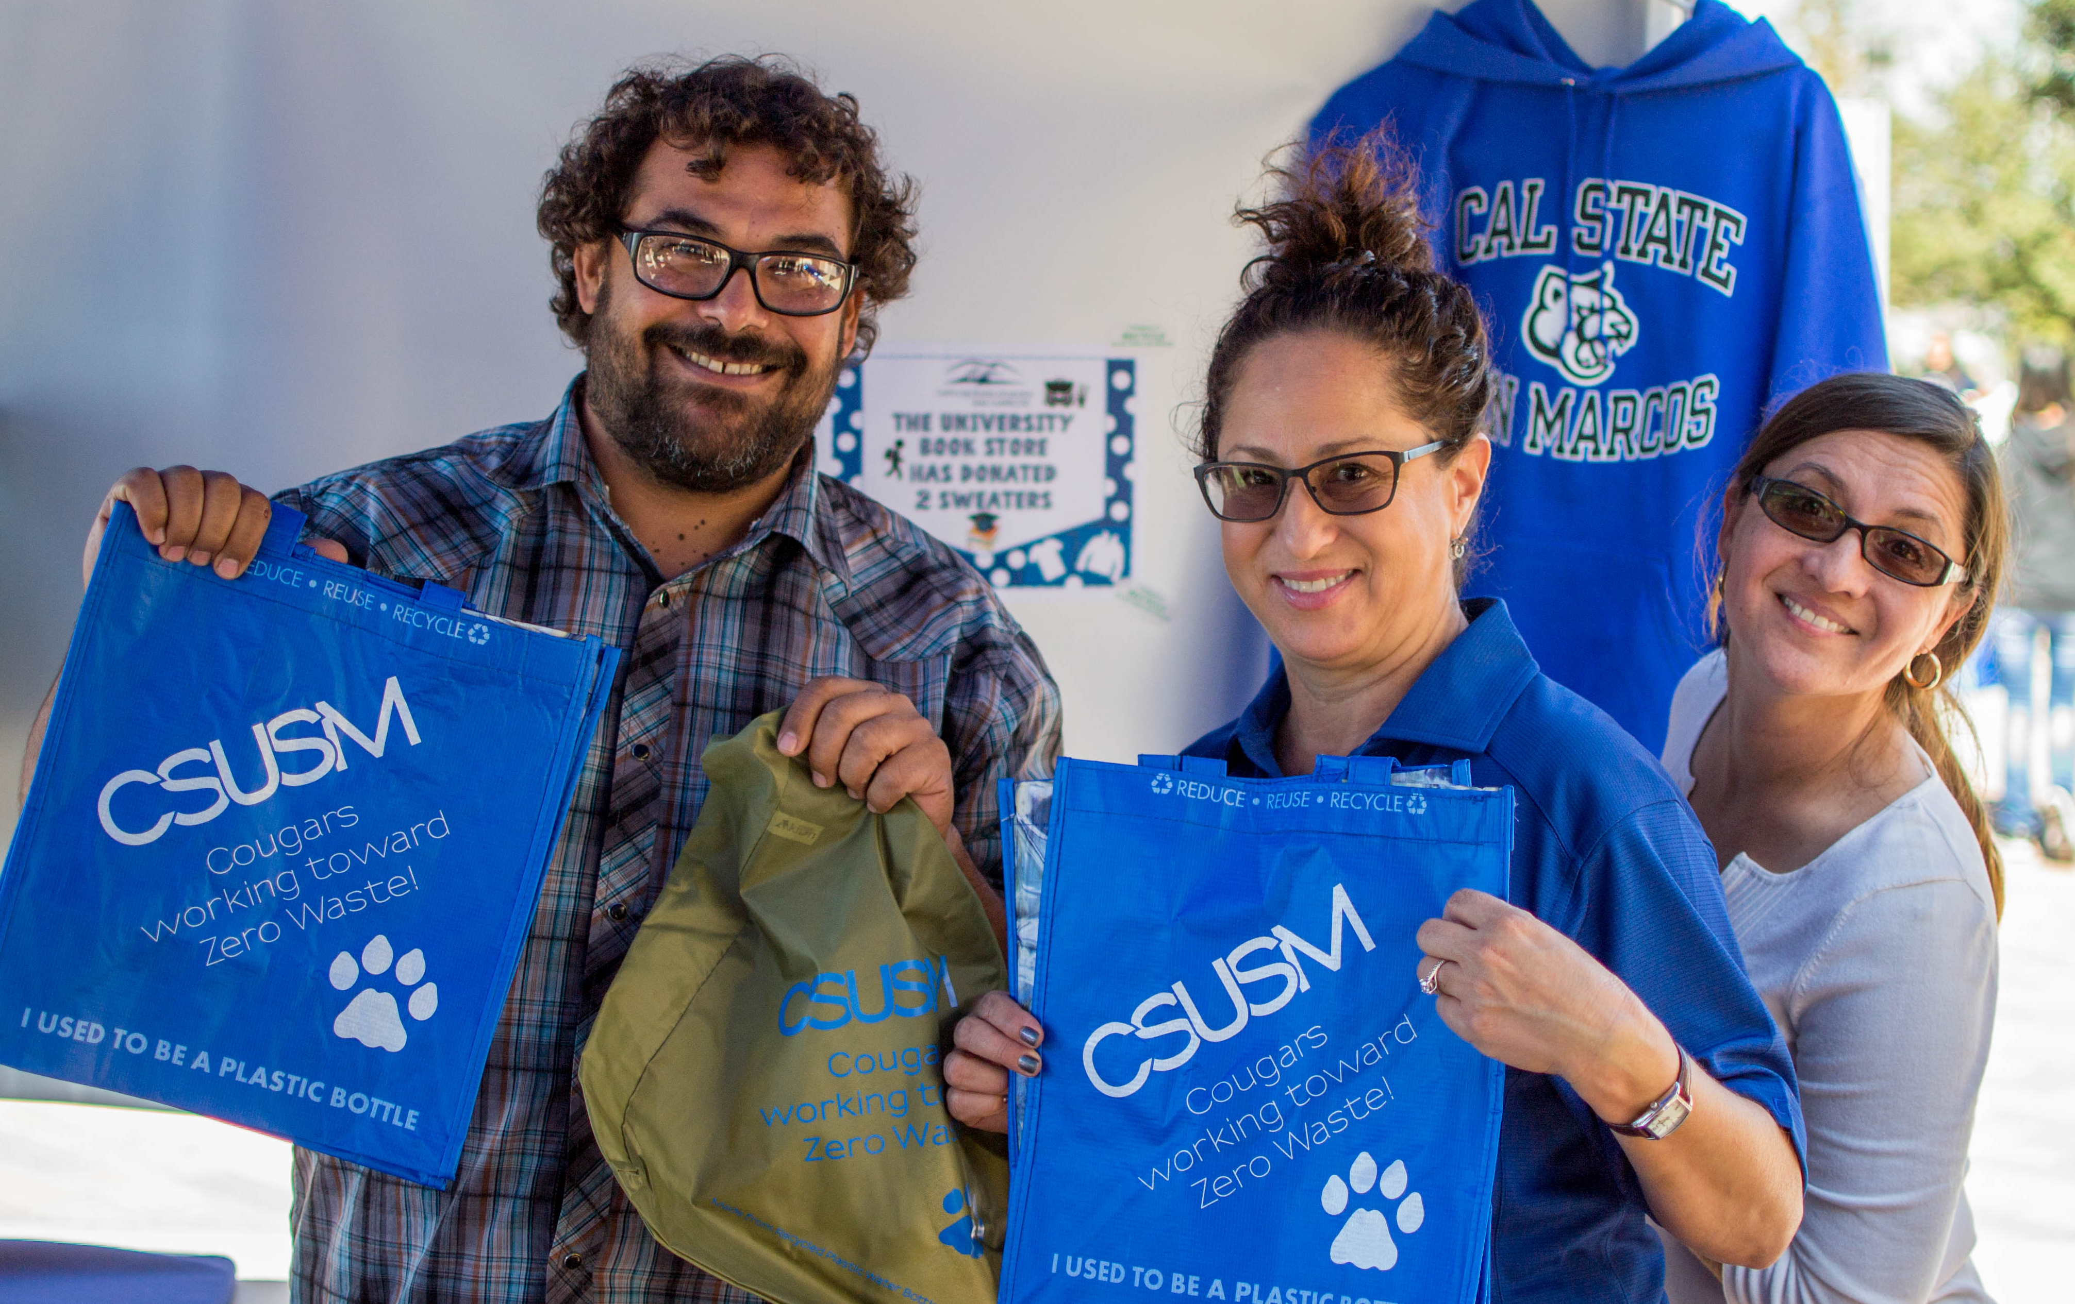
Hello!

Slide 4
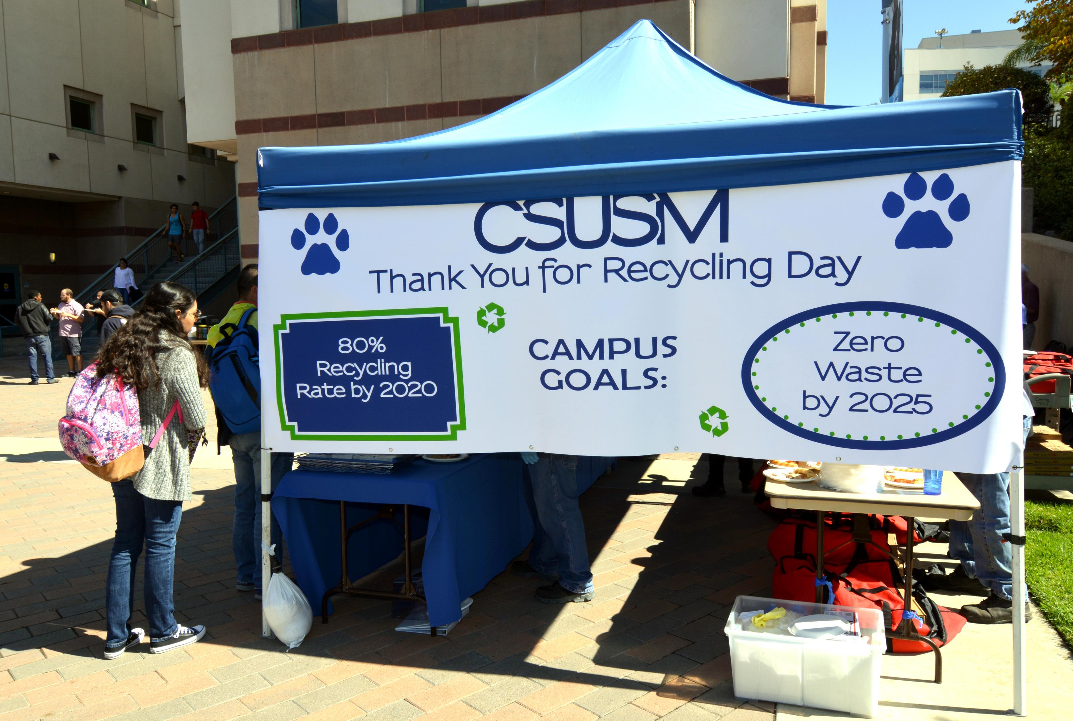

Slide 5
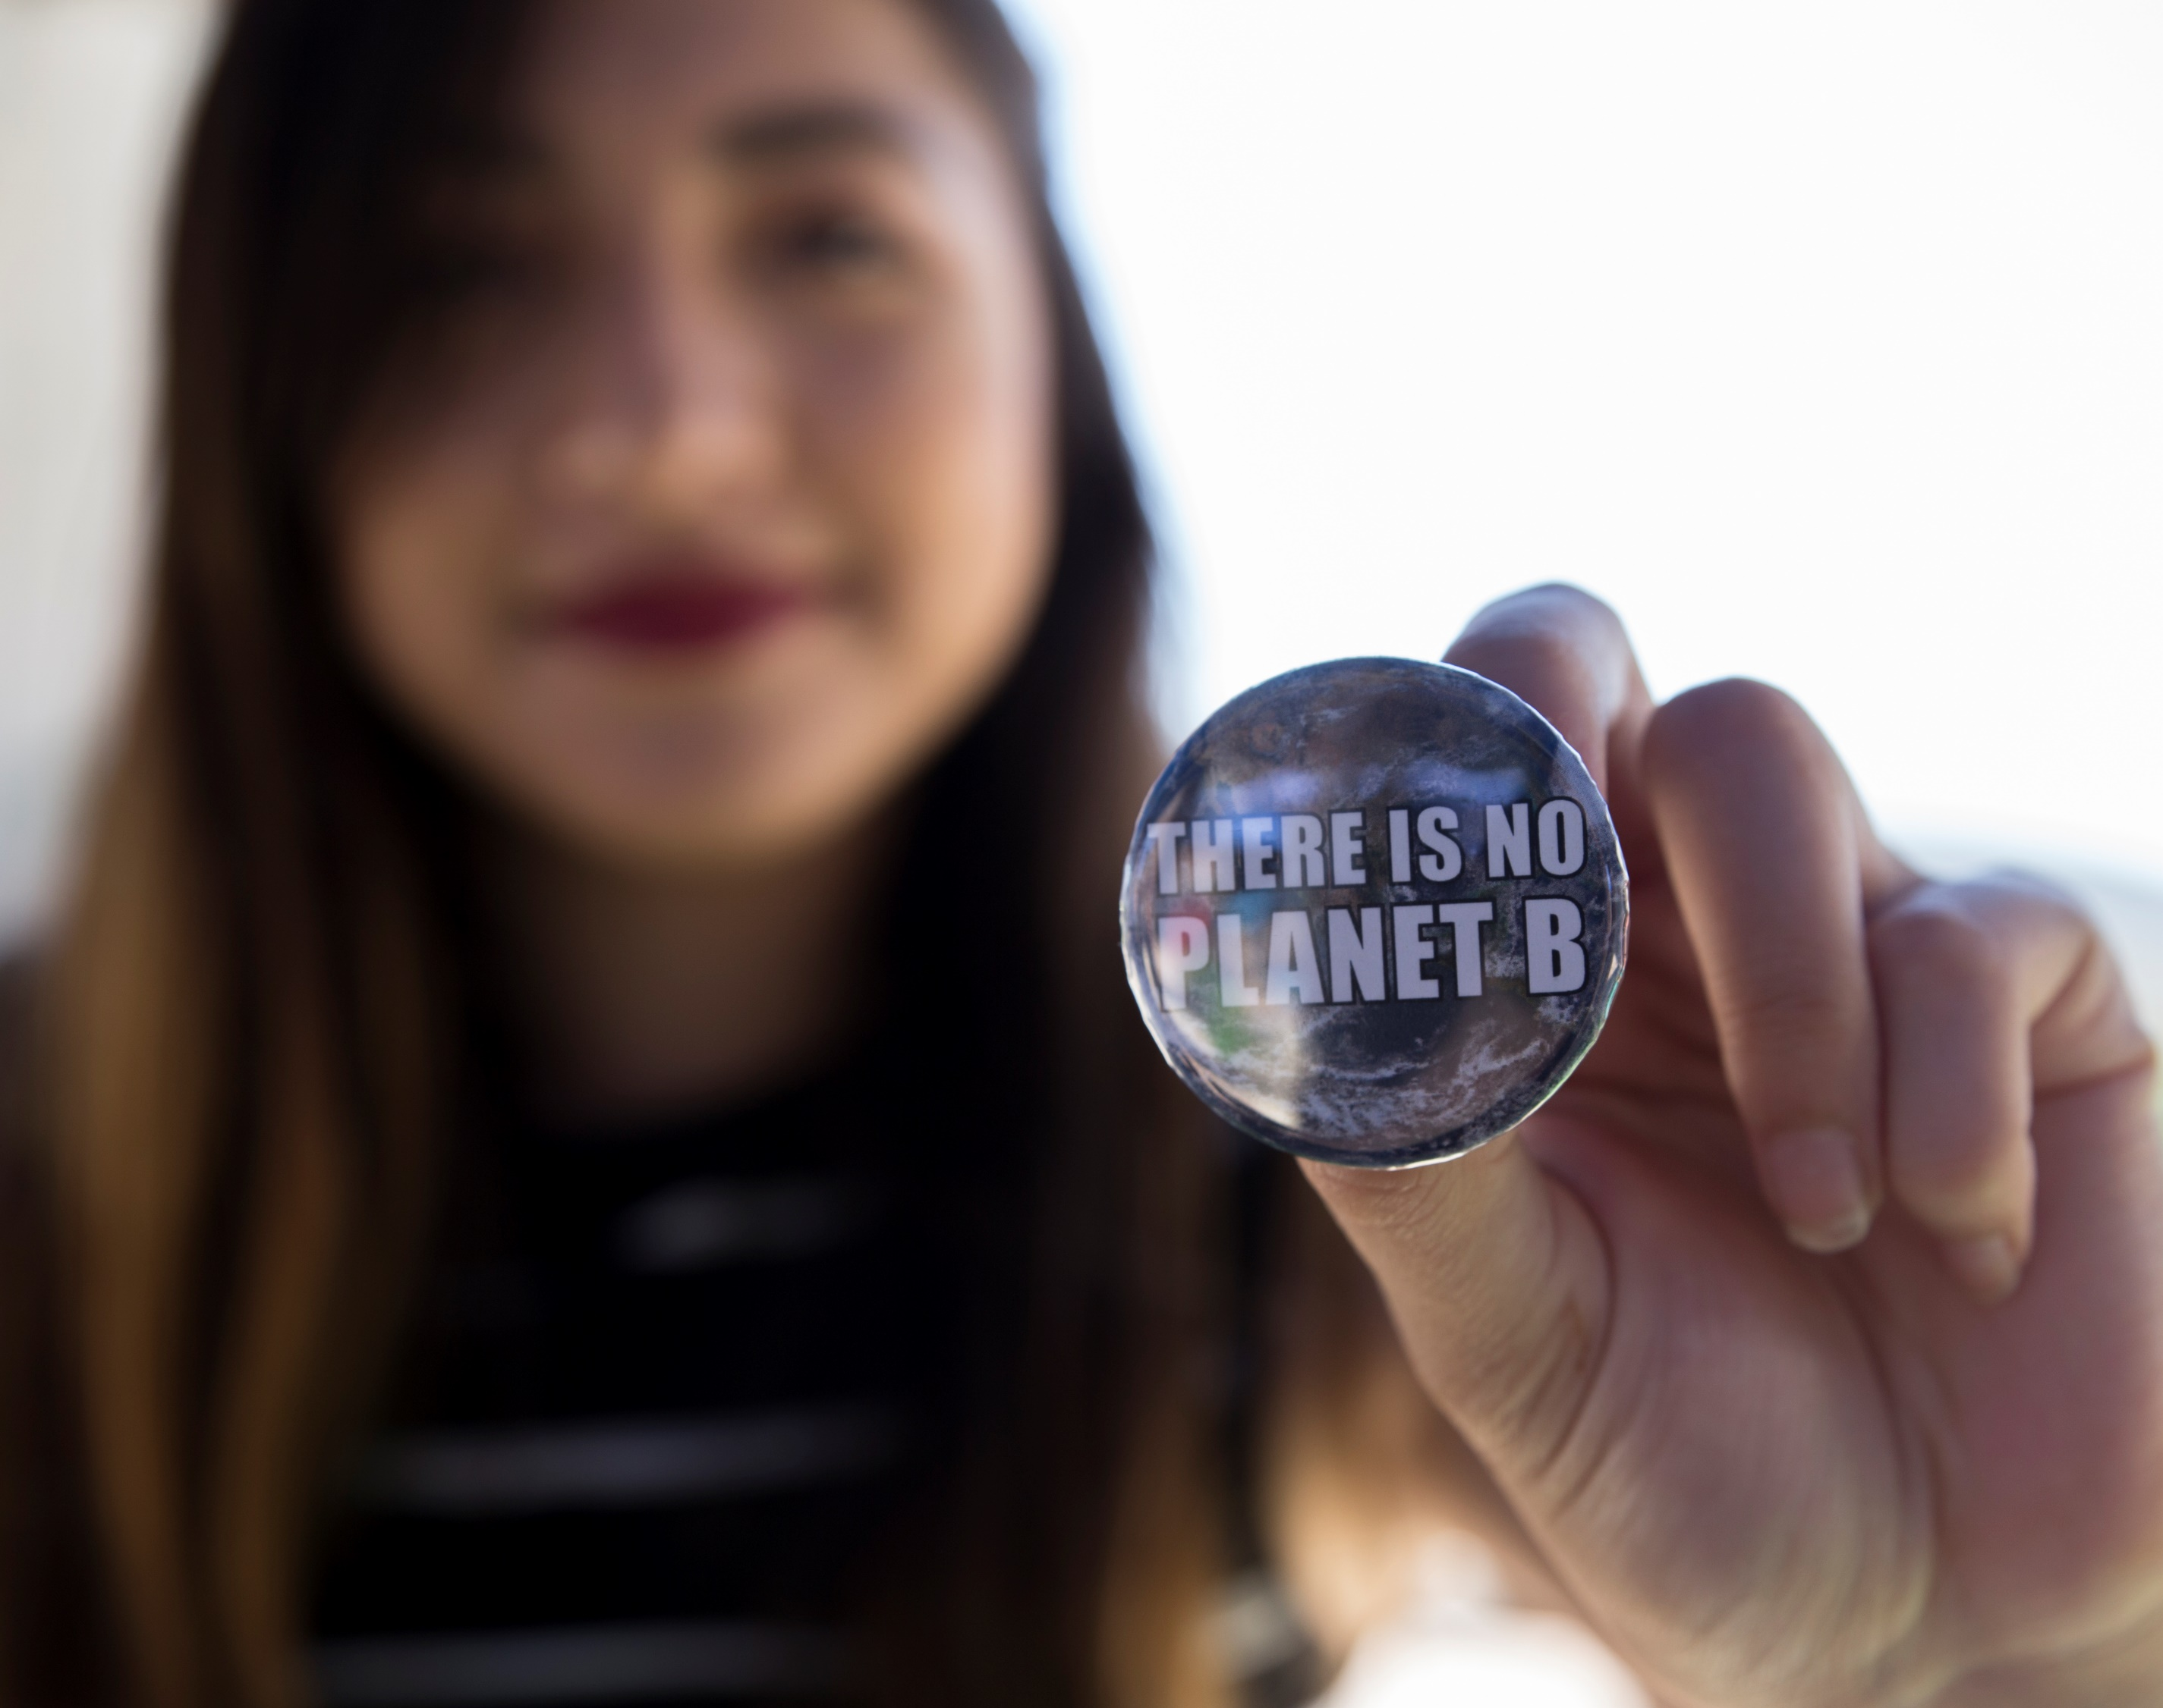
Know your audience

Slide 6
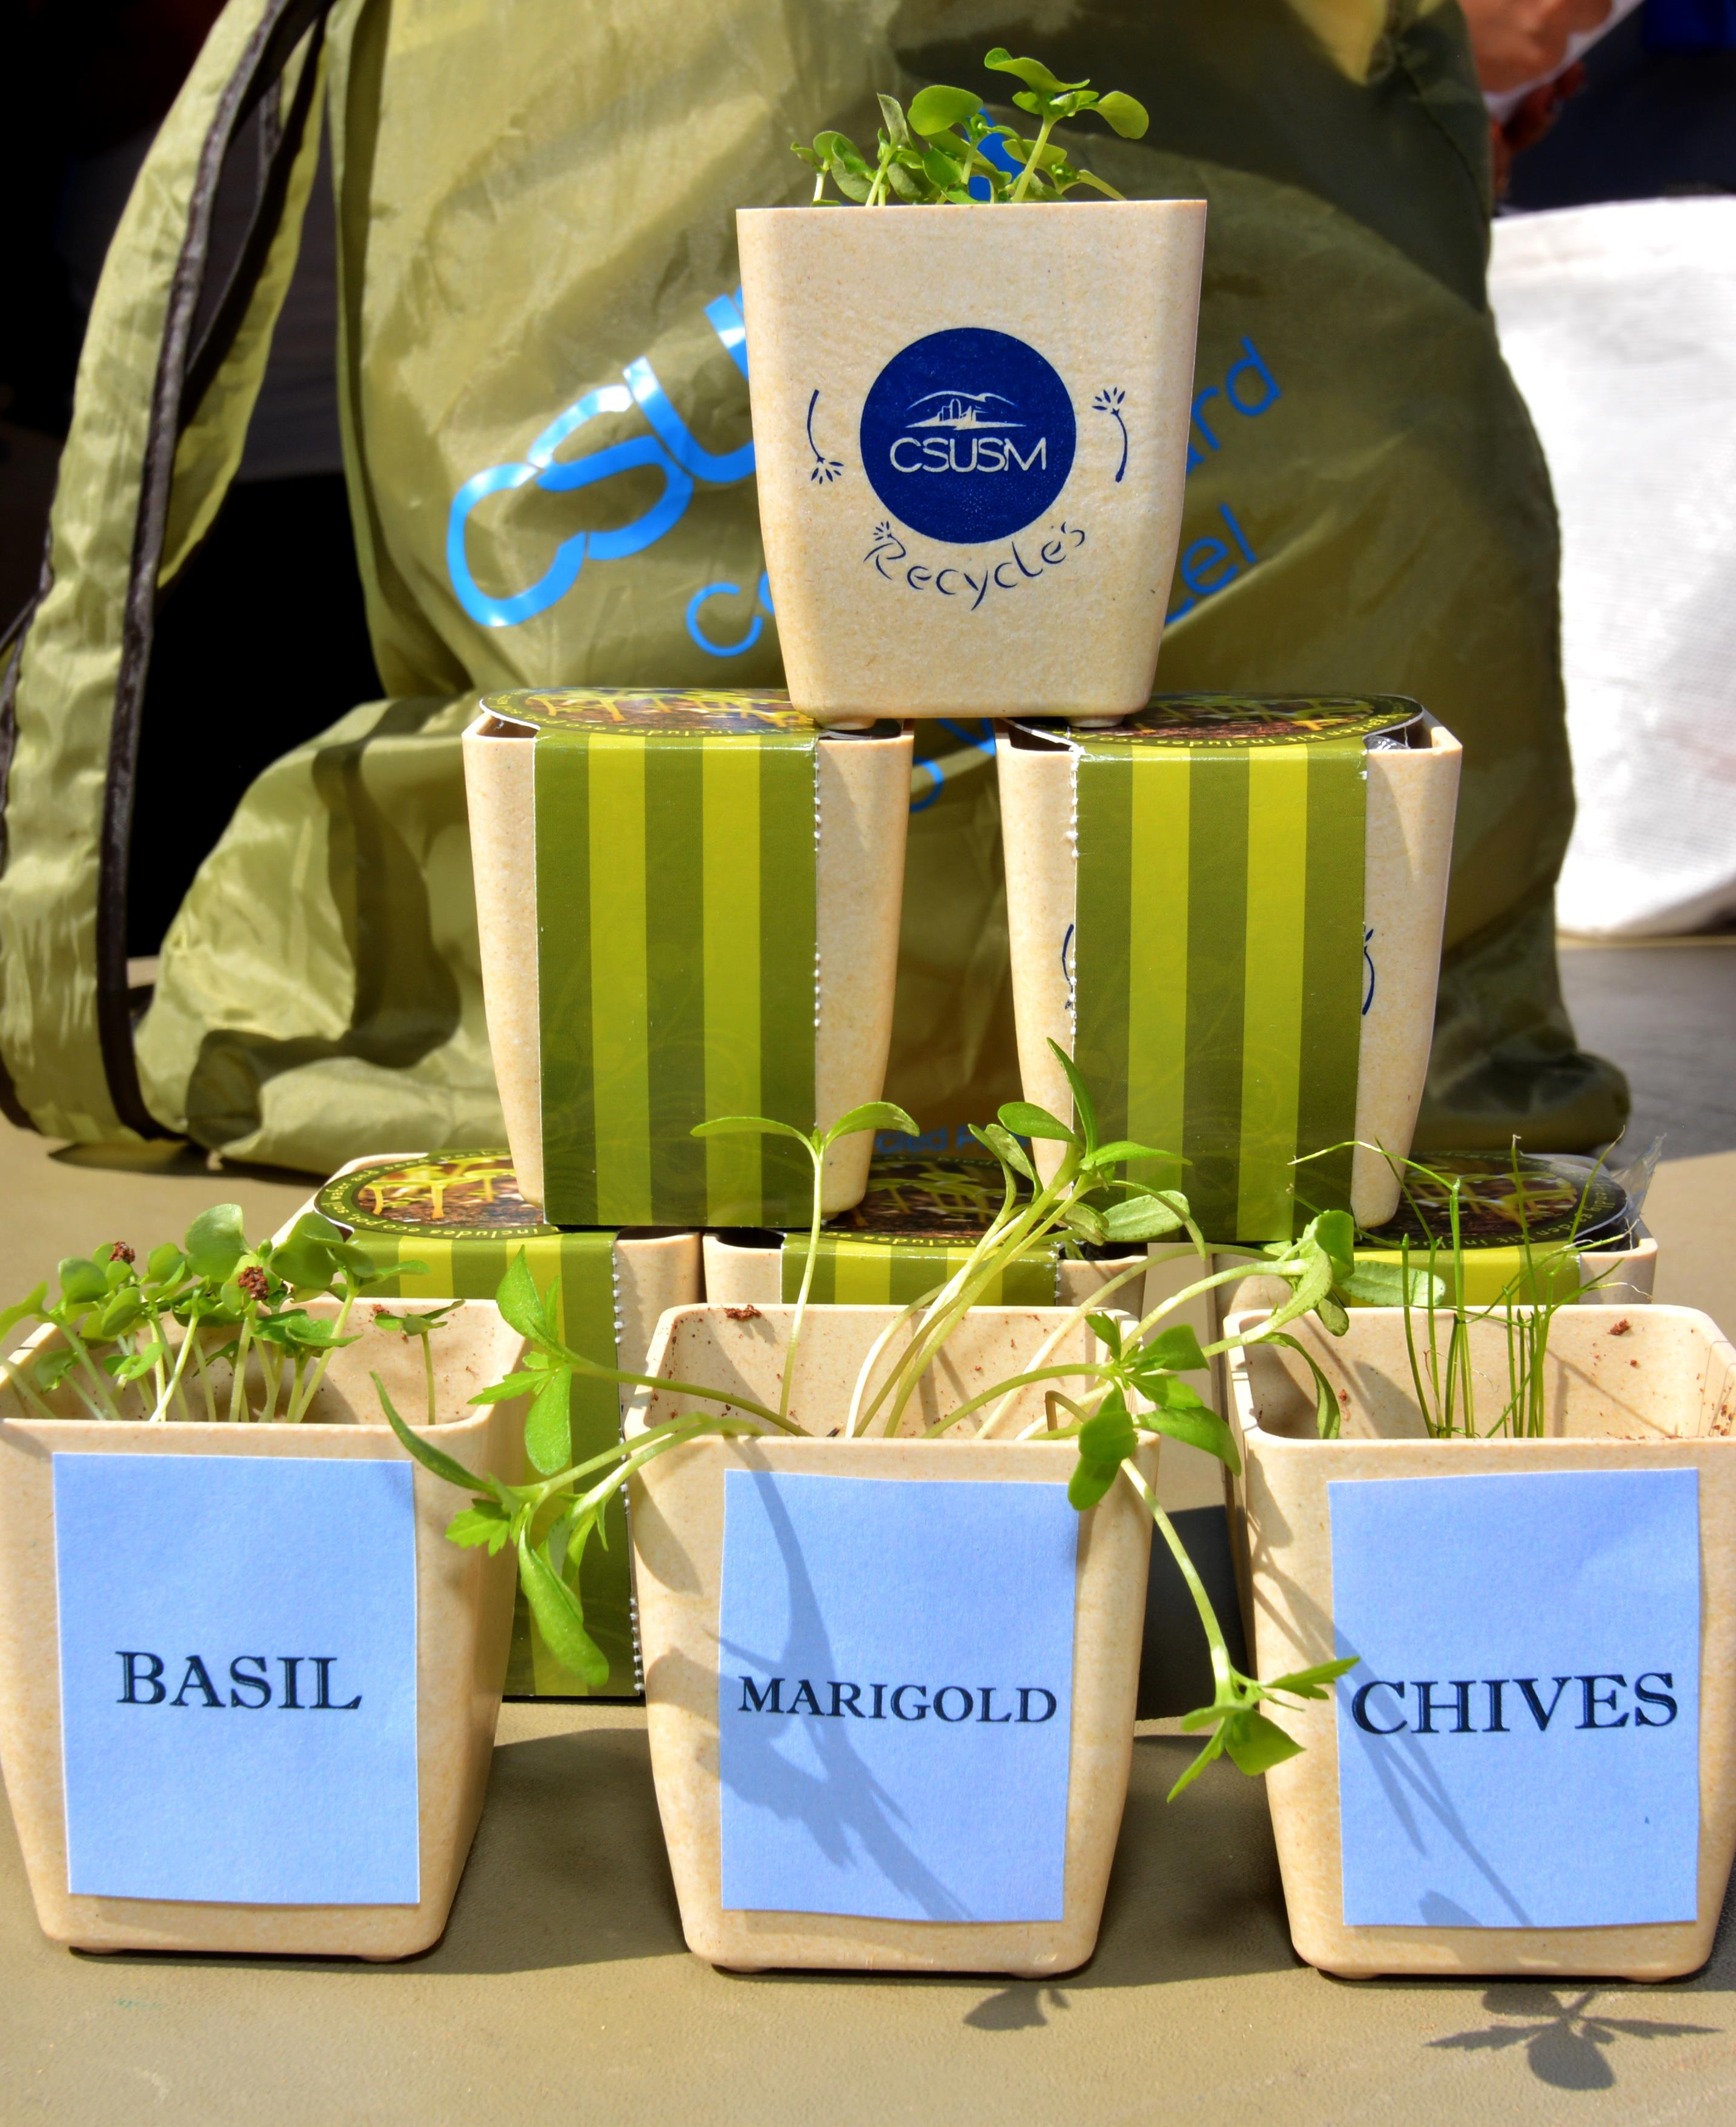
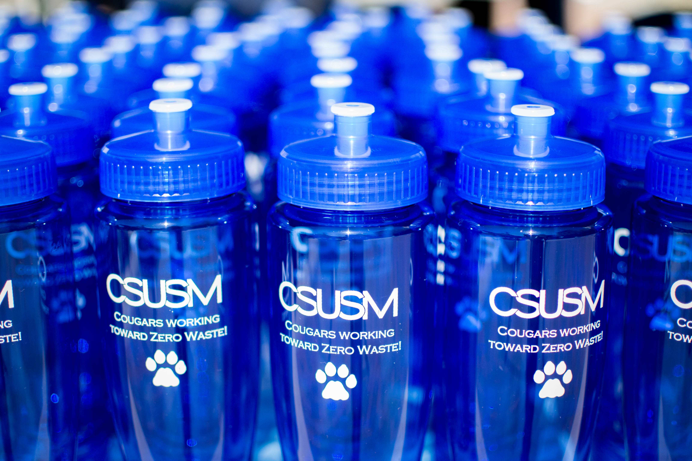
What’s trendy? What will be kept? What will be used?

Slide 7
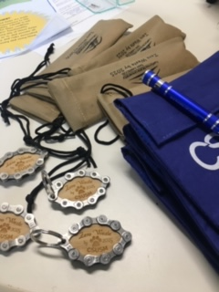
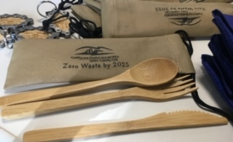
What material is it made out of? Metal straws & bamboo utensil sets

Slide 8
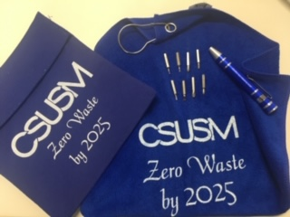
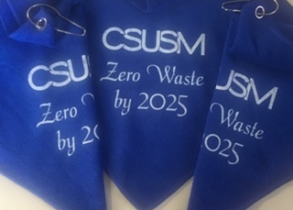
What message are you sending?

Slide 9
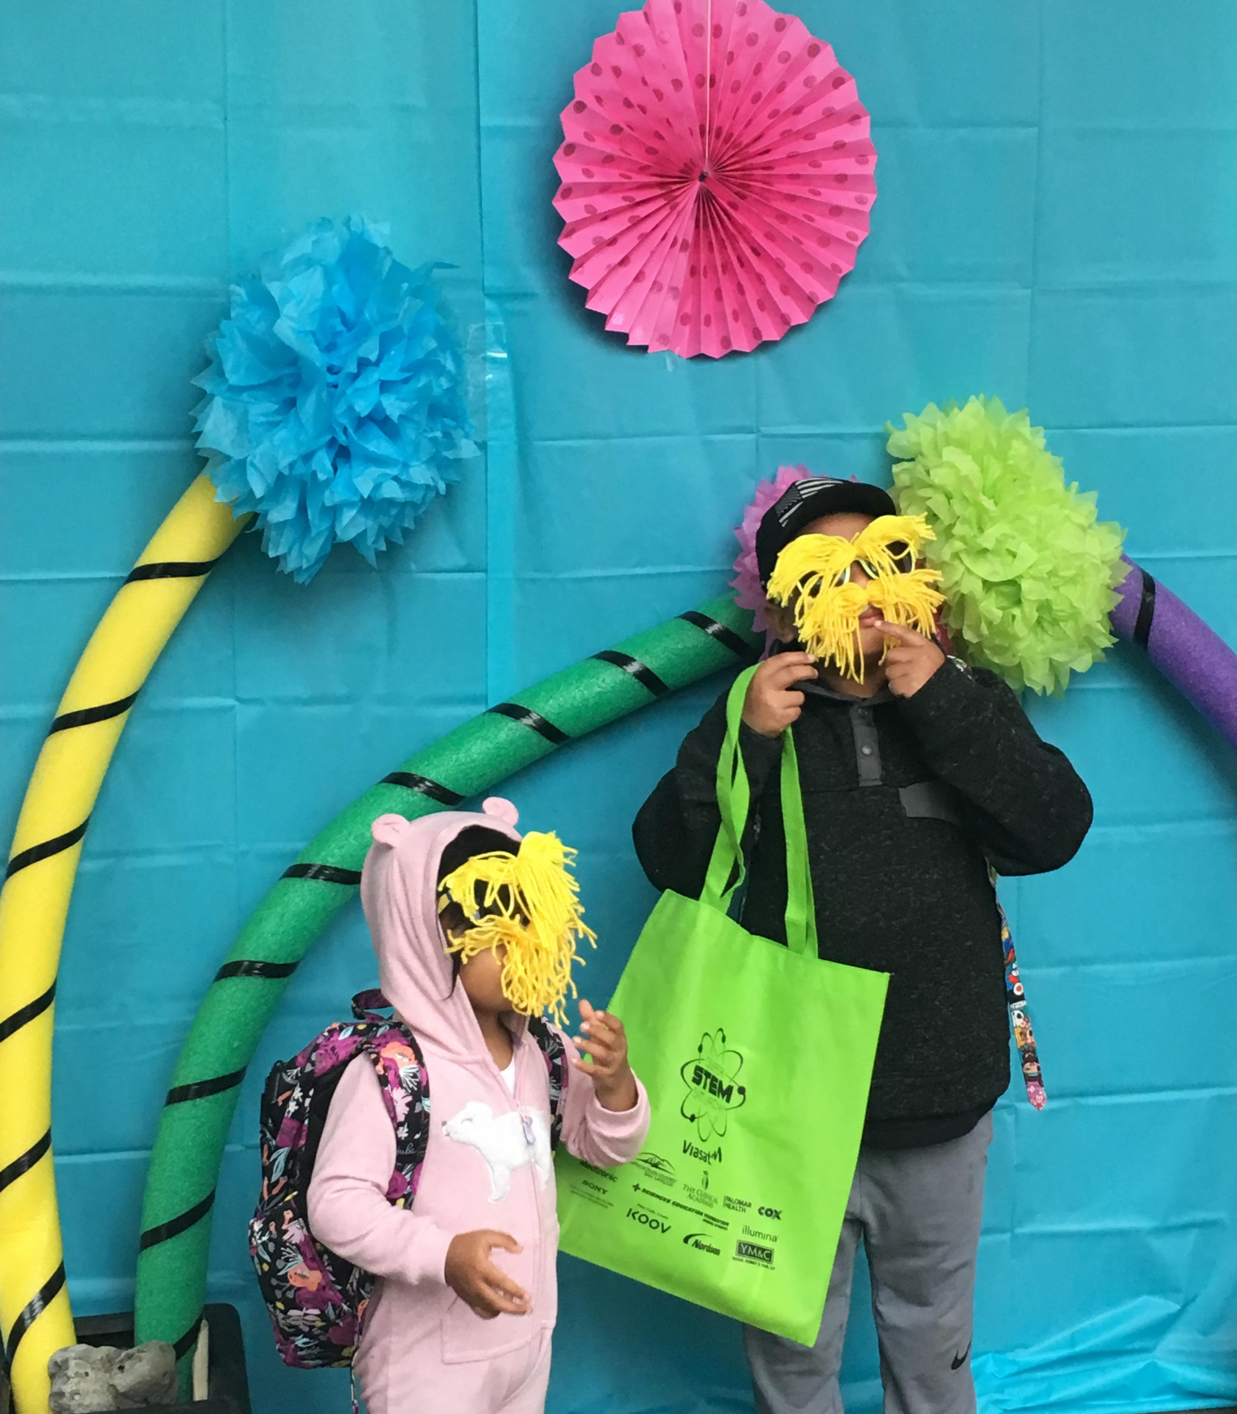
I would like a unicorn
on sale please

Slide 10
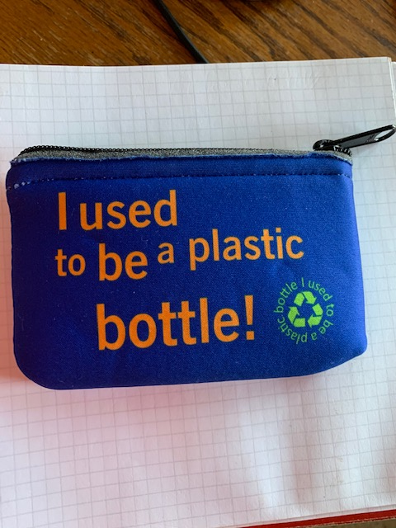
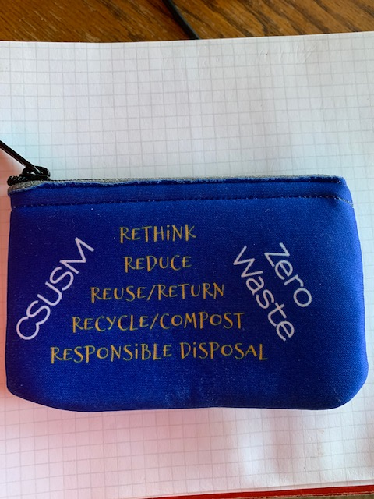

Slide 11
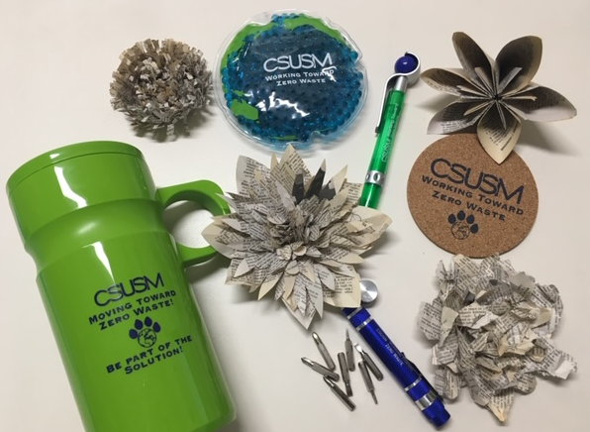

Slide 12
Final Tips:
Start your search early
Talk to Vendors - tell them what you want, price point, sustainable
Verify recycled content

Slide 13
Stephanie Hebert California State University San Marcos shebert@csusm.edu 760-750-4625

