Slide 1
Faculty Student Association (FSA)

Slide 2
Who We Are
FOUNDED
1957
Long Island, New York
Member of the Association of
American Universities
TOP 100
universities in the nation*
TOP 50
public
universities*
*U.S.News & World Report

Slide 3
Who We Are
140+
graduate
programs
200+
undergraduate
programs
25K+
undergraduate and graduate students
Students from nearly ALL 50 STATES and more than 150 COUNTRIES
14K+
Faculty and staff
Notes:
Proud home to Nobel Laureates, Guggenheim fellows and MacArthur grant winners
One of only 10 universities nationwide recognized by the National Science Foundation for combining research with undergraduate education

Slide 4
Southampton
4 Core
Academic Programs and growing
400+
Undergraduate and graduate students, faculty and staff
84 Acre
Campus in
Eastern Long Island
Supports major
conferences:
FOOD LAB
&
SUMMER
WRITERS
SOMAS
Famed School of Marine & Atmospheric Sciences

Slide 5
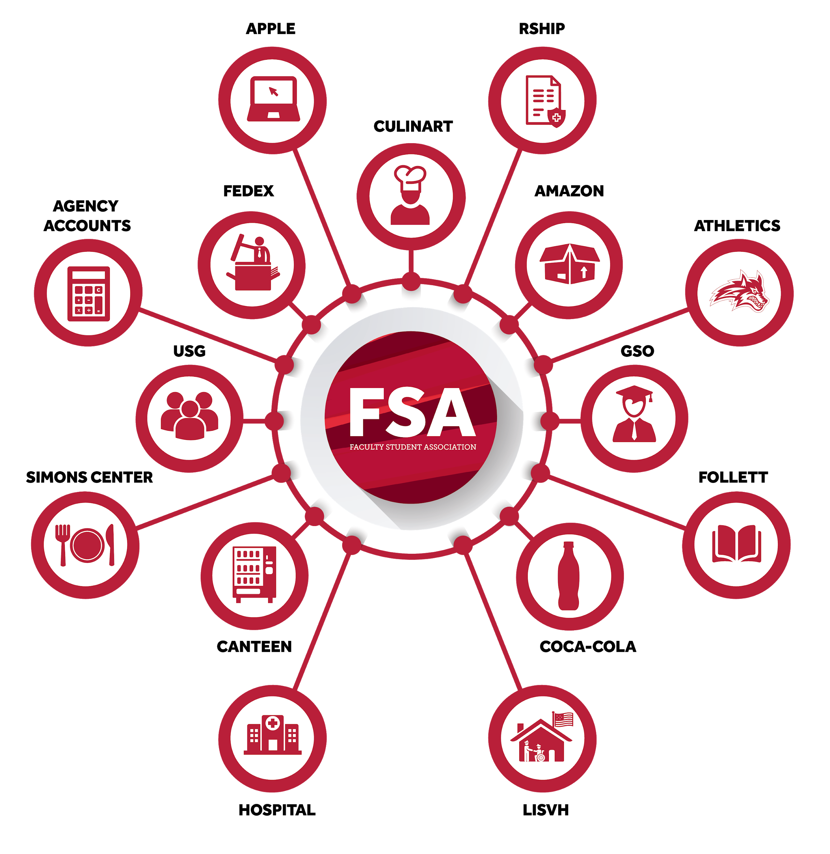
What services does FSA provide?
The Faculty Student Association (FSA) is a
not-for-profit auxiliary services corporation that
operates many of the non-academic services
on the Stony Brook campus.

Slide 6
Major FSA Vendor Partners & Clients

Slide 7
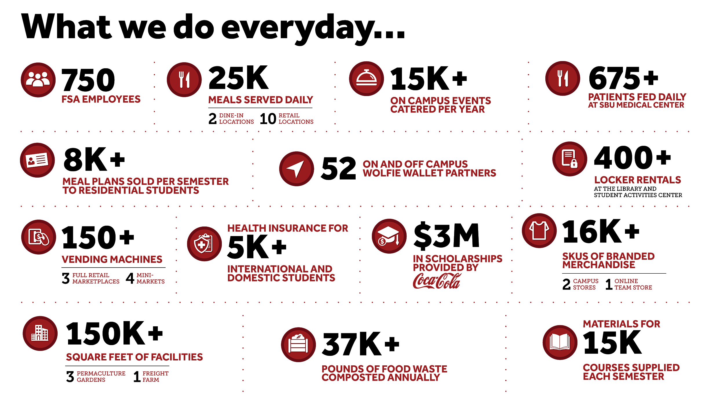

Slide 8
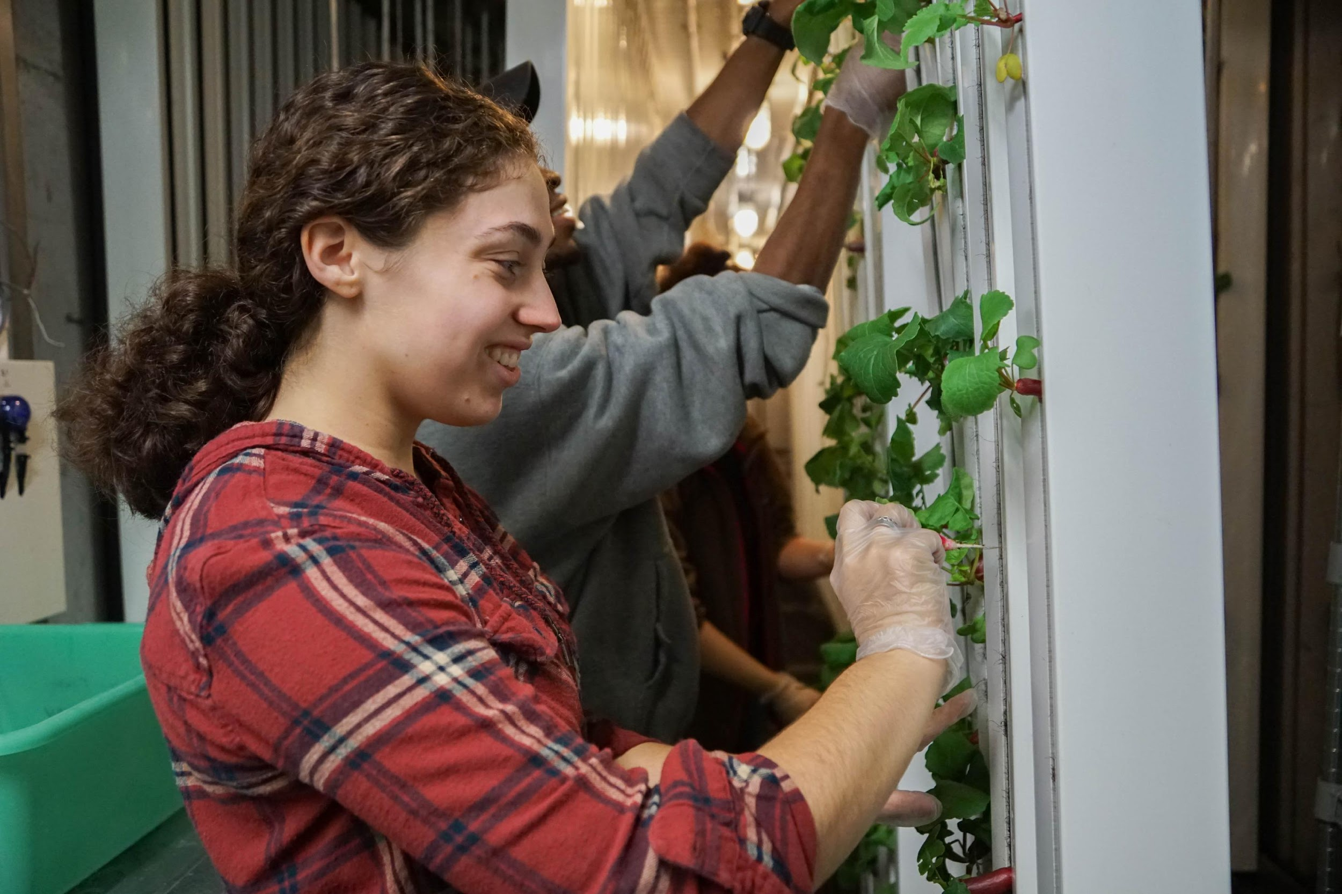
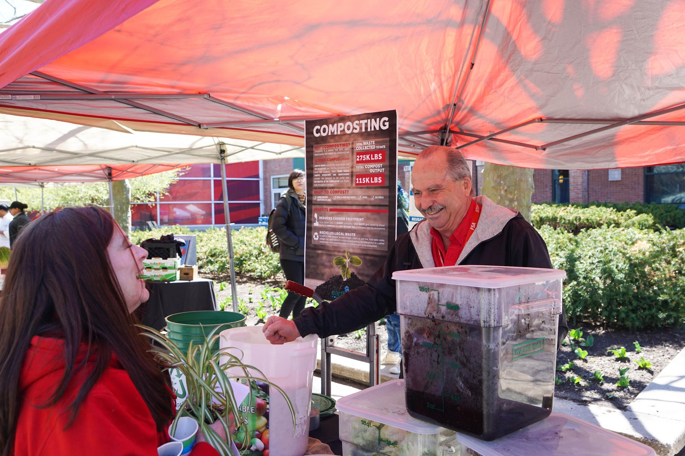
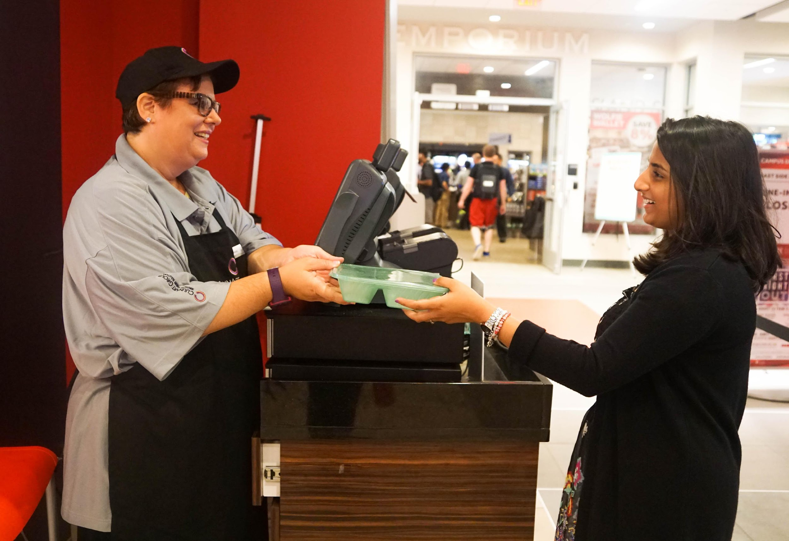
Sustainability Initiatives
Freight Farm grows lettuce hydroponically in a recycled shipping container! Radishes too!
Composting is a process that turns organic waste into nutrient-rich soil and diverts pre-consumer food waste from the landfills each week.
Reusable takeout containers
at East Side, West Side and
Roth Food Court.
Notes:
Students can eat the food they grow while enhancing their knowledge of sustainable agriculture.
Hands-on learning opportunity outside the classroom.
Inspires students to be more sustainable in their lives.
Just like a library card, you’ll use your ID card to check out your reusable takeout container. If you are not exchanging it for a clean container, return it to a cashier to swipe it back onto your card.

Slide 9
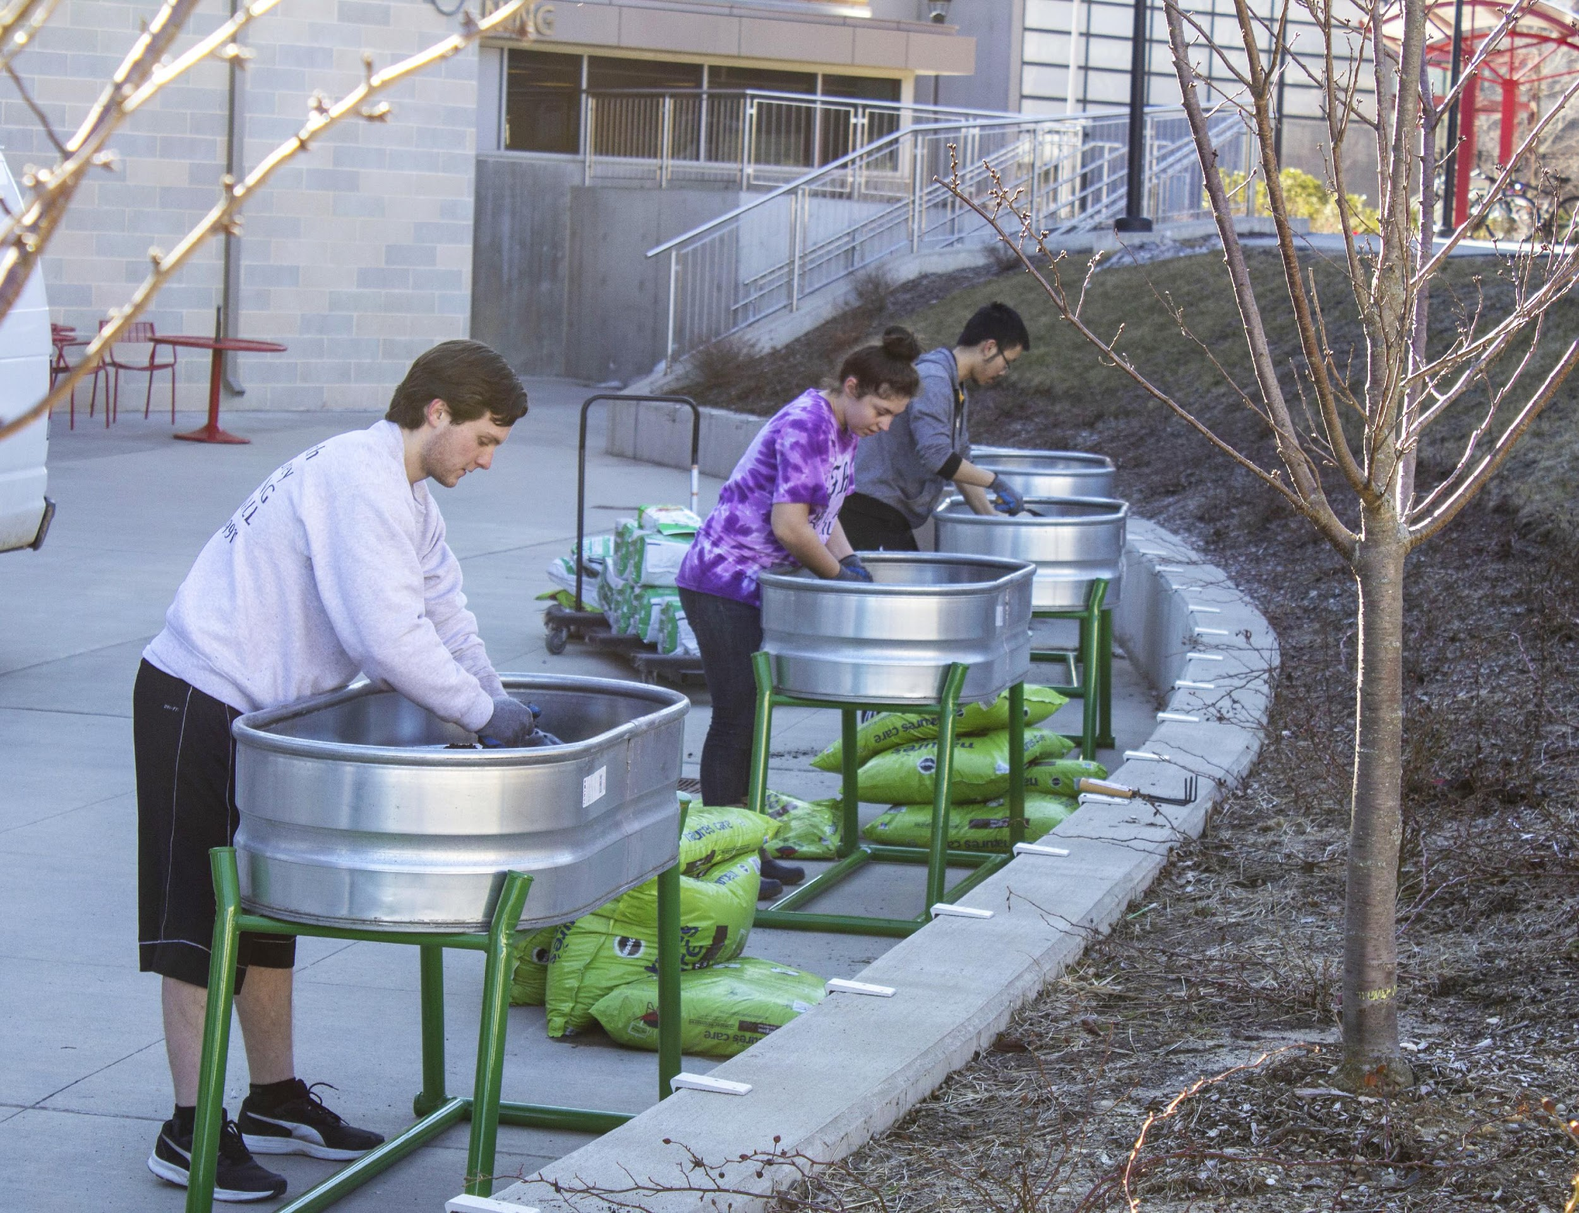
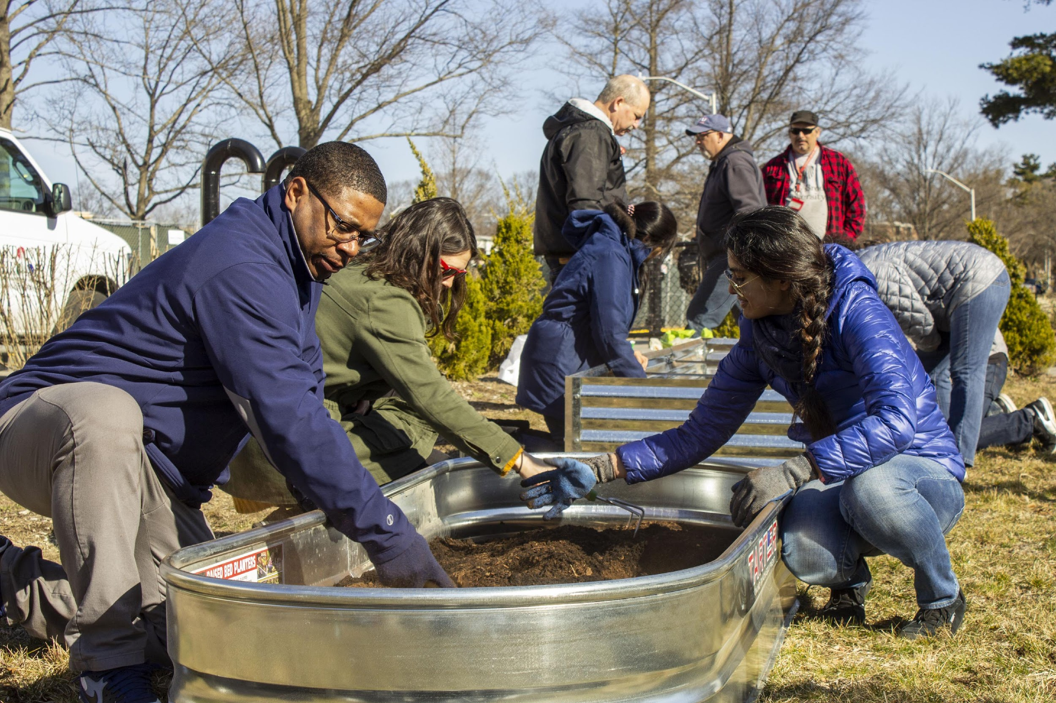
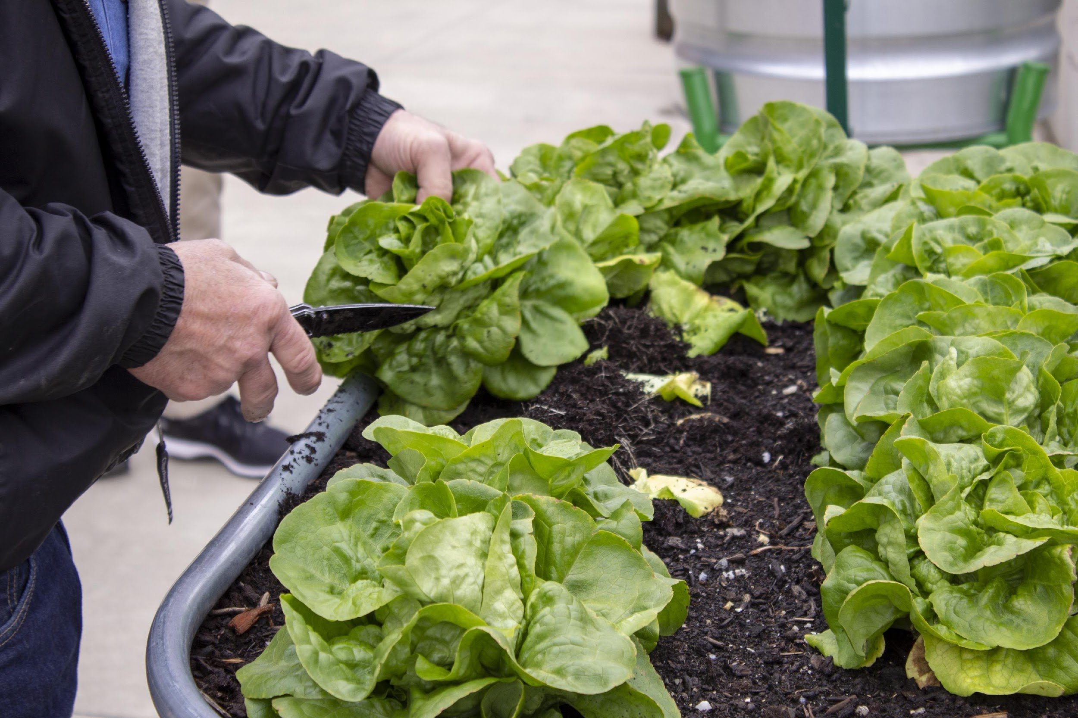
Residential Dining Gardens
Provides healthy ingredients and learning opportunities.

Slide 10
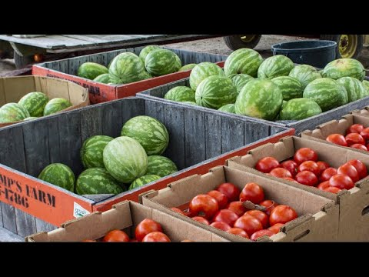
Long Island Farm Tour

Slide 11
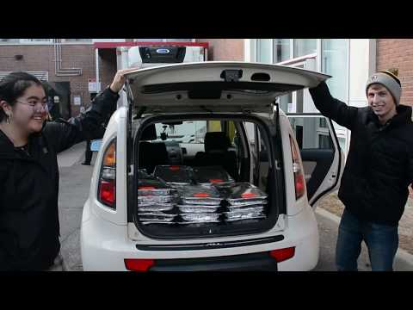
Food Recovery Network
Notes:
A national nonprofit that helps fight food waste and hunger by recovering perishable food that would otherwise go to waste from campus dining and donates it to those in need.
Student volunteers recover surplus food from CulinArt and transport it to organizations from our hunger fighting partner agency, Island Harvest.
Delivered 280 lbs. food to Hands Across Long Island (HALI) in Central Islip in a 2 week period.
Up next … recover grab and go products from our convenience stores prior to expiring and bring them to the Ronald McDonald Room at Stony Brook Children’s Hospital.

Slide 12
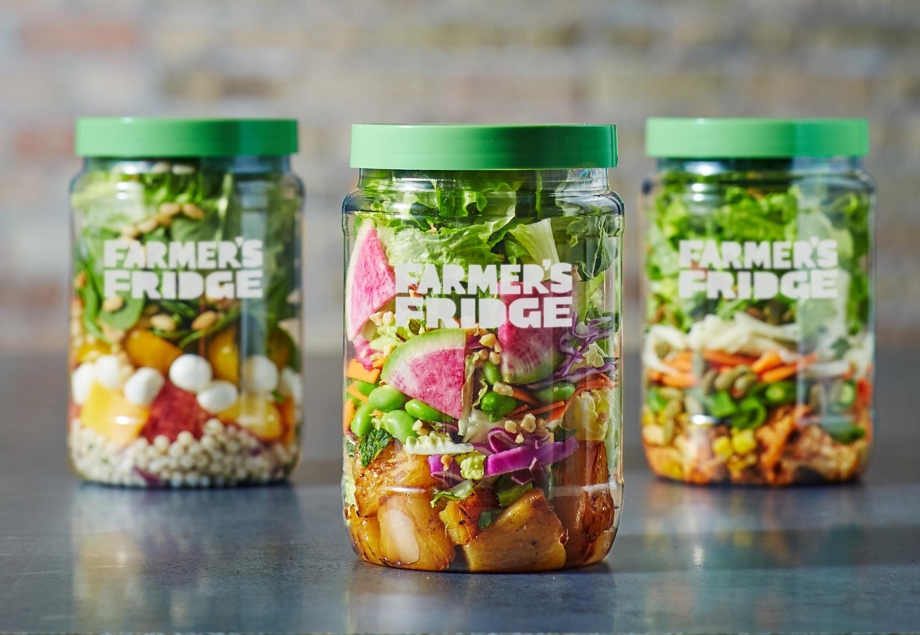
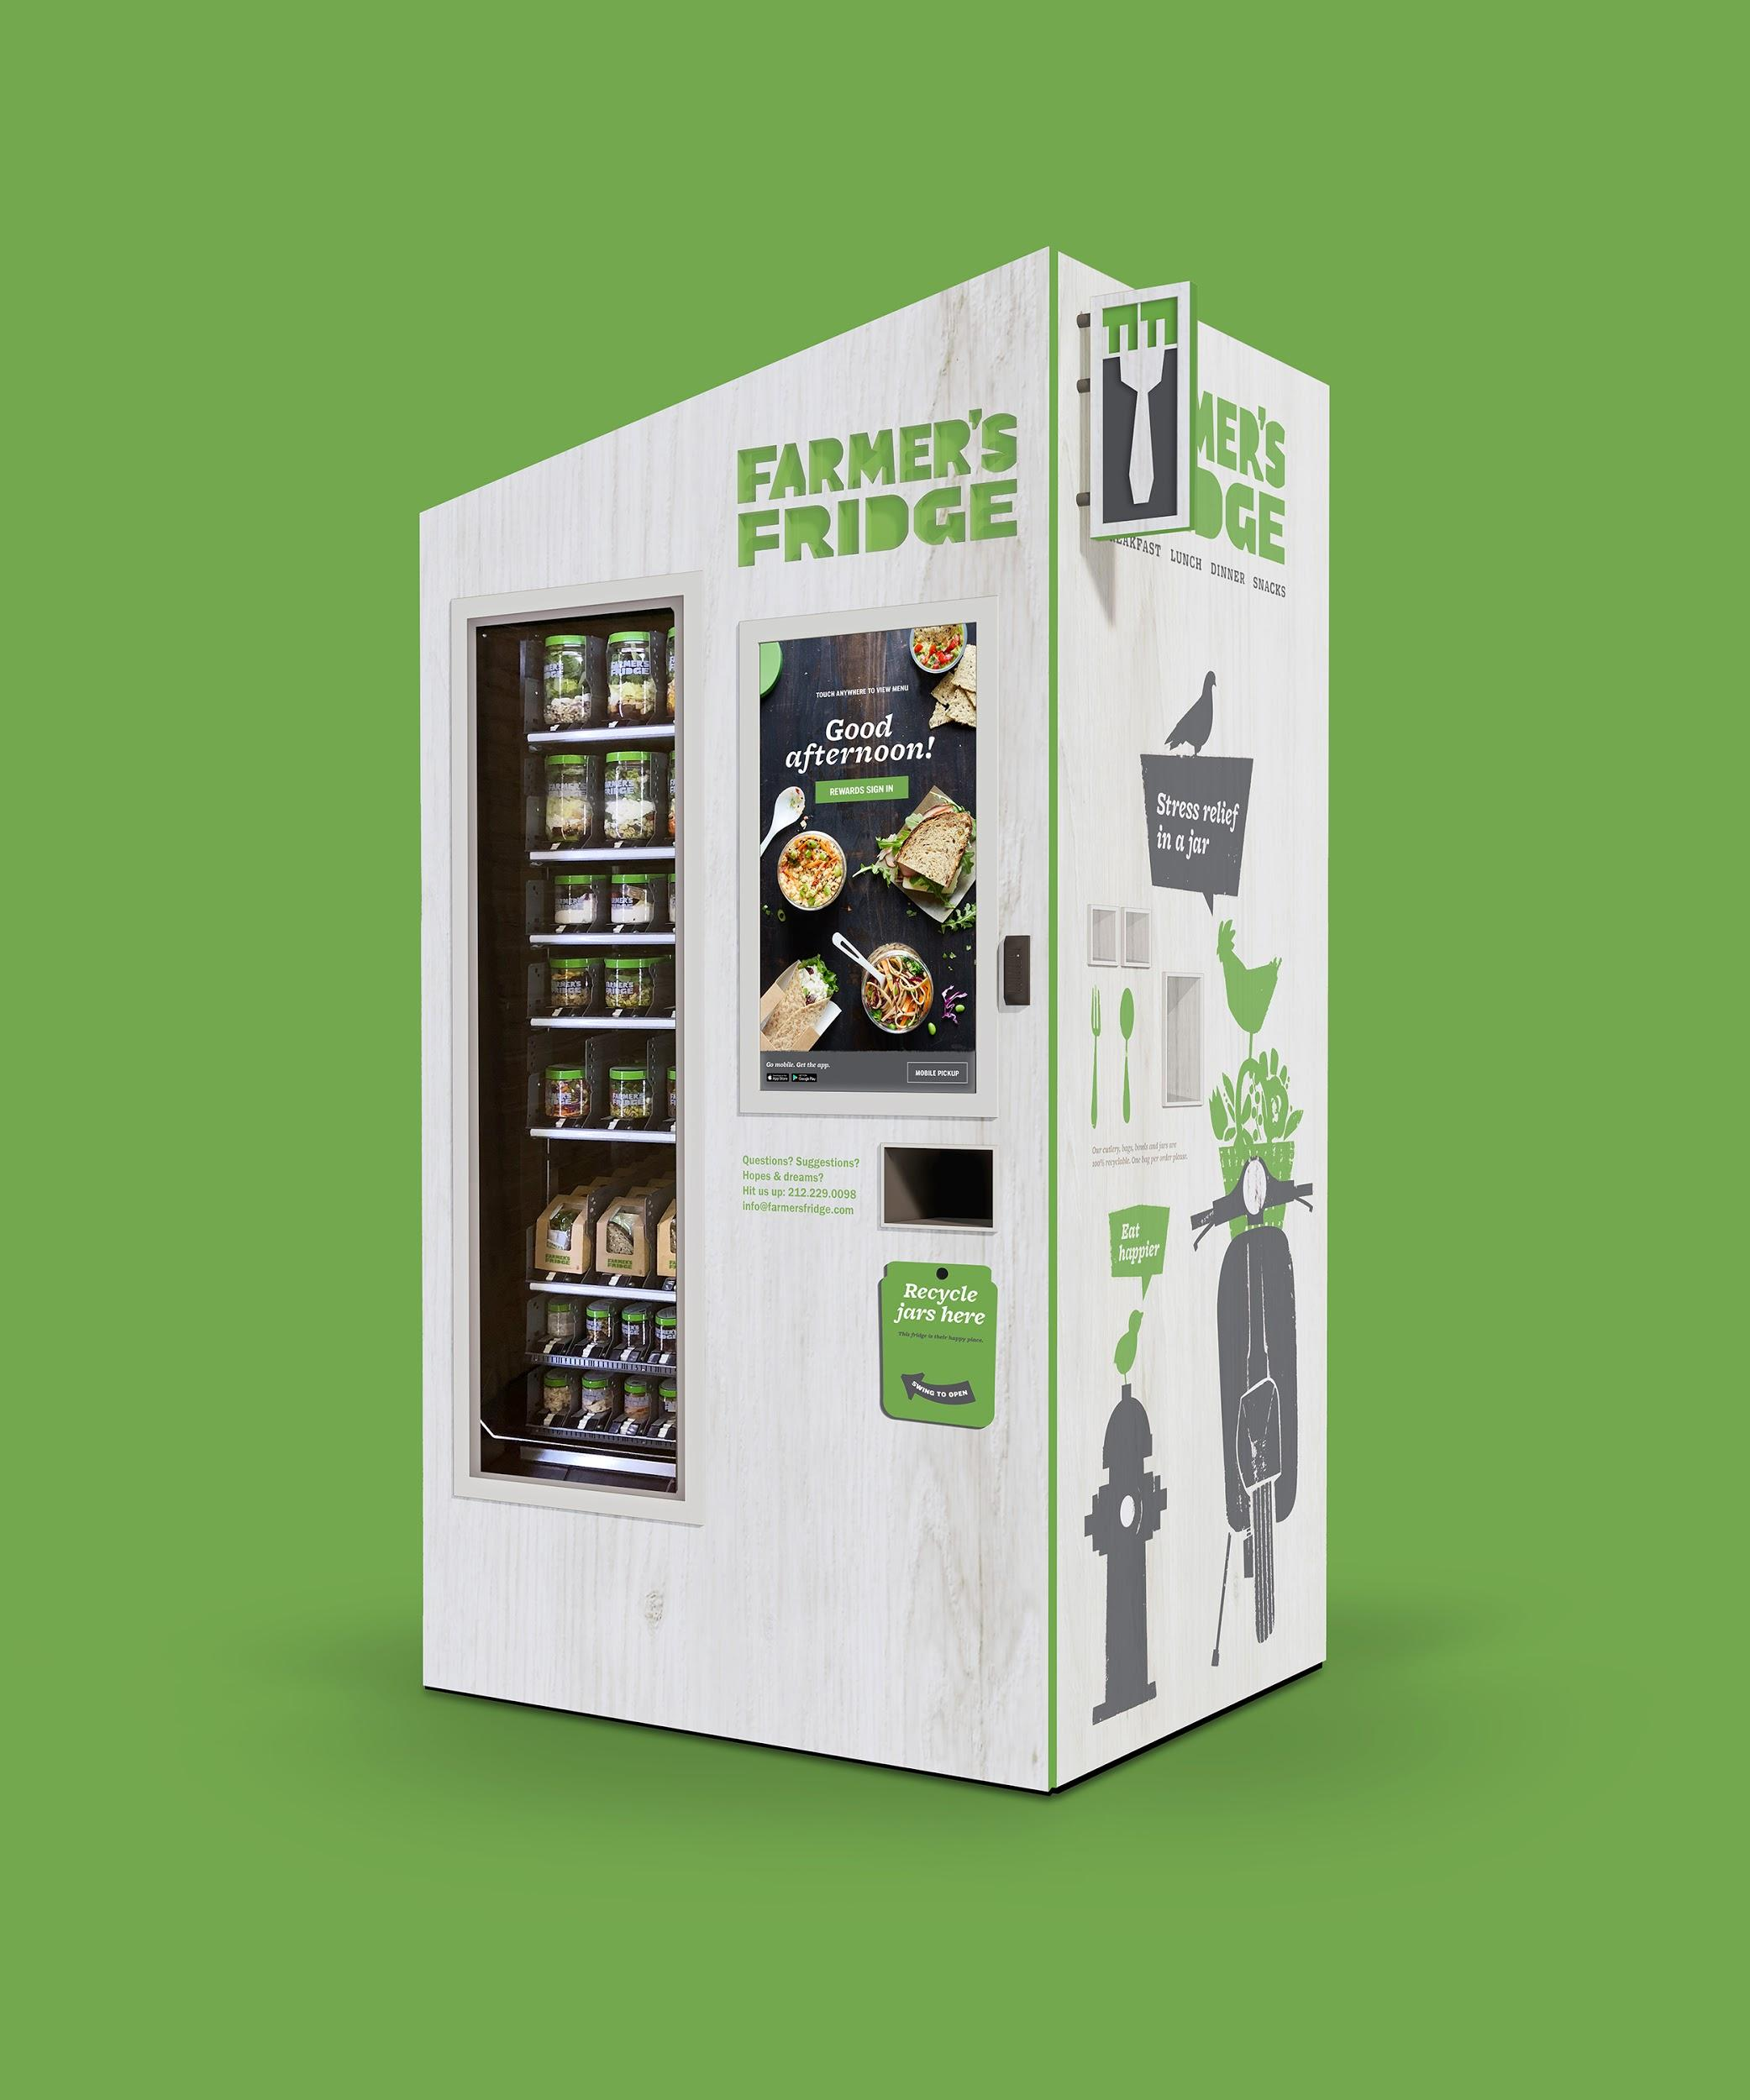
Farmers Fridge
New Vending Options
High quality and seasonal ingredients
Salads, sandwiches, bowls, and trail mix
Javits, Physics, SBS buildings and Tabler Market
Prices range from $4 to $9
Notes:
Working with Farmers Fridge so that unpurchased meals are donated to the SB Food Pantry.

Slide 13
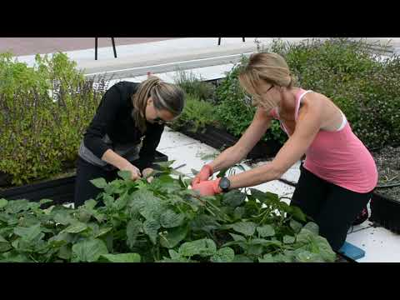
Stony Brook Hospital Rooftop Farm

Slide 14
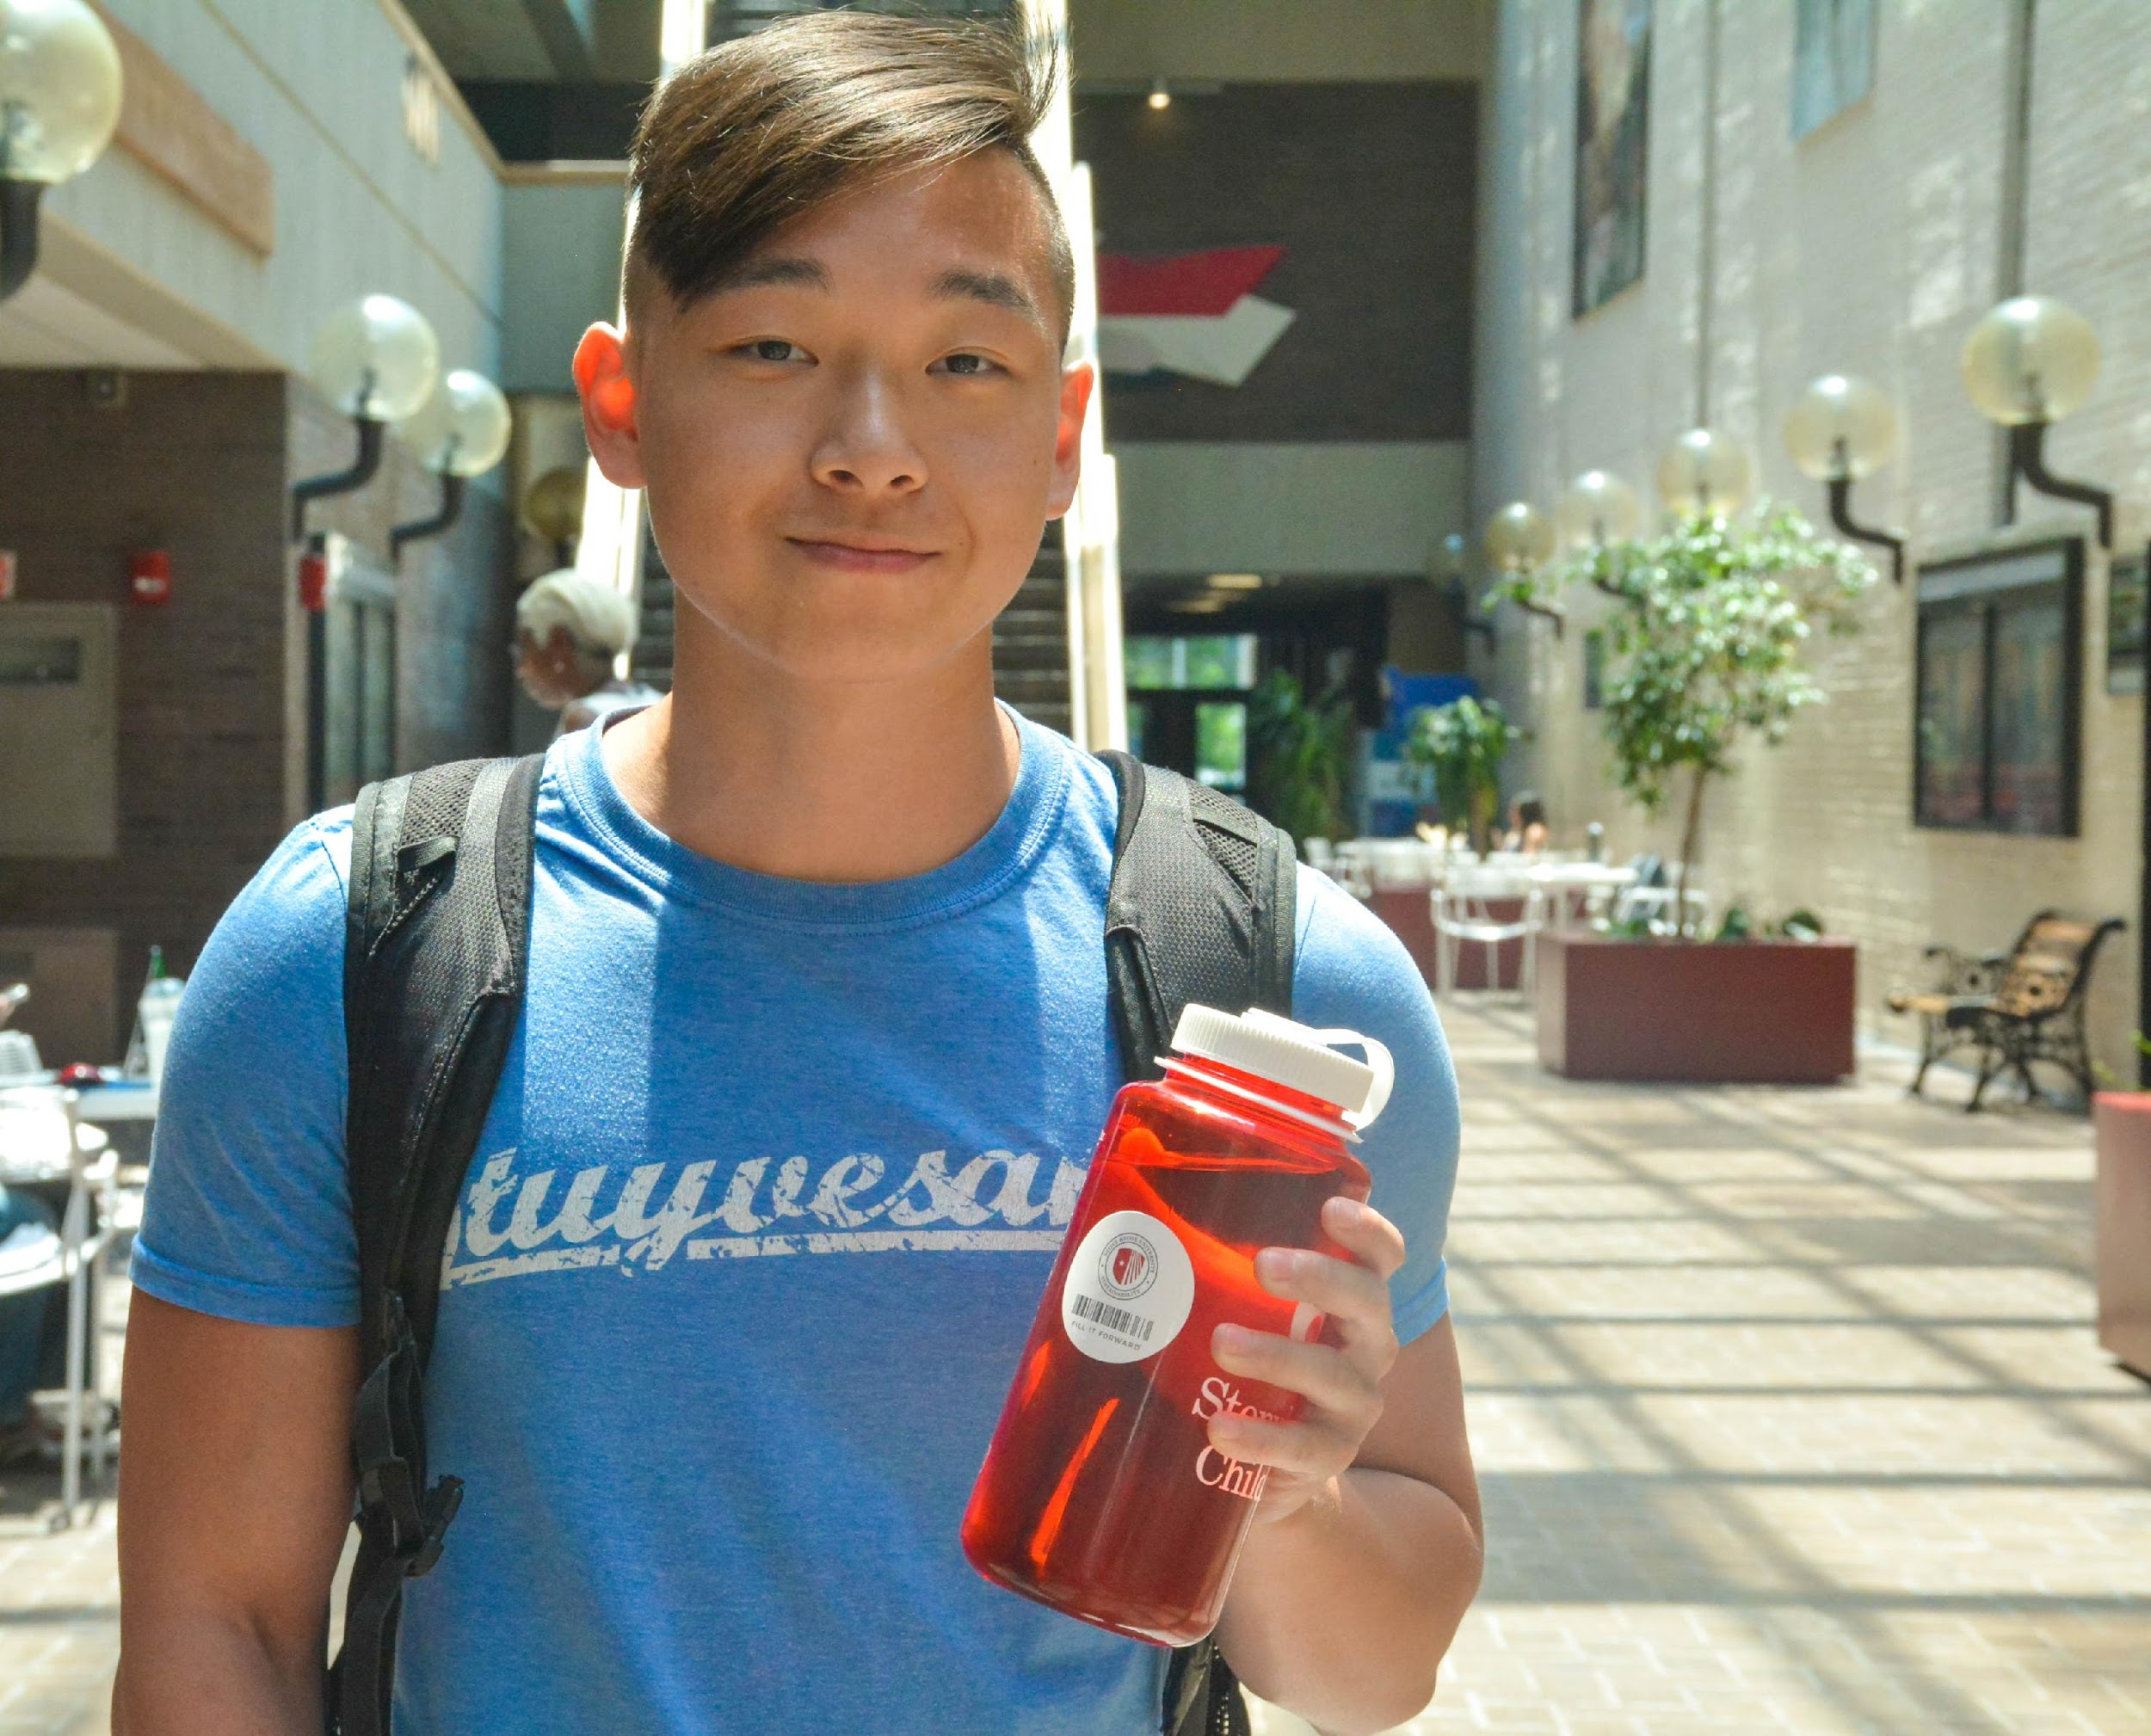
Fill it Forward
Give Clean Water, Track Your Footprint and Stay Hydrated
The Fill it Forward program offers free cup tags to students to promote sustainability, hydration and philanthropy.
Download the app
Refill your reusable water bottle
Earn rewards
Give clean water to poverty-stricken people around the world

Slide 15
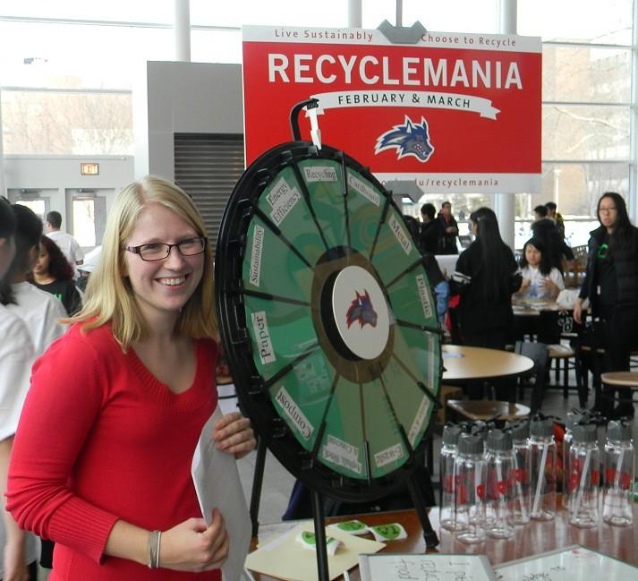
Recyclemania!
Eight week recycling competition
Reduce waste on campus
Increase recycling
Benchmark against other schools
“Get Caught Green Handed” campaign
Reusable mug program with incentives

Slide 16
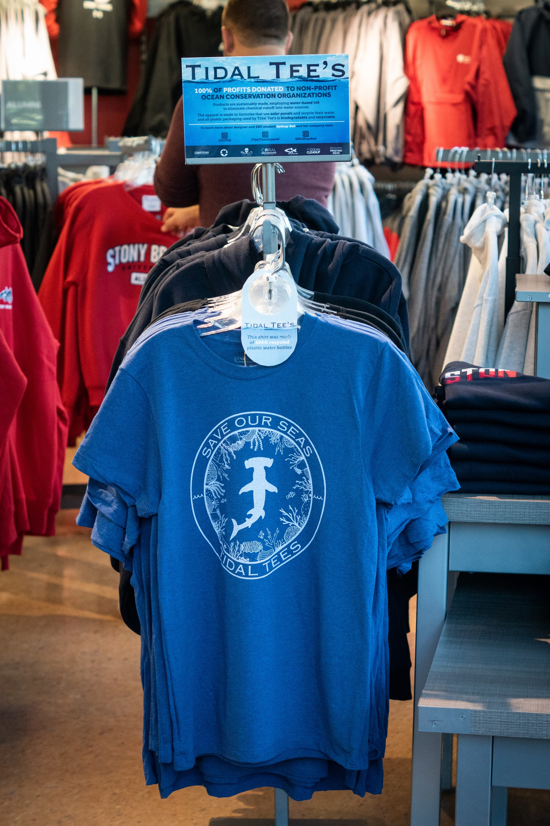
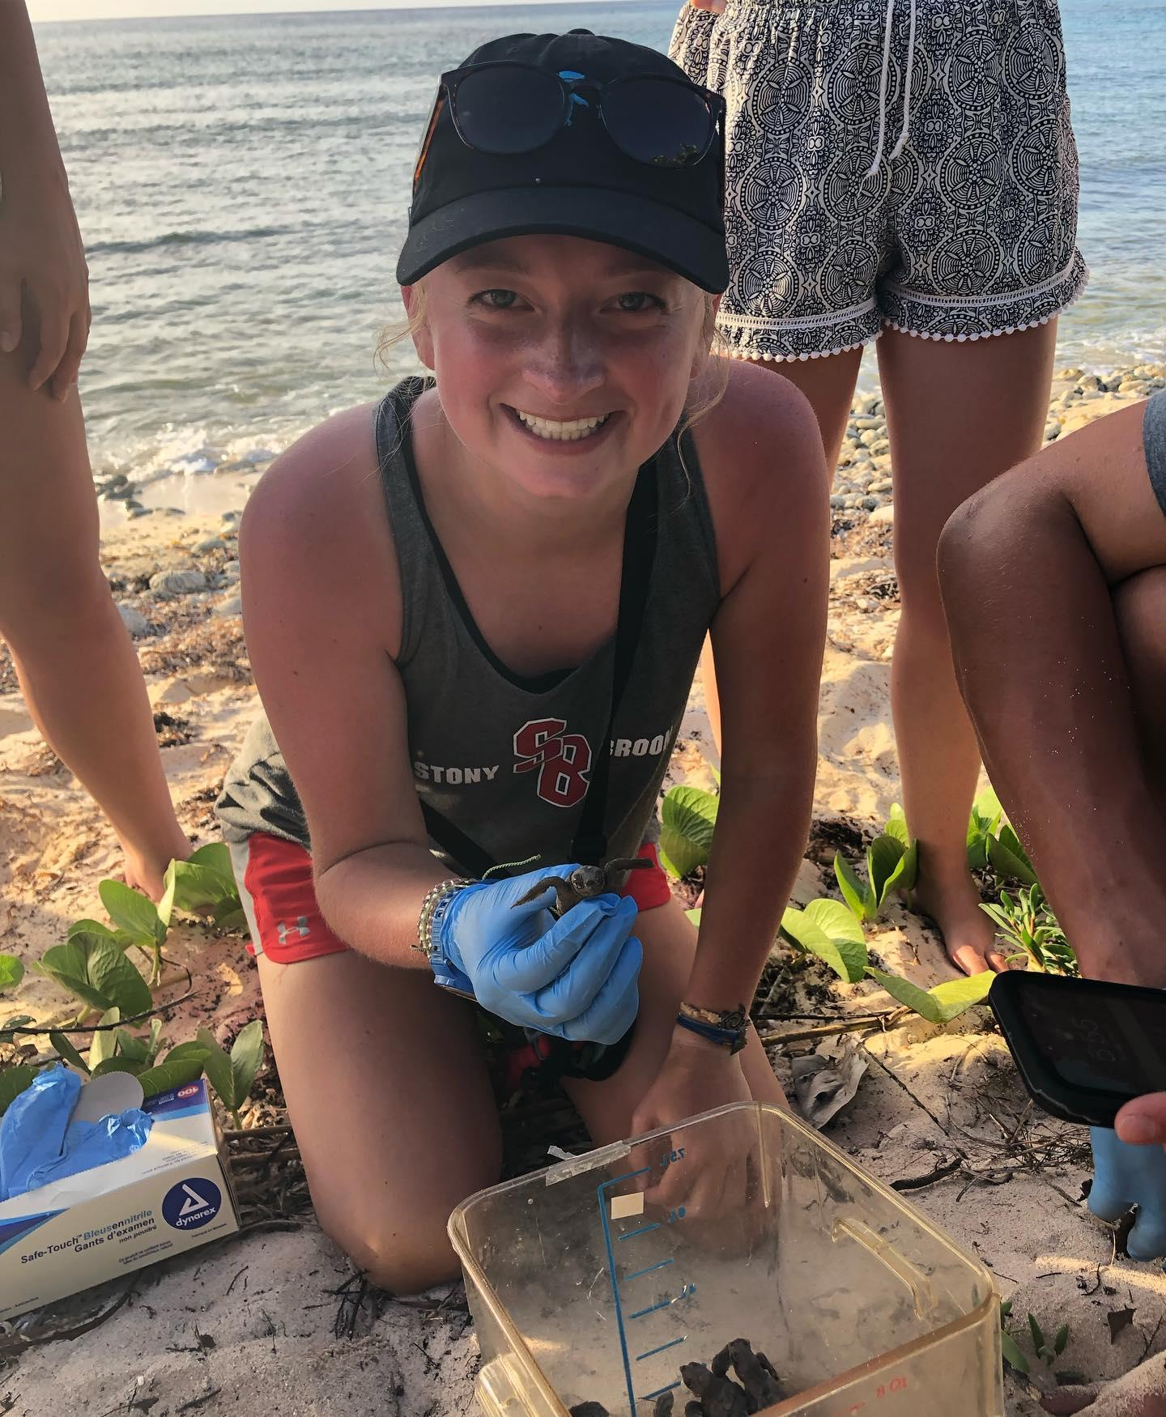
Sydney Bell - Tidal Tees
Tidal Tees apparel, an online store that sells eco-friendly apparel to help save the oceans.
Available at Stony Brook campus stores
Selected as an honoree of the Long Island Business News (LIBN) “30 Under 30” Award
Panelist for the WolfieTank Entrepreneurial Panel

Slide 17
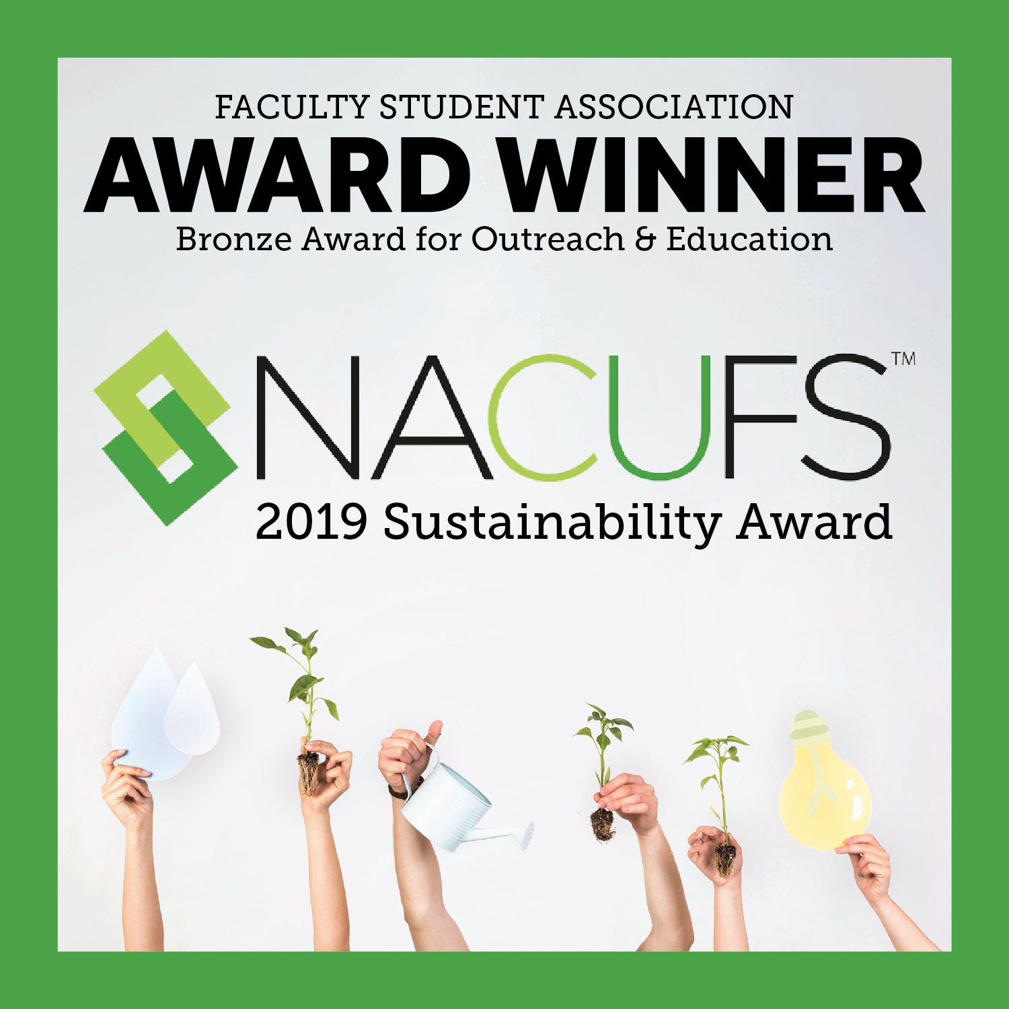
FSA earns
National Award
for Sustainability
FSA is a proud recipient of the NACUFS 2019 National Sustainability Award for Outreach and Education (Bronze Award). Together, we continue to make Stony Brook University a greener campus!

Slide 18
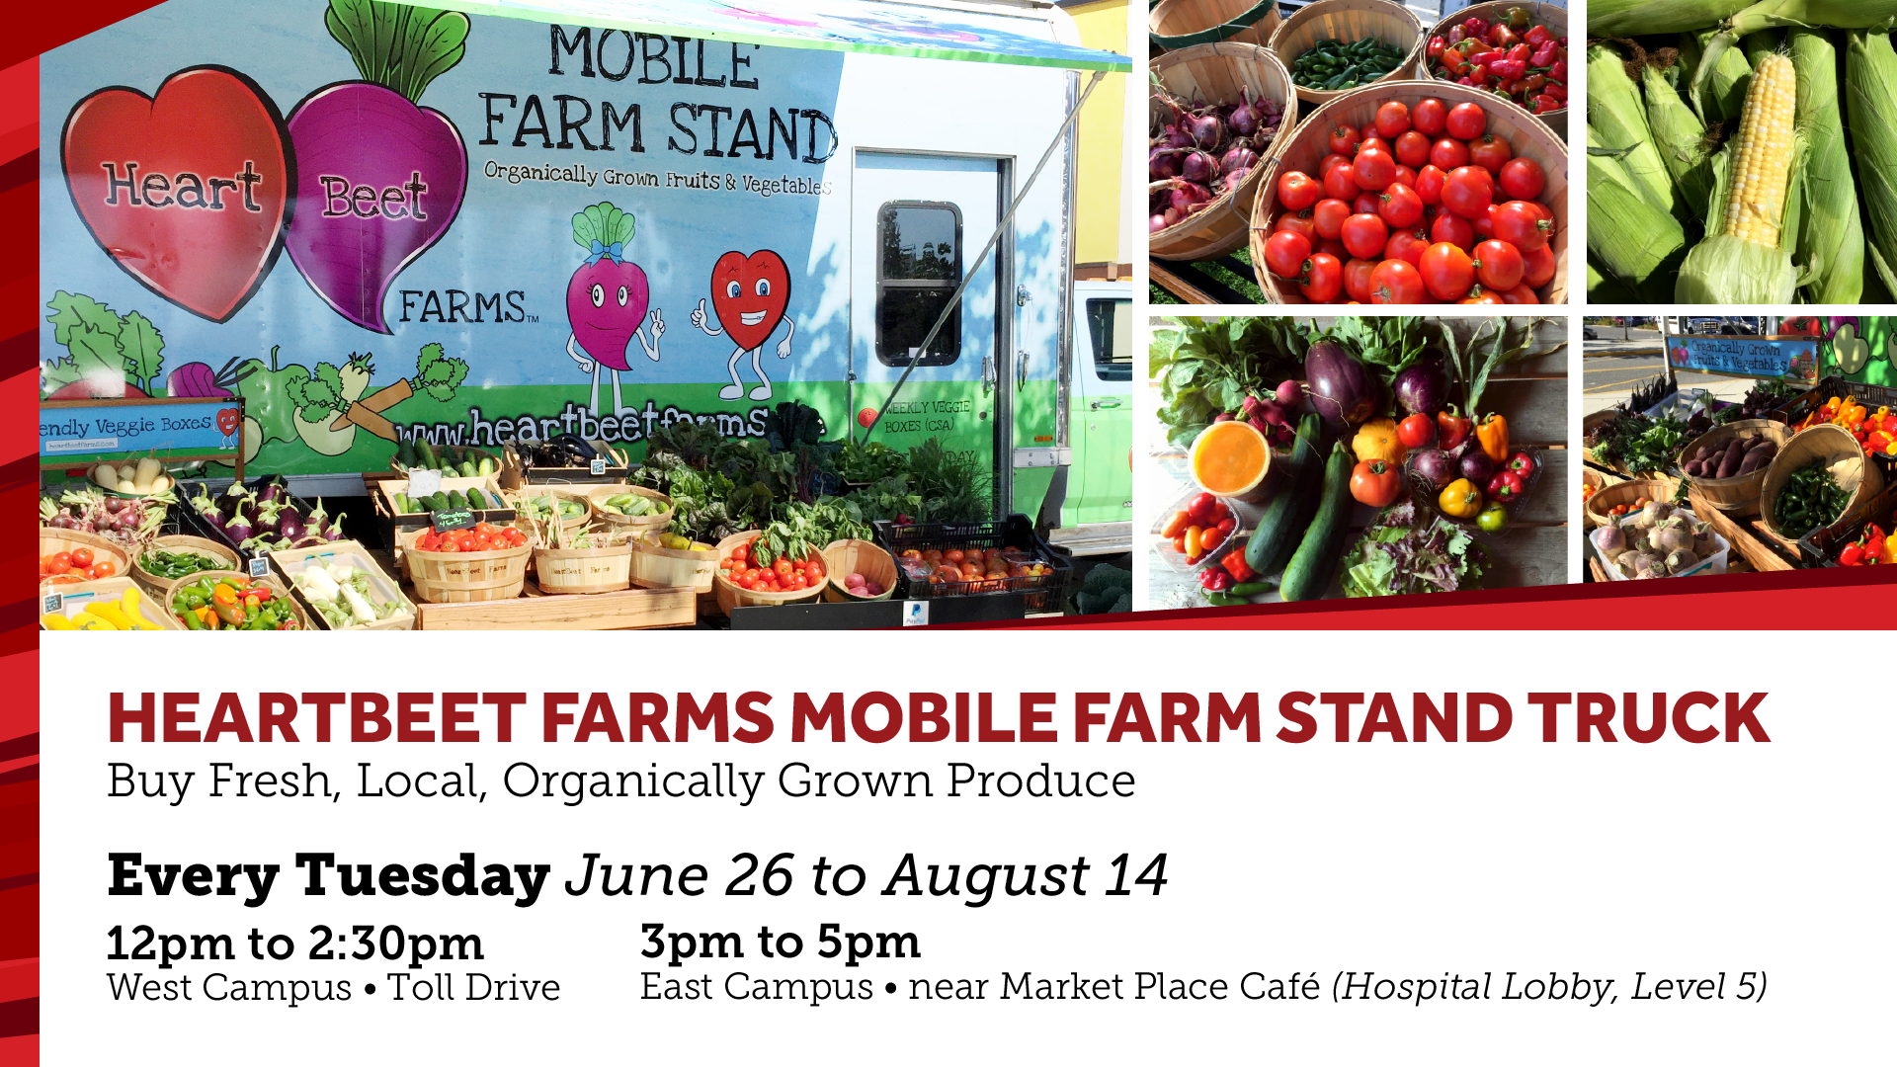

Slide 19
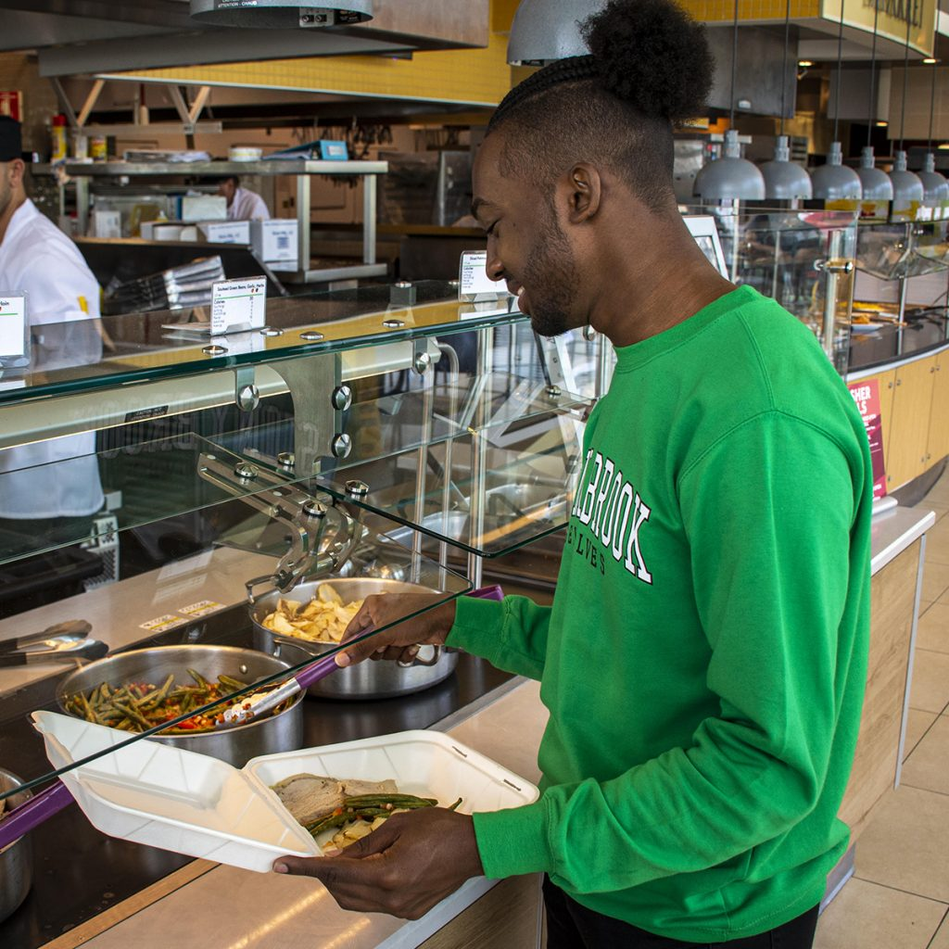
FSA Launches Major Plastic Waste
Reduction in Dining Services
The shift began last spring at Midnight Breakfast where alternative serviceware was used instead of plastic materials and utensils to serve more than 2,900 students.
This academic year dining locations have transitioned away from using disposable plastics and instead are using compostable containers made from sugarcane, paper products and Greenware, drink cups and containers made entirely from annually renewable plants – not petroleum.
“Sustainability is making choices with long-term perspectives to the environment and society. By leading the initiative with FSA to transition away from using disposable plastics, and instead using compostable containers, we are guiding Seawolves to live a greener and more sustainable lifestyle,” explained Shaheer Khan, USG President.

Slide 20
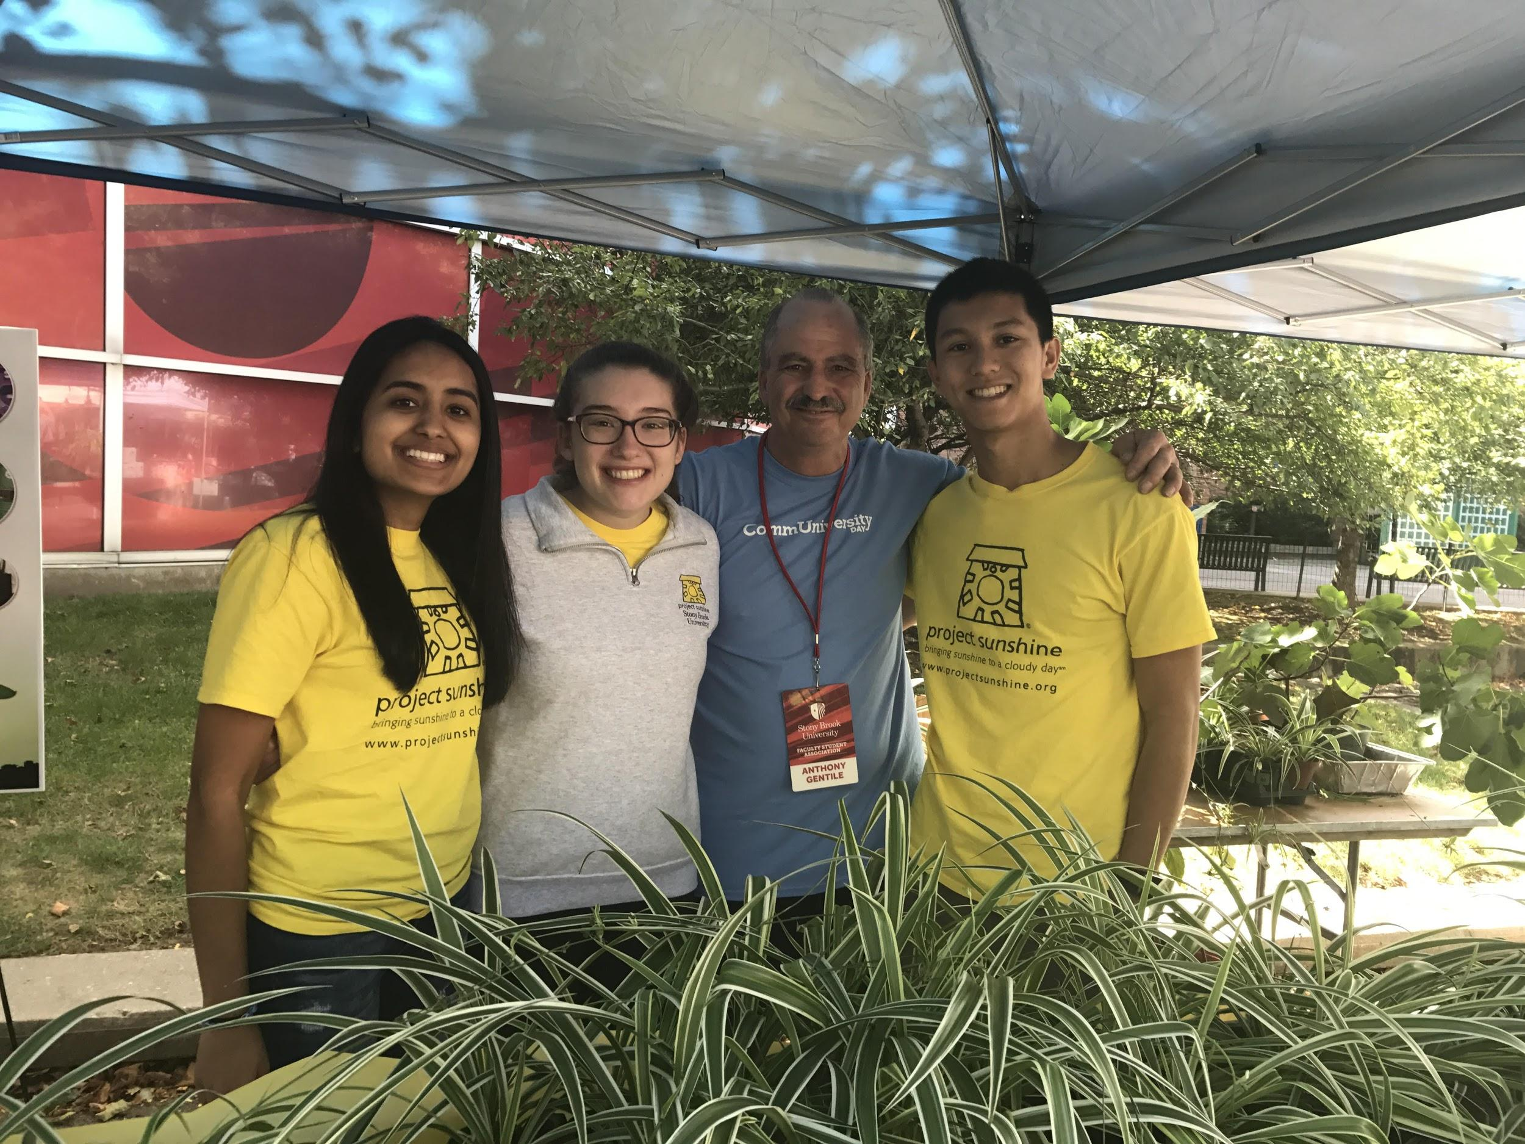
FSA Launches Major Plastic Waste
Reduction in Dining Services
Plastic clamshell containers (24,000) replaced with a hinged container made from sugarcane.
The reusable takeout container program (5000) is now offered at three dining locations.
Plastic hero sandwich containers replaced with paper boats and paper liners.
Soup container plastic lids have been replaced with paper lids.
Stir-fry to-go containers with plastic lids have been replaced with a lid made from pulp.
Smoothie cups are made from Greenware plant-based containers.
The new ecotainer coffee cups (96,000) have lids made from pulp.

Slide 21
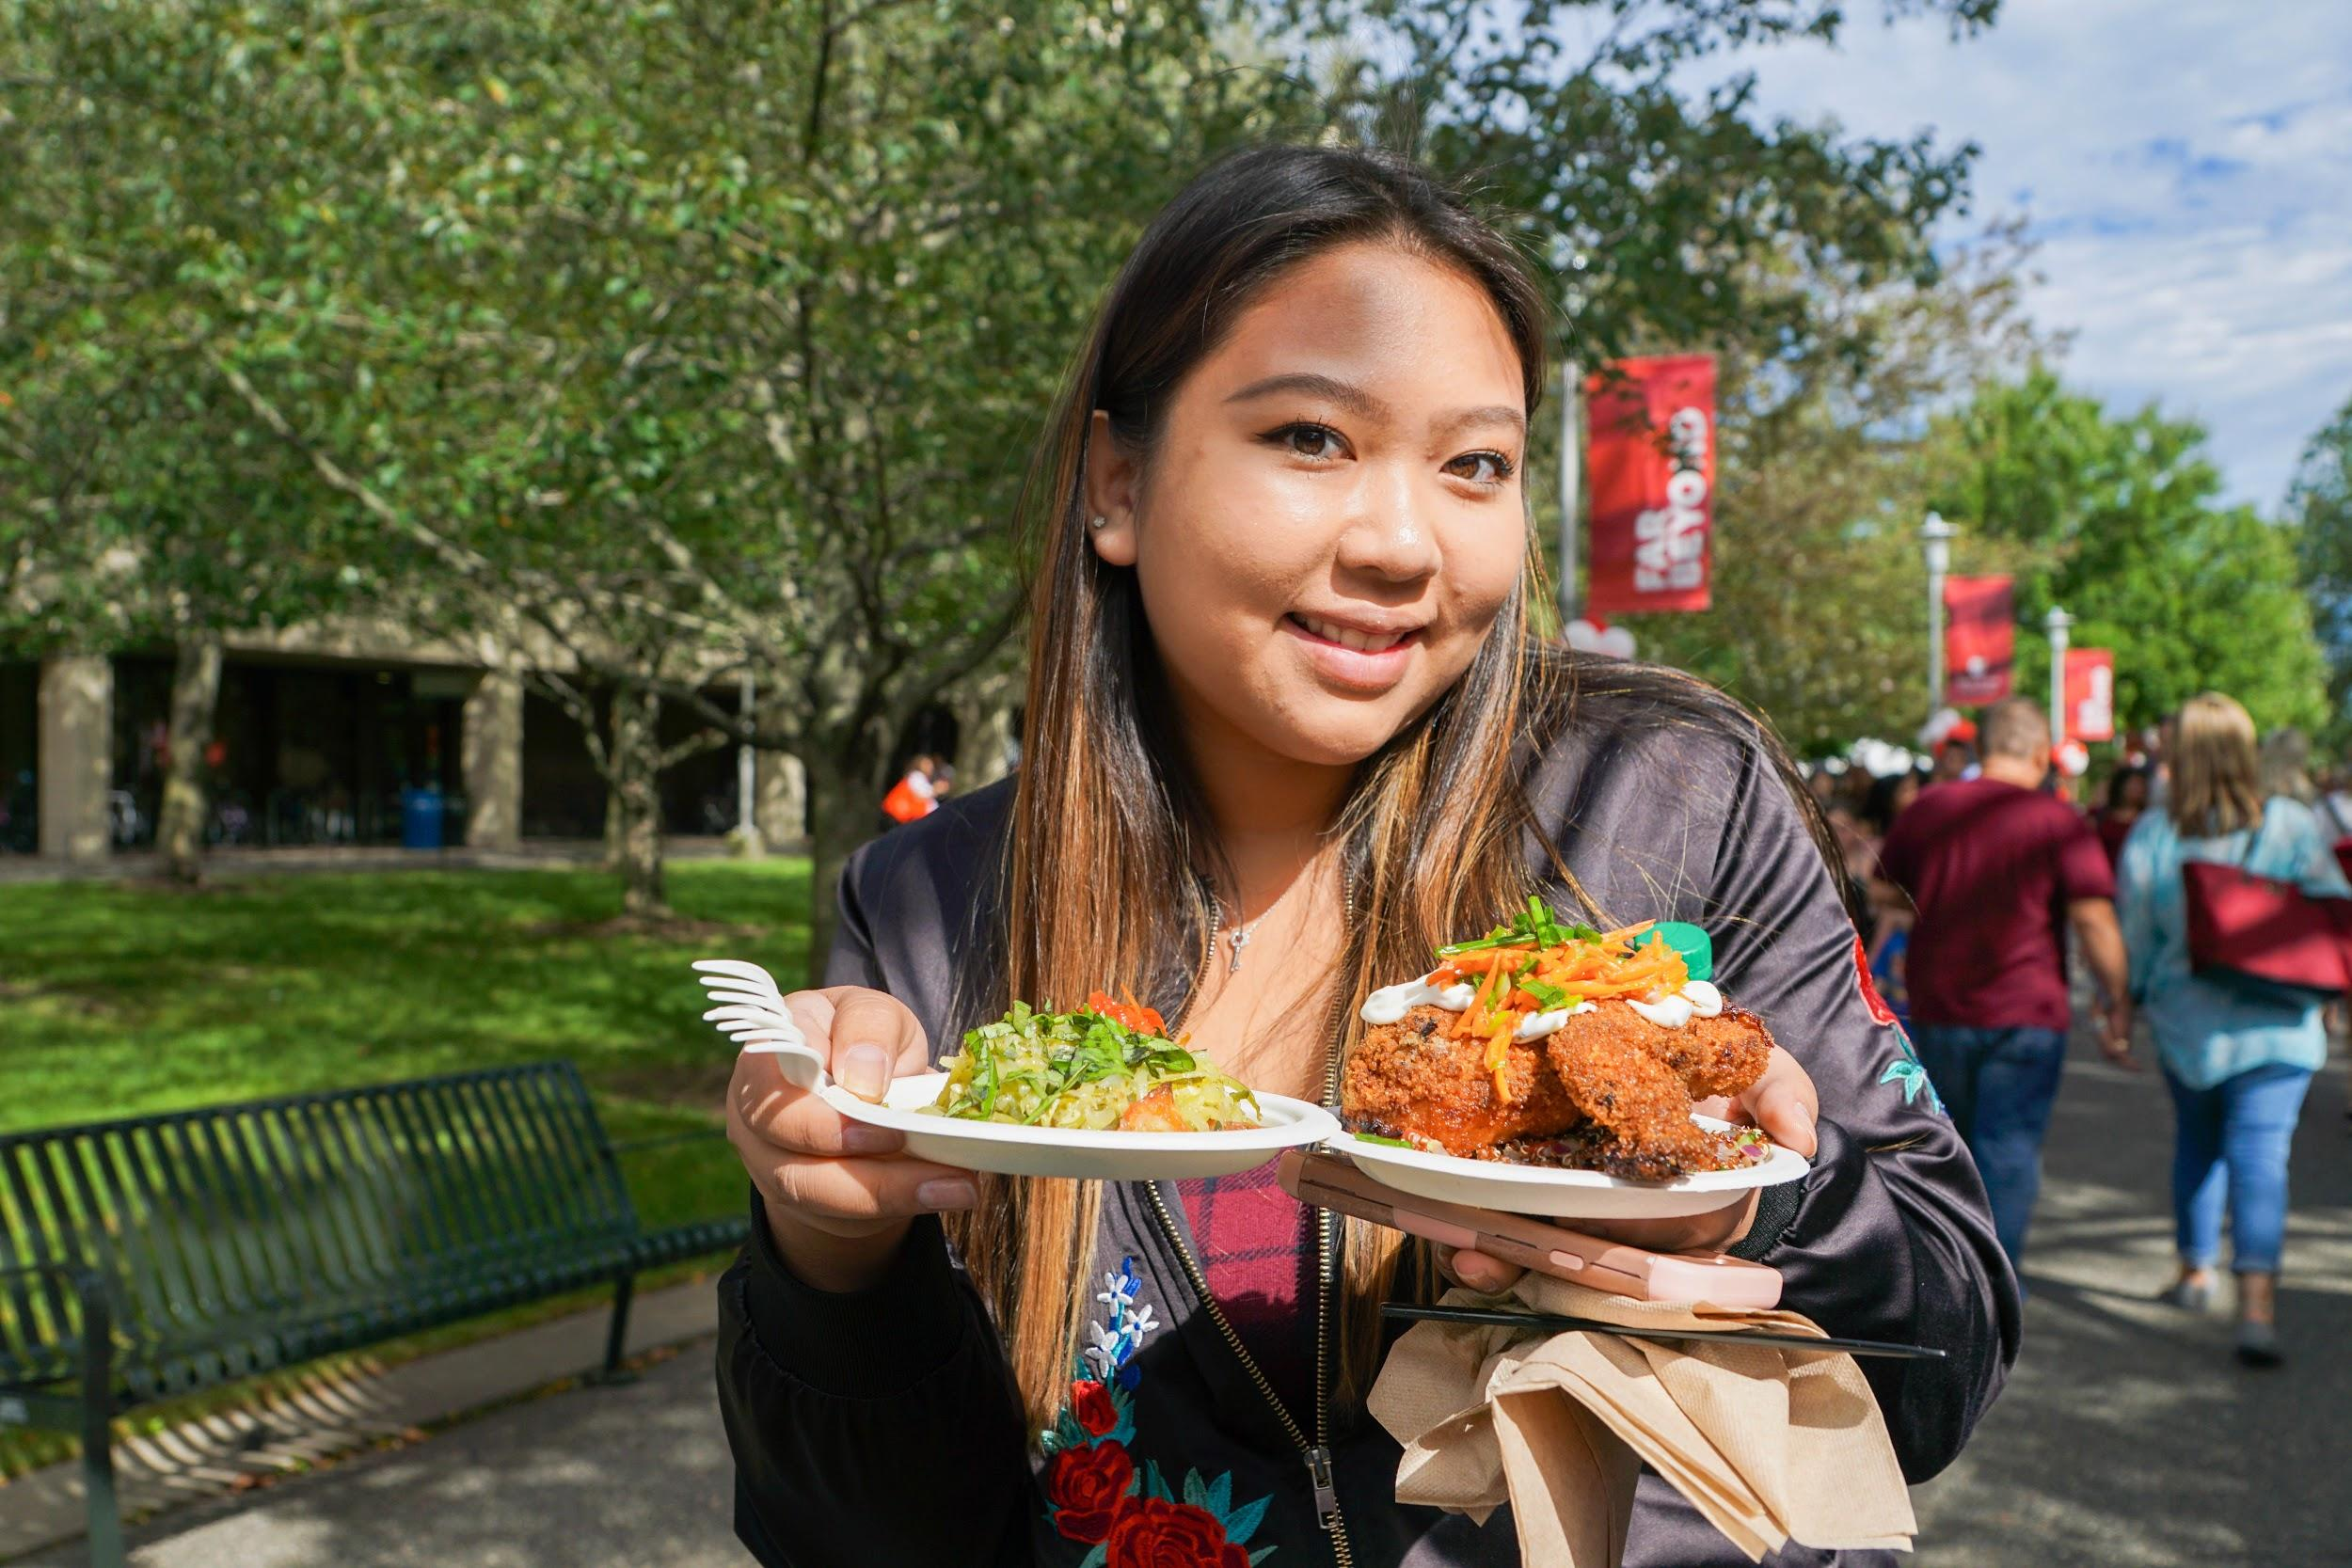
FSA Launches Major Plastic Waste
Reduction in Dining Services
Plastic straws have been eliminated from dining locations, corn straws are only available upon request at the cashier. T
Our campus convenience stores no longer offer plastic bags for purchase and instead sell reusable tote bags
“We pride ourselves on finding ways to make Stony Brook a more sustainable campus, and this impactful transition away from disposable plastics will annually decrease the use of over 300,000 plastic serveware items from the SAC Food Court, for instance,” stated Dawn Villacci, FSA Manager for Campus Dining.

