Slide 1
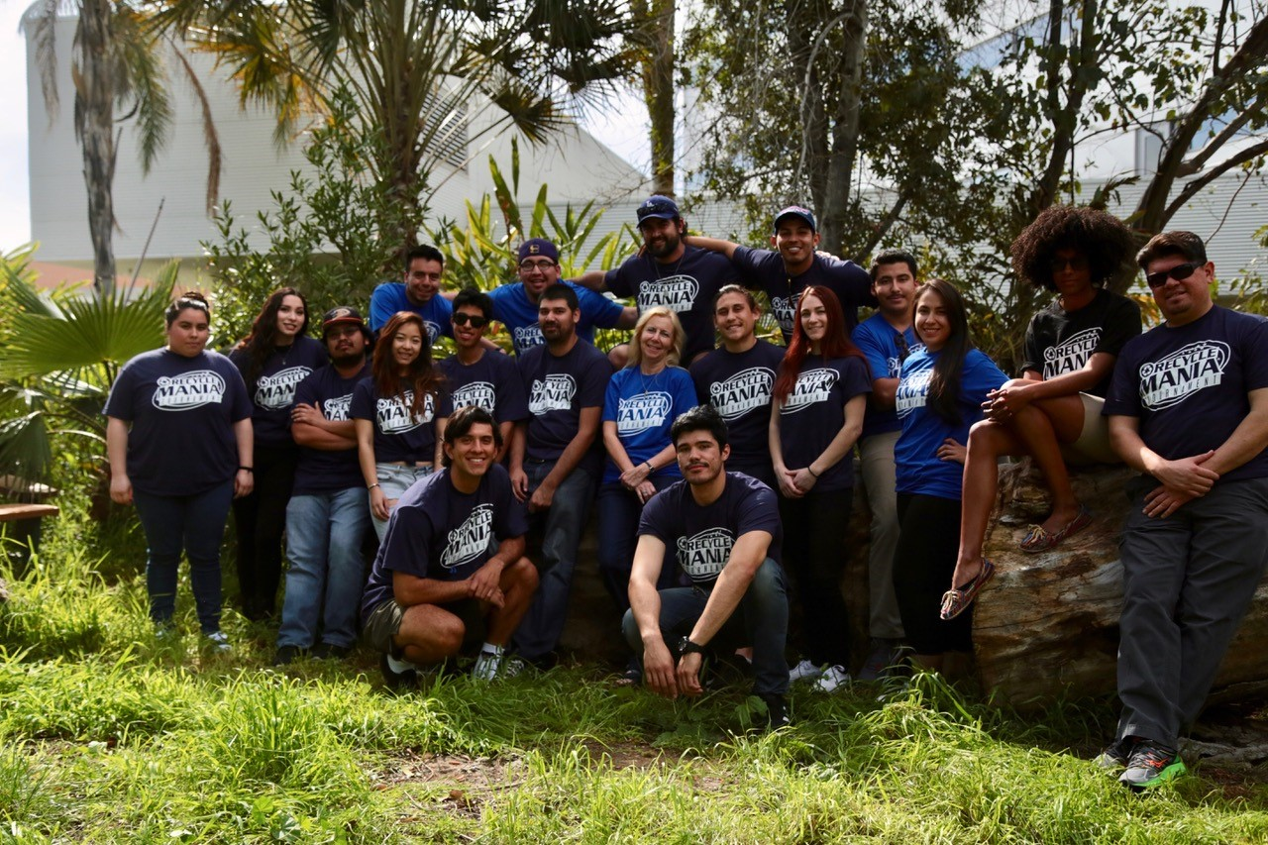
What is RecycleMania?
8 week college & university competition to reduce waste & increase recycling.
Takes place February-March
Campuses have several category choices (participate in one or more):
4 main categories: 8 weeks (report each week)
3 special categories,
one-time reporting
Free to participate
Flexible
California State University Northridge

Slide 2
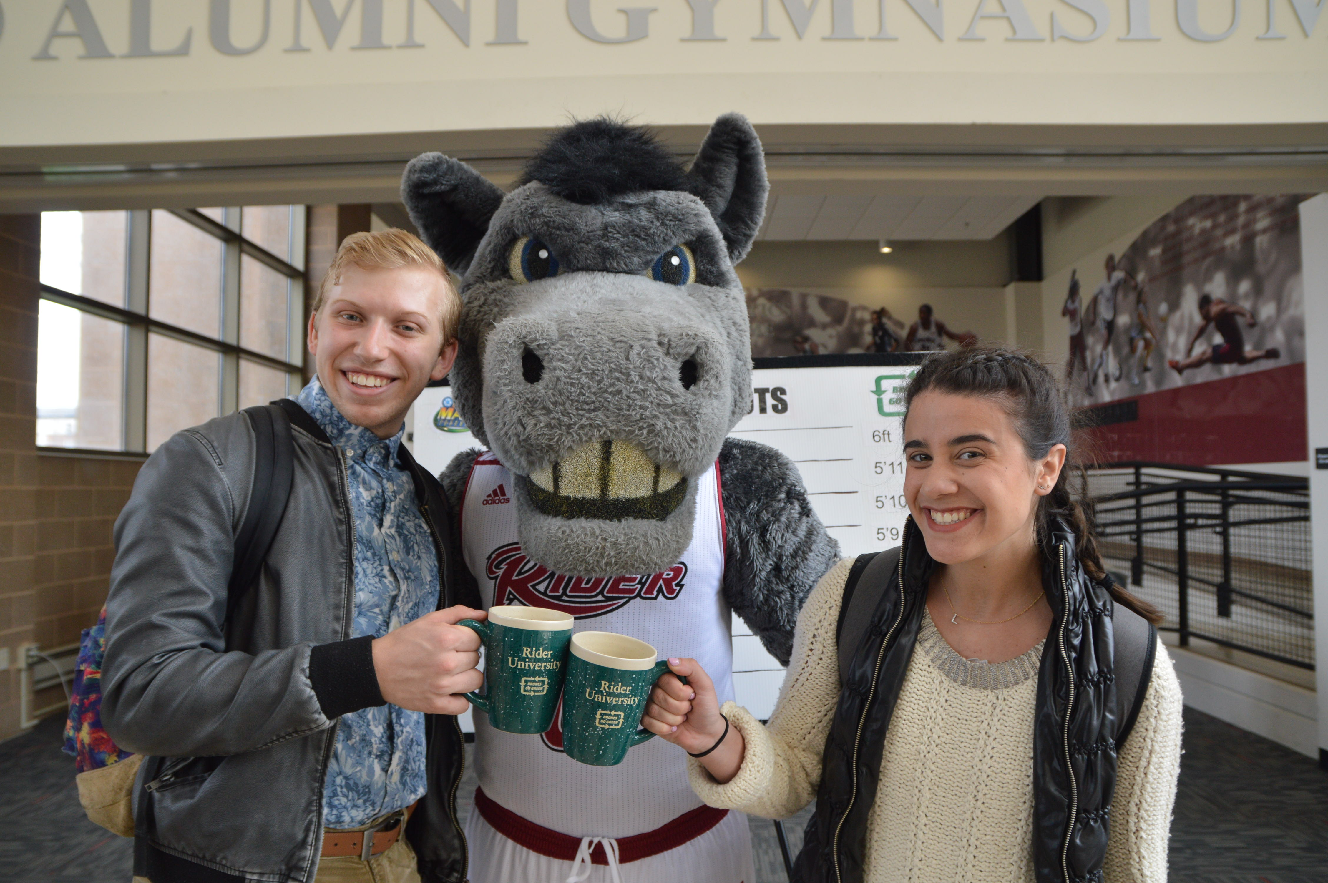
Through RecycleMania, Campuses Can:
Set a benchmark to help set waste reduction goals & develop waste management plans.
Increase recycling & test new strategies to reduce contamination.
Tackle plastic pollution on campus through waste minimization practices.
Host a campus & community event to recycle electronics.
Green your basketball games through GameDay Basketball.
Ramp up zero waste efforts through the NEW Zero Waste category!
Rider University
RecycleMania is a great engagement tool for students and helps build
leadership skills!
RecycleMania Activity Guide for Freshmen, Dorm Dwellers and Student Leaders

Slide 3
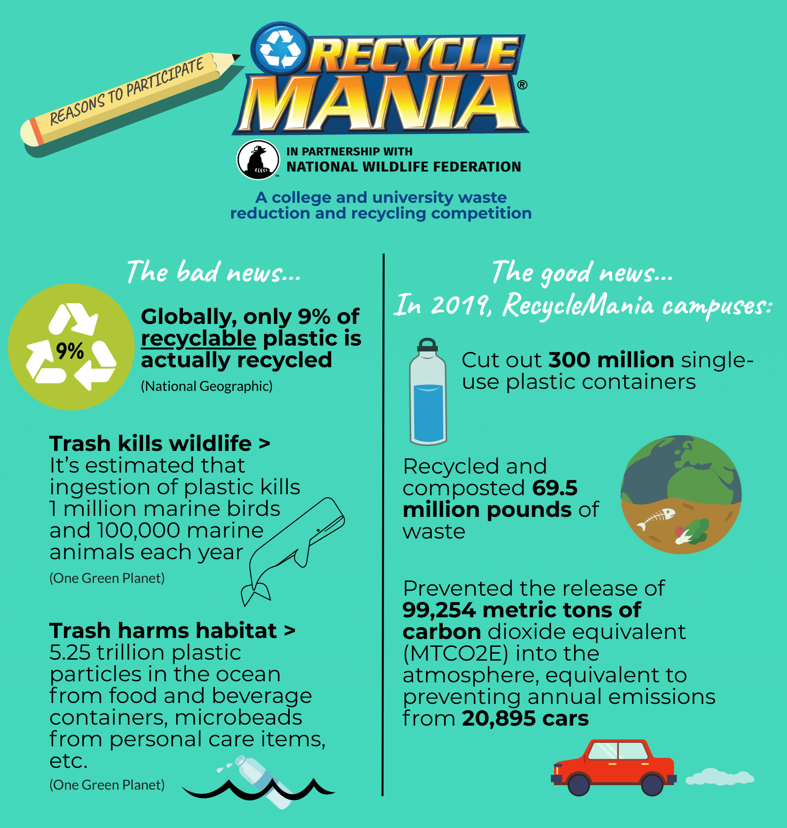
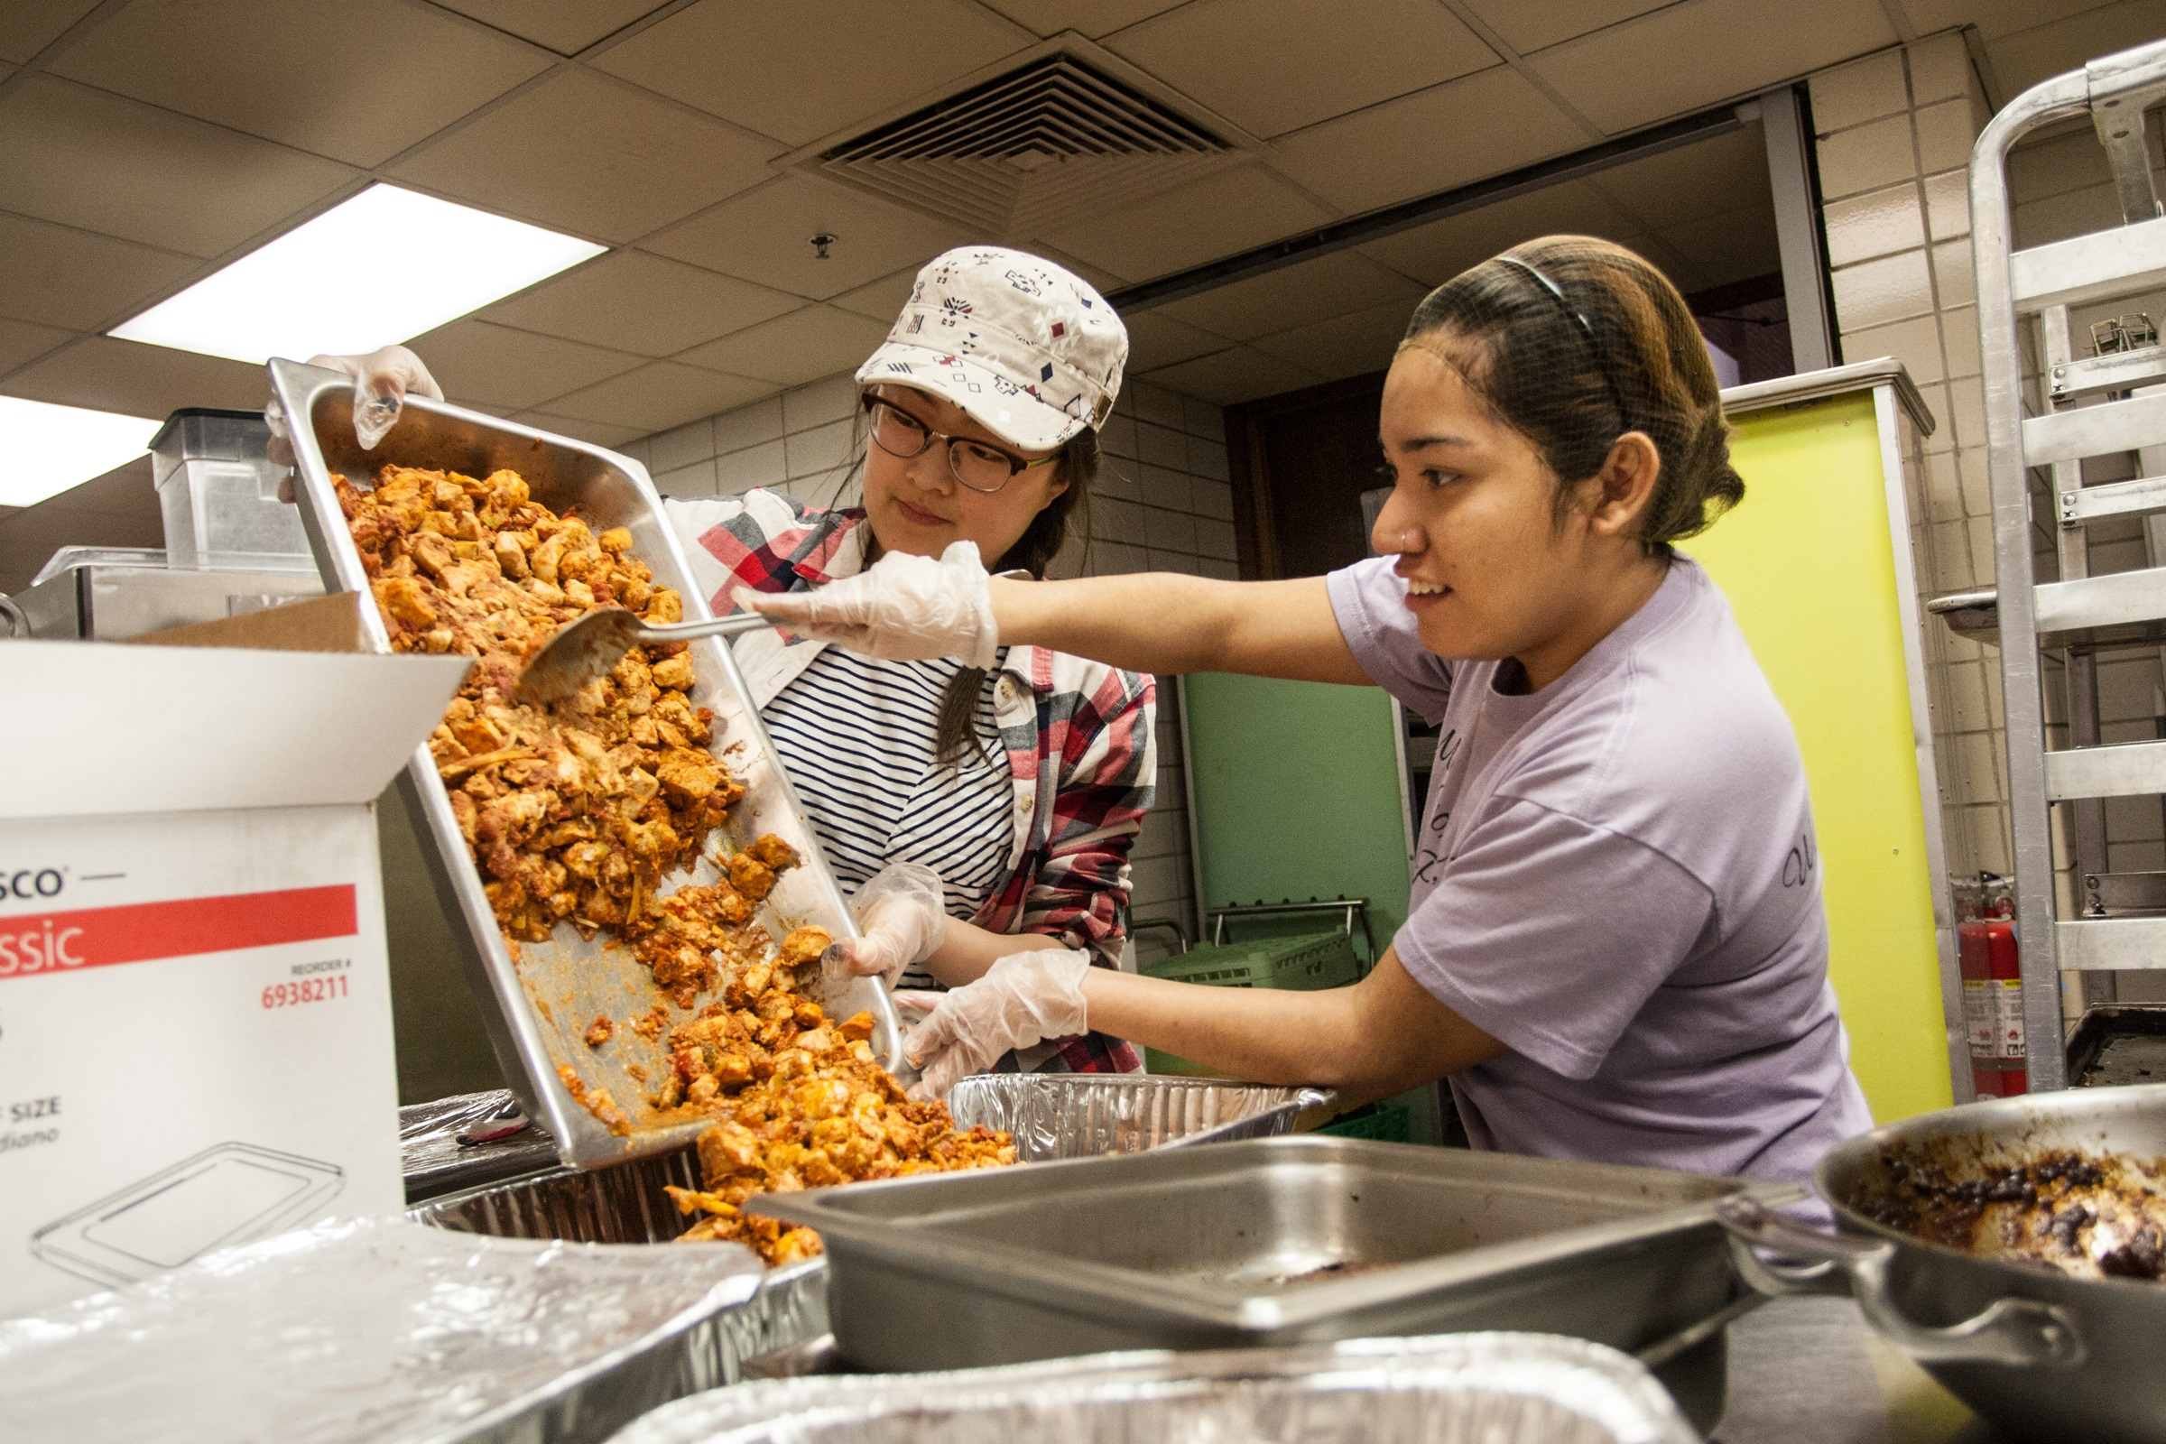
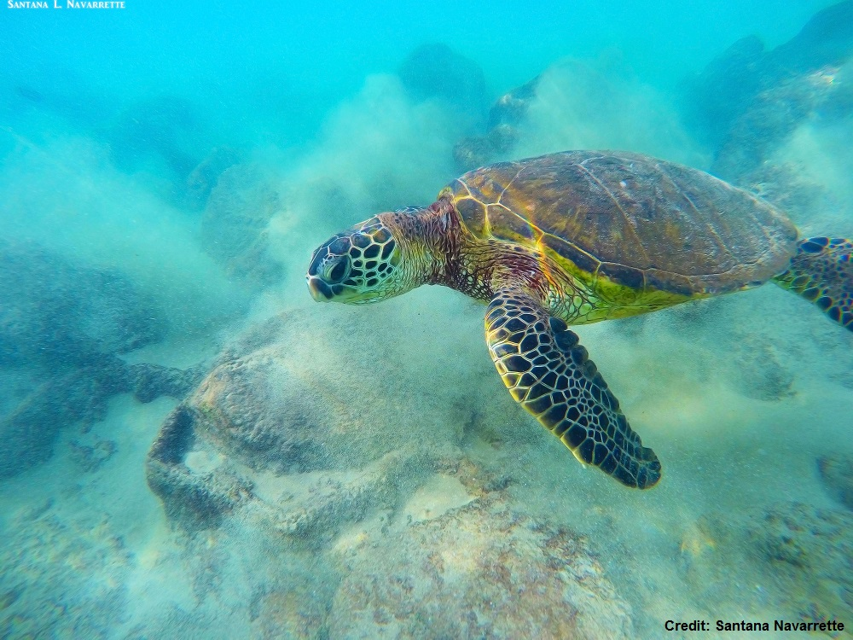
Knox College
Notes:
As a wildlife organization committed to protecting wildlife and habitat we are very interested in working with campuses to address the plastic pollution issue, and help schools reduce their use of plastics, and increase responsible recycling.

Slide 4
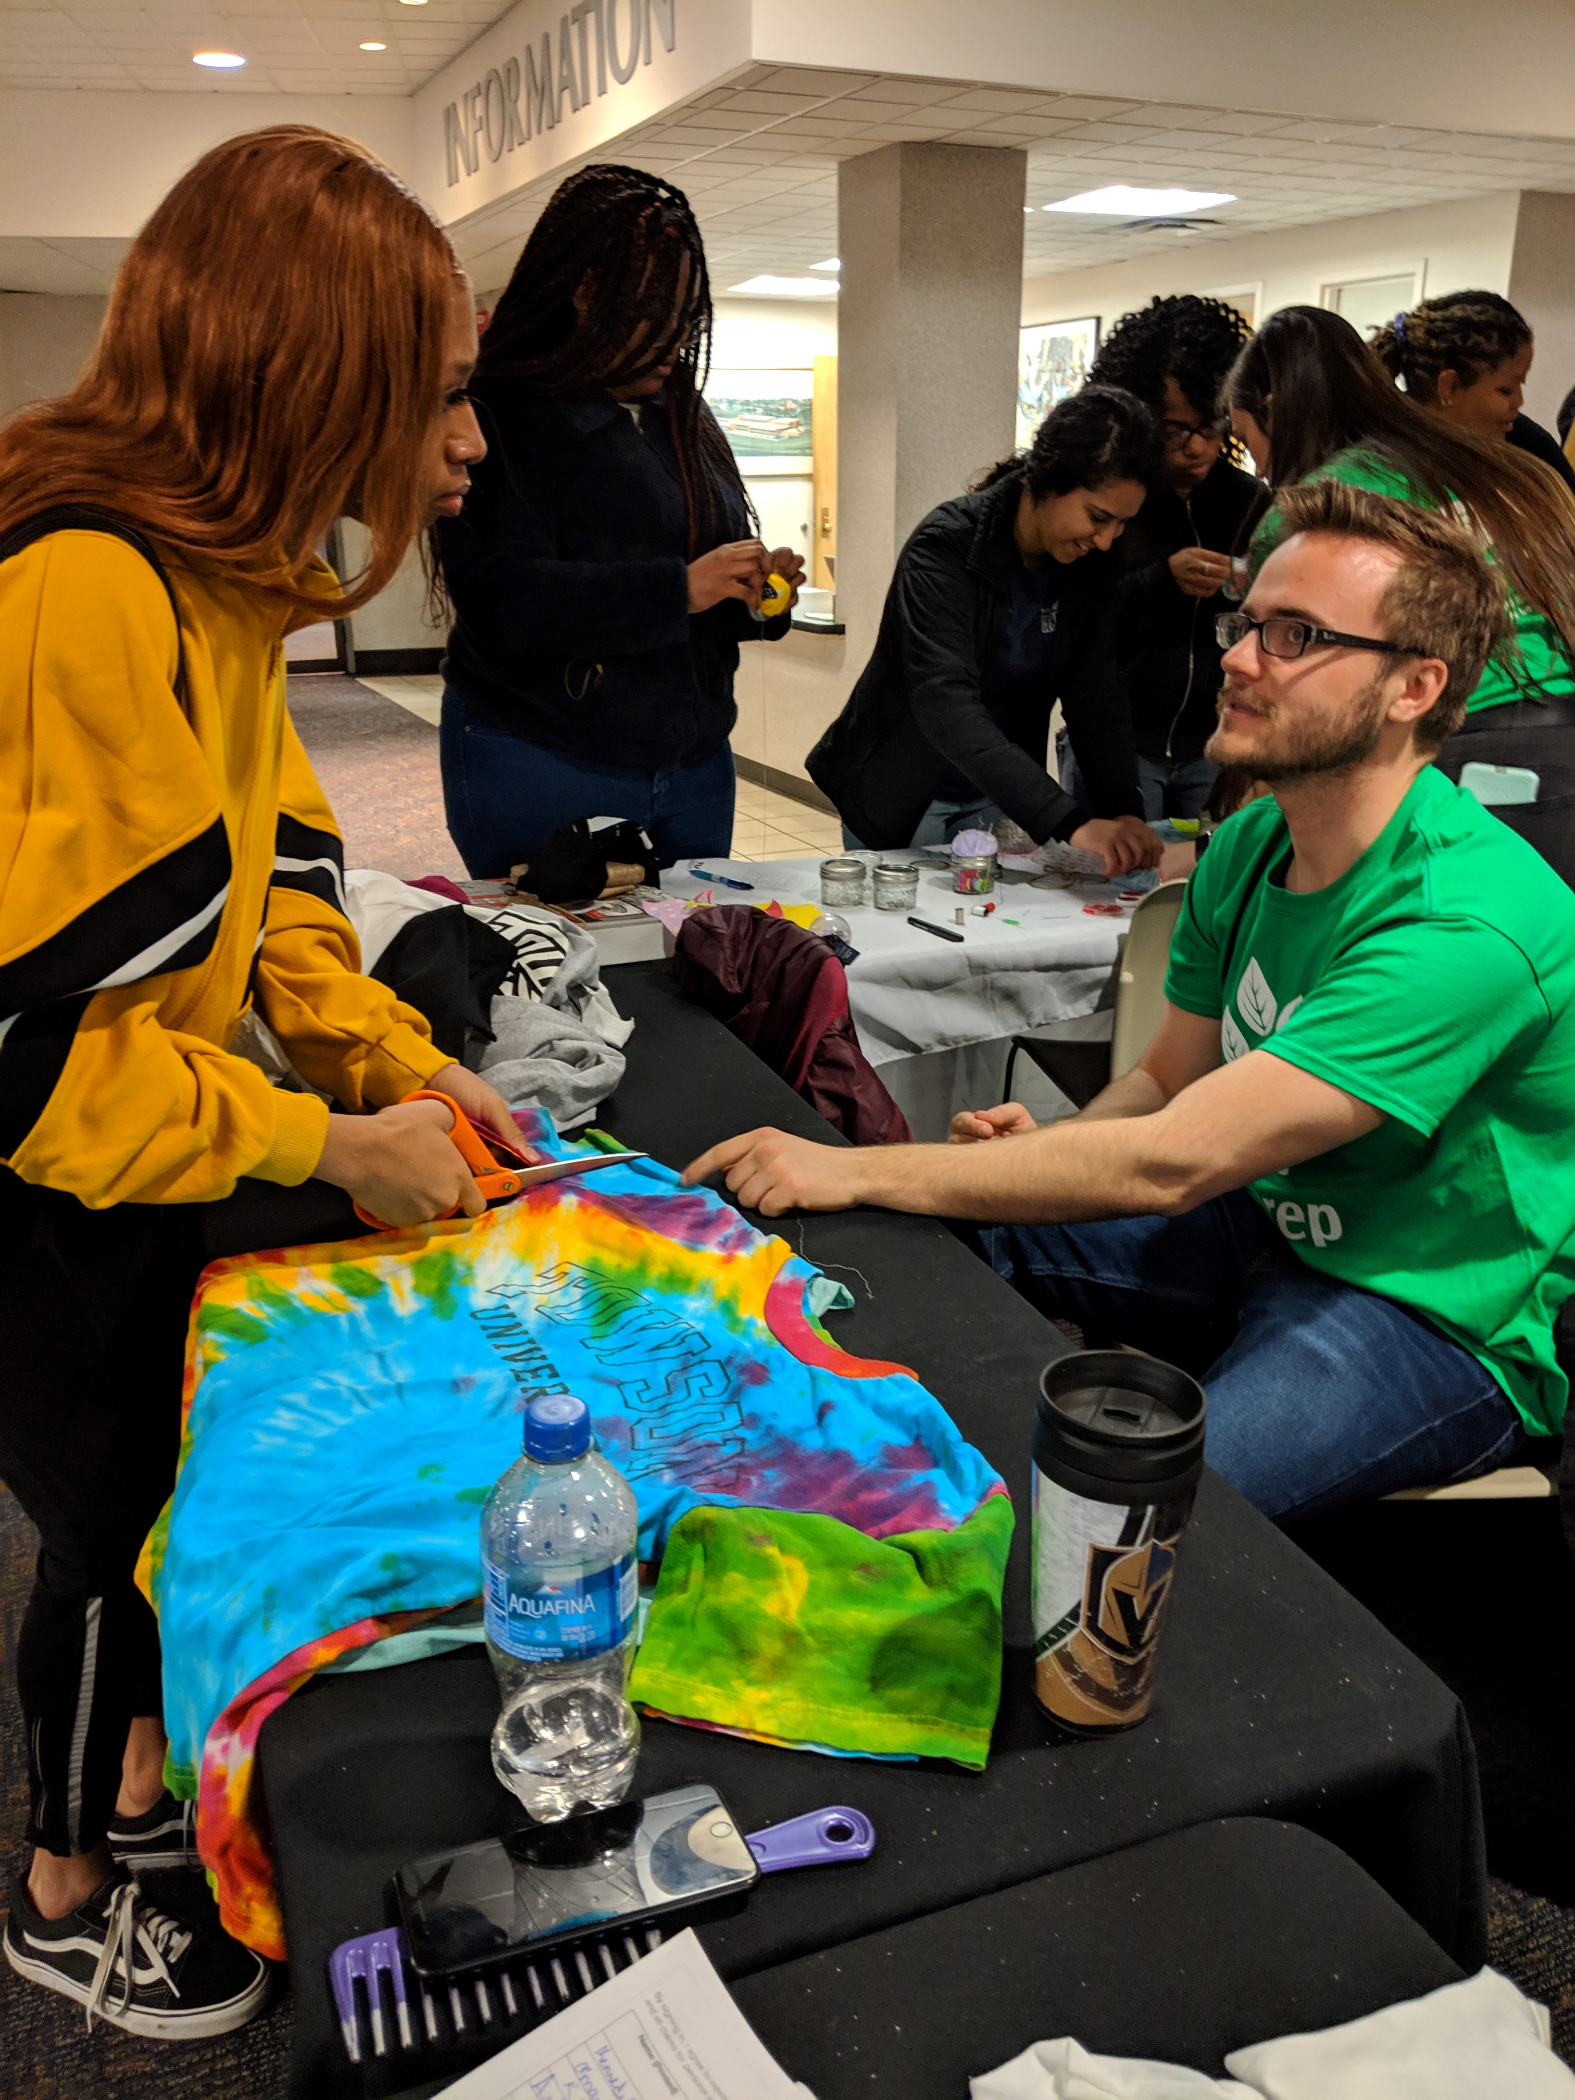
Choose Your Categories
8 week, weekly reporting categories (February-March)
Diversion (trash, food, recyclables)
Per Capita (recyclables)
Zero Waste (New) (trash, food, recyclables, materials for reuse)
Food (food waste and any organic
materials alongside food waste)
Special Categories – One time reporting by end of competition
Electronics (one month tracking)
GameDay Basketball (one home game tracking)
Race to Zero Waste Building (four weeks tracking)
Case Study competition (submissions due end of May)
Towson University

Slide 5
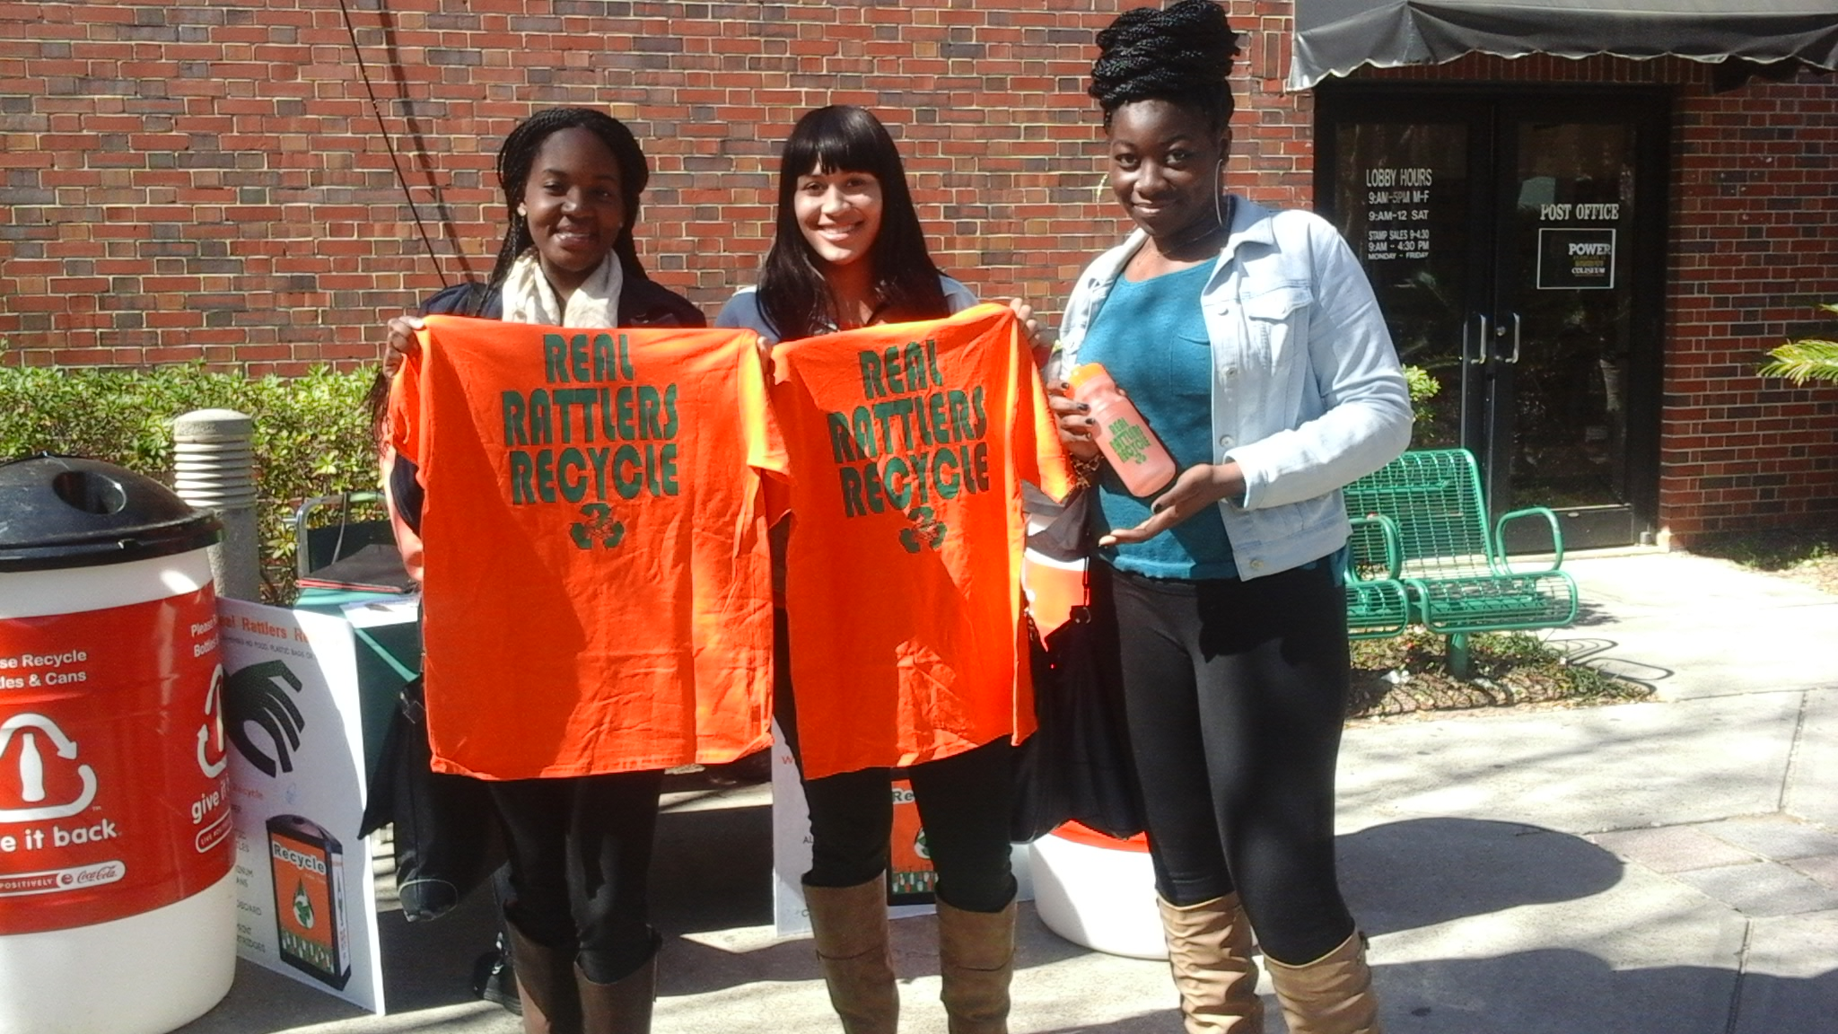
Steps To Get Ready
Register! Registration closes February 1
Set goals & level of participation
Assemble team
Determine resources
Plan outreach activities
Data tracking logistics
Florida A & M University
www.RecycleMania.org

Slide 6
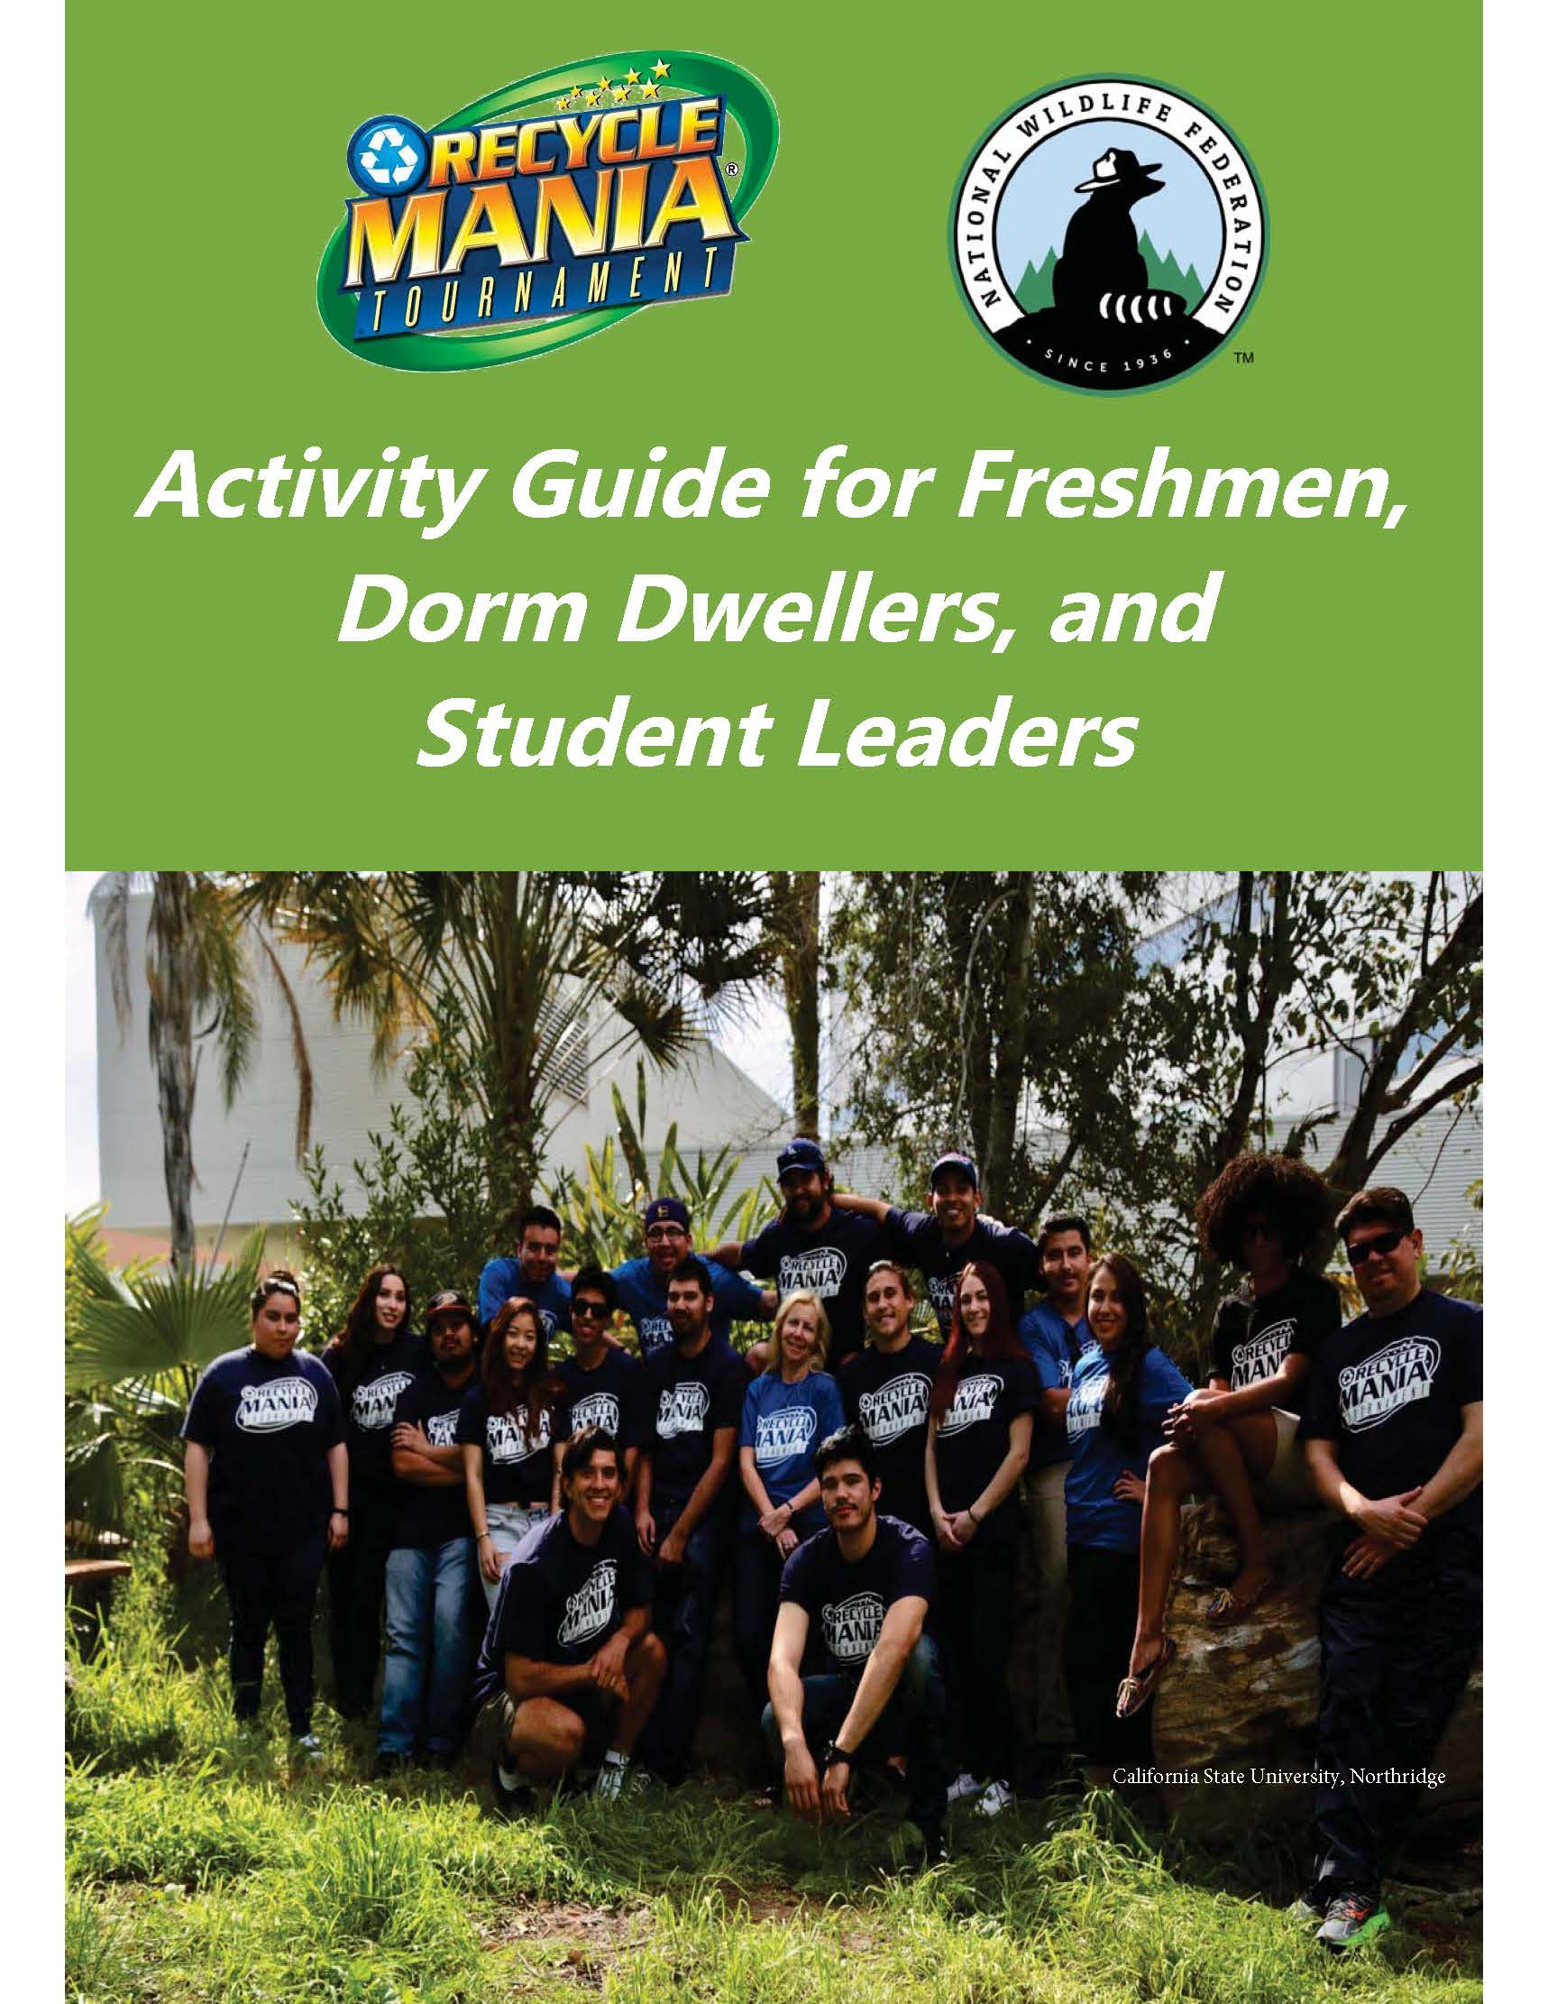
Web Resources
Planning checklist
Rules details
Promo strategy
Download logo, files
Case studies
Activity Ideas
Campus profile pages
www.recyclemania.org
Notes:
Change screenshot

Slide 7
2020 Competition Dates
February 1 - Deadline to Register
Jan 19 to Feb 1 - Pre-season tracking
1/19 – 1/25 Pre-season week1
1/26 – 2/1 Pre-season week 2
February 2 - Competition begins
March 28 - Last day of competition
April 13 - Deadline to report data
April 16 – Unofficial results posted
April 29 – Final results announced

Slide 8
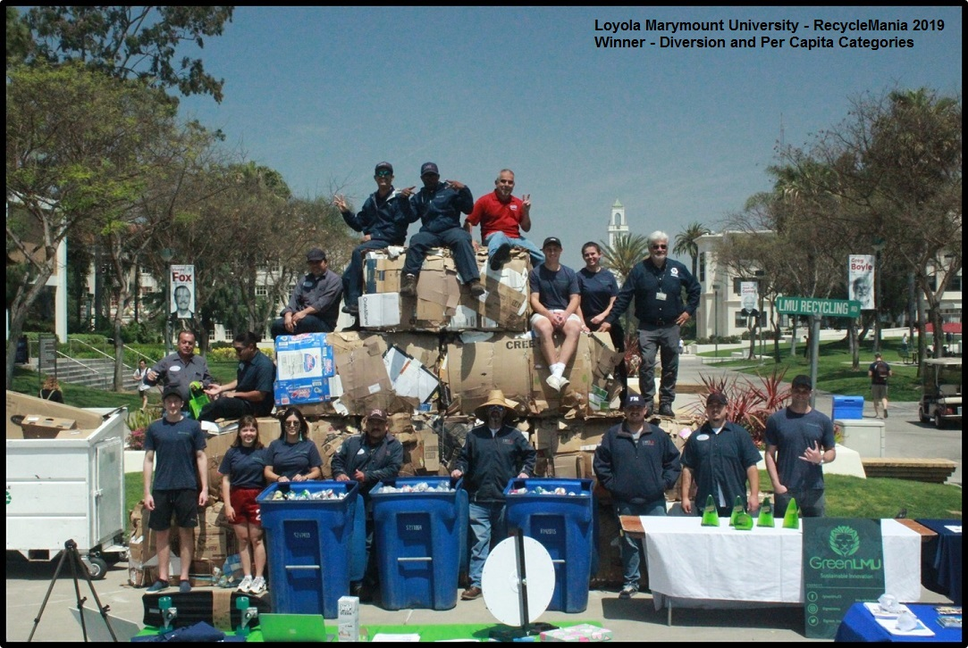
Questions?
Phone: (202) 417 7379
RecycleMania@nwf.org
www.RecycleMania.org
Loyola Marymount University
Notes:
Add hashtag #RecycleMania

