Slide 1
Designing Effective Waste Signage
November 14, 2019
David Cullmer

Slide 2
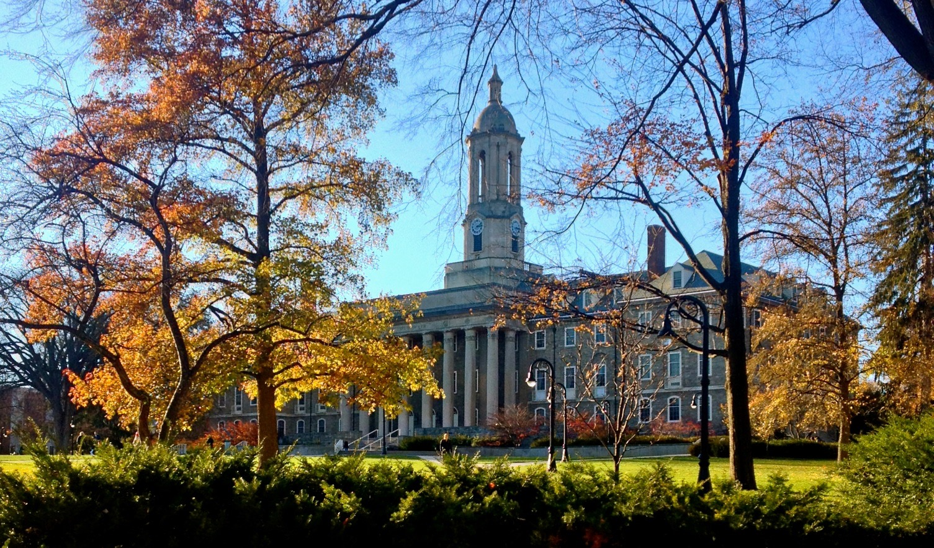
~47,000 students
~17,000 faculty and staff
15,229 tons of waste annually
Diversion rate of 58%
Sorting stations with 7 bins

Slide 3
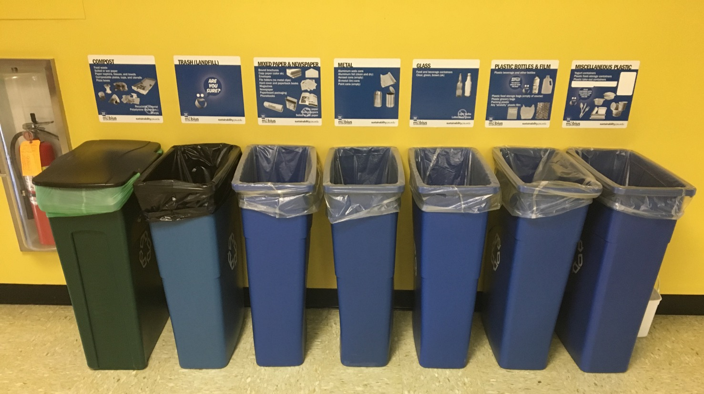
Over 15,000 signs

Slide 4
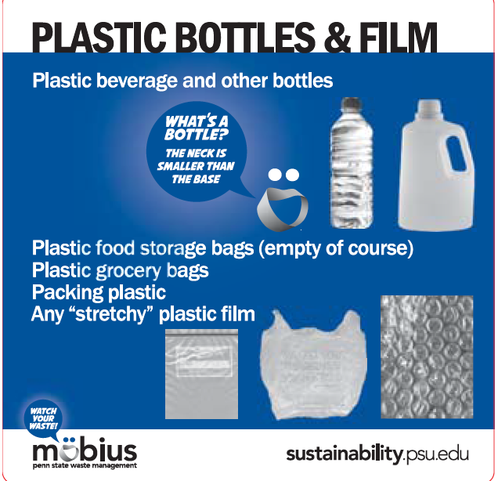
New Signage Needed
Possible bin reductions
Programmatic changes
Opportunity to apply new messaging strategies

Slide 5
Determining Best Practices
Purdue University
George Washington University
University of British Colombia & Vancouver
University of Victoria
Keep America Beautiful & Pepsico
Recycling Partnership

Slide 6
Lessons Learned
Words matter
Color code bins
Signage should illustrate 80% of bin contents
Include frequently confused materials
Combine words and illustrations
Notes:
Use words that are salient with audiences

Slide 7
Research Questions
What sign format guides accurate sorting, especially for sometimes and middle of the road recyclers?
What sign formats best guides those for whom English is not their native language?
Which products are most confusing?
Notes:
Spot audits showed that confusion primarily on compost, landfill, paper and plastic bin sorting

Slide 8
Signage Survey Design and Implementation
Survey pool: 7,500 students and 2,500 faculty/staff
N=1,294 with 61% students, 33% staff and 6% faculty
Launched early April and ran for 2 weeks
$100 VISA card incentive
3 sign formats for 4 bins
Notes:
Spot audits showed that confusion primarily on compost, landfill, paper and plastic bin sorting

Slide 9
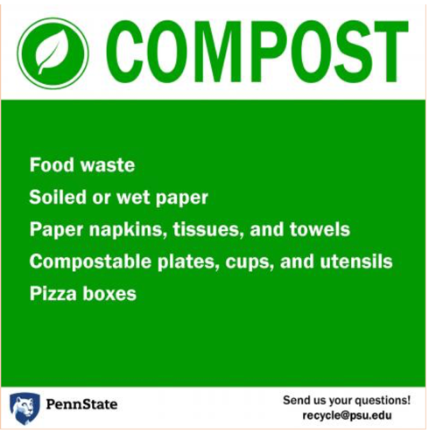
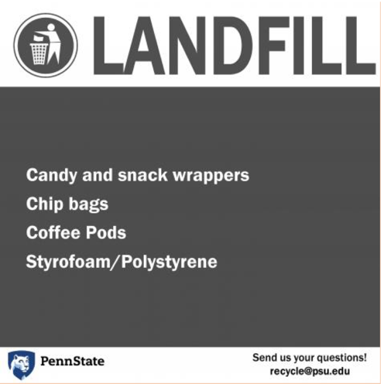
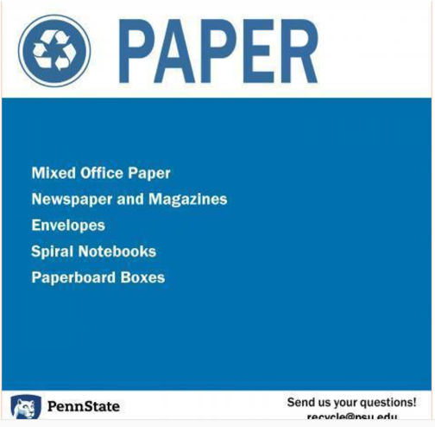
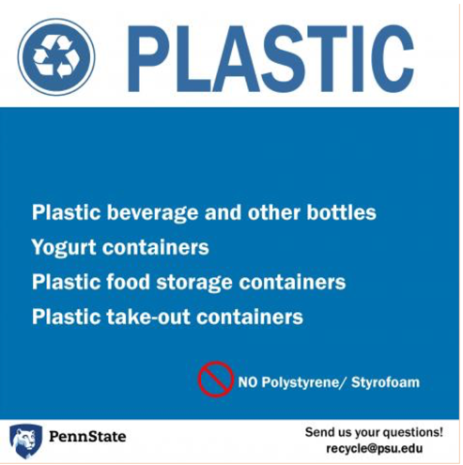
Text Only

Slide 10
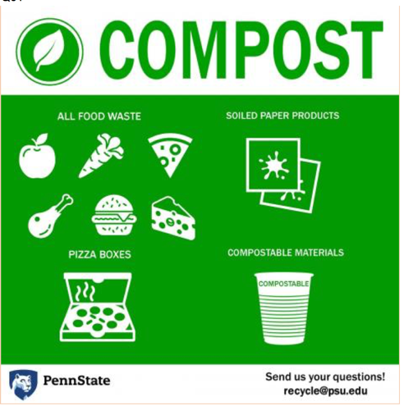
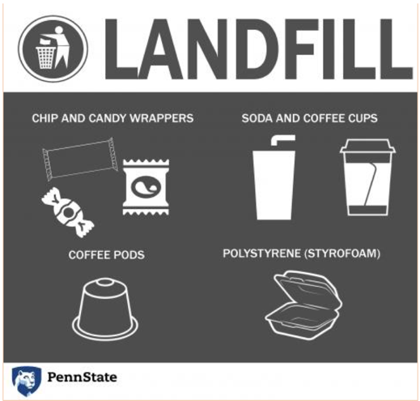
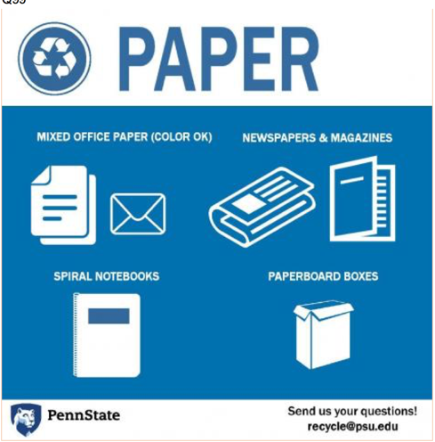
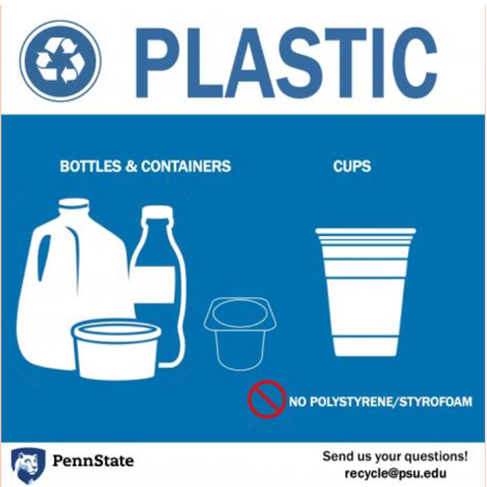
Icons and Text

Slide 11
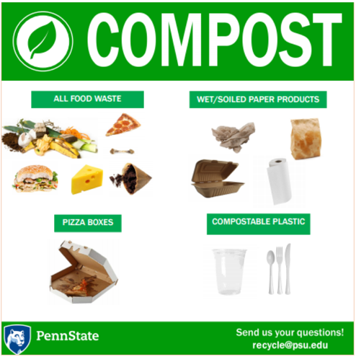
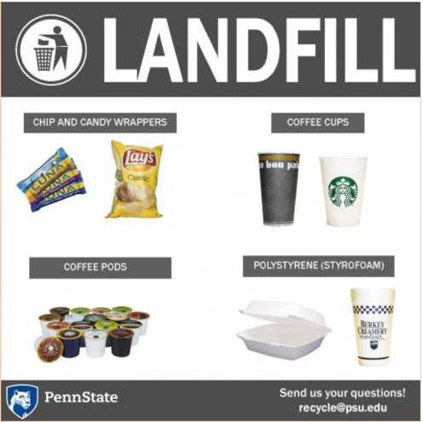
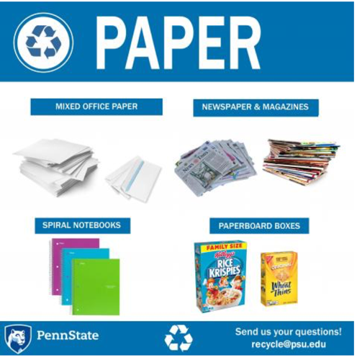
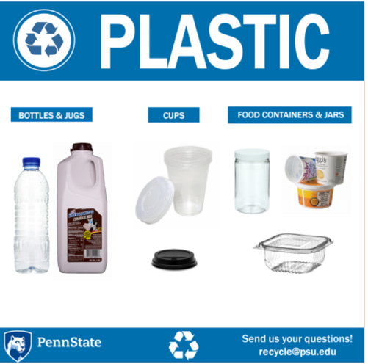
Photos and Text

Slide 12
Sorting Exercise
______ Water Bottle (1)
______ Used Tissue (2)
______ Gum (3)
______ Soiled Pizza Box (4)
______ Styrofoam Container (7)
______ Starbucks Cup (8)
______ Coffee Pod (10)
______ Cheeseburger (11)
______ Candy Wrapper (1)
______ Coffee Pod (5)
______ Styrofoam Container (7)
______ Cheeseburger (10)
______ Dunkin' Donuts Cup (8)
______ Soiled Pizza Box (9)
______ Granola Bar Wrapper (13)
______ Condiment Packet (14)
______ Water Bottle (1)
______ Spiral Notebook (2)
______ Candy Wrapper (3)
______ Soiled Pizza Box (4)
______ Used Napkin (6)
______ Envelope (7)
______ Starbucks Cup (8)
______ Softbound Book (9)
______ Candy Wrapper (2)
______ Solo Cup (3)
______ Ballpoint Pen (4)
______ Yogurt Container (5)
______ Styrofoam Container (7)
______ Starbucks Cup (8)
______ Starbucks Cup Lid (11)
______ Laundry Detergent Bottle (12)

Slide 13
Results
Overall – correct sorting was highest when photo signage was used (mean = 28.57), followed by icons (mean = 28.13). Accuracy is lowest for text signage (mean= 28.02).
Some variation by bin:
  Compost – text and icons slightly more effective
  Landfill – photo and icons slightly more effective than text
Notes:
Slight variation by bin:
Composting – text and icon slightly more helpful than photo
Landfill – correct sorting higher for photo and icon than for text
Plastic and paper – correct sorting highest for photo

Slide 14
Recycling habit classification
Avid recycler
Middle of the road
Sometimes recycler
Not a recycler
Notes:
Comparison to Keep America Beautiful segmentation:
National PSU
Avid 38% 24%
Middle 52% 63%
Sometimes/never 10 13%

Slide 15
Results
For non-recyclers and sometimes recyclers: photo signage outperformed text and icons
These results were accentuated for non-native English speakers (~8% of the survey pool)
Notes:
Slight variation by bin:
Composting – text and icon slightly more helpful than photo
Landfill – correct sorting higher for photo and icon than for text
Plastic and paper – correct sorting highest for photo

Slide 16
Recycling Beliefs
Improve environmental quality
Significantly reduce land used for landfills
Improve public health
Significantly conserve natural resources
Build the local economy and create jobs
Reduce pollution
Eliminates waste from the ocean that is harmful to marine animals
Notes:
On a scale of -2 to +2 in environmental attitudes, the average participant self-reported a 1.33 (above average pro-environmental attitude).

Slide 17
Product Confusion
Starbucks hot cups plastic (landfill)
Pens plastic (landfill)
Gum compost (47%)
Soiled napkins and pizza boxes paper (compost)
Notes:
A few items demonstrated high confusion levels:

Slide 18
Thank You
The University is committed to equal access to programs, facilities, admission, and employment for all persons. It is the policy of the University to maintain an environment free of harassment and free of discrimination against any person because of age, race, color, ancestry, national origin, religion, creed, service in the uniformed services (as defined in state and federal law), veteran status, sex, sexual orientation, marital or family status, pregnancy, pregnancy-related conditions, physical or mental disability, gender, perceived gender, gender identity, genetic information, or political ideas. Discriminatory conduct and harassment, as well as sexual misconduct and relationship violence, violates the dignity of individuals, impedes the realization of the University’s educational mission, and will not be tolerated. Direct all inquiries regarding the nondiscrimination policy to Dr. Kenneth Lehrman III, Vice Provost for Affirmative Action, Affirmative Action Office, The Pennsylvania State University, 328 Boucke Building, University Park, PA 16802-5901; Email: kfl2@psu.edu; Tel 814-863-0471.

