Slide 1
So you want to order a bin? Asking the right questions to optimize program success
Notes:
Sounds simple – many do not realize the complexities involved in bin purchases and how even with the best intentions, some wrong choices or steps could actually set your program up for failure.
- Today we hope to cover the best practices around culture, behaviour and key watch-outs and questions to ask during the planning of your program

Slide 2
Key questions to ask
Is there a standardized program in place?
Who else needs to know?
What are the financial considerations?
What could possibly go wrong?

Slide 3
Standardizing your program
What streams being collected today? What about tomorrow?
Are different buildings collecting different items?
Where are we going to put them?
What size bin do I need?
Are there different aesthetic requirements across campus?
# Streams vs # Containers
What type of graphics are best to use?

Slide 4
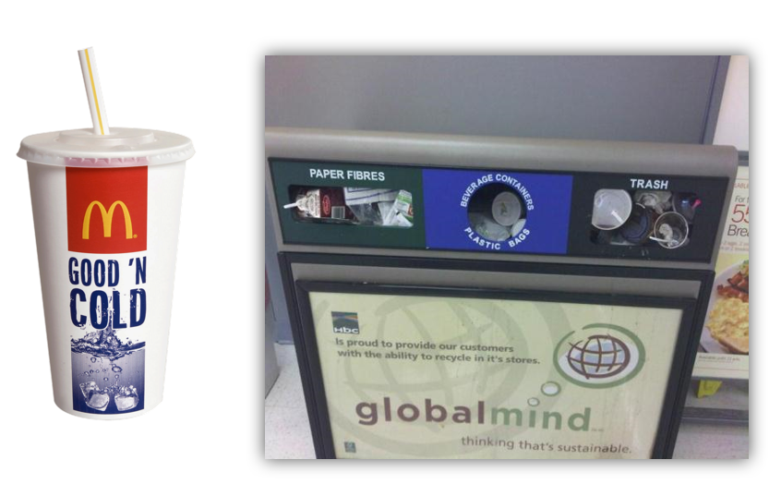
What would you do?

Slide 5
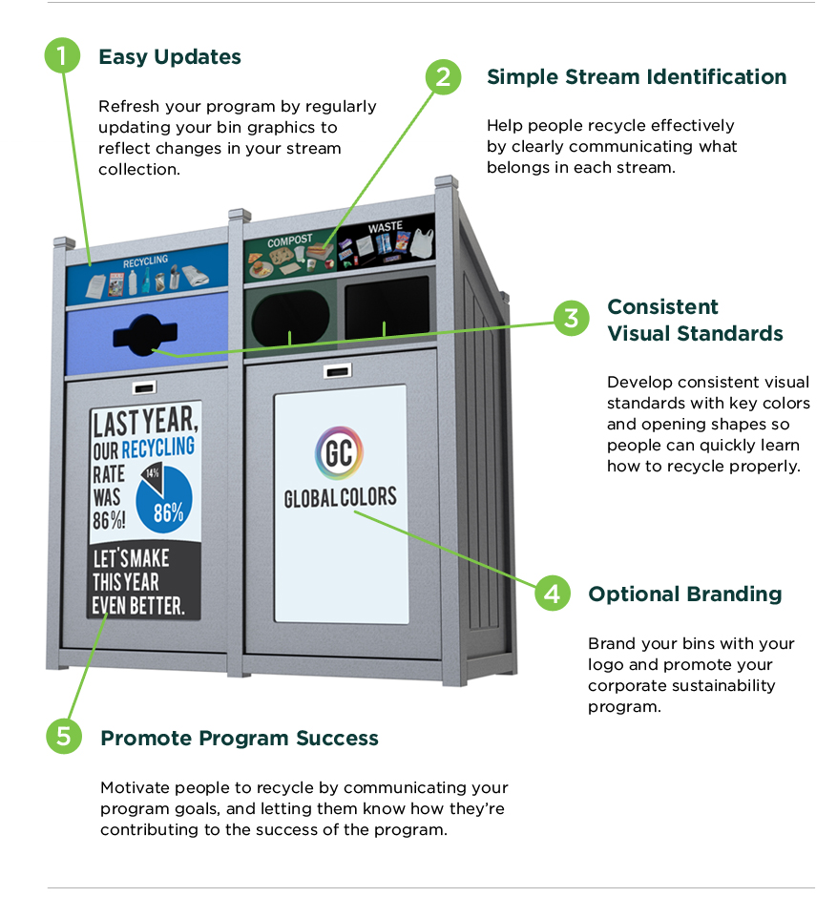
Best practice

Slide 6
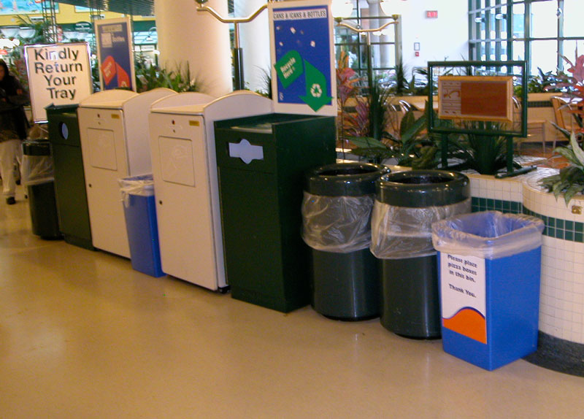
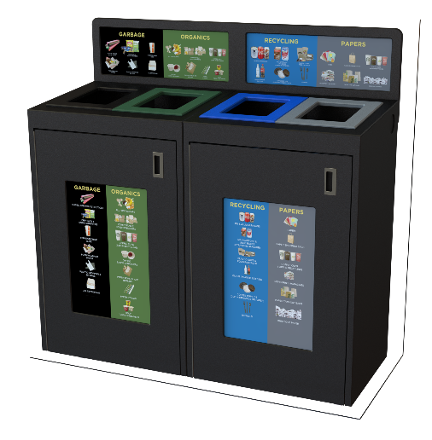
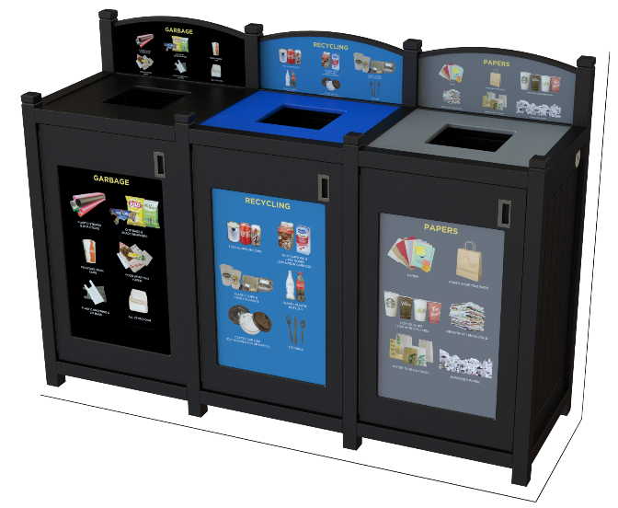
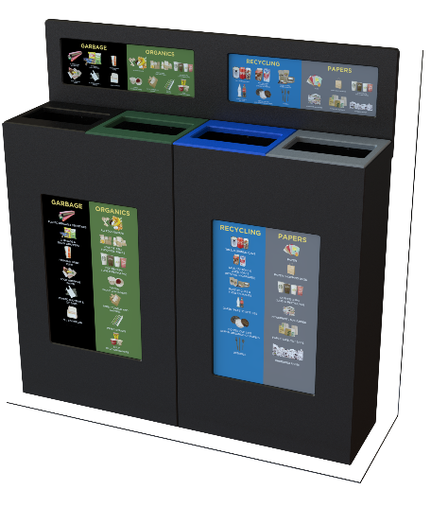
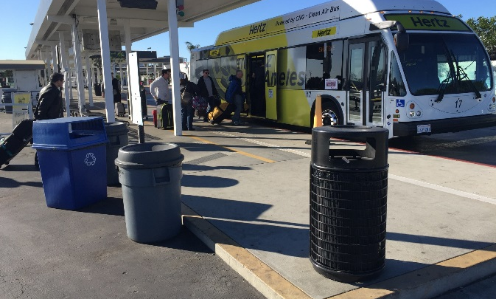
Impact of Standardization
Non – Standardized Programs | Standardized Programs

Slide 7
Who else needs to know?
Senior Management
Unions
Architects
Custodial Staff
Fire Marshalls
Students
Sustainability Department
Finance

Slide 8
Financial Considerations
Grant Programs
Central Collection
Waste Hauler “Net Zero Pick-ups”
Start with a Pilot

Slide 9
What could possibly go wrong
Questions I never thought to ask:
Extra Curricular Activities/ who is responsible?
Night Courses
Sporting events
Flaps on containers
No one wants to touch anything
Outdoor containers
Vermin and Insects
H & S Factors (sharp edges)
Assembly Time & Retrofit Costs
Servicing Time – Liner Removal & Replacement
Ergonomic issue – Front Load vs Top Load weight issues.
ADA – height requirements
Minimal Graphics - Please Recycle or Thank You
Future Ready – Change is inevitable

Slide 10
CULTURE WE LIVE IN
Recycling is like voting… Most people don’t think that they can make a difference.

Slide 11
Thank You
For Listening Q & A

