Slide 1
Exterior Waste Bin Enhancements
CAPITAL PROJECTS – DARCI PELLOM, PLA
IUPUI

Slide 2
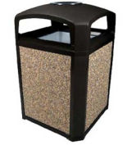
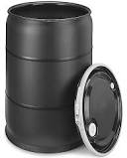
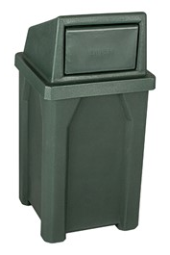
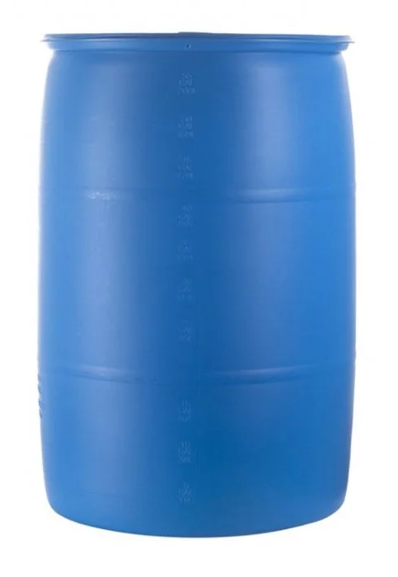
Why?
Purpose:
Improve IUPUI’s outdoor waste infrastructure by assessing outdoor waste bins
Goals:
Reduce number and types of waste bins on campus
Understand littering behavior of campus community and visitors
Identify new architectural waste bin standard
Place new bins in appropriate locations

Slide 3
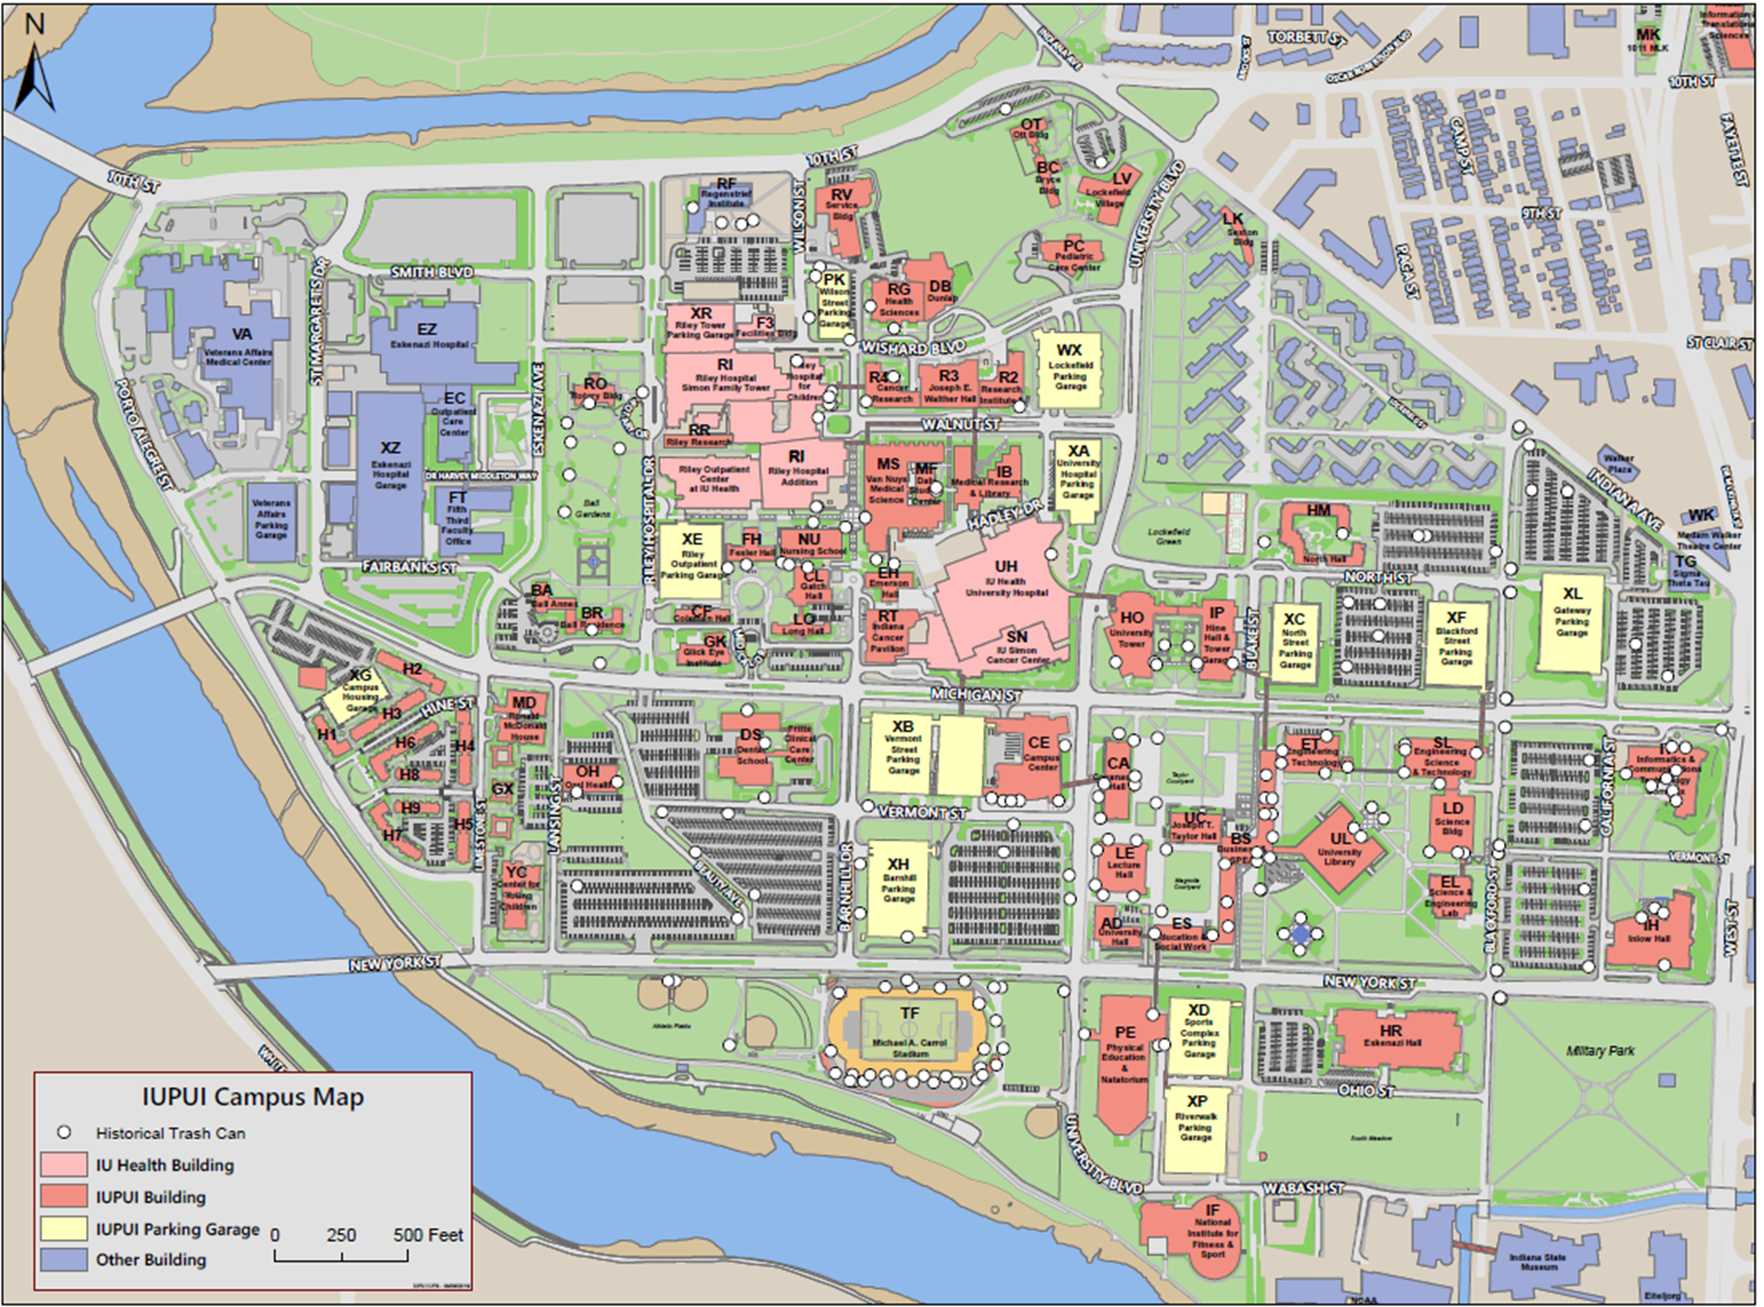
IUPUI BEFORE
320+ Exterior Waste Bins
Mismatched – No architectural Standard
Misplaced – Bins found in close proximity
Only 4 paired with recycle bins
Injury Hazard
heavy liners due to rain collection
often contaminated
potential to attract pests
Large Replacement and Labor Costs - $$$$

Slide 4
PROCESS
Informal Style – Heard about other universities/colleges trying elimination
All exterior bins removed from Zone 1 for 30 days – October 1-31
Changes in litter accumulation monitored by CFS grounds staff
Bins returned in areas of litter accumulation – outdoor eating
Removal expanded to entire campus by January 2019

Slide 5
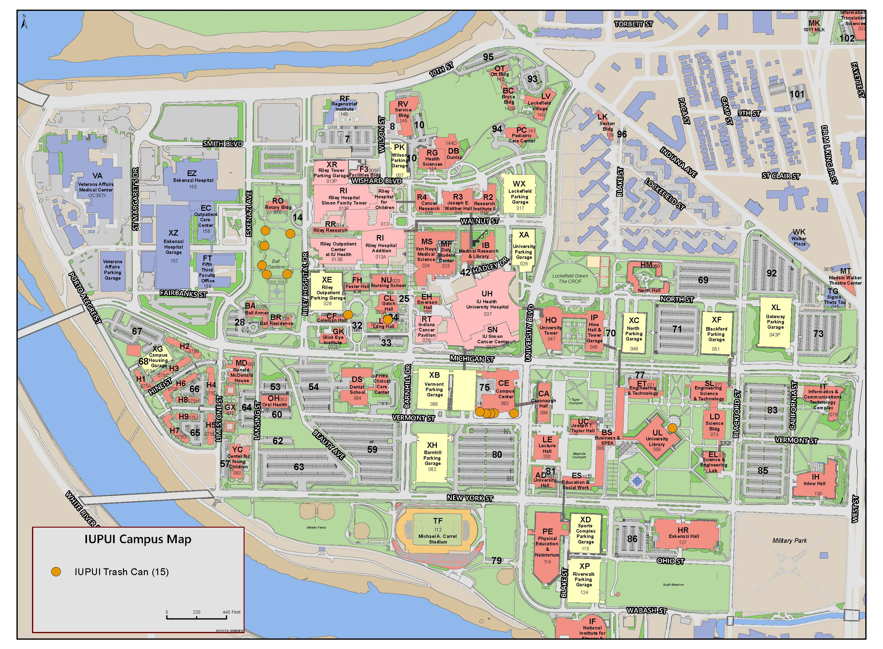
IUPUI AFTER
Under 20 exterior waste bins
Standardized – architectural standard identified
Correct placement – work in progress
High traffic
Outdoor eating/seating
Injury Hazard reduced
Bins capped to prevent rain accumulation, contamination and pests
Waste management moved to interior spaces
Labor redirected to campus beautification efforts

