Slide 1
BYU Student Sustainability Initiative
Presentation by: Tessa Meredith
Notes:
Hi everyone! I’m really excited to be here today and to be presenting to you all on something that myself and a group of students have been working hard on for the past year which is SSI – the BYU Student Sustainability initiative.
Just to start I figured I would tell just a little bit about myself:
My name is Tessa Meredith and I am a student here at BYU.
I’m studying Experience Design and Management and am minoring in Environmental Science.
And I have been involved with helping develop SSI for about a year and currently am the project lead for our recycling project.

Slide 2
“[A BYU] education prepares students who can make a difference in the world…who are able to improve the moral, social, and ecological environment in which they and their families live.”
-Aims of a BYU Education
Notes:
To start, I wanted to share one of the aims of a BYU Education:
I have bolded here the words ecological environment, because although this is included in the educational aims of our university, a number of us students have seen a gap in the fulfillment of this aim. In creating SSI, our hope is to be able to better fulfill this university aim. With the goals we have set we hope that BYU students can become more educated and involved in improving the ecological environment, not only in their time here at the university, but for the rest of their lives.

Slide 3
Our Goal
Establish a university sanctioned, student-led sustainability office that can…
Help BYU administration make more environmentally friendly decisions
Get students involved in sustainable projects on campus
Notes:
Our goal for the Student Sustainability Initiative is as follows:
When we talk about a sustainability office we envision a central location on campus where students can go to get involved in sustainability and learn how to live a more environmentally friendly lifestyle. The committee within the office would be composed of students, and mentored by faculty. The office would also provide leadership opportunites for students and as a whole increase sustainability at BYU.
Our initiative differs from a normal club that is organized on campus. As of now, we are not organized under the university, so we have been able to avoid some of the red tape and regulations that a campus club would typically have to comply to by us being just a student lead initiative. Our end goal is to be much more than a campus club – an office of sustainability that can endure as students leave and enter BYU and make impacts university wide.

Slide 4
How We Will Accomplish This
1. Carrying out projects aimed at campus sustainability
2. Meeting with faculty and administration to advocate for a Sustainability Committee
3. Creating a community through student support and involvement
Notes:
To reach our goal of establishing a sustainability office and committee at BYU, these are the means by which we intend to do so:
These projects will stand as evidence of the work students are willing and passionate to do to make our university more sustainable
Finding faculty and administration who are willing to advocate is key for the establishment of the sustainability committee
Having a diverse community of students who are all passionate about sustainability is something we also feel is vital to be able to make our goal a reality.
All three of these things are key factors to be able to reach our goal of an office of sustainability.
For the last year we have been working hard to carry out these three things and we have been able to see success in all three.
I now want to share with you a few different projects we have successfully carried out and how we have been able to build up our influence as the Student Sustainability Committee and come closer to reaching our goal.

Slide 5
Notes:
The first event we officially held was at the beginning of this last fall semester. The BYU Alternative Transport Fair was intended to share with students the many ways they can get around the city and campus without using a car.

Slide 6
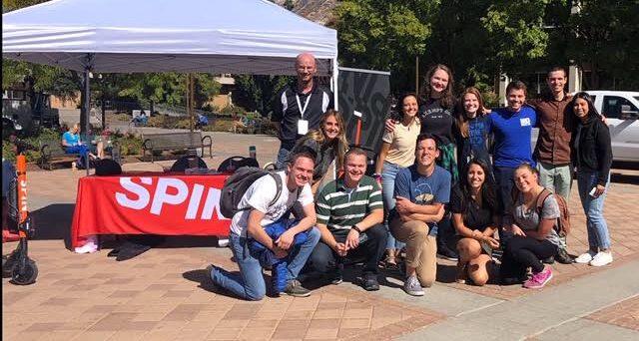
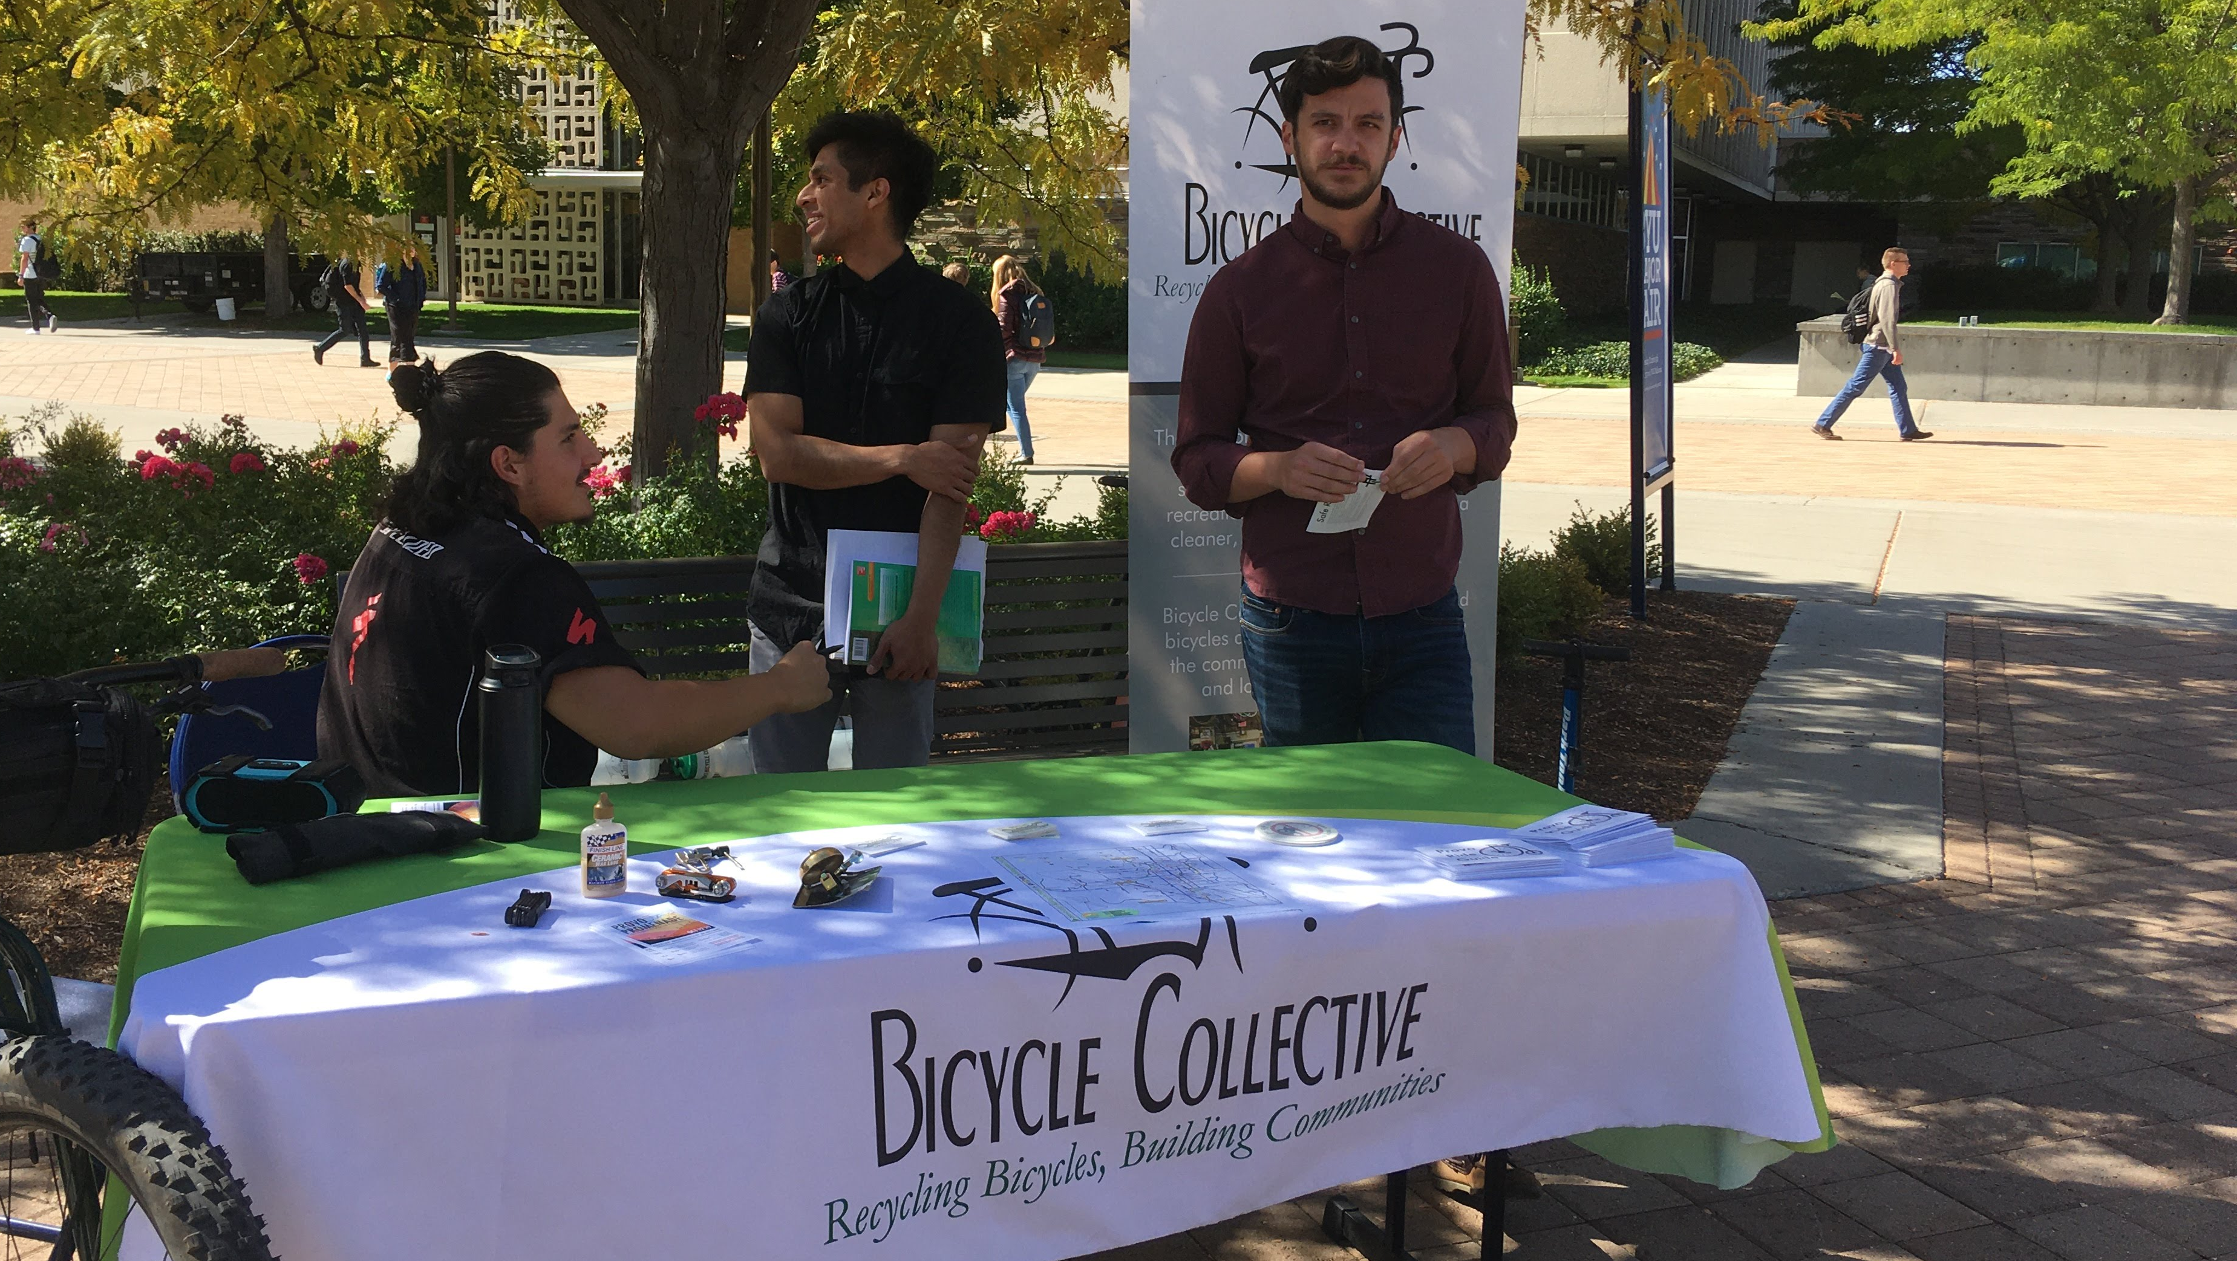
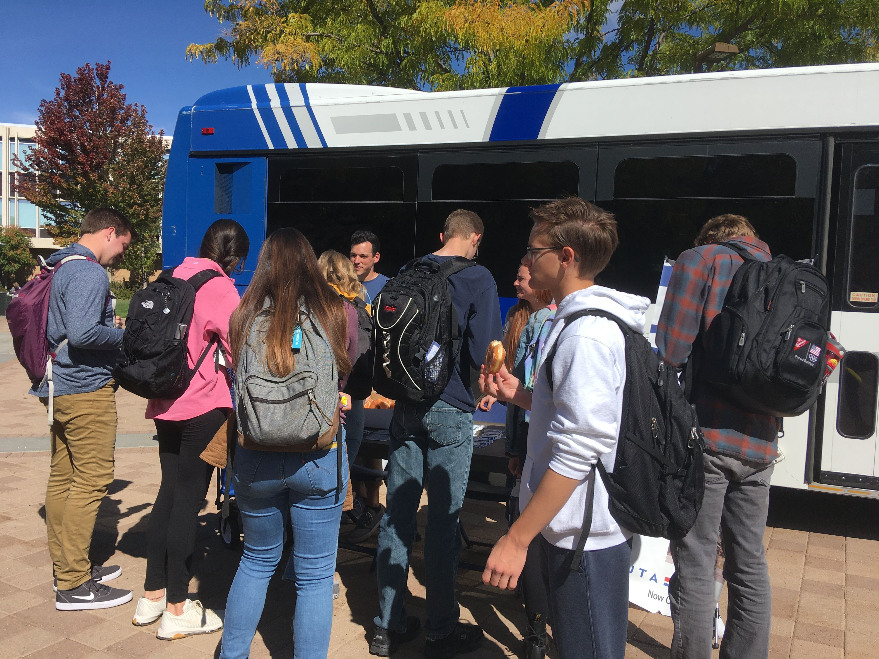
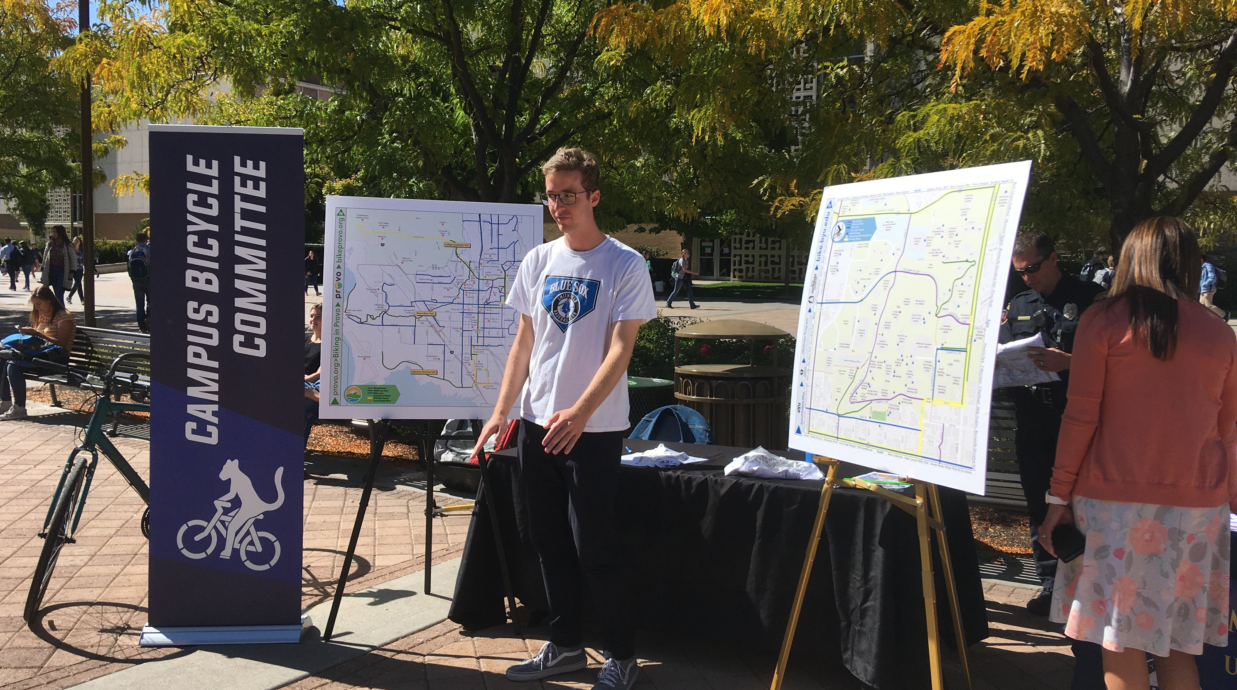
Notes:
We had a number of different booths from
Spin scooters
Provo Bicycle Collective
Campus Bicycle Committee
And UTA transportation
Sharing with students their form of alternative transportation.
Not only was this a successful event to introduce students to this topic, but it was also our first opportunity to introduce the Student Sustainability Initiative and find students who were interested in becoming involved. We ourselves had a booth and invited students to sign up if they were interested in becoming involved.

Slide 7
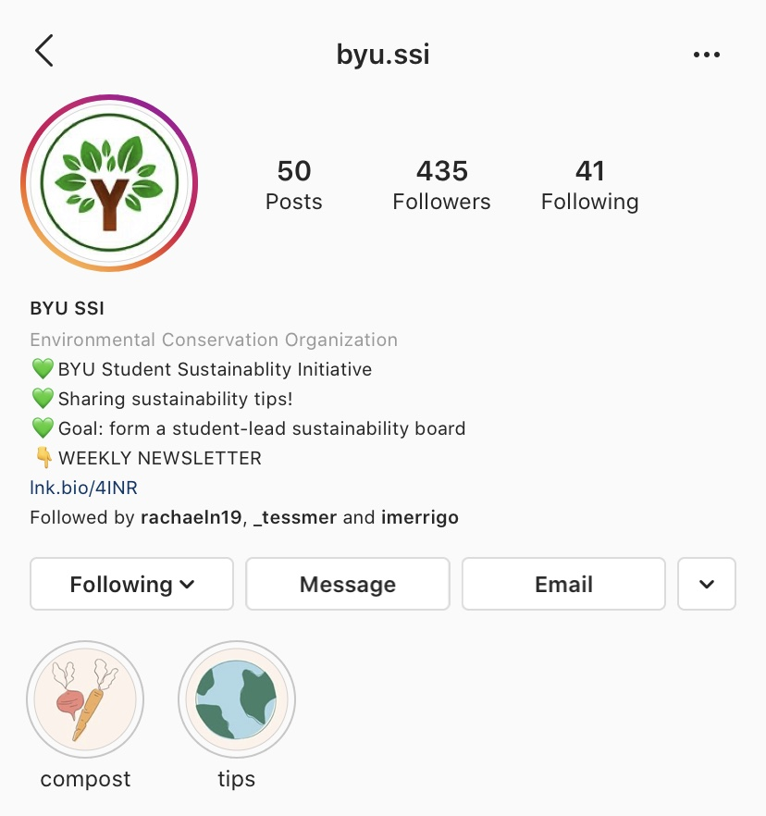
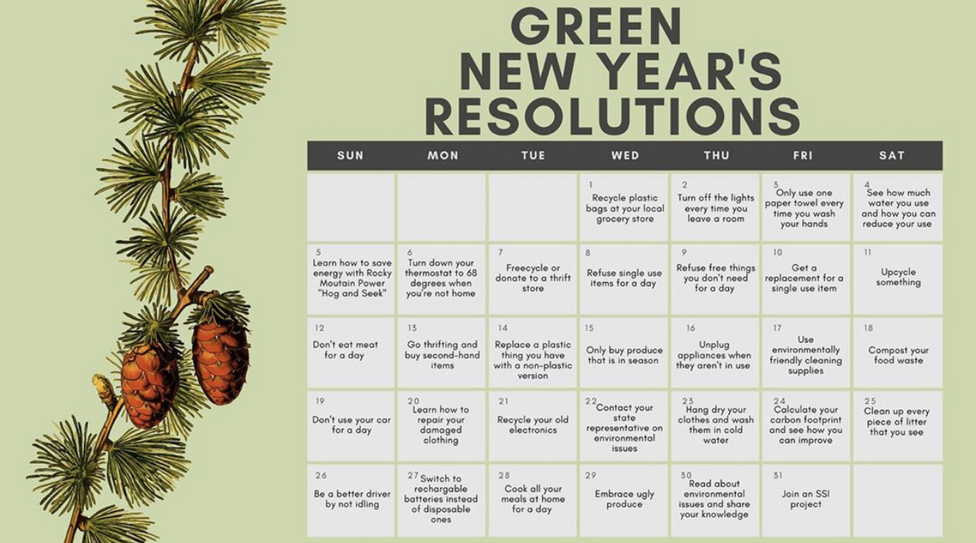
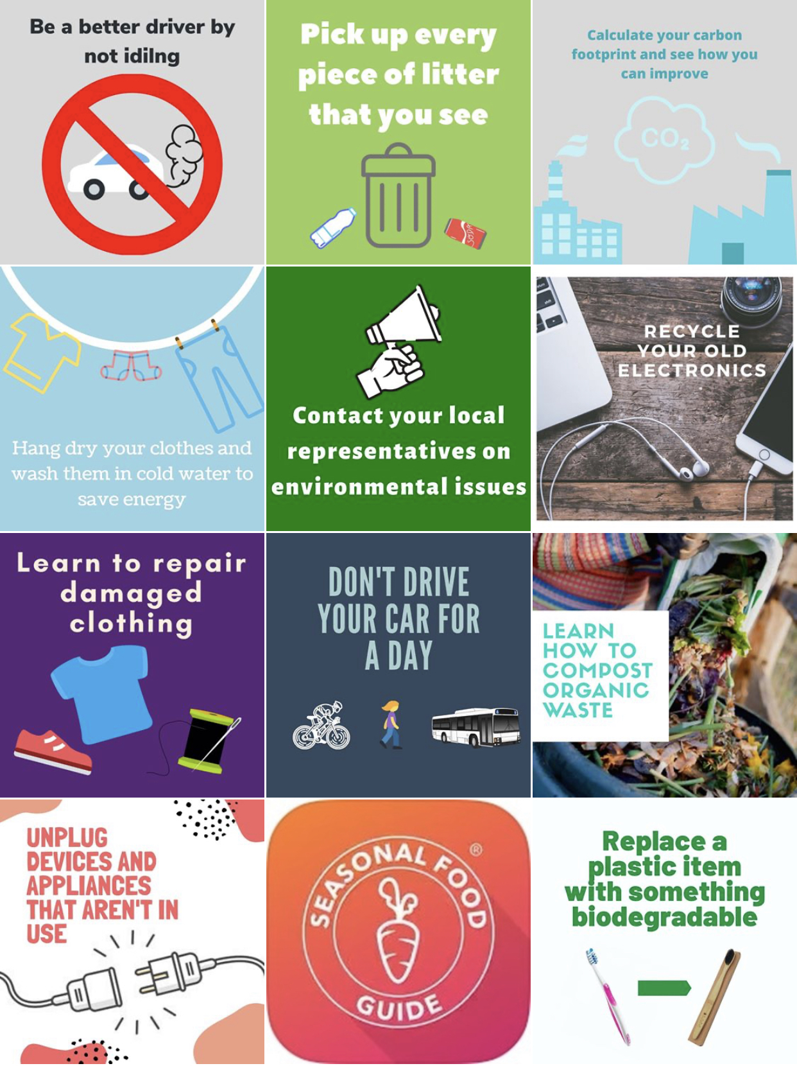
Notes:
That first event was able to give us an audience and pitch SSI to fellow BYU students.
Our Instagram started as a place to introduce ourselves and our goals and find students who were interested to sign up to become involved in projects. We were able to hold SSI information meetings and eventually project brainstorm meetings with a bigger group of passionate students.
Since then, our Instagram influence has continued to find success.
We currently have 435 followers on Instagram and our page is run by a student who is a communications major here at BYU. Our Instagram is still a way to inform students of who we are and get them involved – but we have also been using it to encourage and educate students to become involved in sustainability efforts in their daily lives. In January we had a Green New Year’s Initiative where every day we posted a new sustainability tip for people to consider and try out.

Slide 8
Notes:
At the beginning of this winter semester another project we ran was a plastic bag drive.
For 2 weeks we had collection boxes located in the freshman dorms and eating halls to collect extra plastic bags. By the end of the drive we had collected over 500 plastic bags.
Not only were we able to divert these plastic bags going to waste, but we collaborated with another organization on campus to make sure these plastic bags were put to good use.

Slide 9
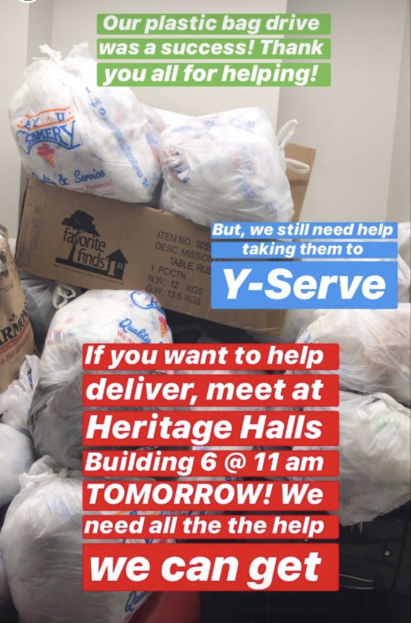
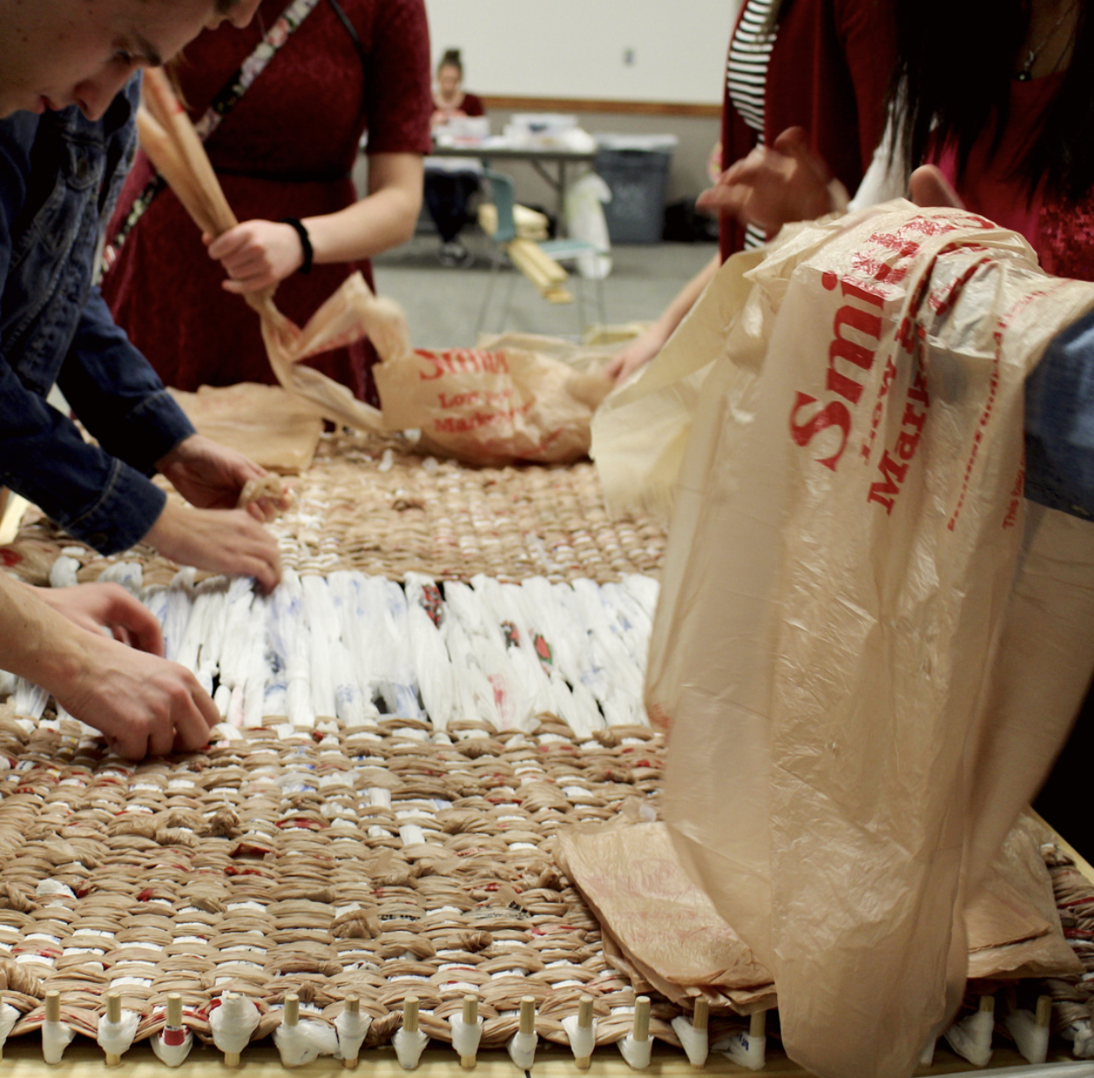
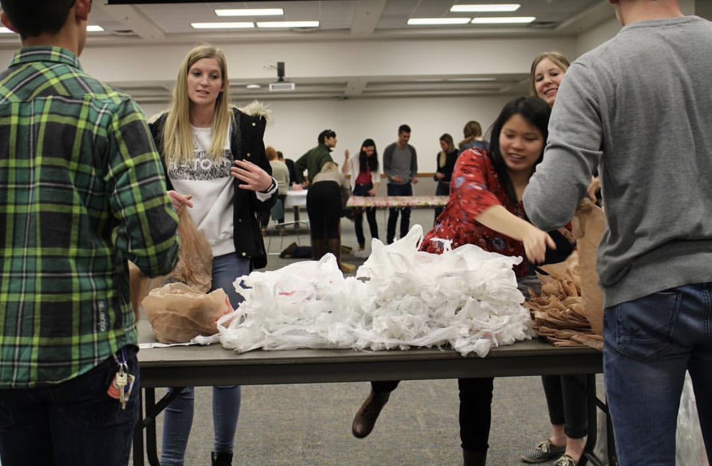
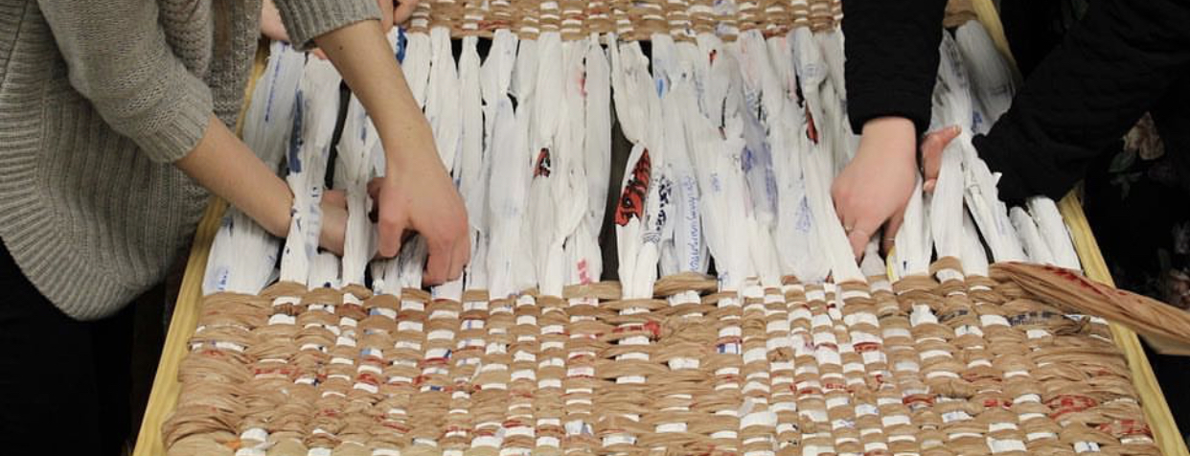
Notes:
Y serve refugee makes matts that are delivered to refugees all over the world.
Collaborating with another BYU organization was a big step for us in continuing to create community around sustainability on our campus.

Slide 10
Weekly Newsletter
Increases range of influence
Provides a professional layout
Updates on projects and how to get involved
Educates on relevant and local topics
Notes:
In the last 2 weeks we have also decided to start a weekly SSI Newsletter.
This newsletter is a way of helping us reach our goal by:
Continues to…
Provides… which differs from our Instagram and helps us reach different audiences
Continues to…
Educates…. The two newsletters we have sent our have discussed more sustainable diets and the cost of dirty air related to here in provo and at BYU
Currently the newsletter is being sent out to 96 people who have signed up for it

Slide 11
Other Project Ideas
SSI campus information booths
Creating student composting
Holding a donation and recycling drive during move-out
Improving biking and walking safety
Information campaign (“Y We Care Week”)
Creating a campus garden
Notes:
Other project ideas we have had and that we are in development of carrying out have been…
These projects are all important in their own way and have many positive outcomes that we hope will come with them

Slide 12
Sustainably Office and Committee
Creating student composting
Holding a donation and recycling drive during move-out
Improving biking and walking safety
Information campaign (“Y We Care Week”)
Creating a campus garden
SSI campus information booths
Notes:
But all of these projects as a whole we hope will be able to contribute to our main goal of establishing this university sanctioned sustainability committee.
Now specifically, I want to take a little bit more of your time to be able to talk about one more project myself and many others have been working on.

Slide 13
“Tour de Bins”
To improve the efficiency and consistency of campus recycling
Notes:
And that project is Tour de Bins – our SSI recycling project.
Tour de bins started as we recognized inconsistencies in recycling across campus, intending to improve the efficiency and consistency of campus recycling – in order to divert unnecessary trash to the landfills and have more accessibility to recycling available to BYU students.
We dubbed our recycling project as “Tour de Bins” as we have been touring our way from one campus building to another, assessing their recycling needs.

Slide 14
4 Step Process
Assess
Report
Bin
Map
Notes:
The way we have been carrying out this recycling project has been through a four step process of assessing, reporting, binning, and mapping.

Slide 15
Assess
Report
Assess campus building by recording…
Where bins are located
Which bins are available
What changes need to be made
Report to…
BYU Recycling to obtain bins
Building maintenance to approve bin changes
Notes:
The first step – the assessment – is when we go into a building for the first time wearing our “recycling glasses”. We have printed out maps of each floor of the building and as encounter what we call “recycling stations” we begin out assessment. We mark on our map: where the bins, or this recycling station is located, which bins are available already, and which changes need to be made. We note potential changes when the recycling station is missing one of our paper, newspaper, plastic, or aluminum bins, if there are duplicates of the same bin, or if we feel the station could be relocated to a more highly trafficked area.
Once we have noted the changes we feel are necessary. We report our numbers to BYU recycling who provide us with the bins necessary and we contact building maintenacne to approve of any big changes we may be making.

Slide 16
Bin
Map
Bin by…
Following assessment map
Adding and removing necessary bins
Digitally map…
Station locations
Bin quantity and types
Notes:
Through student volunteers we then are able to bin a building by following our assessment maps to tell us where and what changes need to be made, and then physically adding or removing bins from that station as necessary.
Finally mapping is done by making a digital map showing where the recycling stations are, and what can be found at each station

Slide 17
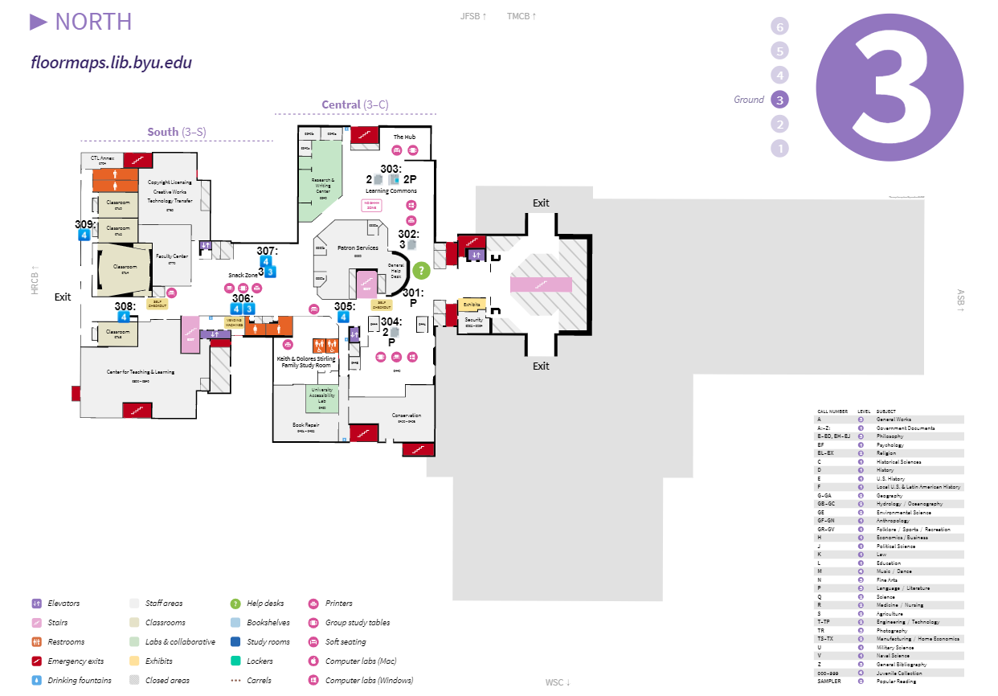
Notes:
This is an example of the library third floor that I made

Slide 18
Notes:
Zooming in, we see the numbers 301-309, showing where the recycling stations are located
Underneath the location number, shows what recycling is available there
The number 4 tells us that the 4 bins we provide: paper, newspaper, plastic, and aluminum are all present
Other symbols show that a specific station has 2 papers, 2 newspapers, and 2 plastics as we assessed was necessary for that location

Slide 19
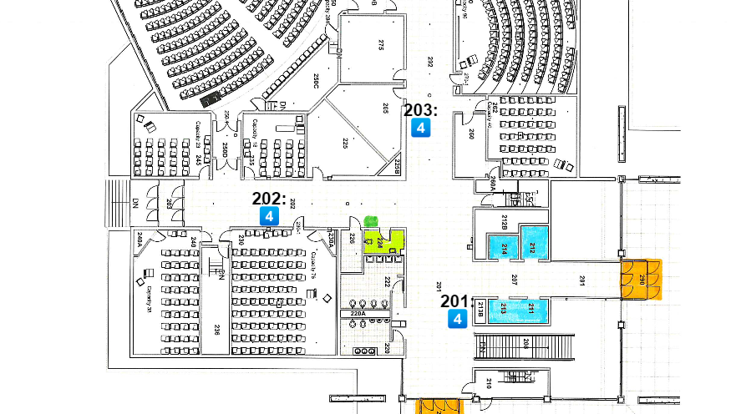
Notes:
Here is one more example of a map of building that was more simple.
We can clearly see that this floor has 3 different recycle stations, all providing the necessary 4 bins

Slide 20
Tour de Bins Goals
1. Complete 4 step process for all main campus buildings
2. Have digital maps accessible on SSI website
3. Increase awareness on why and how we recycle at BYU
4. Use project as evidence of sustainable student involvement
Notes:
For tour de bins specifically I have come up with a list of different goals that I am striving to achieve with the help of SSI volunteers.
The first is being able to complete the 4 step process for all of the main campus buildings
Next is being able to have a place for the digital maps that we create – we are in the process of creating an official website for SSI, and plan on sharing them there
After we finish our 4 steps for the campus buildings, we would like to have different campaigns to increase awarenss on why and how we recycle at BYU
Finally, this project as a whole can act as evidence of sustainable student involvement to be able to reach our overarching SSI goal of establishing a sustainability office and committee

Slide 21
Summary
Goal of SSI: Establish a university sanctioned, student-led sustainability office and committee though:
1. Campus sustainability projects 2. Receiving support from faculty and administration 3. Creating a community of campus involvement
Thank You!
Contact me: Tessa Meredith
tessameredith@hotmail.com
Follow SSI: @byu.ssi
Notes:
Just to conclude I want to return to our main goal of SSI which is to: establish a university sanctioned, student led sustainability committee through
1.
2.
3.
That is all I have prepared, but if we have an extra time and if anyone has not only questions, but suggestions on how we could further out efforts towards out goal – I’d love to hear your opinions!
Also if needed I’ll leave this slide with my contact information and also how you can connect with SSI on Instagram!
Thank you so much listening and letting me share with you!

