Slide 2
Website: http://www.freecycle.org
“Cyber Curbside”
“FreeBay” for free stuff
5000+ local gifting groups – Globally Local Community!
Notes:
Freecycle.org or The Freecycle Network is an online community where people give items away rather than throw them away, like a “FreeBay” for only free stuff, but with a mega dose of local community building in our nearly 5k local gifting groups.
EXAMPLE: First item a bed: Friends / Thrift Store no (Thrift Stores have to throw away 70% of all donations made to them as no resale value)/ truck/landfill societally correct option to take.

Slide 3
388,000
3,400,000
4,170
4,300,000
36,500
10,250
1,310
10,000
Over 30,000,000
Items gifted in the past 5 yrs.
7,000
35,000
452,000
Notes:
Our over 9 million members are spread across over a hundred countries.
About 95% of all members are in English language countries.
Now translated into French, Spanish, Portuguese, and German.

Slide 4
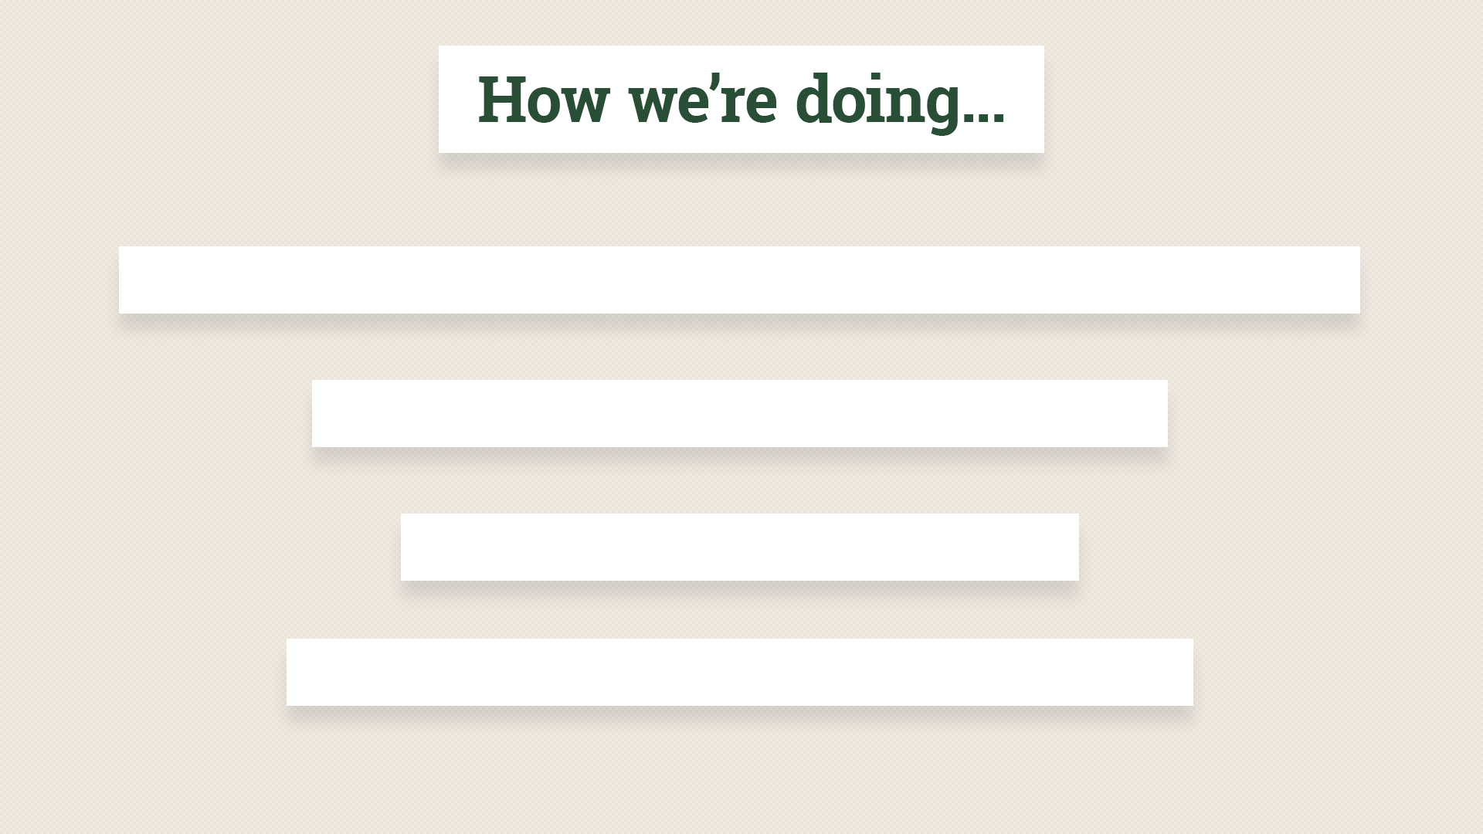
gifting over 32,000 items every day - 1000 tons / day
15 x Everest in the past year alone
One less landfill on the planet
3,000 Volunteers
Notes:
[Slide] +
So, really what we have here is a mass grassroots movement. Freecycle reaches out beyond a limited group of environmentalists, which is what we need to do in order to bring about societal evolution.
Really grassroots, two quick stores: Katrina & Irwin

Slide 5
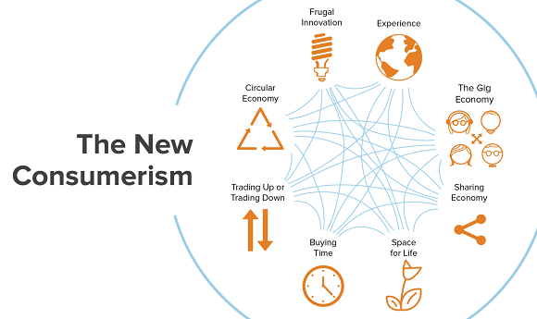
Notes:
NEW CONSUMERISM:
There is a growing trend toward 'New Consumerism', which means that people are buying more conscientiously than ever before.
Skinny jeans became popular ten years ago. “You’ll never catch me dead in those.” A decade later, she still teases me about that comment, as skinny jeans have obviously become a wardrobe staple.
Since then, nothing terribly big or exciting has happened in the fashion world, according to retailer Urban Outfitters:
“Real changes in fashion which spur the public into spending money on a whole new look are few and far between. In mainstream terms, the last really big trend was skinny jeans… And we’re still wearing them” (The Independent).
It appears that people are less interested in buying clothes than they once were. While they’re spending more money than ever, those dollars are being directed elsewhere, typically more toward food and away from fashion, where retailers are reporting decreases in profit. Seasonal trends are increasingly removed from reality, as people don’t want to spend their money on updates that appear insignificant. The Independent reports:
“There is a world of difference between the ‘seasons’ that fashion editors talk about, with different styles offered up to four times a year, and the real world, where people put on layers and just don’t see the need for a new coat every October.”
Today’s consumers are reassessing their priorities and questioning what they really value. This fits into the growing trend of ‘New Consumerism,’ a term coined by research firm Euromonitor International to describe a widespread movement that prioritizes conscientious shopping over conspicuous consumerism. There are eight key trends that comprise New Consumerism:
The eight trends which are combining to form the New Consumerism are:
The sharing economy: this is all about supply and demand. Connecting people and businesses with the resources to those that want them. It removes market inefficiencies, empowers consumers and has disrupted, or has the potential to disrupt, a wide range of sectors.
The circular economy: one where everything is reused and nothing is wasted. It is the antithesis of the linear “build, buy, bury” model of a one-way stream of raw material to factory, to user, then landfill. It has the potential to completely transform the way in which we do business.
Experience: the prioritisation of doing, seeing and feeling over having more “stuff”. The trend is more than this though, with many consumers seeking to “do something different”, searching for unique, often personalised experiences.
Buying time: is increasingly an option for today’s consumers for whom time has become a crucial commodity. This is about more than just convenience, but increasingly about outsourcing tasks. Time has become a luxury in today’s connected world.
Trading places: consumers are more willing than ever to compromise in some areas in order to splash out in others. Although the middle was already feeling the pinch, the financial crisis was an important catalyst for the trading up and down phenomenon. Consumers became smarter shoppers, not ashamed to look for bargains, and technology has also contributed to this.
Frugal innovation signifies eliminating non-essential and often costly features from a product or service. At its heart, frugal innovation is about focusing on customers, observing their core needs and designing products, services and business models that meet these needs.
Space for life: is the trend for smaller living spaces – whether through choice or circumstance. The drivers of this trend are complex: urbanisation and the increase in single-person households play a part. For some it’s a positive choice, but for others it’s because of financial constraints, and life in a small footprint is less welcome.
The gig economy: is the move away from a “job for life” to a working life characterised by short-term contracts, freelance work and entrepreneurship. It is heralded by many as the future of work. It has a two-fold impact on business – with implications on how to manage the workforce, and also on changes in consumer lifestyles and consumption and social trends.
In the fashion world, writes Business of Fashion, New Consumerism has translated into demand for increased transparency, authentic brand values, sustainable production processes, an embrace of the sharing economy, and unique retail experiences, among other things.
Matters look hopeful, in other words. It seems that people are seeing through the evils of the fast fashion industry, realizing it’s a waste of money to buy cheap, poorly-made clothes, and wanting something better for themselves and for the world. They’re more willing to make do with what they have, accessorize rather than replace, celebrate vintage looks, shop second-hand, and swap clothes around with friends.

Slide 6
Notes:
- Rachel Botsman / Sharing Economy
- part of a bigger trend: 20th c Hyperconsumption, 21st c. collaborative consumption
We are all primates at heart, we need community and we need sharing. Whether it’s been barn raisings, quilting bees, Native American potlaches, sharing is a part of our history that is getting reinvigorated with the advent of the virtually free medium of the internet. Technology makes sharing frictionless and fun.
Can you name one or two examples people are talking about when speaking of the sharing economy where maybe it’s not free but still sharing peer to peer? Hotels, cars, etc….

Slide 7
Notes:
From the goliath of eBay and craigslist to BookCrossing.com where people leave books on park benches and track where they end up. Online direct sales, auctioning, swapping, gifting, online communities are suddenly enabled by the relatively free nature of the internet, by taking out the middleman and enabling individuals to connect directly. The flat world of the internet and the freeness of it… - Freecycle brings the open and free concept of the internet back to local community. Each gift is a face-to-face encounter

Slide 8
Pressing unresolved environmental concerns
Global recessions that have fundamentally
shocked consumer behaviors
A renewed belief in the importance of community
A torrent of peer-to-peer social networks and
real-time technologies
Notes:
[Slide] +
ENVIRONMENT: Climate Change, An Inconvenient Truth, IPCC, Climate Conference, US uses 25% of world’s resources with 5% population.
ECONOMY: Recession probable in 2020 / cyclical economic downturns.
COMMUNITY: Local community building grows (zip cars, bicycle sharing, local swaps, free meets)
Internet and freely sharing online
Time for a gift economy!
A shift away, towards non-monetary values and collaboration….

Slide 9
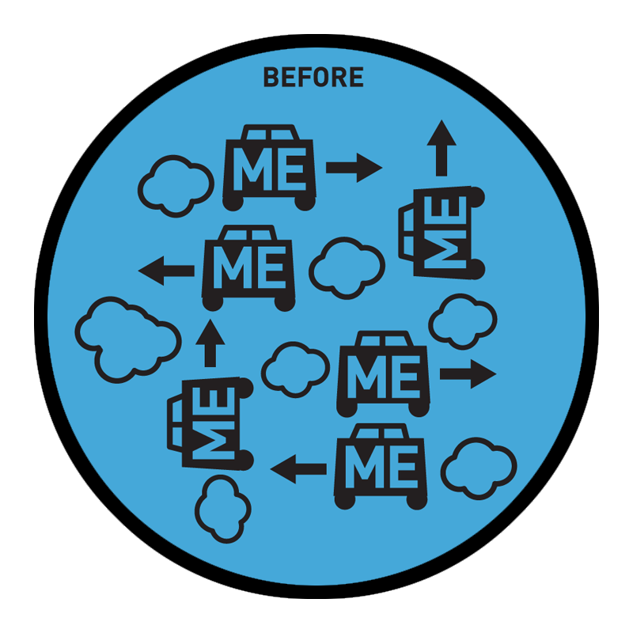
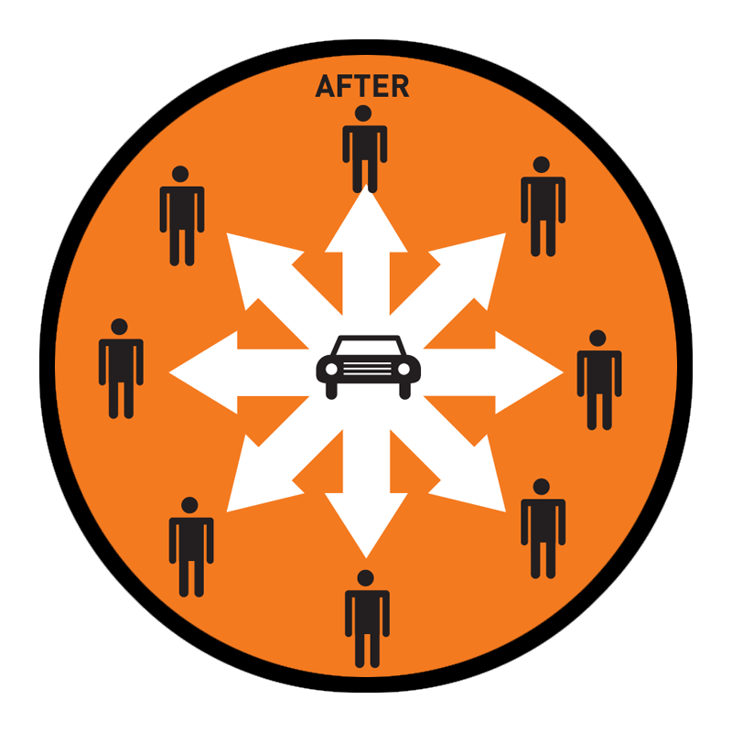
Notes:
This is where one emphasizes the benefit rather than the product. Like bicycle or car sharing, in that it’s about having the service at hand, rather than having to own the product. How many of you own a powerdrill? Guess at the average length of time a drill is used over it’s entire life?
That drill will be used an average of 12-15 minutes in its entire lifetime. Silly, but what you need is the hole, not the drill. why not rent it or enable it to be shared somehow? I don’t want the DVD, I want the movie, I don’t want the CD, I want the music, etc.
How do we see this reflected in new business models? George Soros…

Slide 10
Notes:
Not big on poetic inspiration as a message but definitely motivating!
Businesses need a level playing field and predictability.
Global warming represents instability and the insightful businesses seeks solutions to address this market threat. Corps like Ford, VW, Honda & BMW support CA emissions limits.
Issues such as carbon trading, recycling and reuse have been added to our social and economic vocabulary in a critical and positive way.
Freecycle is one big way of helping address environmental concerns.
We are the best of recycling: reuse!
From a business perspective having a look at the shifting nature of the business model can indeed be insightful…

Slide 11
Car Ownership
Car Sharing /
P2P Car rental
Ride Sharing
Driverless
Notes:
Average car takes $6,000 to run a year and sits idle 23 hours a day. Within the past 8 yrs we’ve gone from the need for ownership to….Peer2Peer.
What we are seeing is a progression from the cradle to grave production cycle to one in which we receive the functional service without the hassle of thousands of dollars a year in purchase and upkeep, to car sharing, to the purchase of a drive peer to peer and ultimately just the service say of a scooter.
Now Elon Musk and others are designing the driverless car with a million mile battery. Cheaper and less consumptive in receiving the service we want rather than the product we no longer need..
"It's what it does, not what it is, that we are after."
We need the hole in the wall, not the drill.
The business cycle become more circular…

Slide 12
Notes:
Cradle to cradle: Production cycle becomes more of a cycle of reuse and less of a cradle to grave concept, from raw materials extraction, thru production cycle, to the landfill without allowing for waste reduction, reuse and recycling.
Oscar Wilde once said…

Slide 13
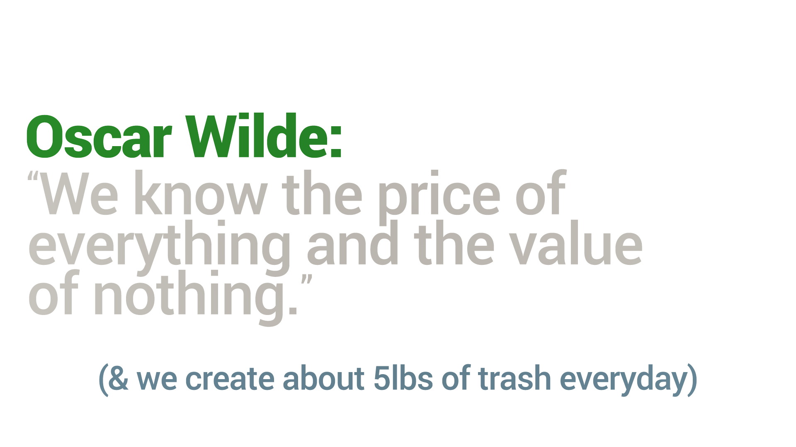
(& we create about 5lbs of trash everyday)
Notes:
[Slide] +
Wilde meant the value of nothing that really matters… And perhaps he was on to something.
Quite literally, Freecycle is all about the value of Wilde’s nothing. Sharing items with each other which have no monetary value whatsoever, and, in doing so, building community and lightening the burden of possession of a lot of stuff one no longer needs anyway.
All items offered must be free: no price, but items which still have plenty of value in them: electronics, household items, construction leftovers and on and on.
We fill this beautiful niche between no price and no value…
Or, to quote Marie Kondo, “Does this item spark joy?” And if not, give it to someone who will thank you effusively for something you were about to throw away!
A thrift store? Maybe, but they have to trash 70%.
It does require one to “think different” and let go of our linear brains a bit…

Slide 14
Notes:
It’s not about our typical cradle-to-grave linear thought process. Just a little more progress on electric vehicles, solar panels, no, solar plants, no, uh, wind farms, uh lithium ion, uh, just over the next horizon…
But when developed economies like the US use 25% of the world’s resources with 5% of the population, unless we can find 4 more planets, we’ll need to shift our means of consuming as the developing world develops similar tastes and increasing incomes.
It’s about reconsidering our perception about the process, itself. [next slide]

Slide 15
Why reuse is so durned important?
REDUCE
REUSE
RECYCLE
REPAIR
REDISTRIBUTE
Notes:
My spiel:
Nominally, Freecycle is…. Reuse.
And, WHY IS REUSE SO GOOD? Question: if you and I and all consumers eliminated all our waste tomorrow,, how much would be left? Half?
Industrial waste.

Slide 16
THE WASTE PYRAMID
2%
Municipal Solid Waste
98%
Non-Hazardous
Industrial Waste
Notes:
Or Waste Iceberg??
[slide] + 100lb sofa

Slide 17
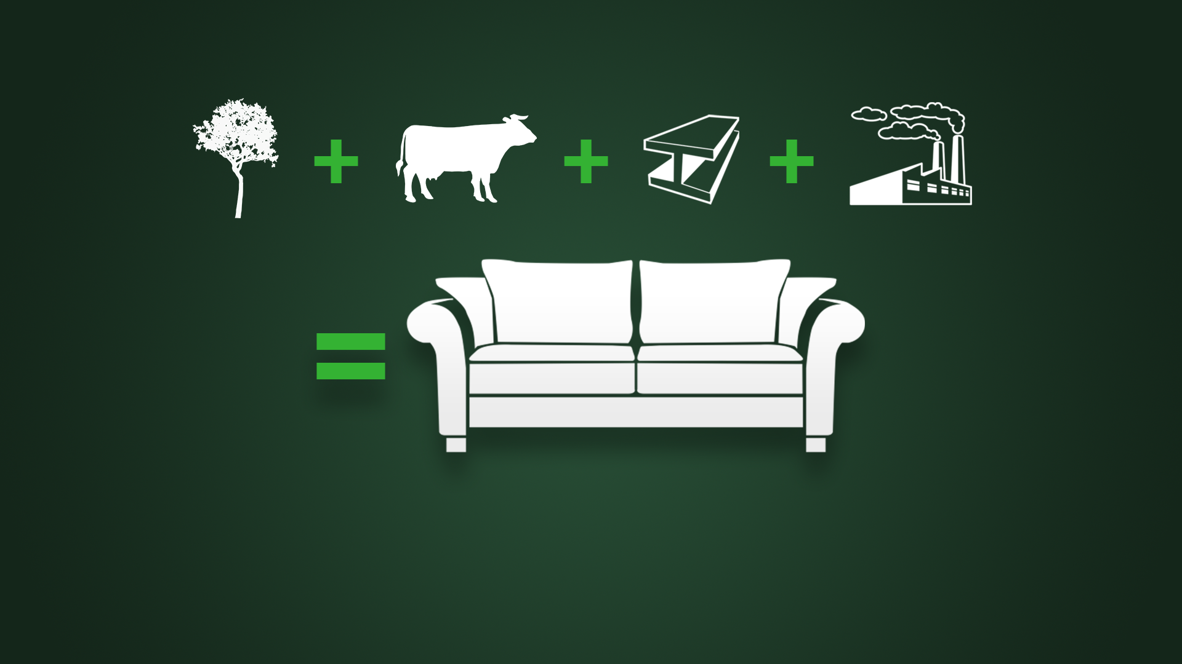
Notes:
[slide] {history next}

Slide 18
RISE, Inc.
One Bed
One Email on
May 1, 2003
One Warehouse
THE WORLD!

Slide 19
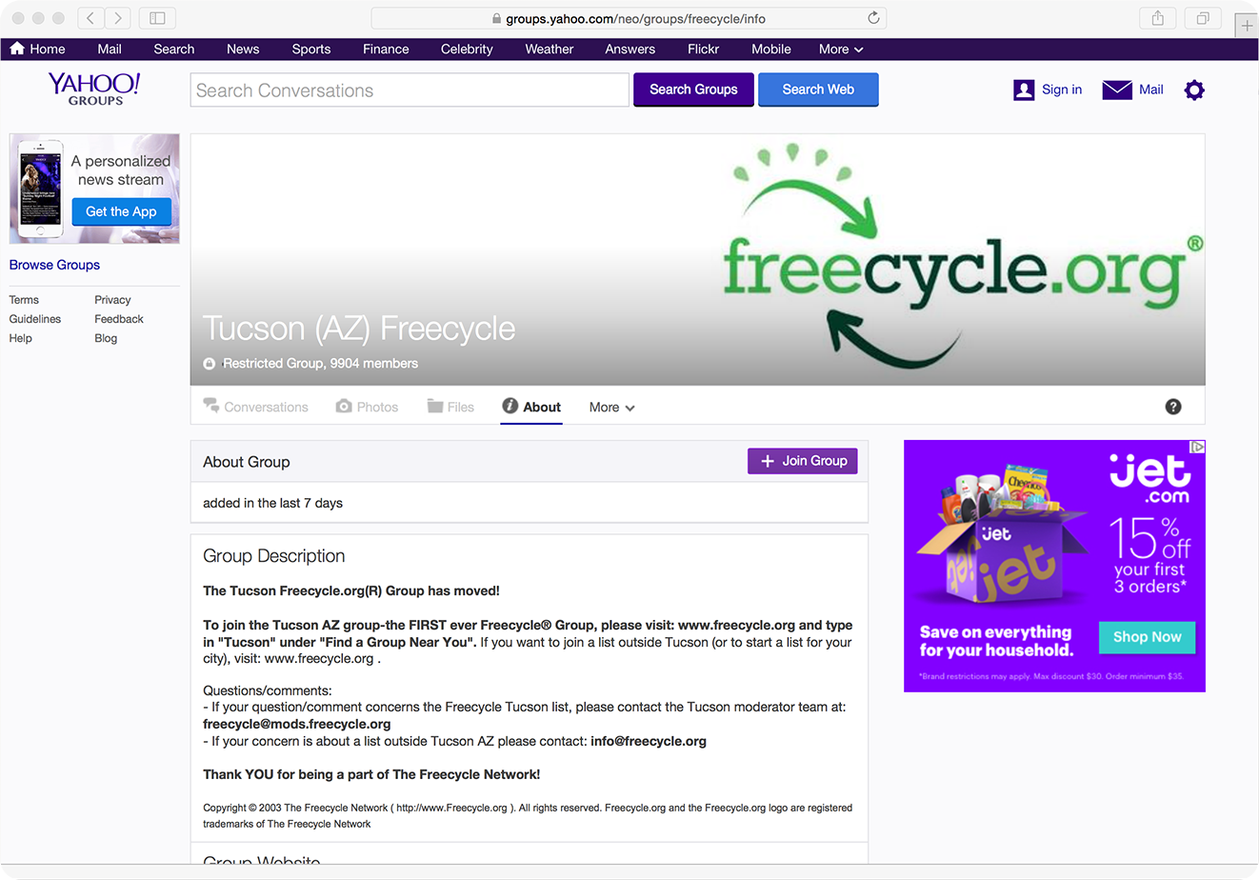
Notes:
This is what our first group looked like on Yahoo.

Slide 20
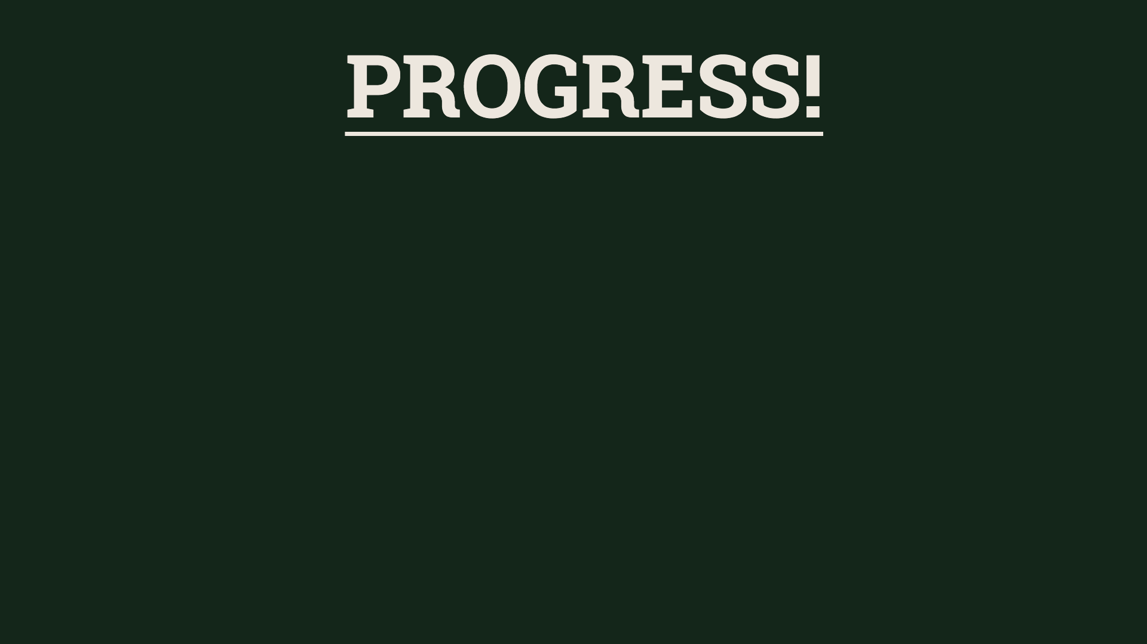
ZERO TECHIES AT STARTUP
VOLUNTEER TECHIES, 2003 - NOW
PART-TIME ENGINEER ON STAFF (2007)
ONE FULL-TIMER AS OF 2008!
OPEN SOURCE SOFTWARE

Slide 21
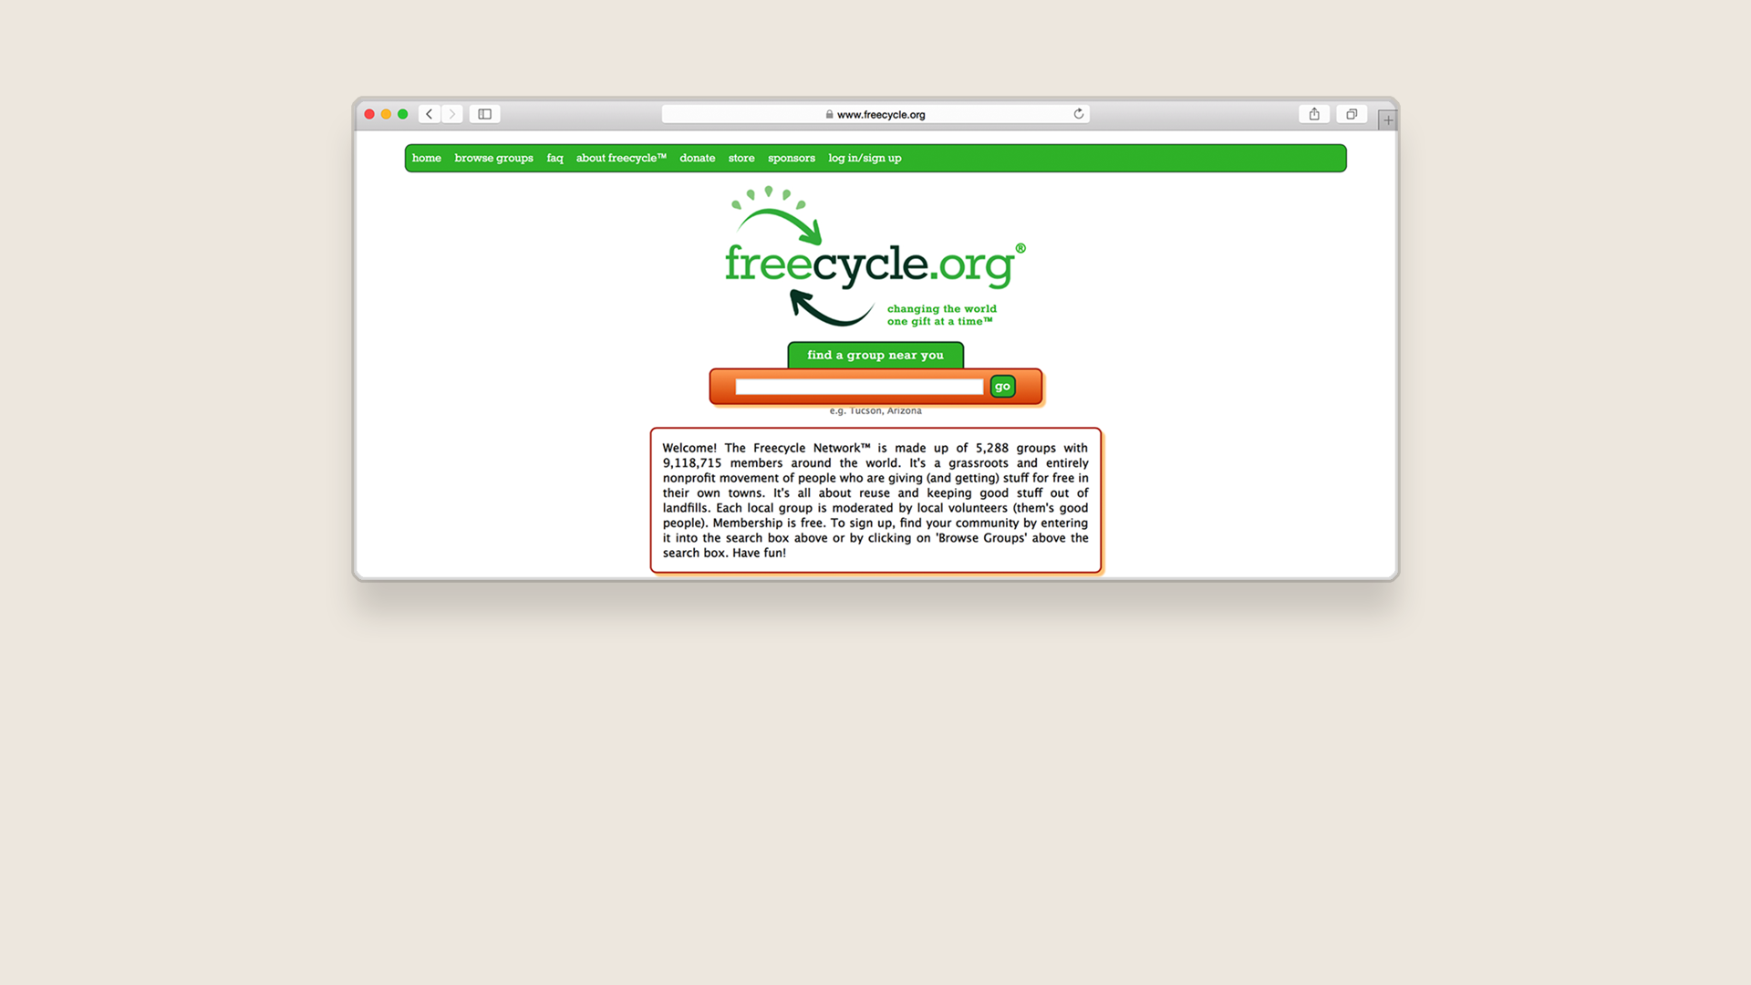
Notes:
Members could not post on site, or track their posts in any way. Nor could local groups be hosted directly on Freecycle.org.
Project goals were twofold:
Make it possible for every Freecycle member to make and track posts directly on Freecycle.org whether to a Y! G or to an indie group.
Enable local groups to move off Yahoo Groups and have their groups be hosted directly on site.

Slide 22
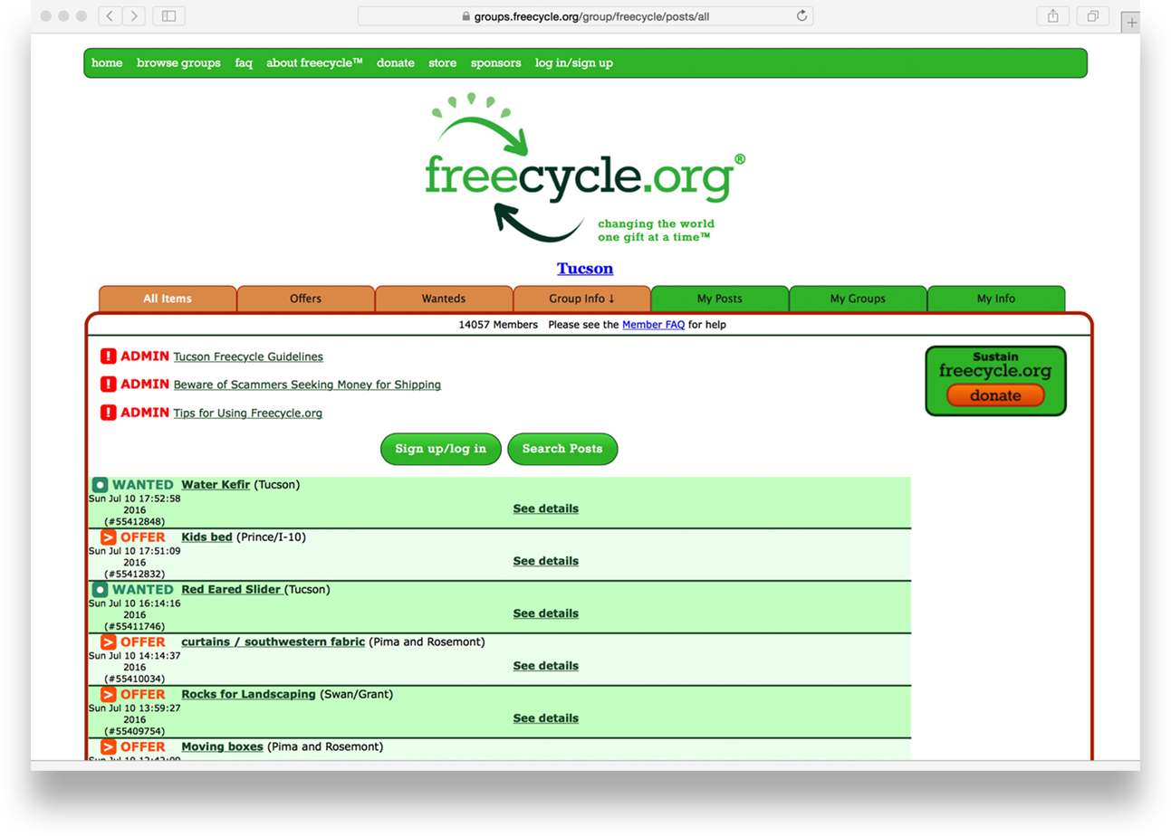
Notes:
Our independent platform was designed, from the beginning, to use the "scale out" approach, and this has worked well for us. Our bulk email platform, which is currently delivering over 3 million emails a day, is easily extendable simply by adding more servers into the herd.
This platform was a great opportunity for us to break free from the restrictions of the Yahoo!Groups system, and our initial development was very much an exercise in evolutionary design - the system was kept as fluid as possible to allow us to try out some new things and to adapt to user feedback. Now that the platform has been running for some time, and has an established user base, we've been going through a process of redeveloping the sites, keeping the same functionality, but removing all of the dead code and utilising new code that may have been developed later in the project.
The Freecycle Network has standardised on two frameworks: for new development and for the current redevelopment. The Freecycle Network operates a geographically dispersed set of servers, to ensure the highest possible availability of the service with the funding available. We have servers hosted in the UK, Germany and the US East and west coasts, with several different hosting providers. We lease servers rather than purchase our own - this has the advantages of no initial capital expenditure on hardware and the fact that the hardware support for the servers is handled by the hosting companies, rather than The Freecyle Network needing to maintain datacenter staff and supplies to deal with failures.
Now that we are happy with the running of our basic platform, we‘ve begun Freecycle 3.0. We have already started a translation programme, to present our system in the native languages of our Members and to make better use of existing social network platforms, such as Facebook. And the new site will be responsive design which means it’ll zip right along on little smart phone screens.

Slide 23
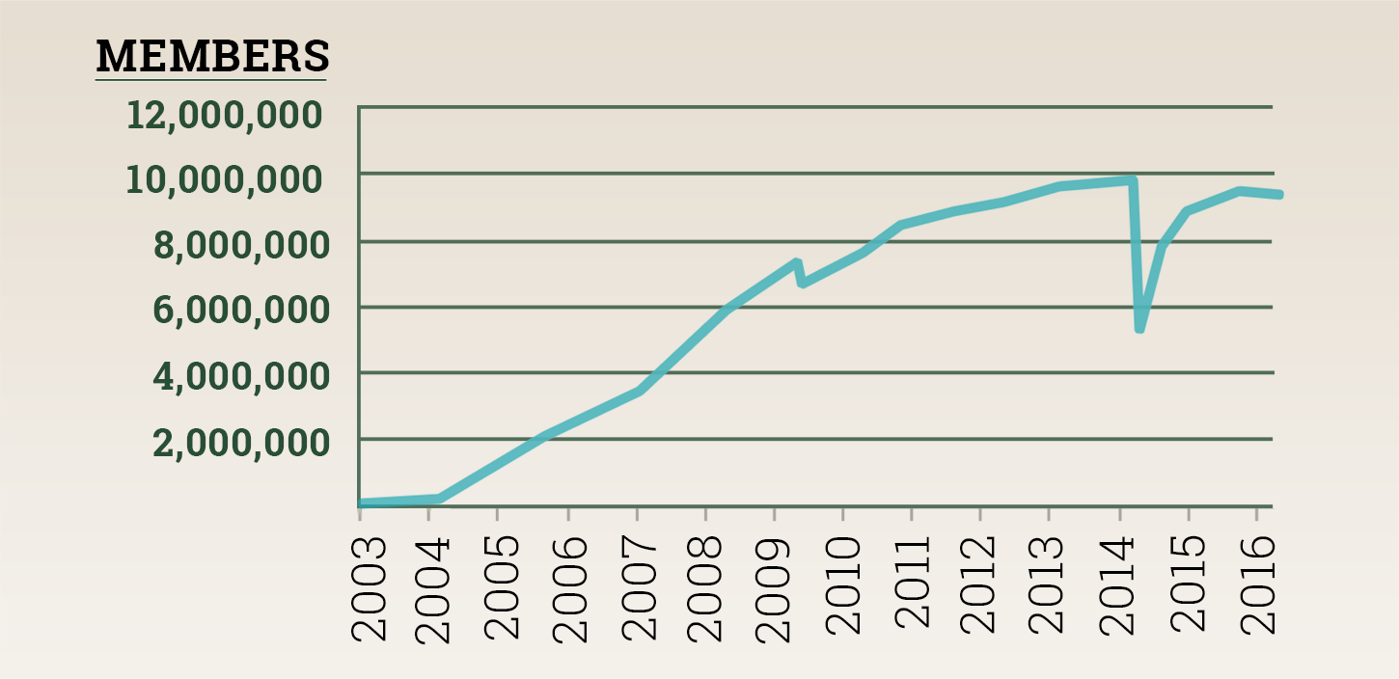
MEMBERSHIP GROWTH
(ABOUT 5,000 NEW MEMBERS A WEEK!)
Notes:
Bumps: first wave of groups moved from Yahoo on site and old groups with thousand of old, unused memberships on Yahoo closed out. Second wave: moved pretty much all of the UK on site at once.
[slide] + But how much stuff are they giving away, and keeping out of landfills?

Slide 24
Freecycle Waste Diversion [Tons/Day]
More than 1,000 tons / 32k items gifted daily!
Notes:
[slide] 1000 tons. How’s that translate into on-site posts of items?

Slide 25
Currently at about 8,000 - 12,000 posts / day on Freecycle.org

Slide 26
1 MILLION
UNIQUE SITE VISITORS / MO.
2.6 MILLION
SESSIONS / MO.
20-22 MILLION
PAGEVIEWS / MO.
Notes:
[SLIDE]
Note stats. This activity keeps about 40 servers busy on three continents.
We have become the largest reuse community on the planet and the largest online environmental community on the planet, bigger than the EPA website.
We are the largest recycling and reuse website on the planet, second only to Greenpeace as regards all environmental websites.
Alexa.com

Slide 27
The Future:
Beta Site / Friends Circles
Click here for Alpha Site Portal

Slide 28
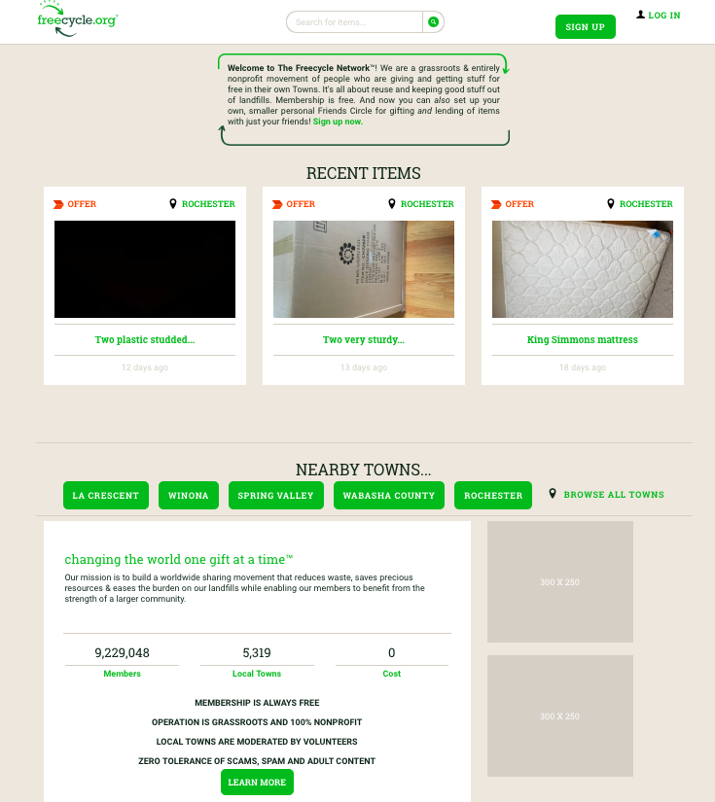
Notes:
New site before logging in

Slide 29
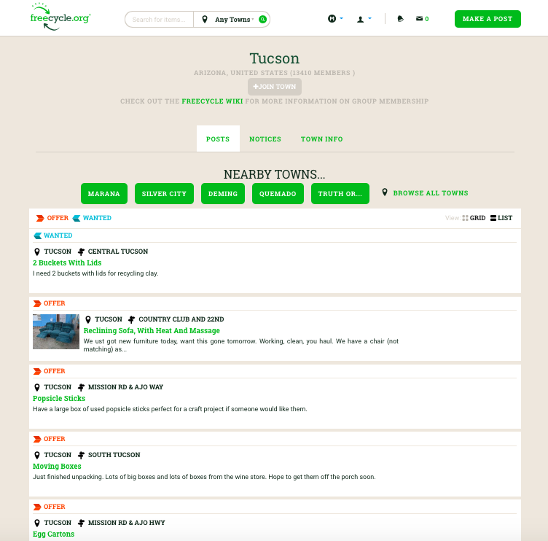
Notes:
List View

Slide 30
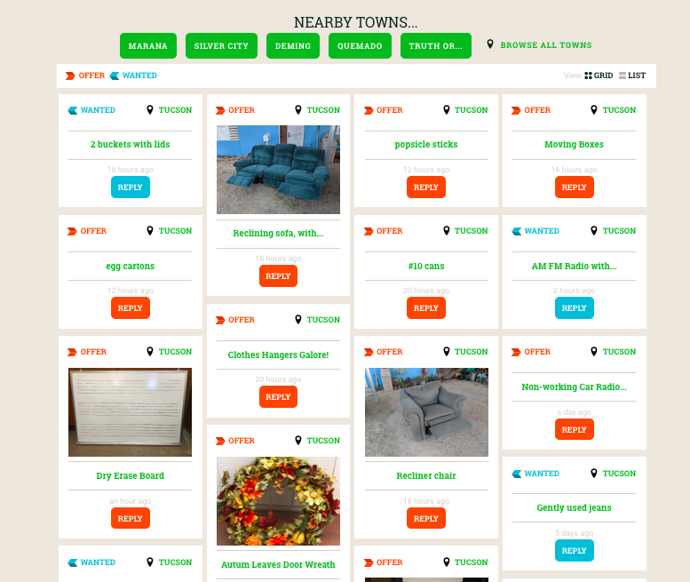
Notes:
Grid View

Slide 31
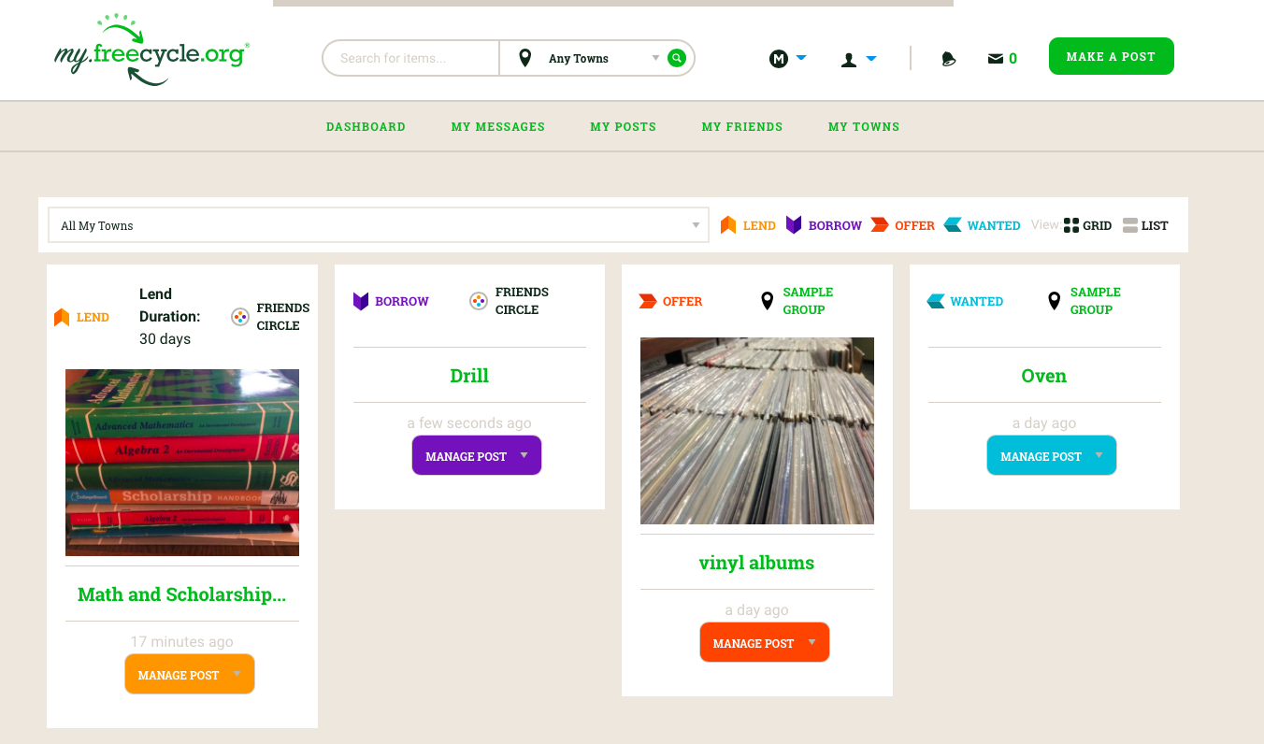
Notes:
User View One of each –OFFER, WANTED, BORROW, LEND

Slide 32
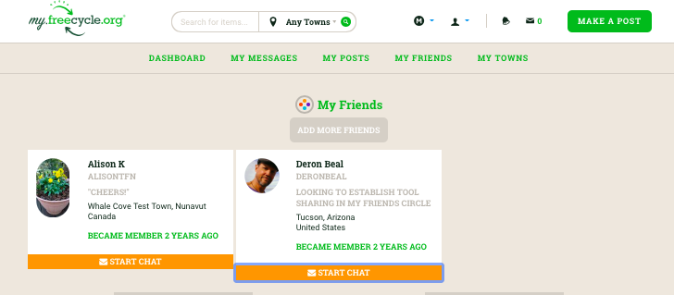
Notes:
We will be Introducing Friends Circles.
Nobody has cracked the peer to peer sharing economy for our own stuff... tools, books, kids stuff... stuff in our sheds that we never even use anymore.... that circular saw you bought and used once? It's out there somewhere waiting...
Chat Feature

Slide 33
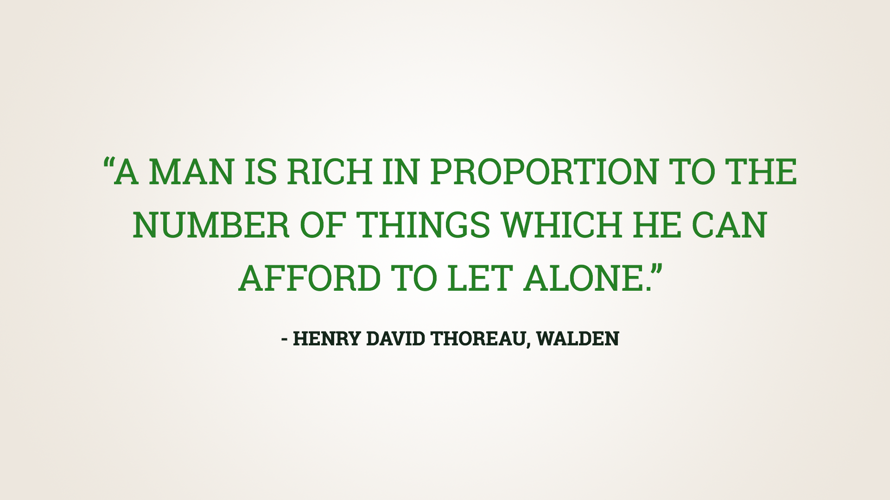

Slide 34
